Slide 1
Ilmu Komunikasi
Identitas Budaya Bag. 2
Cultural Identity Part 2
Komunikasi Antar Budaya
Pertemuan 6

Slide 2
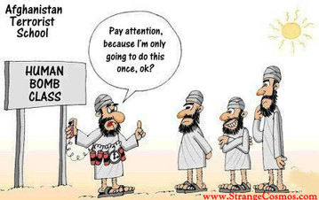
The Dark Side of Identity
Stereotyping
Stereotyping is a complex form of categorization that mentally organizes your experiences with, and guides your behavior toward, a particular group of people. It becomes a means of organizing your perceptions into simplified categories that can be used to represent an entire collection of things or people.
The reason for the pervasive nature of stereotypes is that human beings have a psychological need to categorize and classify. The world is too big, too complex, and too dynamic to comprehend in all its detail. Hence, you tend to classify and pigeonhole.
Stereotypes can be positive or negative. Those that refer to a large group of people as lazy, coarse, vicious, or moronic are obviously negative. There are, of course, positive stereotypes, such as the assumption that all Asian students are hardworking, well mannered, and intelligent.
Samovar et all. 2010. Communication Between Cultures Hal. 202 Versi Bahasa Indonesia

Slide 3
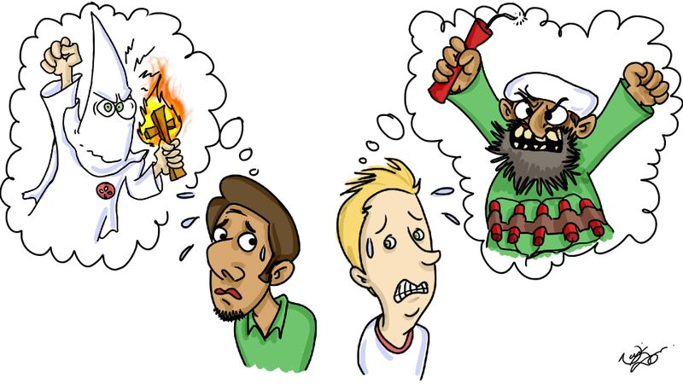

Slide 4
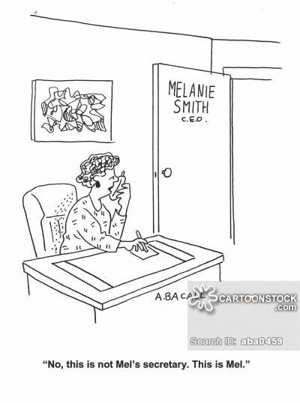
LEARNING STEREOTYPES
When do we learn stereotypes?
Remember, you are not born with stereotypes; they are learned, and like culture, they are learned in a variety of ways.
The most obvious, and perhaps most important, agent of stereotypes is the socialization process, which begins with our parents. While many parents try to avoid teaching their children to think in stereotypes, we tend to agree with Schneider when he notes that often parents directly or indirectly actually promote them.
Many stereotypes are generated by the mass media and widely disseminated through a variety of formats such as advertisements, movies, and TV sitcoms, soap operas, and reality shows.
Television has been guilty of providing distorted images of many ethnic groups, the elderly, and gay people. Media has also played a role in perpetuating certain stereotyped perceptions of women and men.
Samovar et all. 2010. Communication Between Cultures Hal. 203 Versi Bahasa Indonesia

Slide 5
why stereotypes hamper intercultural communication?
First, stereotypes are a kind of filter; they only allow in information that is consistent with information already held by the individual. In this way, what might be the truth can be filtered out. For example, women were stereotyped for many years as a rather one-dimensional group confined to the role of homemaker. That stereotype often kept women from advancing in the workplace.
Second, it is not the act of classifying that creates intercultural problems. Rather, it is the assumption that culture-specific information applies to every member of a particular cultural group. Stereotypes conjecture that all members of a group have exactly the same traits.
Third, stereotypes also keep you from being a successful communicator because they are oversimplified, exaggerated, and overgeneralized. Stereotypes distort because they are based on half-truths and often-untrue premises and assumptions. Guirdham reaffirms this important point when he notes that stereotypes alter intergroup communication because they lead people to base their preparation, transmission, and reception of messages on false assumptions.
Fourth, stereotypes are resistant to change.
Samovar et all. 2010. Communication Between Cultures Hal. 205 Versi Bahasa Indonesia

Slide 6
How to avoid stereotypes?
Let’s discuss it on your Collabor Forum!

Slide 7
The Dark Side of Identity
Prejudice
Prejudice occurs when a person holds a generalization about a group of people or things, often based on little or no factual experience. Prejudice can be positive (liking a certain group or thing) or negative (disliking a certain group or thing).
In a communication setting, according to Ruscher, the negative feelings and attitudes held by those who hold a prejudicial perspective are often exhibited through the use of group labels, hostile humor, or speech that alleges the superiority of one group over another.
The Functions of Prejudice
The ego-defensive function allows individuals to hold a prejudice while denying to themselves that they possess negative beliefs about a group.
The utilitarian function permits people to believe that their prejudicial beliefs produce a positive outcome. This is often found in situations where economic gain is involved.
The value-expressive function occurs when people maintain their prejudice in the belief that their attitudes represent the highest and most moral values of the culture.
The knowledge function enables people to categorize, organize, and construct their perceptions of other people in a manner they see as rational—even if that perception is woefully inaccurate.
Samovar et all. 2010. Communication Between Cultures Hal. 207 Versi Bahasa Indonesia

Slide 8
EXPRESSIONS OF PREJUDICE
First, prejudice can be expressed through what Allport refers to as antilocution, which involves talking about a member of the target group in negative and stereotypical terms.
Second, people act out prejudice through avoidance. This occurs when people avoid and/or withdraw from contact with the disliked group.
Third, when discrimination is the expression of prejudice, the prejudiced person will attempt to exclude all members of the group in question from access to certain types of employment, residential housing, political rights, educational and recreational opportunities, churches, hospitals, or other social institutions.
The fourth level of prejudice involves physical attacks, which often escalate in hostility and intensity if left unchecked.
The fifth, and most alarming, form of prejudice is extermination. This expression of prejudice leads to acts of physical violence with the objective of removing or eliminating all or major segments of the target group community.
Samovar et all. 2010. Communication Between Cultures Hal. 208 Versi Bahasa Indonesia

Slide 9
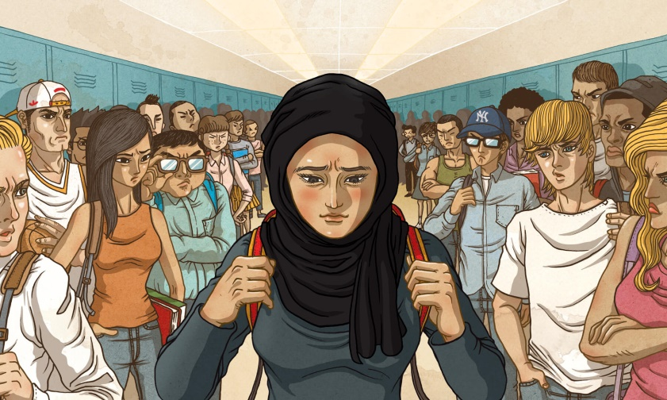
CAUSES OF PREJUDICE
(1) Societal sources: A great deal of prejudice is built into the major organizations and institutions of a society. According to Oskamp, these organizations produce norms, rules, regulations, and laws that give rise to societal prejudice and help “maintain the power of the dominant groups over subordinate ones.”
(2) Maintaining social identity: At the beginning of this chapter we pointed out the important role that identity plays in connecting people to their culture. This link is very personal and emotional because it creates the bond that binds people and culture together.
(3) Scapegoating: Scapegoating occurs when a particular group of people, usually a minority, is singled out to bear the blame for certain events or circumstances, such as economic or social hardships, that adversely affect the dominant group.
Samovar et all. 2010. Communication Between Cultures Hal. 210 Versi Bahasa Indonesia

Slide 10
How to avoid prejudice?
Let’s discuss it on Collabor Forum!

Slide 11
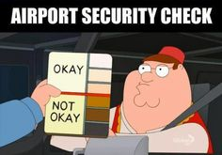
The Dark Side of Identity
Racism
Racism is the belief in the inherent superiority of a particular race. It denies the basic equality of humankind and correlates ability with physical composition. Thus, it assumes that success or failure in any societal endeavor will depend upon genetic endowment rather than environment and access to opportunity. ~ Leone
The idea of superiority allows one group of people to mistreat another group on the basis of race, color, national origin, ancestry, religion, or sexual preference.
Samovar et all. 2010. Communication Between Cultures Hal. 211 Versi Bahasa Indonesia

Slide 12
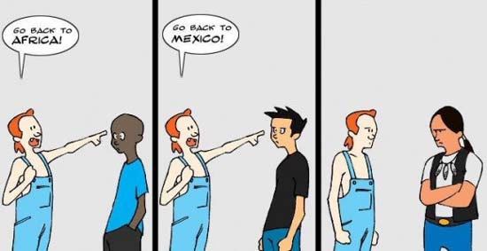
EXPRESSIONS OF RACISM
“Personal racism consists of racist acts, beliefs, attitudes, and behaviors on the part of the individual persons.”
Referring to institutional racism, Bloom is very specific when he writes, “Institutional racism refers to racial inferiorizing or antipathy perpetrated by specific social institutions such as schools, corporations, hospitals, or the criminal justice system as a totality.”
Samovar et all. 2010. Communication Between Cultures Hal. 212 Versi Bahasa Indonesia

Slide 13
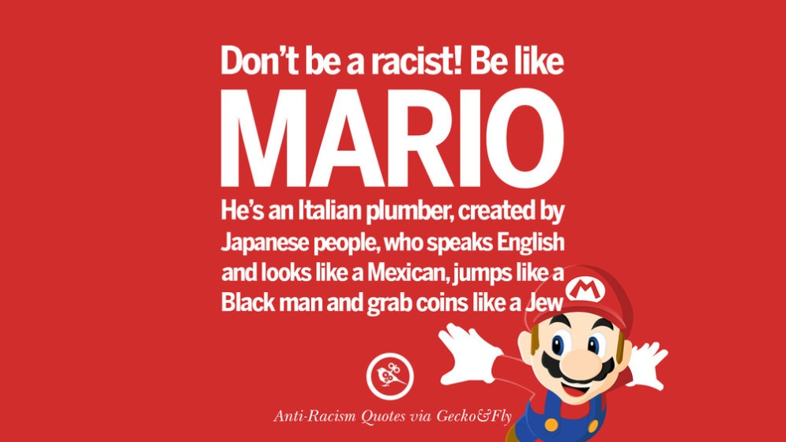
AVOIDING RACISM
First, try to be honest with yourself when deciding if you hold any racist views. It is a simple point to state, but a difficult one to accomplish. Yet, confronting personal racist views is an important first step.
Second, object to racist jokes and insults whenever you hear them. This daring and sometimes courageous act will send a message to other people that you denounce racism in whatever form it may take.
Third, as straightforward as it sounds, respect freedom.
Fourth, examine the historical roots of racism.
Samovar et all. 2010. Communication Between Cultures Hal. 213 Versi Bahasa Indonesia

Slide 14
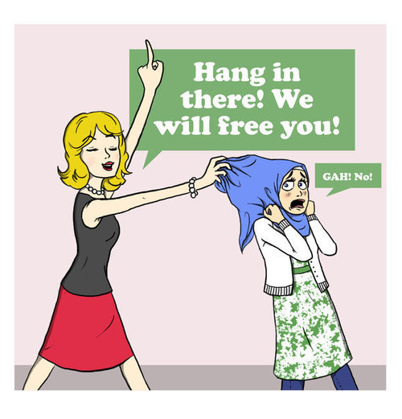
The Dark Side of Identity
Ethnocentrism
Ethnocentrism is the notion that one’s own culture is superior to any other. It is the idea that other cultures should be measured by the degree to which they live up to our cultural standards. We are ethnocentric when we view other cultures through the narrow lens of our own culture or social position. ~ Nanda and Warms.
Samovar et all. 2010. Communication Between Cultures Hal. 214 Versi Bahasa Indonesia

Slide 15
CHARACTERISTICS OF ETHNOCENTRISM
Levels of Ethnocentrism
positive, negative, and extremely negative.
Ethnocentrism Is Universal
Most people are ethnocentric, and a certain degree of ethnocentrism probably is essential if people are to be content with their lives and if their culture is to persist.
Ethnocentrism Contributes to Cultural Identity
Another reason ethnocentrism is so pervasive is that it provides members of a culture with feelings of identity and belonging.
Ethnocentrism is strongest in moral and religious contexts, where emotionalism may overshadow rationality and cause the type of hostility.
Samovar et all. 2010. Communication Between Cultures Hal. 215 Versi Bahasa Indonesia

Slide 16
AVOIDING ETHNOCENTRISM
First, try to avoid dogmatism.
Second, learn to be open to new views.
Samovar et all. 2010. Communication Between Cultures Hal. 216 Versi Bahasa Indonesia

Slide 17
Any questions?

