Slide 1
Akar Kebudayaan : Pandangan budaya mengenai kehidupan
Bagian 2
Komunikasi Antar Budaya – Pertemuan 4

Slide 2
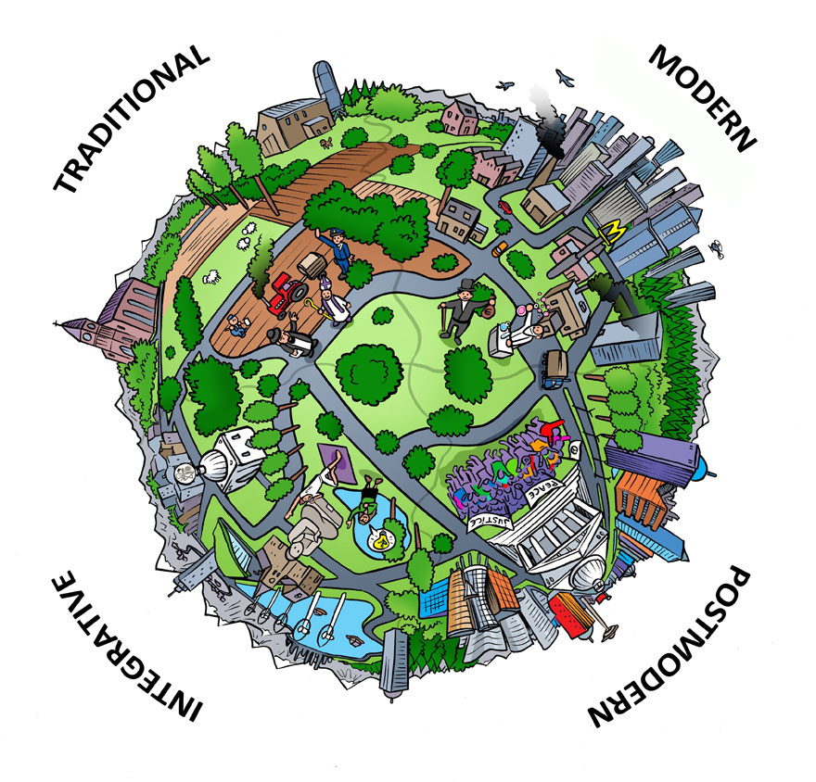
Worldview
The way people interpret reality and events, including images of themselves and how they relate to the world around them. (Peoples & Bailey)
Worldview is a culture’s orientation toward God, humanity, nature, question of existence, the universe and cosmos, life, moral and ethical reasoning, suffering, death, and other philosophical issues that influence how its members perceive their world. (Ishii, Coke, Klopf)

Slide 3
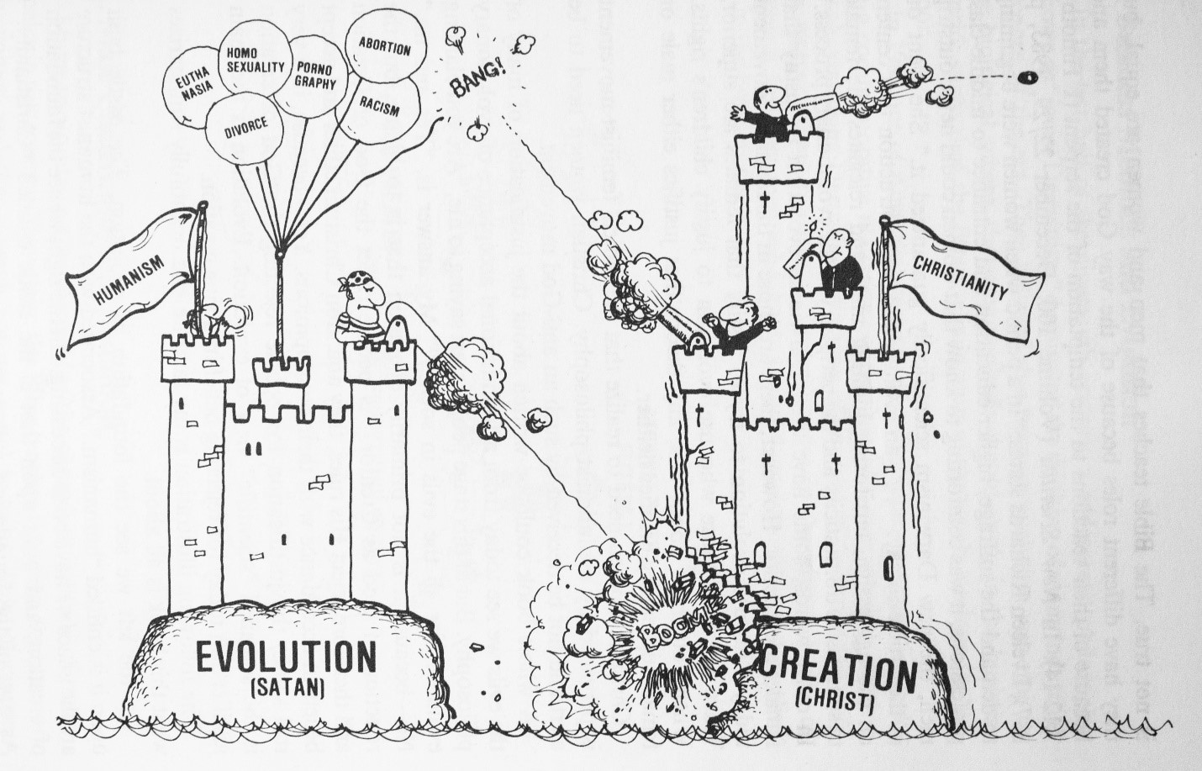
Worldview & Culture
Culture supplies most of a person’s worldview

Slide 4
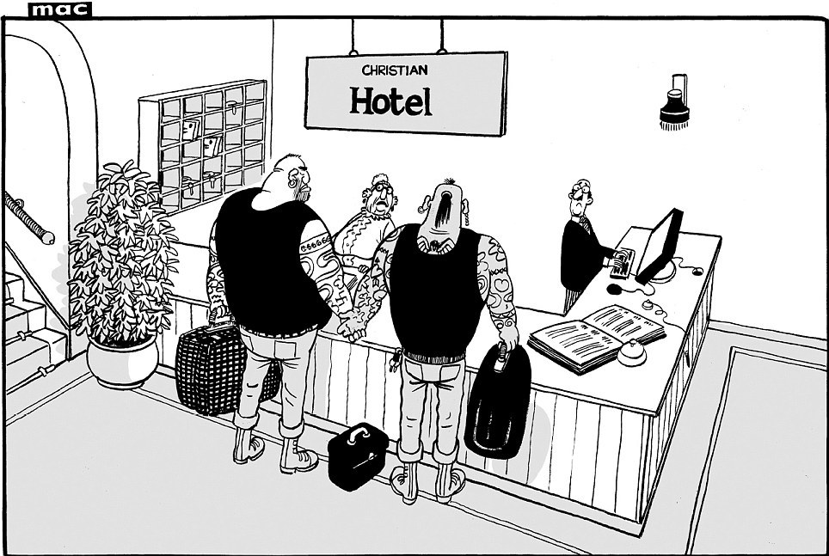
The Importance of Worldview
Perception of women
Perception of nature
Produce different attitudes toward nature
Perception of business

Slide 5
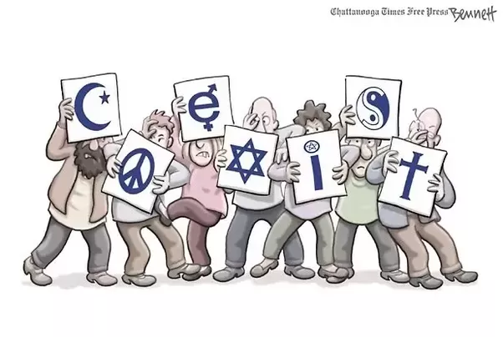
Forms of Worldview
Religion as worldview
Secularism as worldview
Spirituality as worldview

Slide 6
Religion
The Enduring Significance
of Religion
Religion and the Study of Intercultural Communication
It has been linking people together while creating and preserving their cultures’ worldviews.
Perhaps religions’ most enduring aspect has been its attempt to address questions about mortality and immortality, suffering, and the origin of the universe.
Mechanism of social control
Religion and behavior
The study of religion in the 21st Century

Slide 7
Religious Similarities
Speculation
Sacred Scriptures
Rituals
Ethics
Safe Haven

Slide 8
Christianity
Core Assumptions
Cultural Manifestations
  Organized worship
  Individual
  Doing
  The Future
  Gender
  Courage
Notions about death

Slide 9
Judaism
Core Assumptions
Cultural Manifestations
  Oppression and Persecution
  Learning
  Justice
  Family
  Life Cycles
Notions about death

Slide 10
Islam
Core Assumptions
  One God
  Submission
  Fatalism
  Judgment
Cultural Manifestations
  A complete way of life
  Gender
  Art and Architecture
Notions about death

Slide 11
Hinduism
Core Assumptions
  Divine in everything
  Ultimate reality
  Brahman
  Discovery of self
  Multiple paths
Cultural Manifestations
  A complete way of life
  Dharma
  Four stages of life
Notions about death

Slide 12
Buddhism
Core Assumptions
  The Four Noble Truths
  The Noble Eightfold path
Cultural Manifestations
  The improbability of language
  Impermanency
  Karma
Notions about death

Slide 13
Confucianism
Core Assumptions
The analects
Cultural Manifestations
  Jen
  Li
  Te
  Wen
Confucianism and communication
Notions about death

Slide 14
Thank You
Questions?

