Slide 1
Akar Kebudayaan : Pandangan budaya mengenai kehidupan
Bagian 1
Komunikasi Antar Budaya – Pertemuan 3

Slide 2
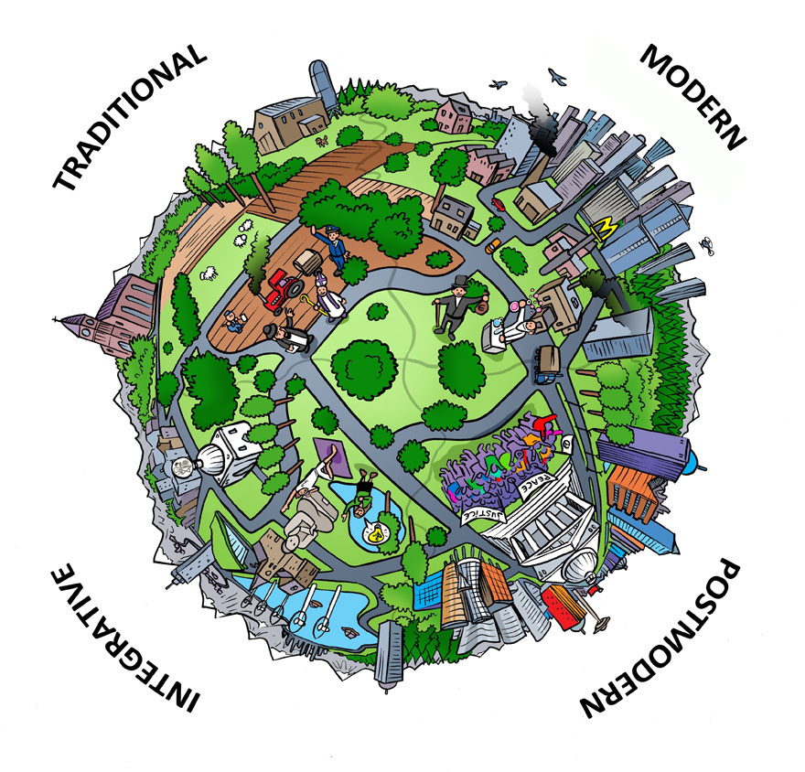
Worldview
The way people interpret reality and events, including images of themselves and how they relate to the world around them. (Peoples & Bailey)
Worldview is a culture’s orientation toward God, humanity, nature, question of existence, the universe and cosmos, life, moral and ethical reasoning, suffering, death, and other philosophical issues that influence how its members perceive their world. (Ishii, Coke, Klopf)

Slide 3
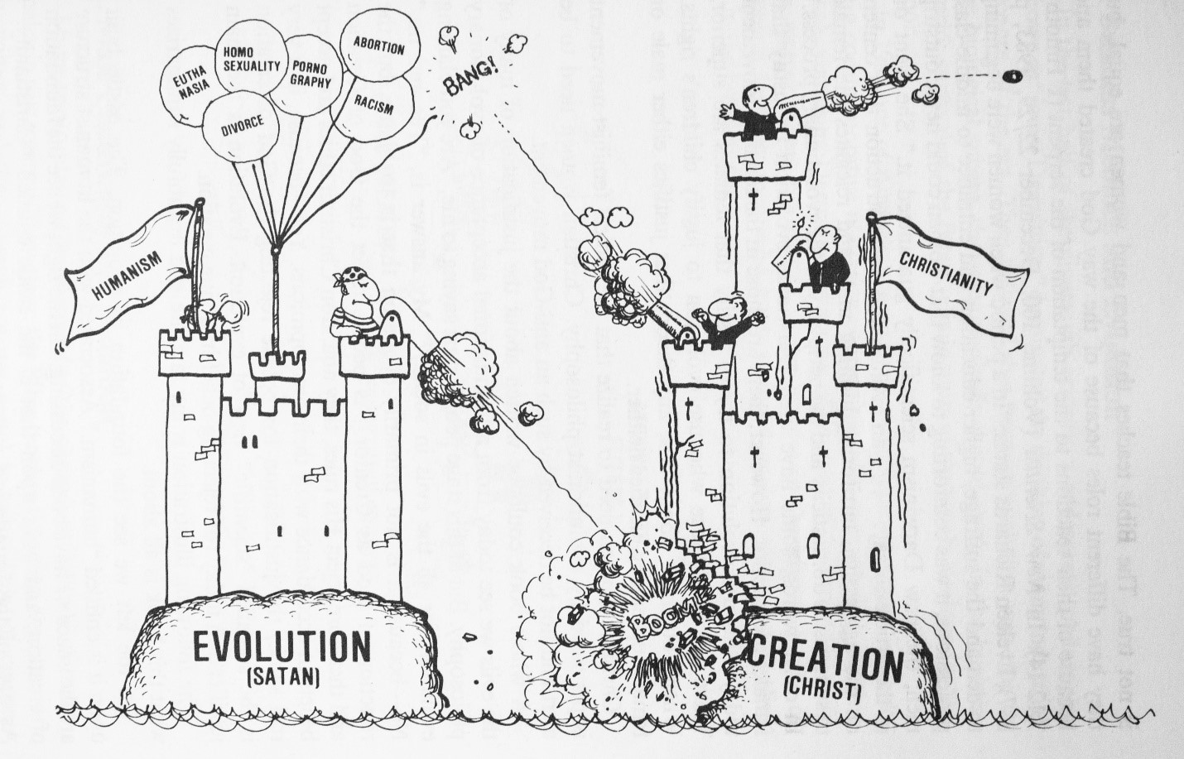
Worldview & Culture
Culture supplies most of a person’s worldview

Slide 4
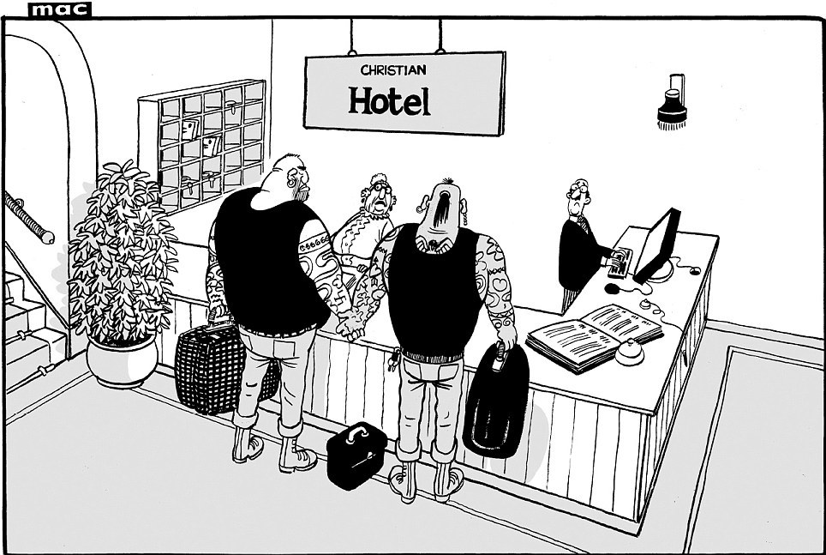
The Importance of Worldview
Perception of women
Perception of nature
Produce different attitudes toward nature
Perception of business

Slide 5
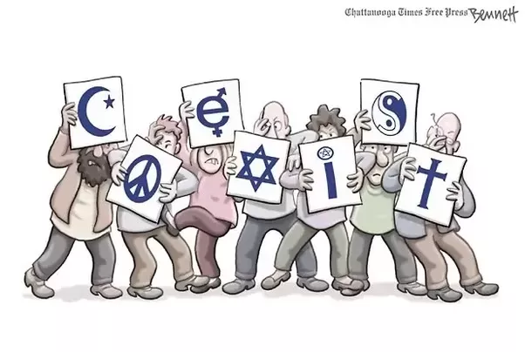
Forms of Worldview
Religion as worldview
Secularism as worldview
Spirituality as worldview

Slide 6
Religion
The Enduring Significance
of Religion
Religion and the Study of Intercultural Communication
It has been linking people together while creating and preserving their cultures’ worldviews.
Perhaps religions’ most enduring aspect has been its attempt to address questions about mortality and immortality, suffering, and the origin of the universe.
Mechanism of social control
Religion and behavior
The study of religion in the 21st Century

