Slide 1
Akar Kebudayaan: Keluarga dan Komunitas
Komunikasi Antar Budaya Pertemuan 2

Slide 2
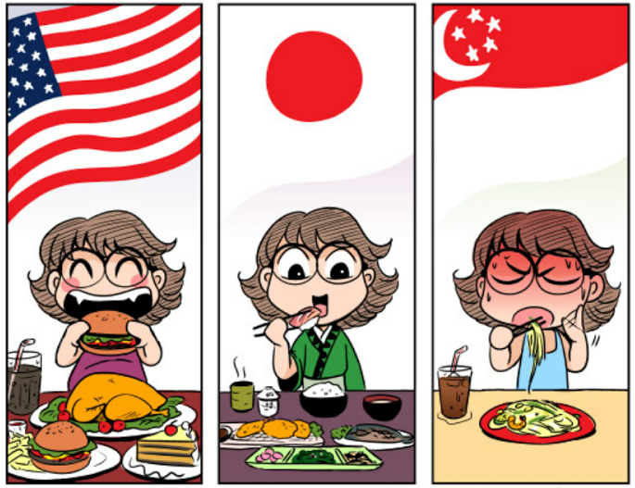
Why are we different?
Why my friend love money so much?
Why do they need to pray five times a day? While I am only doing it once a week?
Why some people prefer to be secluded?
Why some culture celebrate death?
Why some people still lives with their parents?
Why do they eat raw food?
Why their food has so many spices?

Slide 3
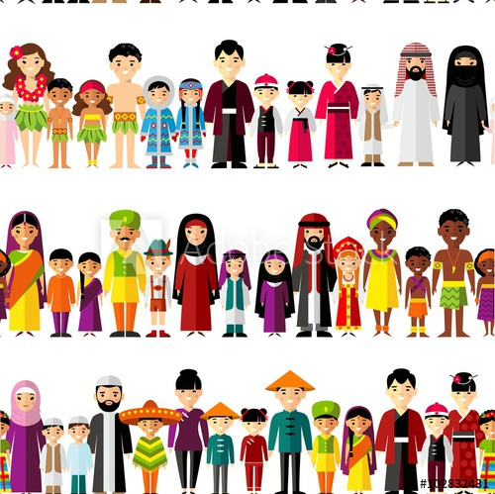
The Deep Structure of Culture
We believe the key to why a culture views the world as it does, can be found in that culture’s deep structure.
“the unconscious assumptions about how the world works, that unifies a culture, makes each culture unique, and explains the ‘how’ and ‘why’ of a culture’s collective action”
At the core of any culture’s deep structure are its social organizations / institutions.
  Family
  Community
  Religion

Slide 4
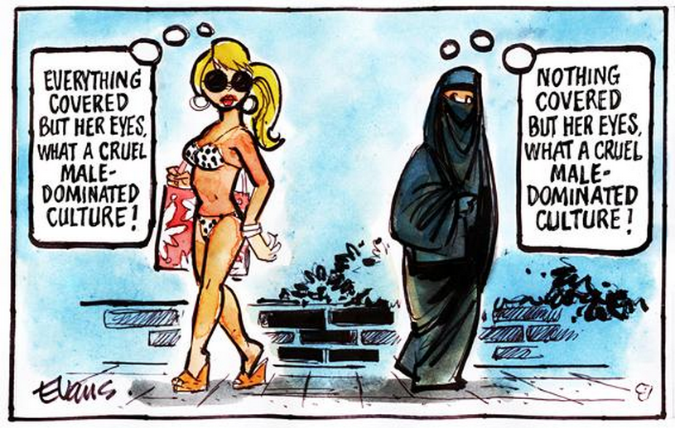
“The people of different civilizations have different views on the relations between God and man, the individual and group, the citizen and the state, parents and children, husband and wife, as well as differing views of the relative importance of rights and responsibilities, liberty and authority, equality and hierarchy”
- Huntington

Slide 5
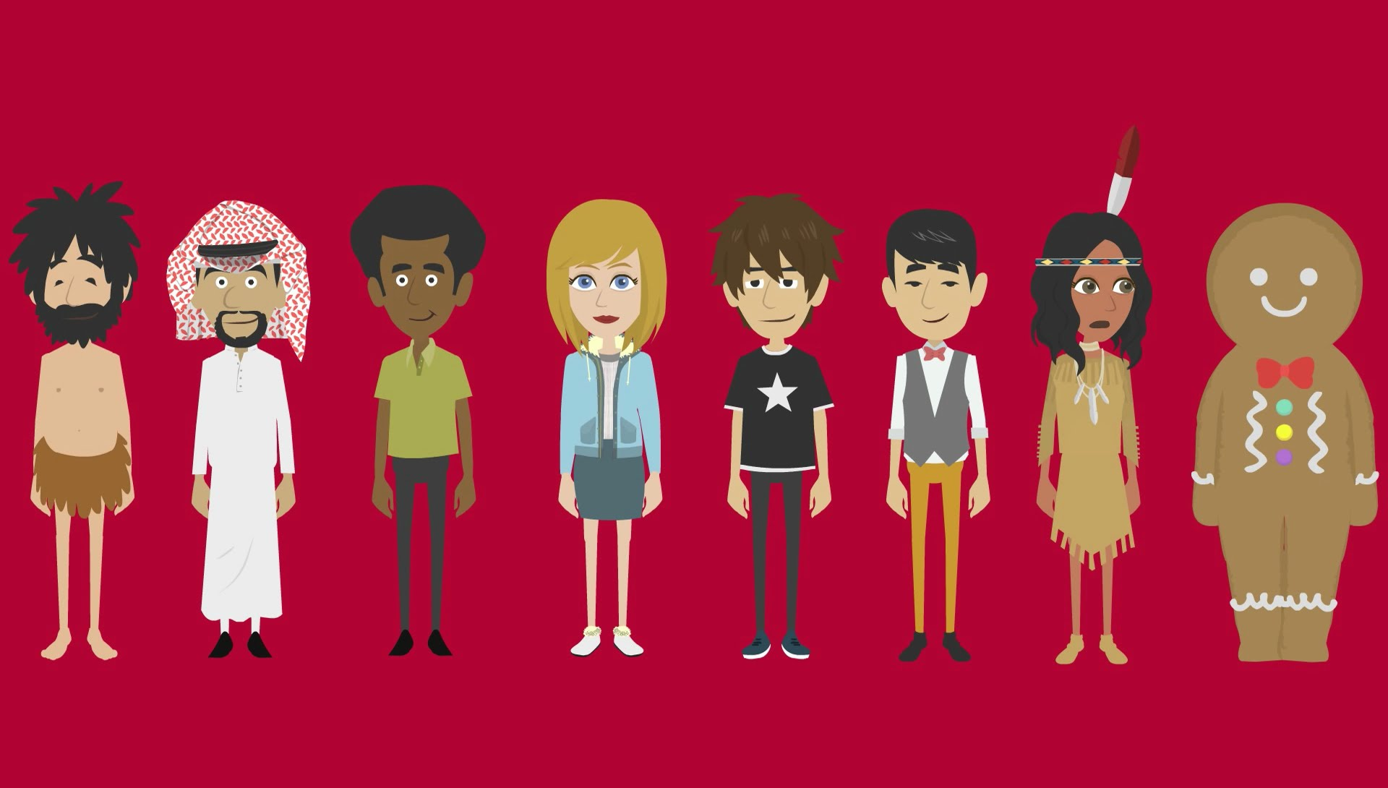
Deep Structure Institutions Carry a Culture’s Most Important Beliefs
Deep Structure Institutions and their messages endure
Deep Structure Institutions and their messages are deeply felt
Deep structure institutions supply much of a person’s identity

Slide 6
Family
“Family is the principal transmitter of knowledge, values, attitudes, roles, and habits from one generation to the next. Through words and example, the family shapes a child’s personality and instills modes of thought and ways of acting that become habitual.”
DeGenova & Rice
“A groups of intimates, who generate a sense of home and group identity; complete with strong ties of loyalty and emotion, and an experience of a history and a future”
- Noller & Fitzpatrick

Slide 7
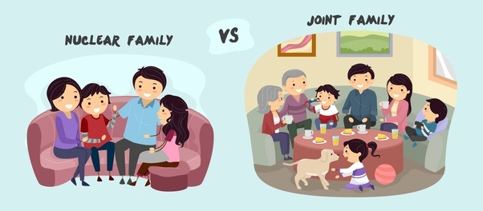
Forms of Family
Nuclear Family
Extended Family
Changing Families in the world
Globalization and Families
  Mass Media
  Immigration

Slide 8
Functions of the Family
Reproduction
Teaching economic values
Socialization
Teaching core values and worldview
Identity development
Communication training

Slide 9
Communication, Culture, and Family
In many ways families, with regard to child-rearing practices, have many similarities
“there is much commonalities across cultures in the construal of infancy and early childhood, based on biological needs for care, nutrition, protections, etc” – Smith and associates

Slide 10
Cultural Variants in Family Interaction
Gender Roles
Changing Gender Roles
Individualism and Collectivism
Age Grouping
Social skills

Slide 11
https://www.youtube.com/watch?v=JB5i6kgkvCg
https://www.youtube.com/watch?v=LqKuXCGBDEc

Slide 12
Let’s read some history on your book!
Yuk baca sejarah terkait budaya di buku kalian halaman 91-113!
Akan ada diskusi mengenai ini di forum yaa…

