Slide 1
TREND ICT

Slide 2
    Pemanfaatan ICT
    Industri ICT sebelum dan sesudah tahun 2000
    Peluang dalam e-commerce
    Kerawanan dalam ICT
    ICT dalam era mobile phone
    Peluang berbagai karir di era ICT

Slide 3
Global ICT Trends Emerging in 2013

Slide 4
SMART HANDHELD DEVICES
Smart handheld devices are red hot.
Early in January each year, the Las Vegas Consumer Electronics Show (CES) is not just the world’s largest consumer electronics exhibition: it’s a strategic battleground for ICT heavyweights.
Moreover, many regard CES as a leading indicator of electronics industry trends. After participating in CES, ITRI has identified 10 new trends in the global ICT industry

Slide 5
ULTRA HIGH DEFINITION
LCD TV Evolves to UHD
Jim Chung, Deputy General Director of ITRI’s IEK, pointed out that of the observed new trends, five are related to components, four are consumer electronics products and one belongs to the infrastructure segment.

Slide 6
PELUNCURAN TELEVISI 4K OLED TV. UKURAN 56 INCH.
SAMSUNG DAN LG DEMONTRASI 55 INCH CURVED DISPLAY.
HAMBARAN untuk OLED TV: BIAYA TINGGI UNTUK LAYAR, keuntungan yang rendah, product life rendah dan sulit meningkatkan kualitas pada resolusi = UHD.

Slide 7
2015 = 3,2 juta; 2017 = 5.95 juta.
Masa depan adalah televisi layar lebar.

Slide 8
Ada kebutuhan data besar untuk analisis intelijen bisnis.
Divisi: manufaktur, kesehatan, telekomunikasi, retail, energi, transportasi, otomotif, keamanan dan lain-lainya.

Slide 9
Membangun cloud applications.

Slide 10
Bisnis tablet akan mencapai 200 juta dengan peningkatan pertahun 38%.

Slide 11
Tablet juga bisa masuk kedalam shopping, logistik, pendidikan, social media, hiburan, konseling kesehatan dan jasa lainnya.
Peningkatan ini diprekdisikan sebesar 52%.

Slide 12
Kecepatan bandwidth akan meningkatan dengan teknologi TD-LTE.
Tidak hanya meningkat namun meluas dengan WIMAX.

Slide 13
Peningkatan prosesor HP meningkat. Quad-core menjadi standar untuk HP yang terjangkau dan kencang.
2017, 600 juta HP di China.
Quad-core smartphone meningkat 55%.

Slide 14
3D IC

Slide 16
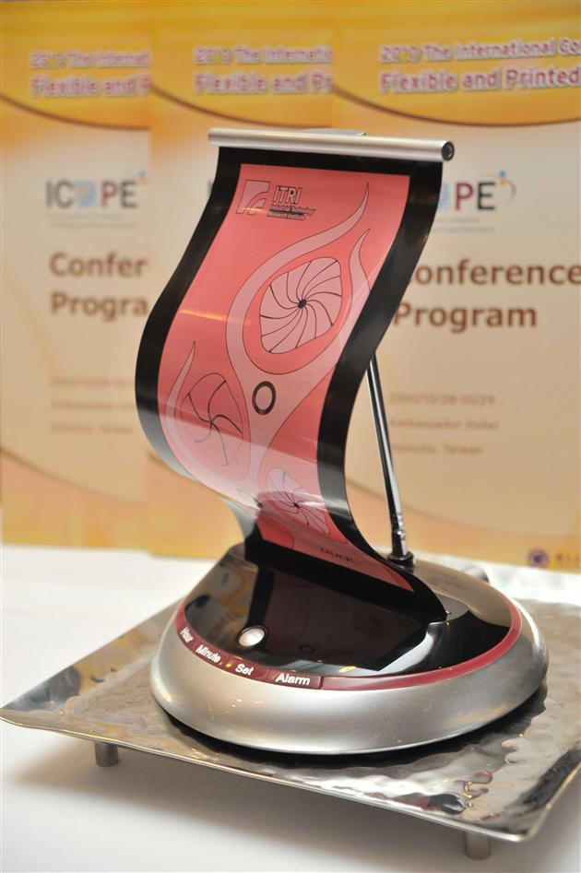

Slide 17
Iphone 5 masih menjadi primadona karena desain lebih tinggi akibat proses produksi yang lebih sederhana dan penurunan komponen.

Slide 18
Teknologi layar sentuh juga akan mendominasi masa depan.

Slide 19
In the touchscreen industry, the space for simple add-on touchscreen makers no longer exists, and manufacturers with embedded touch technology are expected to take the lead.

Slide 20
Teknologi sentuh mulai meningkat sekitar 25%.

Slide 21
Peningkatan produk wireless charging
Teknologi wireless charging mulai meningkat. Banyak produk.

Slide 22
PMA power matters alliance: Google AT&T dan Starbucks.
WPC wireless power consortium: Nokia dan LG
WPC masih terbanyak.

Slide 23
Networked home appliances dan management services
Handheld devices.

Slide 24
Growth engine adalah consumer electronics products.
Smart handheld devices: smartphones, tablets, ultra thin notebooks.
Lebur antara semua alat tersebut.

Slide 26
Kulkas pintar
Wireless thermometer
Wearable computing
Elektronik untuk health care, elektronik mobil dan smart enery systems.

Slide 27
In addition, as innovation continuously gives rise to new intelligent end products, multiscreen linking services will also

Slide 28
Penggunaan screen untuk service platform dan content platform.
Dibutuhkan content industry untuk ICT.

Slide 29
SMART TV masih kekurangan kualitas content.
Perusahaan global mengembangkan content untuk video, social networking, shopping, dll.
Akan ada penggunaan NFC untuk pengelolaan smart home appliances melalui cloud computing.
Smart energy systems.

Slide 30
Teknologi wireless digital health products.
Health care, automotive electronics, smart energy systems.
Mobil lebih aman, nyaman dan enery efficient.

Slide 31
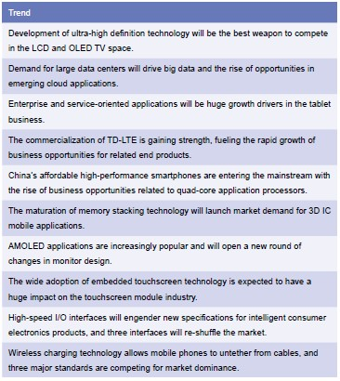

Slide 32
Top Technology Trends for 2014

Slide 33
1. Emergence of the Mobile Cloud
Mobile distributed computing paradigm will lead to explosion of new services.
Mobile and cloud computing are converging to create a new platform—one that has the potential to provide unlimited computing resources.
Mobile devices are constrained by their memory, processing power, and battery life. But combined with cloud computing, data processing and storage can happen outside of mobile devices.

Slide 34
What IDC calls the "Third Platform" will allow for better synchronization of data, improved reliability and scalability, increased ease of integration, anytime-anywhere access to business applications and collaborative services, rich user experiences, and an explosion of new services.
IEEE Computer Society resources: Rock Stars of Mobile Cloud, scheduled for 6 May in Boston, will cover insights into this emerging paradigm shift from leaders in the field.

Slide 36
Ada kebutuhan konektivitas untuk fisik dan digital.
Internet tagging antara internet dan dunia nyata.

Slide 37
The Web of Things will produce large volumes of data related to the physical world, and intelligent solutions are required to enable connectivity, inter-networking, and relevance between the physical world and the corresponding digital world resources.
IEEE Computer Society resources: A January special issue of IEEE Intelligent Systems explores adaptive solutions to assist in efficient utilization of the Web of Things.

Slide 38
BIG DATA SAMPAI EXTREME DATA
DATA: VOLUME, VELOCITY, VARIETY.
MASIH KURANGNYA ANALIS DATA DAN SOFTWARE YANG MUDAH UNTUK MENGUMPULKAN DAN MENGOLAH DATA.

Slide 39
Teknologi 3D printing.
Mudah mencetak apa saja.

Slide 40
Fabrikasi digital: rancang, prototype, produksi.

Slide 41
Online learning: new learning systems.
Massive Open Online Courses (MOOCS)

Slide 42
Butuh identitas dan powerful systems.
Web forums, online meetups, keystroke loggers.
Contextual: locatian based learning
Ubiquitous: pervasive dan embedded technologies.

Slide 43
Mobile phone: multi tasking utk ticketing, payment, audio video,
Butuh infrastruktur, backbones, high speed relays, wireless charging.

Slide 44
Infrastruktur mobile lebih handal ketika bencana.
Communication disaster.

Slide 45
Muncul masalah
privasi: pelanggaran privasi; pencurian identitas

Slide 46
Digital health care

Slide 47
Penggunaaan inteligent data, biomedical, metadata untuk penyebaran penyakit dan kebiasaan kesehatan.

Slide 48
Electronic government: penggunaan ICT dan untuk jasa, transaksi pemerintah dan masyarakat.

Slide 49
Challenges emerging in this area focus on e-government interoperability in cloud computing, open government, and smart city initiatives.
IEEE Computer Society resources: An October 2014 special issue of Computer will focus on e-government interoperability and challenges ahead.

Slide 50
10. Scientific Cloud Computing
Key to solving grand challenges, pursuing breakthroughs.
Scientific computing has already begun to change how science is done, enabling scientific breakthroughs through new kinds of experiments that would have been impossible only a decade ago.
It is the key to solving "grand challenges" in many domains and providing breakthroughs in new knowledge, and it comes in many shapes and forms: high-performance computing (HPC), high-throughput computing (HTC), many-task computing (MTC), and data-intensive computing.

Slide 51
Big data is generating datasets that are increasing exponentially in both complexity and volume, making their analysis, archival, and sharing one of the grand challenges of the 21st century. Not surprisingly, it becomes increasingly difficult to design and operate large scale systems capable of addressing these grand challenges.
IEEE Computer Society resources: A special issue of IEEE Transactions on Cloud Computing will focus on the use of cloud-based technologies to meet new challenge

Slide 52
The first question anyone asks when they meet me is: "What does a corporate anthropologist do?"
I joined Intel, the US semiconductor giant, 12 years ago, at a time when the technology industry was experiencing the first wave of what we now call consumerisation.
By that, I mean PCs were moving from being a tool for the office into the home and becoming part of people's personal lives.
At that time, the question among tech companies was, could you get out ahead of that shift.
So Intel hired me and a number of other people like me to help it better understand human beings.
Over the years, the team has grown to include people of a variety of different stripes: anthropologists, sociologists, cognitive psychologists, industrial designers, interaction designers and human factors engineers.
And our role has evolved to thinking about a broader array of questions.
Continue reading the main story“Start Quote

Slide 53
The proportion of [Indonesia's] online population using Facebook is one of the highest in the world”
Part of this is educational - explaining to a technology company what happens after Moore's Law, in which technology gets progressively smaller, faster and cheaper.
But the job is mainly to help the people who design our products to better understand those who will use them.
That involves getting out into the office, into the field, and into people's homes to ask questions about where technology empowers them, where it frustrates them and to learn about the diversity of experiences they are having with technology around the world.
On the moveOne of my early projects tested the assumption that early adopters of technology in urban Asia would behave the same as in America or western Europe. And of course we found that they are very different.
Indonesia is a fantastic example of that today. The proportion of the country's online population using Facebook is one of the highest in the world.
Tablets are the next evolution in consumer electronics
But because of the issues they have with the quality of broadband, the majority of people accessing the internet are doing it via their phones.

Slide 54
Back in 1998 when I started at Intel, computing was all about the PC. Flash forward 12 years and we are in a world where computing smarts are embedded in all sorts of things - and the interesting question is, what's next?
One place where we expect to see a lot more computing technology in the next few years is in cars.
There are nearly a billion of them on the planet and new cars today already have somewhere between 12 and 24 computer chips in them.
We've been in Singapore, Malaysia, China and Australia asking people to let us turn out the contents of their cars: front to back, glove compartment, doors, in between the seats, under the seats, boot (trunk) and everything.
We put it on a tarpaulin and photograph it, a little like an archaeological dig.
Continue reading the main story“Start Quote

Slide 55
In a sense people there were using their cars to keep them socially safe, not just physically safe”
We want to get a better understanding of the role that content plays in their lives and where computing technology might intersect with that.
In Malaysia and Singapore, for example, we were surprised to find people kept "ang pow" packets (envelopes of money given at Chinese New Year and thought to be lucky) in their cars all year round.
In a sense, people there were using their cars to keep them socially safe, not just physically safe.
Ultimately, my team's role is about making sure the product development processes start from an understanding of what people care about when it comes to technology.
And that as an organisation, we are literally testing our silicon against that ideal at each and every step of the way.
The opinions expressed are those of the author and are not held by the BBC unless specifically stated. The material is for general information only and does not constitute investment, tax, legal or other form of advice. You should not rely on this information to make (or refrain from making) any decisions. Links to external sites are for information only and do not constitute endorsement. Always obtain independent, professional advice for your own particular situatio

