Slide 1
Earthquake Analysis of Linear MDoF System
Mata Kuliah : Dinamika Struktur & Pengantar Rekayasa Kegempaan
Kode : CIV - 308
SKS : 3 SKS
Pertemuan – 11

Slide 2
TIU :
Mahasiswa dapat menjelaskan fenomena-fenomena dinamik secara fisik.
Mahasiswa dapat membuat model matematik dari masalah teknis yang ada serta mencari solusinya
TIK :
Mahasiswa dapat menghitung respon struktur MDoF akibat beban gempa bumi

Slide 3
Sub Pokok Bahasan :
Persamaan Gerak Sistem MDoF Akibat Beban Gempa Bumi
Analisis Riwayat Waktu
Analisis Spektrum Respon

Slide 4
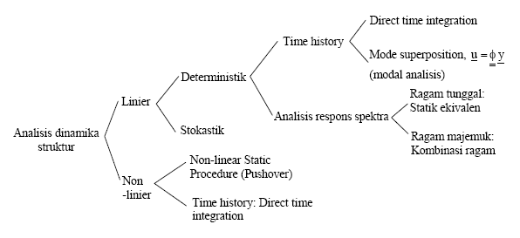

Slide 5
Equation of Motion
With
Introducing the modal analysis equation ,
and pre-multiply with [φ]^{T}

Slide 6
(1)
M_{n}
C_{n}
K_{n}
L_{n}
M_{n} = Generalized Mass
C_{n} = Generalized Damping
K_{n} = Generalized Stiffness
L_{n} = Earthquake Excitation Factor
Dividing Eq.(1) by M_{n}, gives :
(2)

Slide 7
Let
Eq. (2) becomes :
The q_{n}(t) is readily available once Eq.(4) has been solved for D_{n}(t), utilizing numerical time stepping methods for SDF systems.
(3)
SDoF
(4)

Slide 8
Response History Analysis
(5)
(6)
Response Spectrum Analysis
A_{n}(t) = ω_{n}²D_{n}(t)
(7)
(8)
A_{n}= ω_{n}²D_{n}

Slide 9
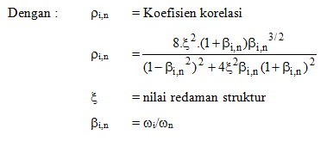
BS Response from each mode can be combine using either SRSS
or CQC Method

Slide 10
Example 1
Determine maximum Base Shear due to El Centro Acc.
Use Respon Spectrum Method
Use SRSS Method to combine BS from each mode
W₂ = 24.000 kgf
u₂
W10x21
W10x21
3 m
W₁ = 11.600 kgf
u₁
W10x45
W10x45
4,5 m

Slide 11
Mode 1, ω₁ = 10,76 rad/dt – T₁ = 2π/ω₁ = 0,58 det
Sd₁ = 2,5 inch = 6,35 cm
Hitung L₁ = {φ₁}^{T}[M]{1}
M₁ = {φ₁}^{T}[M]{φ₁}
Γ₁ = L₁/M₁
{u_{j}} = {φ₁}Γ₁.Sd₁
{fj} = [M]{u_{j}}ω₁²
Mode 2, ω₂ = 38,28 rad/dt – T₂ = 2π/ω₂ = 0,16 det
Sd₂ = 0,18 inch = 0,4572 cm
Hitung L₂ = {φ₂}^{T}[M]{1}
M₂ = {φ₂}^{T}[M]{φ₁}
Γ₂ = L₂/M₂
{u_{j}} = {φ₂}Γ₂.Sd₂
{fj} = [M]{u_{j}}ω₂²

Slide 12
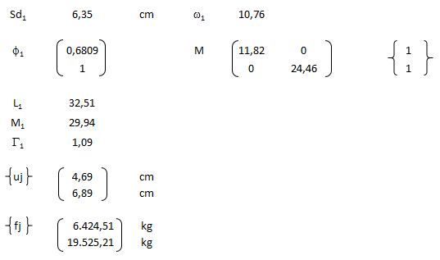
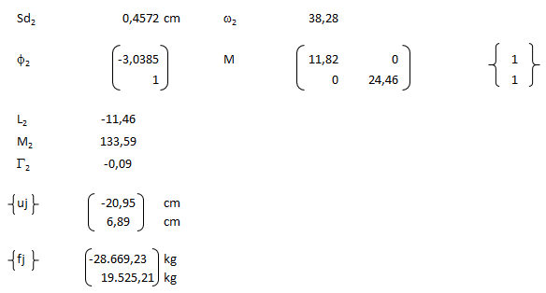

Slide 13
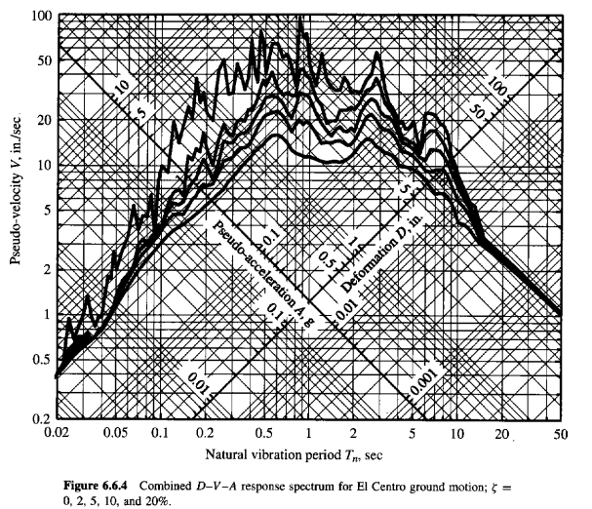

Slide 14
W₂ = 24.000 kgf
u₂
19.525,21 kg
19.525,21 kg
W10x21
W10x21
3 m
W₁ = 11.600 kgf
u₁
6.424,51 kg
28.669,23 kg
W10x45
W10x45
4,5 m
BS₁ = 25.949,72 kg
BS₂ = 9.144,02 kg
Cara SRSS
BS = ((BS1)² + (BS2)²)^{0,5} = 27.513,65 kg

Slide 15
Tugas 8
Determine maximum Base Shear due to El Centro Acc.
Use Respon Spectrum Method
Use SRSS Method to combine BS from each mode
W₃ = 20.000 kgf
u₃
W10x21
W10x21
3 m
W₂ = 24.000 kgf
u₂
W10x21
W10x21
3 m
W₁ = 11.600 kgf
u₁
W10x45
W10x45
4,5 m

