Slide 1
Respon Spektrum Gempa
Mata Kuliah : Dinamika Struktur & Pengantar Rekayasa Kegempaan
Kode : CIV – 308
SKS : 3 SKS
Pertemuan – 10

Slide 2
TIU :
Mahasiswa dapat menjelaskan fenomena-fenomena dinamik secara fisik.
TIK :
Mahasiswa dapat membuat spektrum respon untuk berbagai jenis eksitasi

Slide 3
Sub Pokok Bahasan :
Respon Spektrum
Penentuan Spektrum Rencana

Slide 4
Response Spectrum Concept
GW Housner was instrumental in the widespread acceptance of the concept of the earthquake response spectrum – introduced by MA Biot in 1932 – as a practical means of characterizing ground motions and their effects on structures.
A plot of the peak value of a response quantity as a function of the natural vibration period T_{n} of the system, or a related parameter such as circular frequnecy ω_{n} or cyclic frequency f_{n}, is called the response spectrum for that quantity.

Slide 5
A variety of response spectra can be defined depending on the response quantity that is plotted.
Consider the following peak responses :
The deformation response spectrum is a plot of u_{o} against T_{n} for fixed ξ.
A similar plot for ů_{o} is the relative velocity response spectrum, and for ü_{o} is the acceleration response spectrum

Slide 6
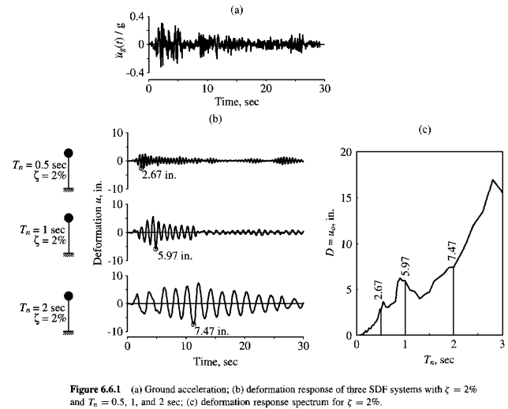
Deformation Response Spectrum

Slide 7
Pseudo-Velocity Response Spectrum
The pseudo-velocity response spectrum is a plot of V as a function of the natural vibration period T_{n}, or natural vibration frequency f_{n}, of the system, where :
The prefix pseudo is used because V is not equal to the peak velocity (ů_{o})
(5)

Slide 8
Pseudo-acceleration Response Spectrum
The pseudo-acceleration response spectrum is a plot of A as a function of the natural vibration period, T_{n}, or natural vibration frequency, f_{n} of the system, where :
The quantity A has units of acceleration and is related to the peak value of base shear V_{bo}
A/g may be interpreted as the base shear coefficient, usually used in building codes.
(6)
(7)

Slide 9
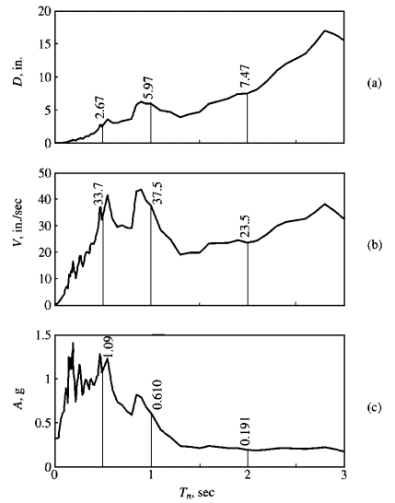
g = 386 in/sec²

Slide 10
A combined plot showing all three of the spectral quantities (deformation, pseudo-velocity and pseudo acceleration), developed for earthquake response spectra, apparently for the first time, by A.S.Veletsos and N.M. Newmark (1960)
This integrated presentation is possible because the three spectral quantities are interrelated by the following equation
(8)

Slide 11
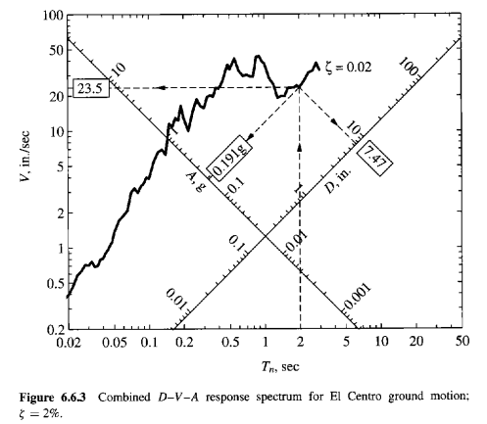

Slide 12
Example 1
A 3,6 m-long vertical cantilever, a 100 mm-nominal diameter standard steel pipe, supports a 2.400 kgf weight attached at the tip as shown if Figure.
The properties of the pipe are : outside diameter, d_{o} = 115 mm, inside diameter d_{i} = 100 mm, thickness t = 7,5 mm, and second moment of cross-sectional area, I = 3,7∙10⁶ mm⁴. Elastic Modulus E = 200 GPa.
Determine the peak deformation and bending stress in the cantilever due to the El Centro ground motion. Assume ξ = 2%.

Slide 13
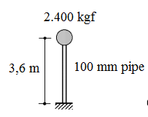
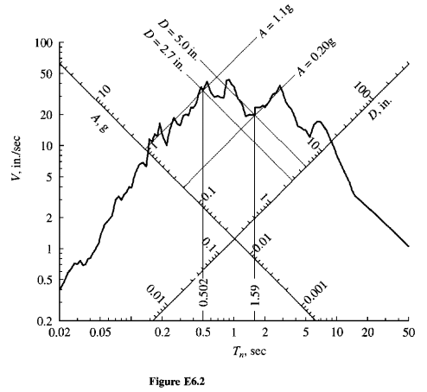
Hitung k = 3EI/L^3
Hitung m = W/g
Hitung Tn
Cari nilai D dari RS curve
Cari nilai A/g ybs
Hitung fso = A/g * w
Hitung σ = Mc/I

Slide 14
Example 2
The stress computed in Example 1 exceeded the allowable stress and the designer decided to increase the size of the pipe to an 200 mm nominal standard steel pipe.
Its properties are d_{o} = 220 mm, inside diameter d_{i} = 200 mm, thickness t = 10 mm, and second moment of cross-sectional area, I = 36,45∙10⁶ mm⁴. Compute the bending stress in the pipe, and comment on the result compare with the 100 mm pipe.

Slide 15
Example 3 (tugas)
A small one-story reinforced concrete building is idealized for purposes of structural analysis as a massless frame supporting a total dead load of 4.500 kgf at the beam level. The frame is 7 m wide and 3,6 m high. Each column and the beam has a 250 mm-square cross section. Assume that the Young’s modulus of concrete is 20.000 MPa and the damping ratio for the building is estimated as 5%. Determine the peak response of this frame to the El Centro ground motion. In particular, determine the peak lateral deformation at the beam level.

Slide 16
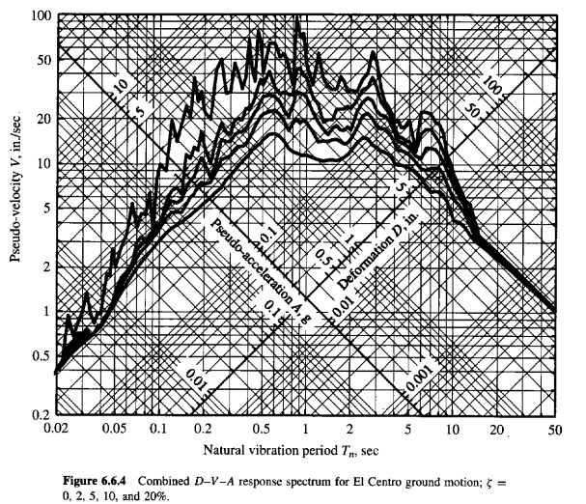

Slide 17
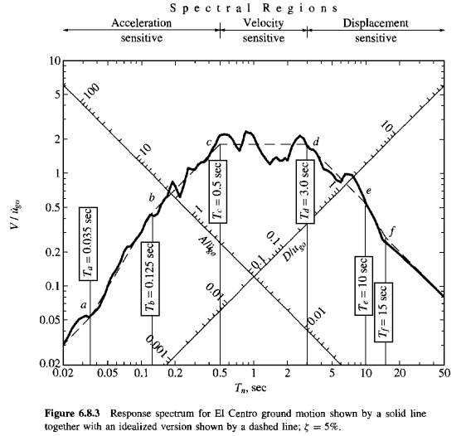
Response Spectrum Characteristic

Slide 18
For , T_{n} < T_{a} = 0,035 sec, the pseudo-acceleration A for all damping values approaches ü_{go} and D is very small
For T_{n} > T_{f} = 15 sec, D for all damping values approaches u_{go} and A is very small; thus the forces in the structure, which are related to mA, would be very small
For short period system, T_{n} between T_{a} = 0,035 sec and T_{c} = 0,5 sec, A exceeds ü_{go} , with the amplification depending on Tn and ξ.
For long period system, T_{n} between T_{d} = 3 sec and T_{f} = 15 sec, D exceeds u_{go} , with the amplification depending on Tn and ξ.
For intermediate-period system, T_{n} between T_{c} = 0,5 sec and T_{d} = 3 sec, V exceeds ů_{go}

Slide 19
Elastic Design Spectrum
The design spectrum should satisfy certain requirements because it is intended for the design of new structures, or the seismic safety evaluation of existing structures, to resist future earthquakes
It is not possible to predict the jagged response spectrum in all its detail for a ground motion that may occur in the future
The design spectrum should consist of a set of smooth curves or a series of straight lines with one curve for each level of damping
The factors that influence the construction of design spectrum include the magnitude of earthquake, the distance of the site from earthquake fault, the fault mechanism, the geology of the travel path of seismic waves from the source to the site and the local soil condition

Slide 20
