Slide 1
Single Degree of Freedom System Forced Vibration
Mata Kuliah : Dinamika Struktur & Pengantar Rekayasa Kegempaan
Kode : CIV - 308
SKS : 3 SKS
Pertemuan - 3

Slide 2
TIU :
Mahasiswa dapat menjelaskan tentang teori dinamika struktur.
Mahasiswa dapat membuat model matematik dari masalah teknis yang ada serta mencari solusinya.
TIK :
Mahasiswa mampu menghitung respon struktur dengan eksitasi harmonik dan eksitasi periodik

Slide 3
Sub Pokok Bahasan :
Eksitasi Harmonik
Eksitasi Periodik

Slide 4
Undamped SDoF Harmonic Loading
The impressed force p(t) acting on the simple oscillator in the figure is assumed to be harmonic and equal to F_{o} sin ωt , where F_{o} is the amplitude or maximum value of the force and its frequency ω is called the exciting frequency or forcing frequency.
u(t)
u(t)
k
f_{S} = ku
m
p(t) = F_{o} sin ωt
f_{I}(t) = mü
F_{o} sin ωt

Slide 5
The differential equation obtained by summing all the forces in the Free Body Diagram, is :
The solution can be expresses as :
(1)
(2)
Complementary Solution
u_{c}(t)= A cos ω_{n}t + B sin ω_{n}t
Particular Solution
u_{p}(t) = U sin ωt
(3.b)
(3.a)

Slide 6
Substituting Eq. (3.b) into Eq. (1) gives :
Or :
Which β represents the ratio of the applied forced frequency to the natural frequency of vibration of the system :
(4)
(5)

Slide 7
Combining Eq. (3.a & b) and (4) with Eq. (2) yields :
With initial conditions :
(6)
(7)
Transient Response
Steady State Response

Slide 9
Steady state response present because of the applied force, no matter what the initial conditions.
Transient response depends on the initial displacement and velocity.
Transient response exists even if
In which Eq. (7) specializes to
It can be seen that when the forcing frequency is equal to natural frequency (β = 1), the amplitude of the motion becomes infinitely large.
A system acted upon by an external excitation of frequency coinciding with the natural frequency is said to be at resonance.
(8)

Slide 10
If ω = ω_{n} (β = 1), the solution of Eq. (1) becomes :
(9)
π

Slide 11
Assignment 3
If system in the figure have initial condition
And subjected to harmonic loading p(t) = 5000 sin (ωt)
Plot a time history of displacement response of the system, for t = 0 s until t = 0,25 s, if ξ = 0%, and :
β = 0,1 ; 0,25 ; 0,60 ; 0,90; 1,00; 1,25 & 1,75
W = 2,5 tons
EI ∞
40x40 cm²
3 m
T2
(b)
E= 23.500 MPa

Slide 12
Damped SDoF Harmonic Loading
Including viscous damping the differential equation governing the response of SDoF systems to harmonic loading is :
(10)
u(t)
u(t)
c
f_{D}(t) = cú
m
p(t)
f_{I}(t) = mü
F_{o} sin ωt
k
f_{S}(t) = ku

Slide 13
The complementary solution of Eq. (9) is :
The particular solution of Eq. (9) is :
Where :
(11)
(12)
(13.a)
(13.b)

Slide 14
The complete solution of Eq. (9) is :
(14)
Transient Response
Steady State Response

Slide 15
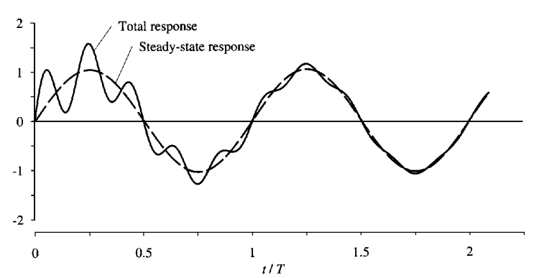
Response of damped system to harmonic force with
= 0,2,
ξ = 0,05,
u(0) = 0,
ú(0) = ω_{n}F_{o}/k

Slide 16
The total response is shown by the solid line and the steady state response by the dashed line.
The difference between the two is the transient response, which decays exponentially with time at a rate depending on β and ξ.
After awhile, essentially the forced response remains, and called steady state response
The largest deformation peak may occur before the system has reached steady state.

Slide 17
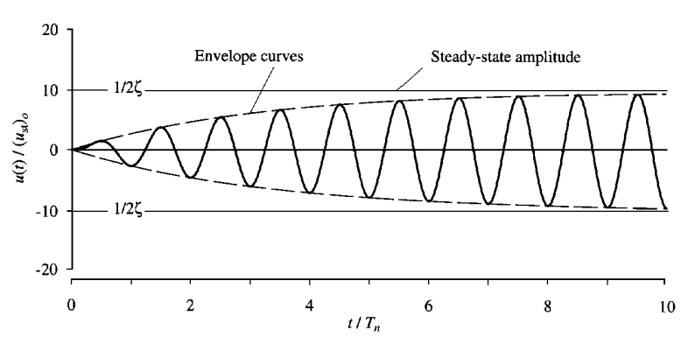
If ω = ω_{n} (β = 1), the solution of Eq. (10) becomes :
(15)

Slide 18
Considering only the steady state response, Eq. (12) & Eq. (13.a, b), can be rewritten as :
Where :
Ratio of the steady state amplitude, U to the static deflection u_{st} (=F_{o}/k) is known as the dynamic magnification factor, D :
(16)
(17)
(18)

Slide 19
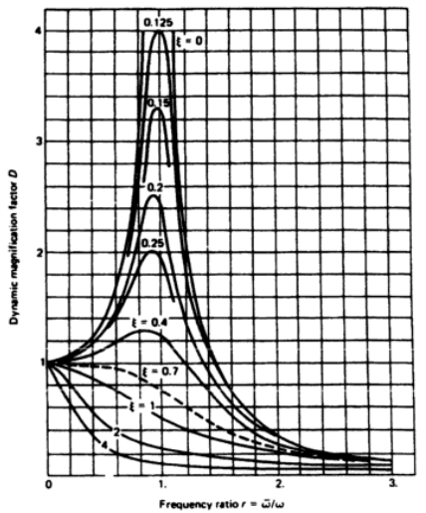
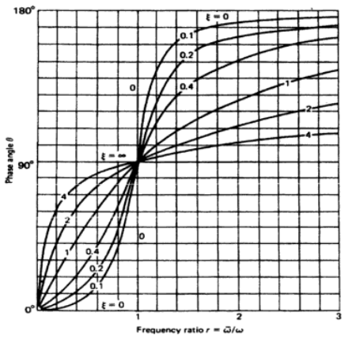

Slide 20
Exercise
The steel frame in the figure supports a rotating machine that exerts a horizontal force at the girder level p(t) = 100 sin 4 t kg. Assuming 5% of critical damping, determine : (a) the steady-state amplitude of vibration and (b) the maximum dynamic stress in the columns. Assume the girder is rigid
W = 6,8 tons
EI ∞
WF 250.125
I = 4,050 cm⁴
4,5 m
(b)
E = 205.000 MPa

Slide 21
Assignment 4
If system in the figure have initial condition
And subjected to harmonic loading p(t) = 5000 sin (ωt)
Plot a time history of displacement response of the system, for t = 0 s until t = 5 s, if : ξ = 5%
W = 2,5 tons
β = 0,1 ; 0,25 ; 0,60 ; 0,90; 1,00; 1,25 & 1,75
EI ∞
40x40 cm²
3 m
T3
(b)
E= 23.500 MPa

