Slide 1
Introduction to Dynamic of Structures
Mata Kuliah : Dinamika Struktur & Pengantar Rekayasa Kegempaan
Kode : CIV – 308
SKS : 3 SKS
Pertemuan - 1

Slide 2
TIU :
Mahasiswa dapat menjelaskan tentang teori dinamika struktur.
Mahasiswa dapat membuat model matematik dari masalah teknis yang ada serta mencari solusinya.
TIK :
Mahasiswa dapat memformulasikan persamaan gerak sistem struktur

Slide 3
Sub Pokok Bahasan :
Persamaan gerak
Newton law of Motion
D’alemberts Principle
Massa, kekakuan dan redaman
Text Book :
    Paz, M. (2004). Structural Dynamics : Theory & Computation. 5th ed. Springer. Van Nostrand, ISBN : 978-1402076671
    Clough and Penzien. (2003). Dynamics of Structures. McGraw Hill, ISBN : 0070113920
    Chopra, A. (2006). Dynamics of Structures. 3rd ed. Prentice Hall. ISBN : 978-0131561748
Bobot Penilaian :
Tugas : 25 %
Ujian Tengah Semester : 35%
Ujian Akhir Semester : 40%

Slide 4
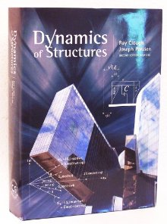

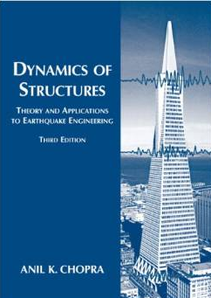

Slide 5

Why do we have to study about Structural Dynamic ?
The 1940 Tacoma Narrows Bridge
It was a steel suspension bridge in the US State of Washington. Construction began in 1938, with the opening on 1st July 1940. From the time the deck was built, it began to move vertically in windy conditions (construction workers nicknamed the bridge Galloping Gertie). The motion was observed even when the bridge opened to the public. Several measures to stop the motion were ineffective, and the bridge’s main span finally collapse under 64 km/h wind conditions the morning of 7th November 1940
http://www.youtube.com/watch?v=uzdQer1gvsU

Slide 6

The Millenium Bridge
It is an iconic steel suspension bridge for pedestrians crossing the River Thames in London. Construction began in 1998, with the opening on 10th June 2000. Londoners nicknamed the bridge the Wobbly Bridge after participants in a charity walk to open the bridge felt an unexpected and uncomfortable swaying motion. The bridge was the closed for almost two years while modifications were made to eliminate the wobble entirely. It was reopened in 2002.
http://www.youtube.com/watch?v=eAXVa__XWZ8

Slide 7
The term dynamic may be defined simply as time-varying
Thus a dynamic load is any load of which its magnitude, direction, and/or position varies with time.
Similarly , the structural response to a dynamic load, i.e., the resulting stresses and deflections, is also time-varying, or dynamic.
In general, structural response to any dynamic loading is expressed basically in terms of the displacements of the structure.
Static vs dynamic loading : https://www.youtube.com/watch?v=wZCFo3Lcbx8

Slide 8
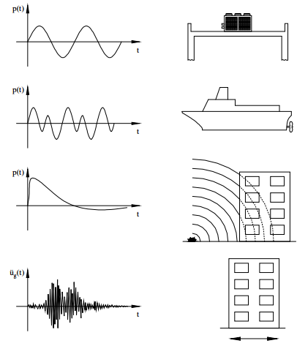
Dynamic Loading
Unbalanced rotating
machine in building
Periodic Loading
Rotating propeller at
stern of ship
Bomb blast pressure
on building
Non-Periodic Loading
Earthquake on building

Slide 9
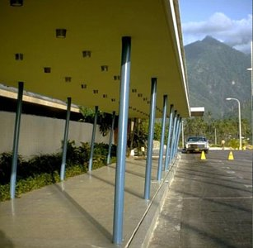
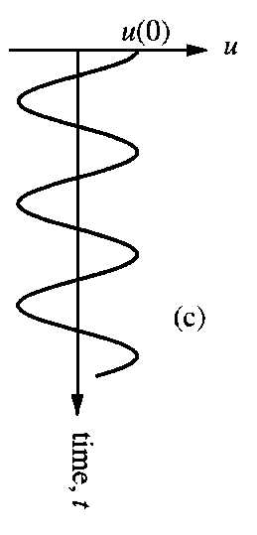
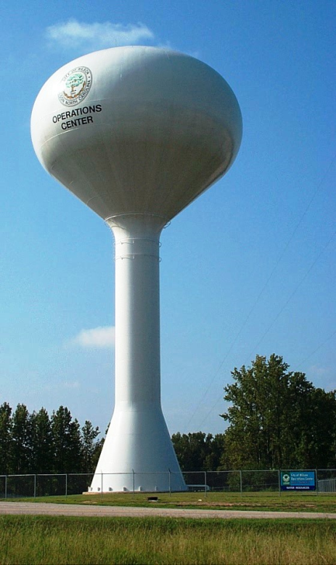
Simple Structures
u(t)
m
k

Slide 10
Degree of Freedom
In structural dynamics the number of independent coordinates necessary to specify the configuration or position of a system at any time is referred to as the number of Degree of Freedom (DoF)
In general, a continuous structure has an infinite number of DoF.
Nevertheless, the process of idealization or selection of an appropriate mathematical model permits the reduction to a discrete number of DoF.

Slide 11
m₃
u₃(t)
EI_{b}∞
u(t)
k₃
m₂
u₂(t)
m
EI_{b}∞
k₂
m₁
k
u₁(t)
EI_{b}∞
k₁
DoF = 1
DoF = 3
DoF = ?
SDoF
MDoF

Slide 12
Equations of Motion (EoM)
The mathematical expressions defining the dynamic displacements are called the Equations of Motion of the structure
The equations of motion of any dynamic system, represent expressions of Newton’ s second law of motion, which states that “the rate of change of momentum of any mass particle m is equal to the force acting on it”

Slide 13
This relationship can be expressed mathematically by the differential equation
where p(t) is the applied force vector and u(t) is the position vector of particle mass m.
For most problems in structural dynamics it may be assumed that mass does not vary with time, in which case Eq. (1) may be written
(1)
(1.a)

Slide 14
where the dots represent differentiation with respect to time.
Equation (1-a), indicating that force is equal to the product of mass and acceleration, may also be written in the form
The concept that a mass develops an inertial force proportional to its acceleration and opposing it is known as d’Alembert’s principle.
(1.b)
Inertial Force

Slide 15
Free Vibration Single DoF System
The essential physical properties of any linearly elastic structural or mechanical system subjected to a dynamic loading are its mass, elastic properties (stiffness), and damping.
u(t)
u(t)
c
f_{D}(t)
f_{I}(t)
m
p(t)
p(t)
k
f_{S}(t)
Idealized SDOF system: (a) basic components; (b) forces in equilibrium

Slide 16
The equation of motion is merely an expression of the equilibrium of these forces as given by
Where :
(2)
Inertial Force
(3.a)
Damping Force
(3.b)
(3.c)
Elastic Force

Slide 17
When Eqs. (3.a-c) are introduced into Eq. (2), the EoM for this SDOF system is found to be
Where :
m is mass, representing the mass and inertial characteristic of the structure
c is viscous damping coeficient, representing the frictional characteristics and energy losses of the structure
k is spring constant, representing the elasting restoring force and potential energy capacity of the structure
(4)

Slide 18
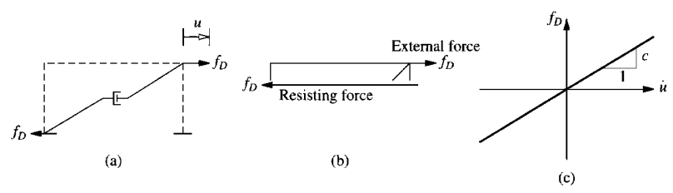
Damping Force (f_{D})
The process by which free vibration steadily diminishes in amplitude is called damping.
In damping, the energy of the vibrating system is dissipated by various mechanism, such as :
steel connections
opening and closing of micro cracks in concrete
friction between the structural and nonstructural elements
The actual damping in a SDF structure can be idealized by a linear viscous damper or dashpot called equivalent viscous damping
https://www.youtube.com/watch?v=9FJ7oFtqxpQ

Slide 19
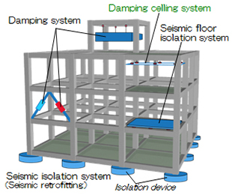

Slide 20
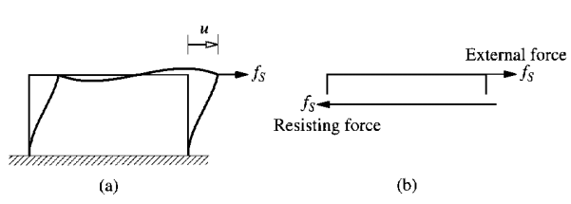
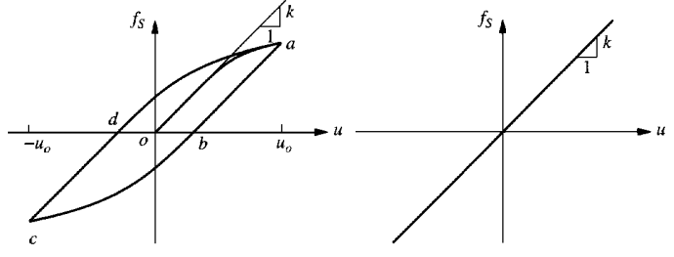
Elastic/Spring Force (f_{S})
SDoF System with no dynamic excitation subjected to an externally applied static forces f_{S} along the DoF u.
The internal force resisting the displacement u is equal and opposite to the external force f_{s}.
The force - displacement would be linear at small deformations but would become non linear at larger deformations

Slide 21
Springs in parallel or in series
Sometimes it is necessary to determine the equivalent spring constant for a system in which two or more springs are arranged in parallel or in series
u
f_{S1} = k₁u
k₁
P
f_{S1} = k₂u
k₂
ΣH = 0
P = f_{S1} + f_{S2}
k_{e}∙u = k₁∙u + k₂∙u k_{e} = k₁+ k₂
P
For n springs in parallel

Slide 22
Springs in series
k₁
k₂
P
For n springs in series

Slide 23
Exercise
Determine effective stiffness, k_{e}, from each system below
k
k
E,I,L
W
k
(b)
(a)
k
EI ∞
(c)
E,I,L
W
EI_{c}
h
k
(d)

Slide 24
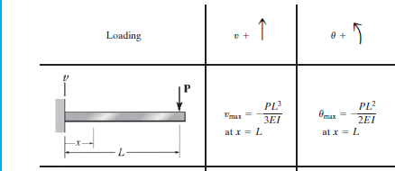
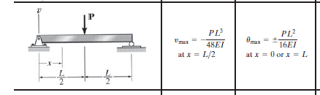
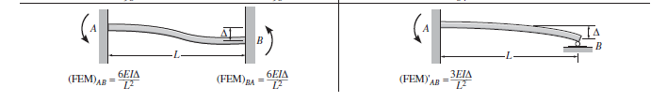

Slide 25
Tugas :
Dari soal c, apabila diketahui :
Modulus Elastis beton = 2,4. 10⁵ kg/cm²
Ukuran kolom 40 x 40 cm²
Berat beban terbagi merata = 2,8 ton/m
Panjang balok 6 m, tinggi kolom 400 cm
Hitung massa struktur dan kekakuan struktur tersebut.

Slide 26
Equation of Motion : Earthquake Excitation
In earthquake prone regions, the principal problem of structural dynamics that concern structural engineers is the behavior of structures subjected to earthquake induced motion of the base of the structure.
The displacement of the ground is denoted by u_{g}, the total displacement of the mass by u^{t}, and relative displacement between the mass and ground by u
At each instant of time these displacement are related by :
u^{t}(t) = u(t) + u_{g}(t)

Slide 27
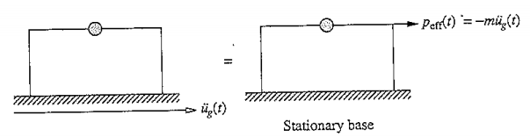
u^{t}
The resulting equation of motion is :
u
f_{I} = mü^{t}
f_{S}
f_{D}
u_{g}
(4)

