Slide 1

Management
Science
Dr. Hendy Tannady, st, mt, mm, mba.
Department of Management
Faculty of Humanities and Business
Universitas Pembangunan Jaya

Slide 2
Linear Programming
Week 2

Slide 3

Case Study : SAN MIGUEL CORPORATION
San Miguel Corporation the most diversified company in the Philippines, generates over 4% of that country’s gross national product.
San Miguel produces six brands of beer and bottles three wine and spirit brands at three different sites. Among its other endeavors are the manufacturing of packaging materials, such as glass containers, plastic crates, polybags, and cardboard boxes, and the development and manufacturing of animal feeds for its chicken, hog, and cattle interests. Other source of profit are the manufacture and distribution of ice cream, butter, cheese, and other dairy and nondiary products, the raising of prawns for export, and the processing and trading of coconut oil.
Since 1971, management science, in general and linear models, in particular have had a significant impact on the company’s bottom line. Projects in which linear models have played a major role include blending problems for determining animal feeds mixes and ice cream based composition, distribution problems for determining allocations among its 68 production facilities and 230 sales offices, and marketing problems, such as minimizing the cost of television advertising.
Use these models has saved the company millions of dollars. By 1995, San Miguel had become the first non-Japanese and non-Australian firm to rank in the top 20 Asian food and beverage companies.

Slide 4
2.1 INTRODUCTION TO LINEAR PROGRAMMING
LINEAR PROGRAMMING is a model that seeks to maximize or minimize a linear objective function subject to a set of linear constraints
A constrained mathematical programming model consists of three components :
A set of decision variables that can be controlled or determined by the decision maker
An objective function that is to be maximized or minimized
A set of constraints that describe the restrictive set of conditions that must be satisfied by any solution to the model

Slide 5
2.1 INTRODUCTION TO LINEAR PROGRAMMING
THE IMPORTANCE OF LINEAR PROGRAMMING
  Many real world problems lend themselves to linear
  programming modeling.
  2. Many real world problems can be approximated by linear models.
  3. There are well-known successful applications in:
    Manufacturing
    Marketing
    Finance (investment)
    Advertising
    Agriculture

Slide 6
2.1 INTRODUCTION TO LINEAR PROGRAMMING
Assumptions of the linear programming model
  The parameter values are known with certainty.
  The objective function and constraints exhibit constant returns to scale (Proportionality).
  There are no interactions between the decision variables (the additivity assumption).

Slide 7
2.2 A PROTOTYPE EXAMPLE
GALAXY INDUSTRIES
Galaxy Industries is an emerging toy manufacturing company that produces two “space age” water guns that are marketed nationwide, primarily to discount toy stores.
The two models, the Space Ray and the Zapper, are produced in lots of one dozen each and are made exclusively from a special plastic compund. Two of limiting resources are the 1000 pounds of the special plastic compound and the 40 hours of production time that are available each week. Two of its recommendation from Marketing Department which has already accepted by Management, are to limit total weekly production to at most 700 dozen units and to prevent weekly production of Space Rays from exceeding that of Zappers by more than 350 dozen.
Product | Profit per Dozen | Plastic (lb.) per Dozen | Production Time (min.) per Dozen
Space Ray | $ 8 | 2 | 3
Zapper | $ 5 | 1 | 4

Slide 8
2.2 A PROTOTYPE EXAMPLE
DECISION VARIABLES
X₁ = number of dozen Space Rays produced weekly
X₂ = number of dozen Zappers produced weekly
OBJECTIVE FUNCTION
Maximize 8X₁ + 5 X₂
CONSTRAINTS
The availability of plastic = 2 X₁ + 1 X₂ ≤ 1000
The weekly limit for production time = 3 X₁ + 4 X₂ ≤ 2400
The maximum production limit of total units = X₁ + X₂ ≤ 700
The mix of Space Rays and Zappers = X₁ ≤ X₂ + 350
= X₁ - X₂ ≤ 350
Nonnegativity of Decision Variables = X₁ , X₂ ≥ 0

Slide 9
2.2 A PROTOTYPE EXAMPLE
THE MATHEMATICAL MODEL
The complete mathematical model for Galaxy Industries is :
MAX | 8X₁ | + | 5X₂ |  |  | (Total weekly profit)
Constraints | 2X₁ | + | X₂ | ≤ | 1000 | (Plastic)
 | 3X₁ | + | 4X₂ | ≤ | 2400 | (Production Time)
 | X₁ | + | X₂ | ≤ | 700 | (Total production)
 | X₁ | - | X₂ | ≤ | 350 | (Mix)
 | X₁ | , | X₂ | ≥ | 0 | (Nonnegativity)

Slide 10
2.3 A GRAPHICAL ANALYSIS
The non-negativity constraints
X₂
X₁

Slide 11
Graphical Analysis – the Feasible Region
2.3 A GRAPHICAL ANALYSIS
X₂
1000
The Plastic constraint
2X₁+X₂ ≤ 1000
700
Total production constraint:
X₁+X₂ ≤ 700 (redundant)
500
Infeasible
Production
Time
3X₁+4X₂ ≤ 2400
Feasible
X₁
500
700

Slide 12
2.3 A GRAPHICAL ANALYSIS
X₂
1000
The Plastic constraint
2X₁+X₂ ≤ 1000
700
Total production constraint:
X₁+X₂ ≤ 700 (redundant)
500
Infeasible
Production mix
constraint:
X₁-X2 ≤ 350
Production
Time
3X₁+4X2≤ 2400
Feasible
500
700
X₁
  Interior points.
  Boundary points.
Extreme points.
There are three types of feasible points

Slide 13
Solving Graphically for an Optimal Solution

Slide 14
The search for an optimal solution
2.3 A GRAPHICAL ANALYSIS
X₂
Start at some arbitrary profit, say profit = $2,000...
1000
Then increase the profit, if possible...
...and continue until it becomes infeasible
700
Profit =$4360
500
X₁
500

Slide 15
Summary of the optimal solution
2.3 A GRAPHICAL ANALYSIS
  Space Rays = 320 dozen
  Zappers = 360 dozen
  Profit = $4360
  This solution utilizes all the plastic and all the production hours.
  Total production is only 680 (not 700).
  Space Rays production exceeds Zappers production by only 40 dozens.

Slide 16
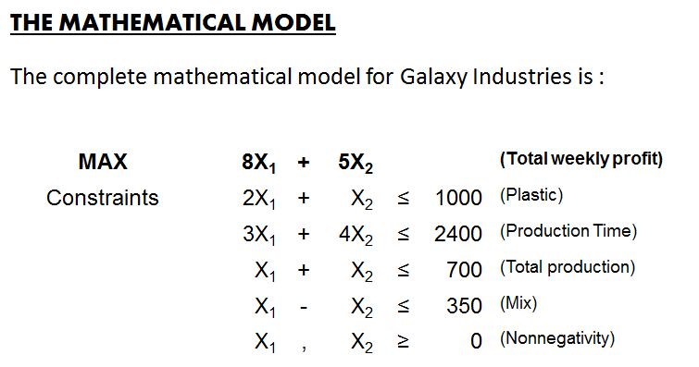
2.4 USING EXCEL SOLVER TO FIND AN OPTIMAL SOLUTION
  EXCEL

Slide 17
2.5 PROBLEMS
Giapetto’s Woodcarving
Giapetto’s Woodcarving, Inc., manufactures two types of wooden toys: soldiers and trains.
A soldier sells for $27 and uses $10 worth of raw materials.
Each soldier that is manufactured increases Giapetto’s variable labor and overhead costs by $14.
A train sells for $21 and uses $9 worth of raw materials.
Each train built increases Giapetto’s variable labor and overhead costs by $10.
The manufacture of wooden soldiers and trains requires two types of skilled
labor: carpentry and finishing.
A soldier requires 2 hours of finishing labor and 1 hour of carpentry labor.
A train requires 1 hour of finishing and 1 hour of carpentry labor.
Each week, Giapetto can obtain all the needed raw material but only 100 finishing hours and 80
carpentry hours. Demand for trains is unlimited, but at most 40 soldiers are brought each week.
Giapetto wants to maximize weekly profit (= revenues – costs).
Formulate a mathematical model of Giapetto’s situation that can be used to maximize Giapetto’s weekly profit.

Slide 18
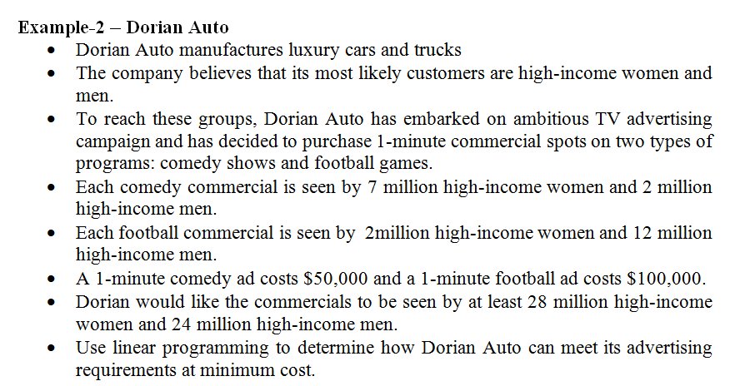
2.5 PROBLEMS

Slide 19
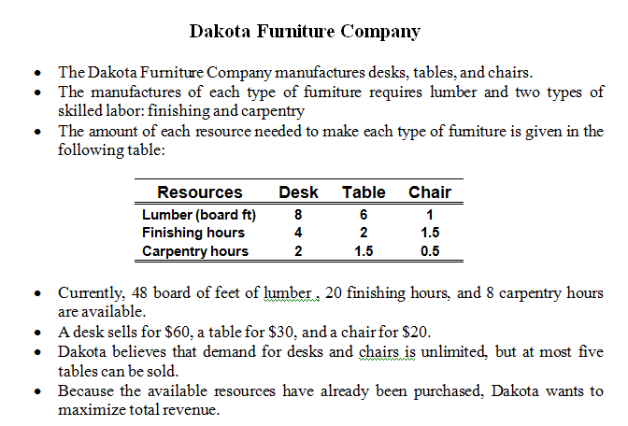
2.5 PROBLEMS

