Slide 1
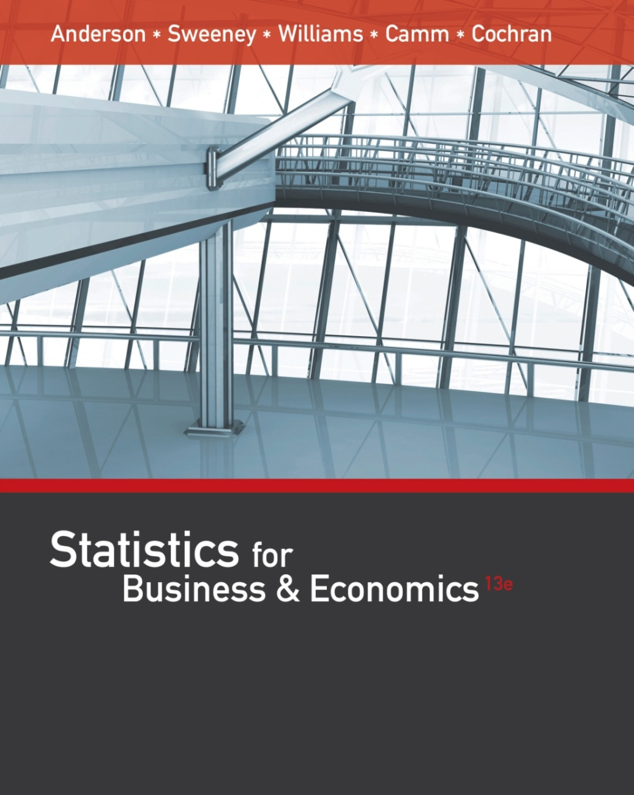
Statistics for
Business and Economics (13e)
Anderson, Sweeney, Williams, Camm, Cochran
© 2017 Cengage Learning
Slides by John Loucks
St. Edwards University

Slide 2
Chapter 16
Regression Analysis: Model Building
General Linear Model
Determining When to Add or Delete Variables
Variable Selection Procedures
Multiple Regression Approach to Experimental Design
Autocorrelation and the Durbin-Watson Test

Slide 3
General Linear Model
Models in which the parameters (β₀, β₁, . . . , β_{p} ) all have exponents of one are called linear models.
A general linear model involving p independent variables is
y = β₀ + β₁z₁ + β₂z₂ + … β_{p}z_{p} + ε
Each of the independent variables z is a function of x₁, x₂,..., x_{k} (the variables for which data have been collected).

Slide 4
General Linear Model
The simplest case is when we have collected data for just one variable x₁ and want to estimate y by using a straight-line relationship. In this case z₁ = x₁.
This model is called a simple first-order model with one predictor variable.
y = β₀ + β₁x₁ + ε

Slide 5

Modeling Curvilinear Relationships
To account for a curvilinear relationship, we might set z₁ = x₁ and z₂ = ${x_{1}}_{}^{2}$.
This model is called a second-order model with one predictor variable.
$$y=β_{0}+β_{1}x_{1}+β_{2}{x_{1}}^{2}+ε$$

Slide 6
Interaction
If the original data set consists of observations for y and two independent variables x₁ and x₂ we might develop a second-order model with two predictor variables.
$$y=β_{0}+β_{1}x_{1}+β_{2}x_{2}+β_{3}{x_{1}}^{2}+β_{4}{x_{2}}^{2}+β_{5}x_{1}x_{2}+ε$$
In this model, the variable z₅ = x₁x₂ is added to account for the potential effects of the two variables acting together.
This type of effect is called interaction.

Slide 7
Transformations Involving the Dependent Variable
Often the problem of nonconstant variance can be corrected by transforming the dependent variable to a different scale.
Most statistical packages provide the ability to apply logarithmic transformations using either the base-10 (common log) or the base e = 2.71828... (natural log).
Another approach, called a reciprocal transformation, is to use 1/y as the dependent variable instead of y.

Slide 8

Nonlinear Models That Are Intrinsically Linear
Models in which the parameters (β₀, β₁, . . . , β_{p} ) have exponents other than one are called nonlinear models.
In some cases we can perform a transformation of variables that will enable us to use regression analysis with the general linear model.
The exponential model involves the regression equation:
$$E\left(y\right)=β_{0}{β_{1}}^{x}$$
We can transform this nonlinear model to a linear model by taking the logarithm of both sides.

Slide 9
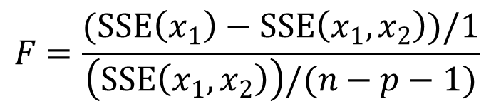
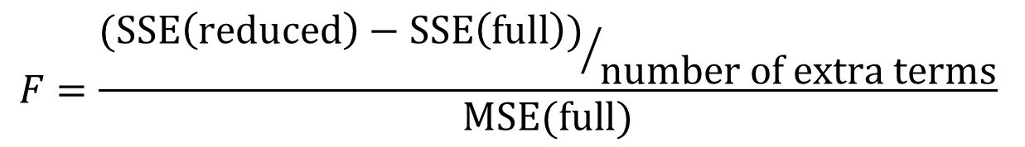
Determining When to Add or Delete Variables
To test whether the addition of x₂ to a model involving x₁ (or the deletion of x₂ from a model involving x₁ and x₂) is statistically significant we can perform an F Test.
The F Test is based on a determination of the amount of reduction in the error sum of squares resulting from adding one or more independent variables to the model.
$$F=\frac{{(SSE\left(reduced\right)−SSE\left(full\right))}/{number of extra terms}}{MSE(full)}$$
$$F=\frac{(SSE\left(x_{1}\right)−SSE\left(x_{1},x_{2}\right))/1}{\left(SSE\left(x_{1},x_{2}\right)\right)/(n−p−1)}$$

Slide 10
Determining When to Add or Delete Variables
The p–value criterion can also be used to determine whether it is advantageous to add one or more dependent variables to a multiple regression model.
The p–value associated with the computed F statistic can be compared to the level of significance α.
It is difficult to determine the p–value directly from the tables of the F distribution, but computer software packages, such as Minitab or Excel, provide the p-value.

Slide 11
Variable Selection Procedures
Stepwise Regression
Forward Selection
Backward Elimination
Iterative; one independent
variable at a time is added or
deleted based on the F statistic
Different subsets of the
independent variables
are evaluated
Best-Subsets Regression
The first 3 procedures are heuristics
and therefore offer no guarantee
that the best model will be found.

Slide 12
Variable Selection: Stepwise Regression
At each iteration, the first consideration is to see whether the least significant variable currently in the model can be removed because its F value is less than the user-specified or default Alpha to remove.
If no variable can be removed, the procedure checks to see whether the most significant variable not in the model can be added because its F value is greater than the user-specified or default Alpha to enter.
If no variable can be removed and no variable can be added, the procedure stops.

Slide 13
Variable Selection: Stepwise Regression
Any
p-value < alpha
to enter
?
Compute F stat. and
p-value for each indep.
variable not in model
No
No
Indep. variable
with largest
p-value is
removed
from model
Yes
Any
p-value > alpha
to remove
?
Yes
Stop
Compute F stat. and
p-value for each indep.
variable in model
next
Indep. variable with
smallest p-value is
entered into model
iteration
Start with no indep.
variables in model

Slide 14
Variable Selection: Forward Selection
This procedure is similar to stepwise regression, but does not permit a variable to be deleted.
This forward-selection procedure starts with no independent variables.
It adds variables one at a time as long as a significant reduction in the error sum of squares (SSE) can be achieved.

Slide 15
Variable Selection: Forward Selection
Start with no indep.
variables in model
Compute F stat. and
p-value for each indep.
variable not in model
Any
p-value < alpha
to enter
?
Yes
Indep. variable with
smallest p-value is
entered into model
No
Stop

Slide 16
Variable Selection: Backward Elimination
This procedure begins with a model that includes all the independent variables the modeler wants considered.
It then attempts to delete one variable at a time by determining whether the least significant variable currently in the model can be removed because its p-value is less than the user-specified or default value.
Once a variable has been removed from the model it cannot reenter at a subsequent step.

Slide 17
Variable Selection: Backward Elimination
Start with all indep.
variables in model
Compute F stat. and
p-value for each indep.
variable in model
Any
p-value > alpha
to remove
?
Yes
Indep. variable with
largest p-value is
removed from model
No
Stop

Slide 18
Variable Selection: Backward Elimination
Example: Clarksville Homes
Tony Zamora, a real estate investor, has just moved to Clarksville and wants to learn about the city’s residential real estate market. Tony has randomly selected 25 house-for-sale listings from the Sunday newspaper and collected the data partially listed on the next slide.
Develop, using the backward elimination procedure, a multiple regression model to predict the selling price of a house in Clarksville.

Slide 19
Variable Selection: Backward Elimination
Partial Data
Selling
House
Number
Number
Garage
Segment
Price
Size
of
of
Size
of City
($000)
(100s sq. ft.)
Bedrms.
Bathrms.
(cars)
Northwest
290
21
4
2
2
South
95
11
2
1
0
Northeast
170
19
3
2
2
Northwest
375
38
5
4
3
West
350
24
4
3
2
South
125
10
2
2
0
West
310
31
4
4
2
West
275
25
3
2
2

Slide 20
Variable Selection: Backward Elimination
Regression Output
Predictor
Coef
SE Coef
T
p
Intercept
-59.416
54.6072
-1.0881
0.28951
House Size
6.50587
3.24687
2.0037
0.05883
Bedrooms
29.1013
26.2148
1.1101
0.28012
Bathrooms
26.4004
18.8077
1.4037
0.17574
Cars
-10.803
27.329
-0.3953
0.69680
Variable to be removed
Greatest p-value > .05

Slide 21
Variable Selection: Backward Elimination
Cars (garage size) is the independent variable with the highest p-value (.697) > .05.
Cars variable is removed from the model.
Multiple regression is performed again on the remaining independent variables.

Slide 22
Variable Selection: Backward Elimination
Regression Output
Predictor
Coef
SE Coef
T
p
Intercept
-47.342
44.3467
-1.0675
0.29785
House Size
6.02021
2.94446
2.0446
0.05363
Bedrooms
23.0353
20.8229
1.1062
0.28113
Bathrooms
27.0286
18.3601
1.4721
0.15581

Slide 23
Variable Selection: Backward Elimination
Bedrooms is the independent variable with the highest p-value (.281) > .05.
Bedrooms variable is removed from the model.
Multiple regression is performed again on the remaining independent variables.

Slide 24
Variable Selection: Backward Elimination
Regression Output
Predictor
Coef
SE Coef
T
p
Intercept
-12.349
31.2392
-0.3953
0.69642
House Size
7.94652
2.38644
3.3299
0.00304
Bathrooms
30.3444
18.2056
1.6668
0.10974

Slide 25
Variable Selection: Backward Elimination
Bathrooms is the independent variable with the highest p-value (.110) > .05.
Bathrooms variable is removed from the model.
Multiple regression is performed again on the remaining independent variable.

Slide 26
Variable Selection: Backward Elimination
Regression Output
Predictor
Coef
SE Coef
T
p
Intercept
-9.8669
32.3874
-0.3047
0.76337
House Size
11.3383
1.29384
8.7633
8.7E-09

Slide 27

Variable Selection: Backward Elimination
House size is the only independent variable remaining in the model.
The estimated regression equation is:
$$\hat{y}=−9.8669+11.3383(House Size)$$

Slide 28
Variable Selection: Best-Subsets Regression
The three preceding procedures are one-variable-at-a-time methods offering no guarantee that the best model for a given number of variables will be found.
Some software packages include best-subsets regression that enables the user to find, given a specified number of independent variables, the best regression model.
Minitab output identifies the two best one-variable estimated regression equations, the two best two-variable equation, and so on.

Slide 29
Variable Selection: Best-Subsets Regression
Example: PGA Tour Data
The Professional Golfers Association keeps a variety of statistics regarding performance measures. Data include the average driving distance, percentage of drives that land in the fairway, percentage of greens hit in regulation, average number of putts, percentage of sand saves, and average score.

Slide 30
Variable-Selection Procedures
Variable Names and Definitions
Drive: average length of a drive in yards
Fair: percentage of drives that land in the fairway
Green: percentage of greens hit in regulation (a par-3 green is “hit in regulation” if the player’s first shot lands on the green)
Putt: average number of putts for greens that have been hit in regulation
Sand: percentage of sand saves (landing in a sand trap and still scoring par or better)
Score: average score for an 18-hole round

Slide 31
Variable-Selection Procedures
Sample Data (Part 1)
Drive Fair Green Putt Sand Score
277.6 .681 .667 1.768 .550 69.10
259.6 .691 .665 1.810 .536 71.09
269.1 .657 .649 1.747 .472 70.12
267.0 .689 .673 1.763 .672 69.88
267.3 .581 .637 1.781 .521 70.71
255.6 .778 .674 1.791 .455 69.76
272.9 .615 .667 1.780 .476 70.19
265.4 .718 .699 1.790 .551 69.73

Slide 32
Variable-Selection Procedures
Sample Data (Part 2)
Drive Fair Green Putt Sand Score
272.6 .660 .672 1.803 .431 69.97
263.9 .668 .669 1.774 .493 70.33
267.0 .686 .687 1.809 .492 70.32
266.0 .681 .670 1.765 .599 70.09
258.1 .695 .641 1.784 .500 70.46
255.6 .792 .672 1.752 .603 69.49
261.3 .740 .702 1.813 .529 69.88
262.2 .721 .662 1.754 .576 70.27

Slide 33
Variable-Selection Procedures
Sample Data (Part 3)
Drive Fair Green Putt Sand Score
260.5 .703 .623 1.782 .567 70.72
271.3 .671 .666 1.783 .492 70.30
263.3 .714 .687 1.796 .468 69.91
276.6 .634 .643 1.776 .541 70.69
252.1 .726 .639 1.788 .493 70.59
263.0 .687 .675 1.786 .486 70.20
263.0 .639 .647 1.760 .374 70.81
253.5 .732 .693 1.797 .518 70.26
266.2 .681 .657 1.812 .472 70.96

Slide 34
Variable-Selection Procedures
Sample Correlation Coefficients
Score Drive Fair Green Putt
Drive
-.154
Fair
-.427 -.679
Green
-.556 -.045 .421
Putt
.258 -.139 .101 .354
Sand
-.278 -.024 .265 .083 -.296

Slide 35
Variable-Selection Procedures
Best Subsets Regression of SCORE
Vars R-sq R-sq(a) C-p s D F G P S
1 30.9 27.9 26.9 .39685 X
1 18.2 14.6 35.7 .43183 X
2 54.7 50.5 12.4 .32872 X X
2 54.6 50.5 12.5 .32891 X X
3 60.7 55.1 10.2 .31318 X X X
3 59.1 53.3 11.4 .31957 X X X
4 72.2 66.8 4.2 .26913 X X X X
4 60.9 53.1 12.1 .32011 X X X X
5 72.6 65.4 6.0 .27499 X X X X X

Slide 36
Variable-Selection Procedures
Minitab Output
The regression equation
Score = 74.678 - .0398(Drive) - 6.686(Fair)
- 10.342(Green) + 9.858(Putt)
Predictor Coef Stdev t-ratio p
Constant 74.678 6.952 10.74 .000
Drive -.0398 .01235 -3.22 .004
Fair -6.686 1.939 -3.45 .003
Green -10.342 3.561 -2.90 .009
Putt 9.858 3.180 3.10 .006
s = .2691 R-sq = 72.4% R-sq(adj) = 66.8%

Slide 37
Variable-Selection Procedures
Minitab Output
Analysis of Variance
SOURCE DF SS MS F P
Regression 4 3.79469 .94867 13.10 .000
Error 20 1.44865 .07243
Total 24 5.24334

Slide 38
Multiple Regression Approach to Experimental Design
The use of dummy variables in a multiple regression equation can provide another approach to solving analysis of variance and experimental design problems.
We will use the results of multiple regression to perform the ANOVA test on the difference in the means of three populations.

Slide 39
Multiple Regression Approach to Experimental Design
Example: Reed Manufacturing
Janet Reed would like to know if there is any significant difference in the mean number of hours worked per week for the department managers at
her three manufacturing plants (in Buffalo, Pittsburgh, and Detroit).
A simple random sample of five managers from each of the three plants was taken and the number of hours worked by each manager for the previous week is shown on the next slide.

Slide 40
Multiple Regression Approach to Experimental Design
Plant 1
Buffalo
Plant 2
Pittsburgh
Plant 3
Detroit
Observation
1
2
3
4
5
48
54
57
54
62
73
63
66
64
74
51
63
61
54
56
Sample Mean
55 68 57
Sample Variance
26.0 26.5 24.5

Slide 41
Multiple Regression Approach to Experimental Design
We begin by defining two dummy variables, A and B, that will indicate the plant from which each sample observation was selected.
In general, if there are k populations, we need to define k – 1 dummy variables.
A = 0, B = 0 if observation is from Buffalo plant
A = 1, B = 0 if observation is from Pittsburgh plant
A = 0, B = 1 if observation is from Detroit plant

Slide 42
Multiple Regression Approach to Experimental Design
Input Data
Plant 1
Buffalo
Plant 2
Pittsburgh
Plant 3
Detroit
A B y
A B y
A B y
0
0
0
0
0
0
0
0
0
0
48
54
57
54
62
1
1
1
1
1
0
0
0
0
0
73
63
66
64
74
0
0
0
0
0
1
1
1
1
1
51
63
61
54
56

Slide 43
Multiple Regression Approach to Experimental Design
E(y) = expected number of hours worked = β₀ + β₁A + β₂B
For Buffalo: E(y) = β₀ + β₁(0) + β₂(0) = β₀
For Pittsburgh: E(y) = β₀ + β₁(1) + β₂(0) = β₀ + β₁
For Detroit: E(y) = β₀ + β₁(0) + β₂(1) = β₀ + β₂

Slide 44
Multiple Regression Approach to Experimental Design
Excel produced the regression equation:
y = 55 +13A + 2B
Plant
Estimate of E(y)
Buffalo
Pittsburgh
Detroit
b₀ = 55
b₀ + b₁ = 55 + 13 = 68
b₀ + b₂ = 55 + 2 = 57

Slide 45
Multiple Regression Approach to Experimental Design
Next, we observe that if there is no difference in the means:
E(y) for the Pittsburgh plant – E(y) for the Buffalo plant = 0
E(y) for the Detroit plant – E(y) for the Buffalo plant = 0

Slide 46
Multiple Regression Approach to Experimental Design
Because β₀ equals E(y) for the Buffalo plant and β₀ + β₁ equals E(y) for the Pittsburgh plant, the first difference is equal to (β₀ + β₁) - β₀ = β₁.
Because β₀ + β₂ equals E(y) for the Detroit plant, the second difference is equal to (β₀ + β₂) - β₀ = β₂.
We would conclude that there is no difference in the three means if β₁ = 0 and β₂ = 0.

Slide 47
Multiple Regression Approach to Experimental Design
The null hypothesis for a test of the difference of means is
H₀: β₁ = β₂ = 0
To test this null hypothesis, we must compare the value of MSR/MSE to the critical value from an F distribution with the appropriate numerator and denominator degrees of freedom.

Slide 48
Multiple Regression Approach to Experimental Design
ANOVA Table Produced by Excel
Source of
Variation
Sum of
Squares
Degrees of
Freedom
Mean
Squares
F
p
Regression
Error
Total
490
308
798
2
12
14
245
25.667
9.55
.003

Slide 49
Multiple Regression Approach to Experimental Design
At a .05 level of significance, the critical value of F with k – 1 = 3 – 1 = 2 numerator d.f. and n_{T} – k = 15 – 3 = 12 denominator d.f. is 3.89.
Because the observed value of F (9.55) is greater than the critical value of 3.89, we reject the null hypothesis.
Alternatively, we reject the null hypothesis because the p-value of .003 < a = .05.

Slide 50
Autocorrelation and the Durbin-Watson Test
Often, the data used for regression studies in business and economics are collected over time.
It is not uncommon for the value of y at one time period to be related to the value of y at previous time periods.
In this case, we say autocorrelation (or serial correlation) is present in the data.

Slide 51
Autocorrelation and the Durbin-Watson Test
With positive autocorrelation, we expect a positive residual in one period to be followed by a positive residual in the next period.
With positive autocorrelation, we expect a negative residual in one period to be followed by a negative residual in the next period.
With negative autocorrelation, we expect a positive residual in one period to be followed by a negative residual in the next period, then a positive residual, and so on.

Slide 52
Autocorrelation and the Durbin-Watson Test
When autocorrelation is present, one of the regression assumptions is violated: the error terms are not independent.
When autocorrelation is present, serious errors can be made in performing tests of significance based upon the assumed regression model.
The Durbin-Watson statistic can be used to detect first-order autocorrelation.

Slide 53

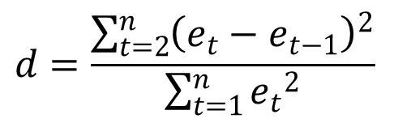
Autocorrelation and the Durbin-Watson Test
Durbin-Watson Test Statistic
$$d=\frac{\sum_{t=2}^{n}{{\left(e_{t}−e_{t−1}\right)}^{2}}}{\sum_{t=1}^{n}{{e_{t}}^{2}}}$$
The ith residual is denoted $e_{i}=y_{i}−{\hat{y}}_{i}$

Slide 54
Autocorrelation and the Durbin-Watson Test
Durbin-Watson Test Statistic
The statistic ranges in value from zero to four.
If successive values of the residuals are close together (positive autocorrelation is present), the statistic will be small.
If successive values are far apart (negative autocorrelation is present), the statistic will be large.
A value of two indicates no autocorrelation.

Slide 55
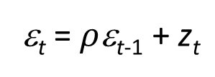
Autocorrelation and the Durbin-Watson Test
Suppose the values of e (residuals) are not independent but are related in the following manner:
ε_{t} = $ρ$ε_{t-1} + z_{t}
where r is a parameter with an absolute value less than one and z_{t} is a normally and independently distributed random variable with a mean of zero and variance of σ ².
We see that if r = 0, the error terms are not related.
The Durbin-Watson test uses the residuals to determine whether r = 0.

Slide 56

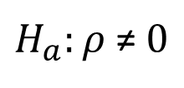


Autocorrelation and the Durbin-Watson Test
The null hypothesis always is:
$$H_{0}:ρ=0$$
there is no autocorrelation
The alternative hypothesis is:
$$H_{a}:ρ>0$$
to test for positive autocorrelation
$$H_{a}:ρ<0$$
to test for negative autocorrelation
$H_{a}:ρ$≠ $0$
to test for positive or negative
autocorrelation

Slide 57
Autocorrelation and the Durbin-Watson Test
A Sample Of Critical Values For The
Durbin-Watson Test For Autocorrelation
 |  | Significance Points of d_{L} and d_{U}: α = .05
 |  | Number of Independent Variables
 | 1 |  | 2 |  | 3 |  | 4 |  | 5
n | d_{L} | d_{U} | d_{L} | d_{U} | d_{L} | d_{U} | d_{U} | d_{U} | d_{U} | d_{U}
15 | 1.08 | 1.36 | 0.95 | 1.54 | 0.82 | 1.75 | 0.69 | 1.97 | 0.56 | 2.21
16 | 1.10 | 1.37 | 0.98 | 1.54 | 0.86 | 1.73 | 0.74 | 1.93 | 0.62 | 2.15
17 | 1.13 | 1.38 | 1.02 | 1.54 | 0.90 | 1.71 | 0.78 | 1.90 | 0.67 | 2.10
18 | 1.16 | 1.39 | 1.05 | 1.53 | 0.93 | 1.69 | 0.82 | 1.87 | 0.71 | 2.06

Slide 58
Autocorrelation and the Durbin-Watson Test
Positive
autocor-
relation
Incon-
clusive
No evidence of
positive autocorrelation
0
d_{L}
d_{U}
2
4-d_{U}
4-d_{L}
4
No evidence of
negative autocorrelation
Incon-
clusive
Negative
autocor-
relation
0
d_{L}
d_{U}
2
4-d_{U}
4-d_{L}
4
Positive
autocor-
relation
Incon-
clusive
No evidence of
autocorrelation
Incon-
clusive
Negative
autocor-
relation
0
d_{L}
d_{U}
2
4-d_{U}
4-d_{L}
4

Slide 59
End of Chapter 16

