Slide 1
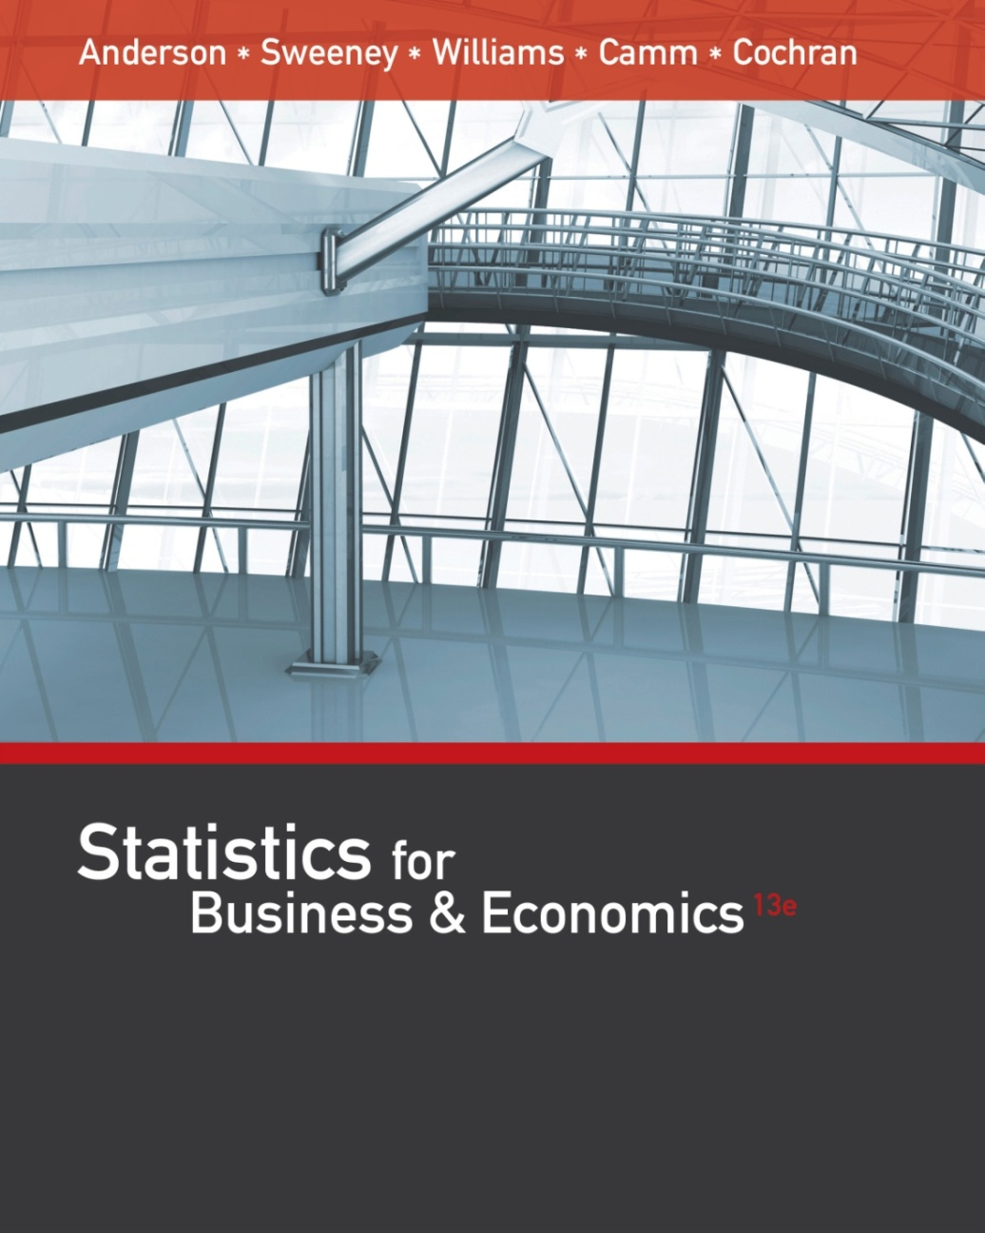
Statistics for
Business and Economics (13e)
Anderson, Sweeney, Williams, Camm, Cochran
© 2017 Cengage Learning
Slides by John Loucks
St. Edwards University

Slide 2
Chapter 14, Part B
Simple Linear Regression
Using the Estimated Regression Equation for Estimation and Prediction
Computer Solution
Residual Analysis: Validating Model Assumptions
Residual Analysis: Outliers and Influential Observations

Slide 3
Using the Estimated Regression Equation
for Estimation and Prediction
A confidence interval is an interval estimate of the mean value of y for a given value of x.
A prediction interval is used whenever we want to predict an individual value of y for a new observation corresponding to a given value of x.
The margin of error is larger for a prediction interval.

Slide 4


Using the Estimated Regression Equation
for Estimation and Prediction
Confidence Interval Estimate of E(y*)
$${\hat{y}}^{∗}±t_{α/2}s_{{\hat{y}}^{∗}}$$
Prediction Interval Estimate of y*
$${\hat{y}}^{∗}±t_{α/2}s_{pred}$$
where:
confidence coefficient is 1 - α and t_{α/2} is based on a t distribution with n - 2 degrees of freedom

Slide 5

Point Estimation
If 3 TV ads are run prior to a sale, we expect the mean number of cars sold to be:
$$\hat{y}=10+5\left(3\right)=25 cars$$

Slide 6
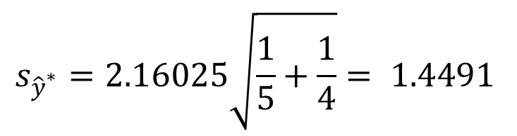
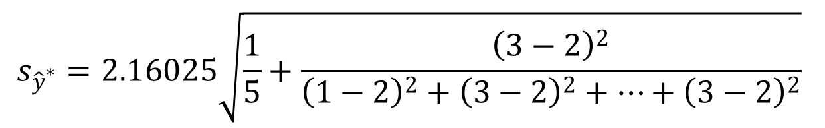

Confidence Interval for E(y*)
Estimate of the Standard Deviation of ${\hat{y}}^{∗}$
$$s_{{\hat{y}}^{∗}}=s\sqrt{\frac{1}{n}+\frac{{\left(x^{∗}−\overline{x}\right)}^{2}}{\sum{{\left(x_{i}−\overline{x}\right)}^{2}}}}$$
$$s_{{\hat{y}}^{∗}}=2.16025\sqrt{\frac{1}{5}+\frac{{\left(3−2\right)}^{2}}{{\left(1−2\right)}^{2}+{\left(3−2\right)}^{2}+…+{\left(3−2\right)}^{2}}}$$
$$s_{{\hat{y}}^{∗}}=2.16025\sqrt{\frac{1}{5}+\frac{1}{4}}= 1.4491$$

Slide 7

Confidence Interval for E(y*)
The 95% confidence interval estimate of the mean number of cars sold when 3 TV ads are run is:
$${\hat{y}}^{∗}±t_{α/2}s_{{\hat{y}}^{∗}}$$
25 + 3.1824(1.4491)
25 + 4.61
20.39 to 29.61 cars

Slide 8
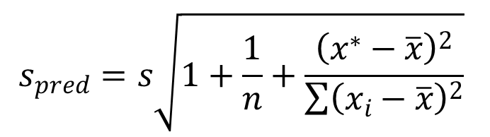
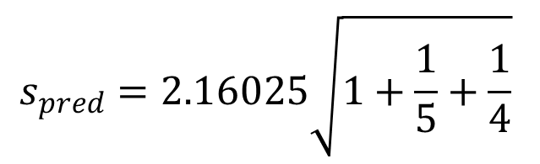
Prediction Interval for y*
Estimate of the Standard Deviation of an Individual Value of y*
$$s_{pred}=s\sqrt{1+\frac{1}{n}+\frac{{\left(x^{∗}−\overline{x}\right)}^{2}}{\sum{{\left(x_{i}−\overline{x}\right)}^{2}}}}$$
$$s_{pred}=2.16025\sqrt{1+\frac{1}{5}+\frac{1}{4}}$$
s_{pred} = 2.16025(1.20416) = 2.6013

Slide 9

Prediction Interval for y*
The 95% prediction interval estimate of the number of cars sold in one particular week when 3 TV ads are run is:
$${\hat{y}}^{∗}±t_{α/2}s_{pred}$$
25 + 3.1824(2.6013)
25 + 8.28
16.72 to 33.28 cars

Slide 10
Computer Solution
Up to this point, you have seen how Excel can be used for various parts of a regression analysis.
Excel also has a comprehensive tool in its Data Analysis package called Regression.
The Regression tool can be used to perform a complete regression analysis.

Slide 11
Computer Solution
Performing the regression analysis computations without the help of a computer can be quite time consuming.
On the next slide we show Minitab output for the Reed Auto Sales example.
Recall that the independent variable was named Ads and the dependent variable was named Cars in the example.

Slide 12
Minitab
Output
The regression equation is
Cars = 10.0 + 5.00 Ads
Predictor | Coef | SE Coef | T | p
Constant | 10.000 | 2.366 | 4.23 | 0.024
Ads | 5.0000 | 1.080 | 4.63 | 0.019
S = 2.16025 | R-sq = 87.7% |  | R-sq(adj) = 83.6%
Analysis of Variance
SOURCE | DF | SS | MS | F | p
Regression | 1 | 100 | 100 | 21.43 | 0.019
Residual Err. | 3 | 14 | 4.667
Total | 4 | 114
Predicted Values for New Observations
New
Obs | Fit | SE Fit | 95% C.I. |  | 95% P.I.
1 | 25 | 1.45 | (20.39, 29.61) |  | (16.72, 33.28)
Estimated
Regression
Equation
ANOVA
Table
Interval
Estimates

Slide 13
Minitab Output
Minitab prints the estimated regression equation as Cars = 10.0 + 5.00 Ads.
For each of the coefficients b₀ and b₁, the output shows its value, standard deviation, t value, and p-value.
Minitab prints the standard error of the estimate, s, as well as information about the goodness of fit. .
The standard ANOVA table is printed.
Also provided are the 95% confidence interval estimate of the expected number of cars sold and the 95% prediction interval estimate of the number of cars sold for an individual weekend with 3 ads.

Slide 14
Using Excel’s Regression Tool
Excel Output (top portion)
A
B
C
9
10
Regression Statistics
11
Multiple R
0.936585812
12
R Square
0.877192982
13
Adjusted R Square
0.83625731
14
Standard Error
2.160246899
15
Observations
5
16

Slide 15
Using Excel’s Regression Tool
Excel Output (middle portion)
A
B
C
D
E
F
16
17
ANOVA
18
df
SS
MS
F
Significance F
19
Regression
1
100
100
21.4286
0.018986231
20
Residual
3
14
4.66667
21
Total
4
114
22

Slide 16
Using Excel’s Regression Tool
Excel Output (bottom-left portion)
Note: Columns F-I are not shown.

Slide 17
Using Excel’s Regression Tool
Excel Output (bottom-right portion)
Note: Columns C-E are hidden.

Slide 18

Residual Analysis
If the assumptions about the error term ε appear questionable, the hypothesis tests about the significance of the regression relationship and the interval estimation results may not be valid.
The residuals provide the best information about ε .
Residual for observation i
$$y_{i}−{\hat{y}}_{i}$$
Much of the residual analysis is based on an examination of graphical plots.

Slide 19
Residual Plot Against x
If the assumption that the variance of ε is the same for all values of x is valid, and the assumed regression model is an adequate representation of the relationship between the variables, then the residual plot should give an overall impression of a horizontal band of points.

Slide 20

Residual Plot Against x
$$y−\hat{y}$$
Good Pattern
Residual
0
x

Slide 21

Residual Plot Against x
$$y−\hat{y}$$
Nonconstant Variance
Residual
0
x

Slide 22
Residual Plot Against x
$$y−\hat{y}$$
Model Form Not Adequate
Residual
0
x

Slide 23
Residual Plot Against x
Residuals
Observation
Predicted Cars Sold
Residuals
1
15
-1
2
25
-1
3
20
-2
4
15
2
5
25
2

Slide 24
Residual Plot Against x

Slide 25
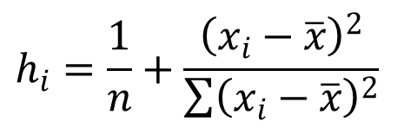


Standardized Residuals
Standardized Residual for Observation i
$$\frac{y_{i}−{\hat{y}}_{i}}{s_{y_{i}−{\hat{y}}_{i}}}$$
where:
$$s_{y_{i}−{\hat{y}}_{i}}=s\sqrt{1−h_{i}}$$
$$h_{i}=\frac{1}{n}+\frac{{\left(x_{i}−\overline{x}\right)}^{2}}{\sum{{\left(x_{i}−\overline{x}\right)}^{2}}}$$

Slide 26
Standardized Residual Plot
The standardized residual plot can provide insight about the assumption that the error term ε has a normal distribution.
If this assumption is satisfied, the distribution of the standardized residuals should appear to come from a standard normal probability distribution.

Slide 27
Standardized Residual Plot
Standardized Residuals
Standardized
Observation
Predicted y
Residual
Residual
1
15
-1
-0.5345
2
25
-1
-0.5345
3
20
-2
-1.0690
4
15
2
1.0690
5
25
2
1.0690

Slide 28
Standardized Residual Plot
Standardized Residual Plot

Slide 29
Standardized Residual Plot
All of the standardized residuals are between –1.5 and +1.5 indicating that there is no reason to question the assumption that e has a normal distribution.

Slide 30
Outliers and Influential Observations
Detecting Outliers
  An outlier is an observation that is unusual in comparison with the other data.
  Minitab classifies an observation as an outlier if its standardized residual value is < -2 or > +2.
  This standardized residual rule sometimes fails to identify an unusually large observation as being an outlier.
  This rule’s shortcoming can be circumvented by using studentized deleted residuals.
  The |i th studentized deleted residual| will be larger than the |i th standardized residual|.

Slide 31
End of Chapter 14, Part B

