Slide 1
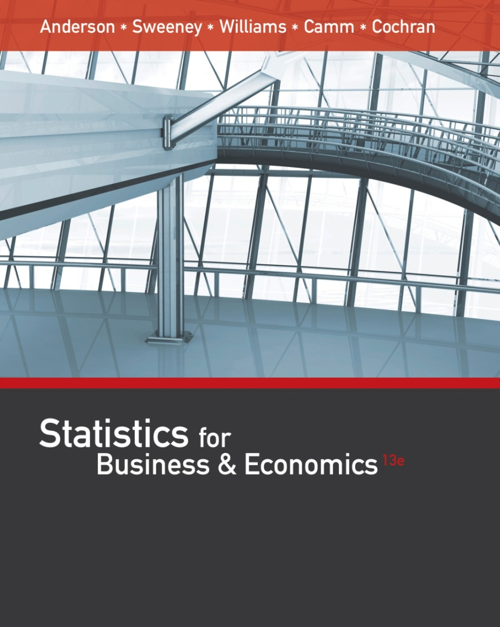
Statistics for
Business and Economics (13e)
Slides by
John
Loucks
St. Edward’s
University
Anderson, Sweeney, Williams, Camm, Cochran
© 2017 Cengage Learning
Slides by John Loucks
St. Edwards University

Slide 2
Chapter 14, Part A: Simple Linear Regression
Simple Linear Regression Model
Least Squares Method
Coefficient of Determination
Model Assumptions
Testing for Significance

Slide 3
Simple Linear Regression
Managerial decisions often are based on the relationship between two or more variables.
Regression analysis can be used to develop an equation showing how the variables are related.
The variable being predicted is called the dependent variable and is denoted by y.
The variables being used to predict the value of the dependent variable are called the independent variables and are denoted by x.

Slide 4
Simple Linear Regression
Simple linear regression involves one independent variable and one dependent variable.
The relationship between the two variables is approximated by a straight line.
Regression analysis involving two or more independent variables is called multiple regression.

Slide 5
Simple Linear Regression Model
The equation that describes how y is related to x and an error term is called the regression model.
The simple linear regression model is:
y = β₀ + β₁x + ε
where:
  β₀ and β₁ are called parameters of the model.
  ε is a random variable called the error term.

Slide 6
Simple Linear Regression Equation
The simple linear regression equation is:
E(y) = β₀ + β₁x
  Graph of the regression equation is a straight line.
  β₀ is the y intercept of the regression line.
  β₁ is the slope of the regression line.
  E(y) is the expected value of y for a given x value.

Slide 7
Simple Linear Regression Equation
Positive Linear Relationship
E(y)
Regression line
Intercept
β₀
Slope β₁
is positive
x

Slide 8
Simple Linear Regression Equation
Negative Linear Relationship
E(y)
Intercept
β₀
Regression line
Slope β₁
is negative
x

Slide 9
Simple Linear Regression Equation
No Relationship
E(y)
Intercept
β₀
Regression line
Slope β₁
is 0
x

Slide 10

Estimated Simple Linear Regression Equation
The estimated simple linear regression equation
$$\hat{y}=b_{0}+b_{1}x$$
  The graph is called the estimated regression line.
  b₀ is the y intercept of the line.
  b₁ is the slope of the line.
  $\hat{y}$is the estimated value of y for a given x value.

Slide 11

Estimation Process
Regression Model
y = β₀ + β₁x +ε
Regression Equation
E(y) = β₀ + β₁x
Unknown Parameters
β₀, β₁
Sample Data:
x y
x₁ y₁
. .
. .
x_{n} y_{n}
b₀ and b₁
provide estimates of
β₀ and β₁
Estimated
Regression Equation
Sample Statistics
b₀, b₁
$$\hat{y}=b_{0}+b_{1}x$$

Slide 12
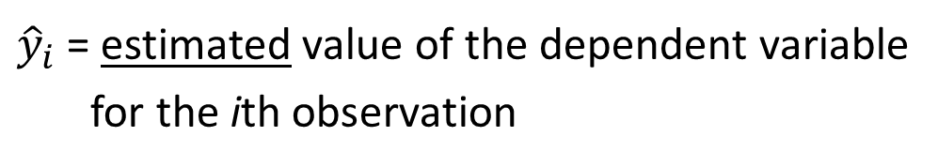
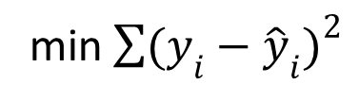
Least Squares Method
Least Squares Criterion
min$\sum{{(y_{i}−{\hat{y}}_{i})}^{2}}$
where:
y_{i} = observed value of the dependent variable
for the ith observation
${\hat{y}}_{i}$ = estimated value of the dependent variable
for the ith observation

Slide 13
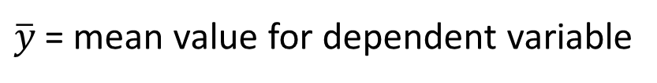
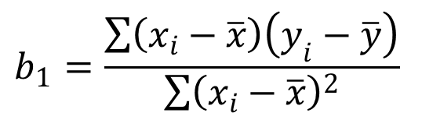
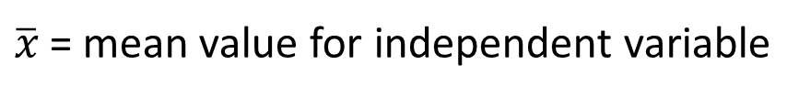
Least Squares Method
Slope for the Estimated Regression Equation
$$b_{1}=\frac{\sum{\left(x_{i}−\overline{x}\right)\left(y_{i}−\overline{y}\right)}}{\sum{{\left(x_{i}−\overline{x}\right)}^{2}}}$$
where:
x_{i} = value of independent variable for ith observation
y_{i} = value of dependent variable for ith observation
$\overline{x}$= mean value for independent variable
$\overline{y}$ = mean value for dependent variable

Slide 14

Least Squares Method
y-Intercept for the Estimated Regression Equation
$$b_{0}=\overline{y}−b_{1}\overline{x}$$

Slide 15
Simple Linear Regression
Example: Reed Auto Sales
Reed Auto periodically has a special week-long sale. As part of the advertising campaign Reed runs one or more television commercials during the weekend preceding the sale. Data from a sample of 5 previous sales are shown on the next slide.

Slide 16


Simple Linear Regression
Example: Reed Auto Sales
Number of
TV Ads (x)
Number of
Cars Sold (y)
1
3
2
1
3
14
24
18
17
27
Σx = 10
Σy = 100
$$\overline{x}=2$$
$$\overline{y}=20$$

Slide 17


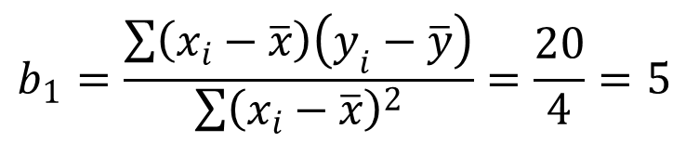
Estimated Regression Equation
Slope for the Estimated Regression Equation
$$b_{1}=\frac{\sum{\left(x_{i}−\overline{x}\right)\left(y_{i}−\overline{y}\right)}}{\sum{{\left(x_{i}−\overline{x}\right)}^{2}}}=\frac{20}{4}=5$$
y-Intercept for the Estimated Regression Equation
$$b_{0}=\overline{y}−b_{1}\overline{x}=20−5\left(2\right)=10$$
Estimated Regression Equation
$$\hat{y}=10+5x$$

Slide 18
Using Excel’s Chart Tools for
Scatter Diagram & Estimated Regression Equation
Reed Auto Sales Estimated Regression Line

Slide 19
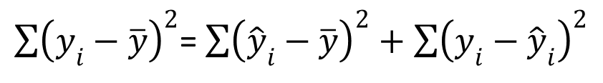
Coefficient of Determination
Relationship Among SST, SSR, SSE
SST = SSR + SSE
$\sum{{\left(y_{i}−\overline{y}\right)}^{2}}$= $\sum{{\left({\hat{y}}_{i}−\overline{y}\right)}^{2}+\sum{{\left(y_{i}−{\hat{y}}_{i}\right)}^{2}}}$
where:
SST = total sum of squares
SSR = sum of squares due to regression
SSE = sum of squares due to error

Slide 20
Coefficient of Determination
The coefficient of determination is:
r² = SSR/SST
where:
SSR = sum of squares due to regression
SST = total sum of squares

Slide 21
Coefficient of Determination
r² = SSR/SST = 100/114 = .8772
The regression relationship is very strong; 87.72% of the variability in the number of cars sold can be explained by the linear relationship between the number of TV ads and the number of cars sold.

Slide 22
Using Excel to Compute the Coefficient of Determination
Adding r ² Value to Scatter Diagram
Reed Auto Sales Estimated Regression Line

Slide 23

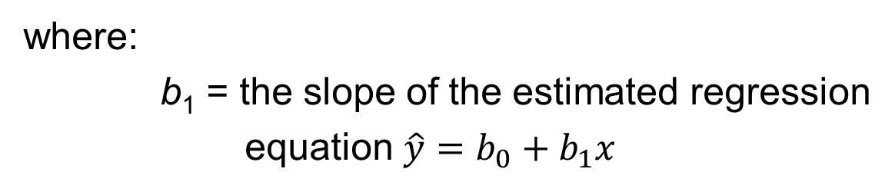
Sample Correlation Coefficient
$$r_{xy}=(sign of b_{1})\sqrt{Coefficient of Determination}$$
$$r_{xy}=(sign of b_{1}) \sqrt{r^{2}}$$
where:
b₁ = the slope of the estimated regression
equation $\hat{y}=b_{0}+b_{1}x$

Slide 24



Sample Correlation Coefficient
$$r_{xy}=(sign of b_{1}) \sqrt{r^{2}}$$
The sign of b₁ in the equation $\hat{y} \text{= 10 + 5}\text{x} \text{is}\text{ "+"}.$
$$r_{xy}=+\sqrt{.8772}$$
r_{xy} = +.9366

Slide 25
Assumptions About the Error Term ε
1. The error ε is a random variable with mean of zero.
2. The variance of ε , denoted by σ ², is the same for all values of the independent variable.
3. The values of ε are independent.
4. The error ε is a normally distributed random variable.

Slide 26
Testing for Significance
To test for a significant regression relationship, we must conduct a hypothesis test to determine whether the value of β₁ is zero.
Two tests are commonly used:
t Test
and
F Test
Both the t test and F test require an estimate of σ ², the variance of ε in the regression model.

Slide 27
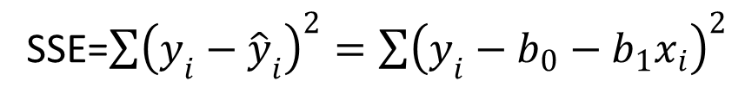
Testing for Significance
An Estimate of σ ²
  The mean square error (MSE) provides the estimate of σ ², and the notation s² is also used.
s ² = MSE = SSE/(n - 2)
where:
SSE=$\sum{{\left(y_{i}−{\hat{y}}_{i}\right)}^{2}}=\sum{{\left(y_{i}−b_{0}−b_{1}x_{i}\right)}^{2}}$

Slide 28
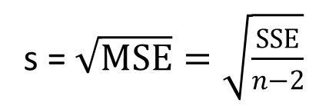
Testing for Significance
An Estimate of σ
To estimate σ, we take the square root of s².
The resulting s is called the standard error of the estimate.
s = $\sqrt{MSE}=\sqrt{\frac{SSE}{n−2}}$

Slide 29

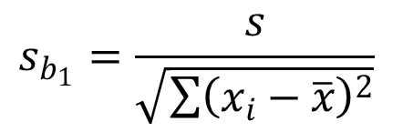
Testing for Significance: t Test
Hypotheses
Test Statistic
H₀: β₁ = 0
H_{a}: β₁ ≠ 0
$$t=\frac{b_{1}}{s_{b_{1}}}$$
$$s_{b_{1}}=\frac{s}{\sqrt{\sum{{\left(x_{i}−\overline{x}\right)}^{2}}}}$$
where

Slide 30
Testing for Significance: t Test
Rejection Rule
Reject H₀ if p-value < α
or t < -t_{α/2} or t > t_{α/2}
where:
t_{α/2} is based on a t distribution
with n - 2 degrees of freedom

Slide 31
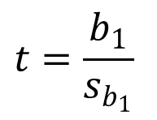
Testing for Significance: t Test
1. Determine the hypotheses.
H₀: β₁ = 0
H_{a}: β₁ ≠ 0
2. Specify the level of significance.
α = .05
$$t=\frac{b_{1}}{s_{b_{1}}}$$
3. Select the test statistic.
4. State the rejection rule.
Reject H₀ if p-value < .05
or |t| > 3.182 (with
3 degrees of freedom)

Slide 32
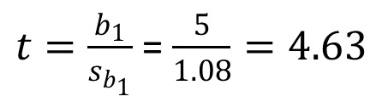
Testing for Significance: t Test
5. Compute the value of the test statistic.
$t=\frac{b_{1}}{s_{b_{1}}}$= $\frac{5}{1.08}=4.63$
6. Determine whether to reject H₀.
t = 4.541 provides an area of .01 in the upper tail. Hence, the p-value is less than .02. (Also,
t = 4.63 > 3.182.) We can reject H₀.

Slide 33
Confidence Interval for β₁
We can use a 95% confidence interval for β₁ to test the hypotheses just used in the t test.
H₀ is rejected if the hypothesized value of β₁ is not included in the confidence interval for β₁.

Slide 34
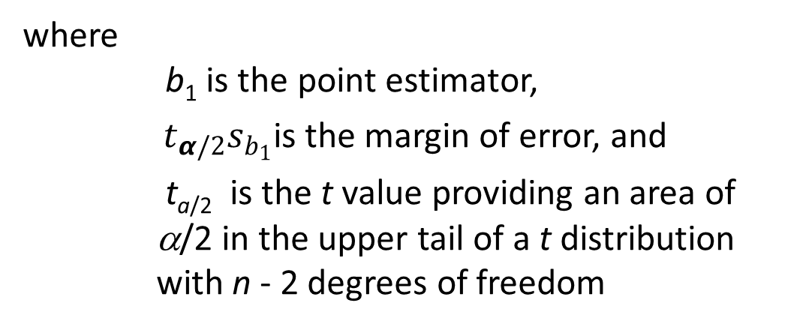

Confidence Interval for β₁
The form of a confidence interval for β₁ is:
$$b_{1}±t_{α/2}s_{b_{1}}$$
where
b₁ is the point estimator,
${ t}_{α/2}s_{b_{1}}$is the margin of error, and
t_{a/2} is the t value providing an area of α/2 in the upper tail of a t distribution with n - 2 degrees of freedom

Slide 35

Confidence Interval for β₁
Rejection Rule
Reject H₀ if 0 is not included in the confidence interval for β₁.
95% Confidence Interval for β₁
$$b_{1}±t_{α/2}s_{b_{1}}$$
= 5 +/- 3.182(1.08) = 5 +/- 3.44 or 1.56 to 8.44
Conclusion
0 is not included in the confidence interval. Reject H₀

Slide 36
Testing for Significance: F Test
Hypotheses
Test Statistic
H₀: b₁ = 0
H_{a}: b₁ ≠ 0
F = MSR/MSE

Slide 37
Testing for Significance: F Test
Rejection Rule
Reject H₀ if
p-value < α
or F > F_{α}
where:
F_{α} is based on an F distribution with
1 degree of freedom in the numerator and
n - 2 degrees of freedom in the denominator

Slide 38
Testing for Significance: F Test
1. Determine the hypotheses.
H₀: b₁ = 0
H_{a}: b₁ ≠ 0
2. Specify the level of significance.
α = .05
3. Select the test statistic.
F = MSR/MSE
4. State the rejection rule.
Reject H₀ if p-value < .05 or
F > 10.13 (with 1 d.f. in
numerator and 3 d.f. in denominator)

Slide 39
Testing for Significance: F Test
5. Compute the value of the test statistic.
F = MSR/MSE = 100/4.667 = 21.43
6. Determine whether to reject H₀.
F = 17.44 provides an area of .025 in the upper tail. Thus, the p-value corresponding to F = 21.43 is less than .025. Hence, we reject H₀.
The statistical evidence is sufficient to conclude that we have a significant relationship between the number of TV ads aired and the number of cars sold.

Slide 40
Some Cautions about the
Interpretation of Significance Tests
Rejecting H₀: β₁ = 0 and concluding that the relationship between x and y is significant does not enable us to conclude that a cause-and-effect relationship is present between x and y.
Just because we are able to reject H₀: β₁ = 0 and demonstrate statistical significance does not enable us to conclude that there is a linear relationship between x and y.

Slide 41
End of Chapter 14, Part A

