Slide 1
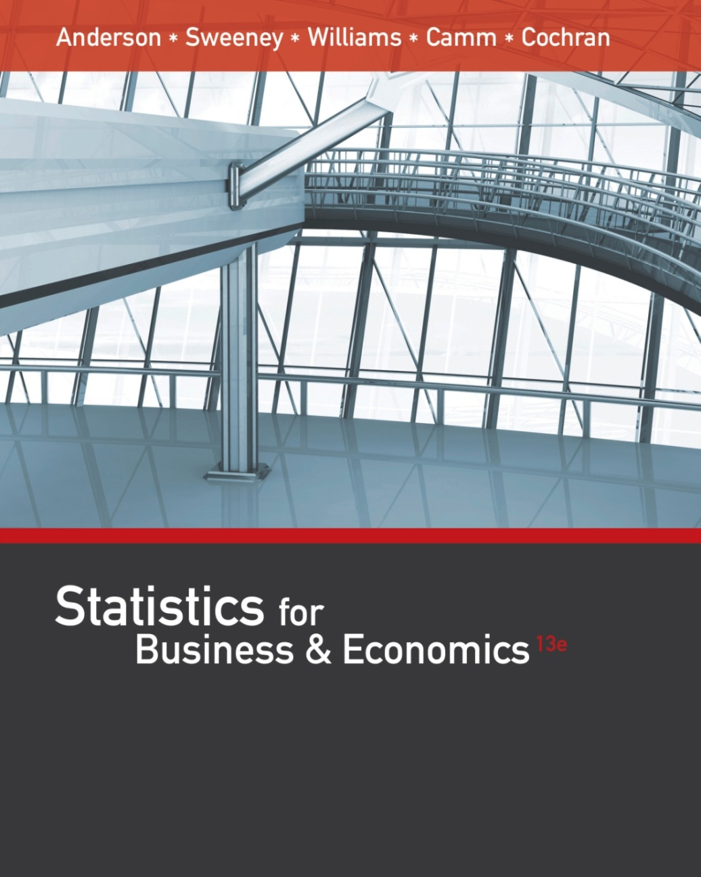
Statistics for
Business and Economics (13e)
Anderson, Sweeney, Williams, Camm, Cochran
© 2017 Cengage Learning
Slides by John Loucks
St. Edwards University

Slide 2
Chapter 4
Introduction to Probability
Random Experiments, Counting Rules, and Assigning Probabilities
Events and Their Probability
Some Basic Relationships of Probability
Conditional Probability
Bayes’ Theorem

Slide 3
Uncertainties
Managers often base their decisions on an analysis of uncertainties such as the following:
What are the chances that sales will decrease if we increase prices?
What is the likelihood a new assembly method will increase productivity?
What are the odds that a new investment will be profitable?

Slide 4
Probability
Probability is a numerical measure of the likelihood that an event will occur.
Probability values are always assigned on a scale from 0 to 1.
A probability near zero indicates an event is quite unlikely to occur.
A probability near one indicates an event is almost certain to occur.

Slide 5
Probability as a Numerical Measure of the Likelihood of Occurrence
Increasing Likelihood of Occurrence
Probability:
0
.5
1
The event
is very
unlikely
to occur.
The occurrence
of the event is
just as likely as
it is unlikely.
The event
is almost
certain
to occur.

Slide 6
Statistical Experiments
In statistics, the notion of an experiment differs somewhat from that of an experiment in the physical sciences.
In statistical experiments, probability determines outcomes.
Even though the experiment is repeated in exactly the same way, an entirely different outcome may occur.
For this reason, statistical experiments are sometimes called random experiments.

Slide 7
Random Experiment and Its Sample Space
A Random experiment is a process that generates well-defined experimental outcomes.
The sample space for an experiment is the set of all experimental outcomes.
An experimental outcome is also called a sample point.

Slide 8
Random Experiment and Its Sample Space
Experiment
Toss a coin
Inspect a part
Conduct a sales call
Roll a die
Play a football game
Experiment Outcomes
Head, tail
Defective, non-defective
Purchase, no purchase
1, 2, 3, 4, 5, 6
Win, lose, tie

Slide 9
Random Experiment and Its Sample Space
Example: Bradley Investments
Bradley has invested in two stocks, Markley Oil and Collins Mining. Bradley has determined that the possible outcomes of these investments three months from now are as follows:
Investment Gain or Loss
in 3 Months (in $1000s)
Markley Oil
Collins Mining
10
5
0
-20
8
-2

Slide 10
A Counting Rule for Multiple-Step Experiments
If an experiment consists of a sequence of k steps in which there are n₁ possible results for the first step, n₂ possible results for the second step, and so on, then the total number of experimental outcomes is given by (n₁)(n₂) . . . (n_{k}).
A helpful graphical representation of a multiple-step experiment is a tree diagram.

Slide 11
A Counting Rule for Multiple-Step Experiments
Example: Bradley Investments
Bradley Investments can be viewed as a two-step experiment. It involves two stocks, each with a set of experimental outcomes.
Markley Oil: n₁ = 4
Collins Mining: n₂ = 2
Total Number of
Experimental Outcomes: n₁n₂ = (4)(2) = 8

Slide 12
Tree Diagram
Example: Bradley Investments
Markley Oil
(Stage 1)
Collins Mining
(Stage 2)
Experimental
Outcomes
Gain 8
(10, 8) Gain $18,000
(10, -2) Gain $8,000
Gain 10
Lose 2
Gain 8
(5, 8) Gain $13,000
Lose 2
(5, -2) Gain $3,000
Gain 5
Gain 8
(0, 8) Gain $8,000
0
(0, -2) Lose $2,000
Lose 20
Lose 2
Gain 8
(-20, 8) Lose $12,000
Lose 2
(-20, -2) Lose $22,000

Slide 13
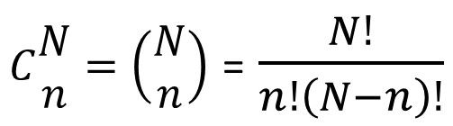
Counting Rule for Combinations
Number of Combinations of N Objects Taken n at a Time
A second useful counting rule enables us to count the number of experimental outcomes when n objects are to be selected from a set of N objects.
$C\begin{matrix}N \\ n\end{matrix}=\left(\begin{matrix}N \\ n\end{matrix}\right)$ = $\frac{N!}{n!\left(N−n\right)!}$
where: N! = N(N - 1)(N - 2) . . . (2)(1)
n! = n(n - 1)(n - 2) . . . (2)(1)
0! = 1

Slide 14
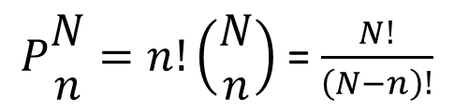
Counting Rule for Permutations
Number of Permutations of N Objects Taken n at a Time
A third useful counting rule enables us to count the number of experimental outcomes when n objects are to be selected from a set of N objects, where the order of selection is important.
$P\begin{matrix}N \\ n\end{matrix}=n!\left(\begin{matrix}N \\ n\end{matrix}\right)$ = $\frac{N!}{\left(N−n\right)!}$
where: N! = N(N - 1)(N - 2) . . . (2)(1)
n! = n(n - 1)(n - 2) . . . (2)(1)
0! = 1

Slide 15
Assigning Probabilities
Basic Requirements for Assigning Probabilities
1. The probability assigned to each experimental outcome must be between 0 and 1, inclusively.
0 < P(E_{i}) < 1 for all i
where: E_{i} is the i th experimental outcome
and P(E_{i}) is its probability

Slide 16
Assigning Probabilities
Basic Requirements for Assigning Probabilities
2. The sum of the probabilities for all experimental outcomes must equal 1.
P(E₁) + P(E₂) + . . . + P(E_{n}) = 1
where: n is the number of experimental outcomes

Slide 17
Assigning Probabilities
Classical Method
Assigning probabilities based on the assumption of equally likely outcomes
Relative Frequency Method
Assigning probabilities based on experimentation or historical data
Subjective Method
Assigning probabilities based on judgment

Slide 18
Classical Method
Example: Rolling a Die
If an experiment has n possible outcomes, the classical method would assign a probability of 1/n to each outcome.
Experiment: Rolling a die
Sample Space: S = {1, 2, 3, 4, 5, 6}
Probabilities: Each sample point has a 1/6 chance of occurring

Slide 19
Relative Frequency Method
Example: Lucas Tool Rental
Lucas Tool Rental would like to assign probabilities to the number of car polishers it rents each day. Office records show the following frequencies of daily rentals for the last 40 days.
Number of
Polishers Rented
Number
of Days
0
1
2
3
4
4
6
18
10
2

Slide 20
Relative Frequency Method
Example: Lucas Tool Rental
Each probability assignment is given by dividing the frequency (number of days) by the total frequency (total number of days).
Number of
Polishers Rented
Number
of Days
Probability
0
1
2
3
4
4
6
18
10
2
40
.10 = 4/40
.15
.45
.25
.05
1.00

Slide 21
Subjective Method
When economic conditions or a company’s circumstances change rapidly it might be inappropriate to assign probabilities based solely on historical data.
We can use any data available as well as our experience and intuition, but ultimately a probability value should express our degree of belief that the experimental outcome will occur.
The best probability estimates often are obtained by combining the estimates from the classical or relative frequency approach with the subjective estimate.

Slide 22
Subjective Method
Example: Bradley Investments
An analyst made the following probability estimates.
Experimental Outcome
Net Gain or Loss
Probability
(10, 8)
(10, -2)
(5, 8)
(5, -2)
(0, 8)
(0, -2)
(-20, 8)
(-20, -2)
$18,000 Gain
$8,000 Gain
$13,000 Gain
$3,000 Gain
$8,000 Gain
$2,000 Loss
$12,000 Loss
$22,000 Loss
.20
.08
.16
.26
.10
.12
.02
.06
1.00

Slide 23
Events and Their Probabilities
An event is a collection of sample points.
The probability of any event is equal to the sum of the probabilities of the sample points in the event.
If we can identify all the sample points of an experiment and assign a probability to each, we can compute the probability of an event.

Slide 24
Events and Their Probabilities
Example: Bradley Investments
Event M = Markley Oil Profitable
M = {(10, 8), (10, -2), (5, 8), (5, -2)}
P(M) = P(10, 8) + P(10, -2) + P(5, 8) + P(5, -2)
= .20 + .08 + .16 + .26
= .70

Slide 25
Events and Their Probabilities
Example: Bradley Investments
Event C = Collins Mining Profitable
C = {(10, 8), (5, 8), (0, 8), (-20, 8)}
P(C) = P(10, 8) + P(5, 8) + P(0, 8) + P(-20, 8)
= .20 + .16 + .10 + .02
= .48

Slide 26
Some Basic Relationships of Probability
There are some basic probability relationships that can be used to compute the probability of an event without knowledge of all the sample point probabilities.
Complement of an Event
Union of Two Events
Intersection of Two Events
Mutually Exclusive Events

Slide 27
Complement of an Event
The complement of event A is defined to be the event consisting of all sample points that are not in A.
The complement of A is denoted by A^{c}.
Sample
Space S
Event A
A^{c}
Venn Diagram

Slide 28
Union of Two Events
The union of events A and B is the event containing all sample points that are in A or B or both.
The union of events A and B is denoted by A ∪ B.
Sample
Space S
Event A
Event B
Venn Diagram

Slide 29
Union of Two Events
Example: Bradley Investments
Event M = Markley Oil Profitable
Event C = Collins Mining Profitable
M ∪ C = Markley Oil Profitable
or Collins Mining Profitable (or both)
M ∪ C = {(10, 8), (10, -2), (5, 8), (5, -2), (0, 8), (-20, 8)}
P(M ∪ C) = P(10, 8) + P(10, -2) + P(5, 8) + P(5, -2) + P(0, 8) + P(-20, 8)
= .20 + .08 + .16 + .26 + .10 + .02
= .82

Slide 30
Intersection of Two Events
The intersection of events A and B is the set of all sample points that are in both A and B.
The intersection of events A and B is denoted by A ∩ B.
Intersection of A and B
Sample
Space S
Event A
Event B
Venn Diagram

Slide 31
Intersection of Two Events
Example: Bradley Investments
Event M = Markley Oil Profitable
Event C = Collins Mining Profitable
M ∩ C = Markley Oil Profitable and Collins Mining Profitable
M ∩ C = {(10, 8), (5, 8)}
P(M ∩ C) = P(10, 8) + P(5, 8)
= .20 + .16
= .36

Slide 32
Addition Law
The addition law provides a way to compute the probability of event A, or B, or both A and B occurring.
The law is written as:
P(A ∪ B) = P(A) + P(B) − P(A ∩ B)

Slide 33
Addition Law
Example: Bradley Investments
Event M = Markley Oil Profitable
Event C = Collins Mining Profitable
M ∪ C = Markley Oil Profitable or Collins Mining Profitable
We know: P(M) = .70, P(C) = .48, P(M ∩ C) = .36
Thus: P(M ∪ C) = P(M) + P(C) - P(M ∩ C)
= .70 + .48 - .36
= .82
(This result is the same as that obtained earlier
using the definition of the probability of an event.)

Slide 34
Mutually Exclusive Events
Two events are said to be mutually exclusive if the events have no sample points in common.
Two events are mutually exclusive if, when one event occurs, the other cannot occur.
Sample
Space S
Event A
Event B
Venn Diagram

Slide 35
Mutually Exclusive Events
If events A and B are mutually exclusive, P(A ∩ B) = 0.
The addition law for mutually exclusive events is:
P(A ∪ B) = P(A) + P(B)

Slide 36
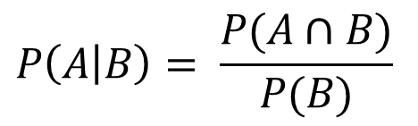
Conditional Probability
The probability of an event given that another event has occurred is called a conditional probability.
The conditional probability of A given B has already occurred is denoted by P(A|B).
A conditional probability is computed as follows :
$$P\left(A | B\right)= \frac{P(A∩B)}{P(B)}$$

Slide 37
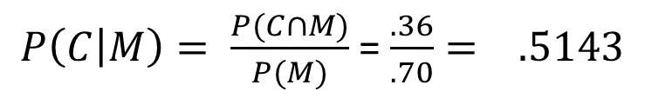
Conditional Probability
Example: Bradley Investments
Event M = Markley Oil Profitable
Event C = Collins Mining Profitable
P(C|M) = Collins Mining Profitable given Markley Oil Profitable
We know: P(M ∩ C) = .36, P(M) = .70
Thus:
$P\left(C | M\right)= \frac{P(C∩M)}{P(M)}$ = $\frac{.36}{.70}= .5143$

Slide 38
Multiplication Law
The multiplication law provides a way to compute the probability of the intersection of two events.
The law is written as:
P(A ∩ B) = P(B)P(A|B)
or
P(A ∩ B) = P(A)P(B|A)

Slide 39
Multiplication Law
Example: Bradley Investments
Event M = Markley Oil Profitable
Event C = Collins Mining Profitable
M ∩ C = Markley Oil Profitable and Collins Mining Profitable
We know: P(M) = .70, P(C|M) = .5143
Thus: P(M ∩ C) = P(M)P(M|C)
= (.70)(.5143)
= .36
(This result is the same as that obtained earlier
using the definition of the probability of an event.)

Slide 40
Joint Probability Table
Collins Mining
Profitable (C) Not Profitable (C^{c})
Markley Oil
Profitable (M)
Not Profitable (M^{c})
Total
.70
.30
1.00
.36 .34
.12 .18
Total .48 .52
Joint probabilities appear in the body of the table.
Marginal probabilities appear in the margins of the table.

Slide 41
Independent Events
If the probability of event A is not changed by the existence of event B, we would say that events A and B are independent.
Two events A and B are independent if:
P(A|B) = P(A) or P(B|A) = P(B)

Slide 42
Multiplication Law for Independent Events
The multiplication law also can be used as a test to see if two events are independent.
The law is written as:
P(A ∩ B) = P(A)P(B)

Slide 43
Multiplication Law for Independent Events
Example: Bradley Investments
Event M = Markley Oil Profitable
Event C = Collins Mining Profitable
Are events M and C independent?
Does P(M ∩ C) = P(M)P(C) ?
We know: P(M ∩ C) = .36, P(M) = .70, P(C) = .48
But: P(M)P(C) = (.70)(.48) = .34, not .36
Hence: M and C are not independent.

Slide 44
Mutual Exclusiveness and Independence
Do not confuse the notion of mutually exclusive events with that of independent events.
Two events with nonzero probabilities cannot be both mutually exclusive and independent.
If one mutually exclusive event is known to occur, the other cannot occur.; thus, the probability of the other event occurring is reduced to zero (and they are therefore dependent).
Two events that are not mutually exclusive, might or might not be independent.

Slide 45
Bayes’ Theorem
Often we begin probability analysis with initial or prior probabilities.
Then, from a sample, special report, or a product test we obtain some additional information.
Given this information, we calculate revised or posterior probabilities.
Bayes’ theorem provides the means for revising the prior probabilities.
Prior
Probabilities
New
Information
Application
of Bayes’
Theorem
Posterior
Probabilities

Slide 46
Bayes’ Theorem
Example: L. S. Clothiers
A proposed shopping center will provide strong competition for downtown businesses like L. S. Clothiers. If the shopping center is built, the owner of L. S. Clothiers feels it would be best to relocate to the shopping center.
The shopping center cannot be built unless a zoning change is approved by the town council. The planning board must first make a recommendation, for or against the zoning change, to the council.

Slide 47
Prior Probabilities
Example: L. S. Clothiers
Let:
A₁ = town council approves the zoning change
A₂ = town council disapproves the change
Using subjective judgment:
P(A₁) = .7, P(A₂) = .3

Slide 48
New Information
Example: L. S. Clothiers
The planning board has recommended against the zoning change. Let B denote the event of a negative recommendation by the planning board.
Given that B has occurred, should L. S. Clothiers revise the probabilities that the town council will approve or disapprove the zoning change?

Slide 49
Conditional Probabilities
Example: L. S. Clothiers
Past history with the planning board and the town council indicates the following:
P(B|A₁) = .2 and P(B|A₂) = .9
Hence:
P(B^{C}|A₁) = .8 and P(B^{C}|A₂) = .1

Slide 50
Tree Diagram
Example: L. S. Clothiers
Town Council
Planning Board
Experimental Outcomes
P(B|A₁) = .2
P(A₁ ∩ B) = .14
P(A₁) = .7
P(A₁ ∩ B^{c}) = .56
P(B^{c}|A₁) = .8
P(B|A₂) = .9
P(A₂ ∩ B) = .27
P(A₂) = .3
P(A₂ ∩ B^{c}) = .03
P(B^{c}|A₂) = .1
1.00

Slide 51
Bayes’ Theorem
To find the posterior probability that event A_{i} will occur given that event B has occurred, we apply Bayes’ theorem.
$$P\left(A_{i} | B\right)= \frac{P\left(A_{i}\right)P(B|A_{i})}{P\left(A_{1}\right)P\left(B | A_{1}\right)+P\left(A_{2}\right)P\left(B | A_{2}\right)+…+P\left(A_{n}\right)P(B|A_{n})}$$
Bayes’ theorem is applicable when the events for which we want to compute posterior probabilities are mutually exclusive and their union is the entire sample space.

Slide 52
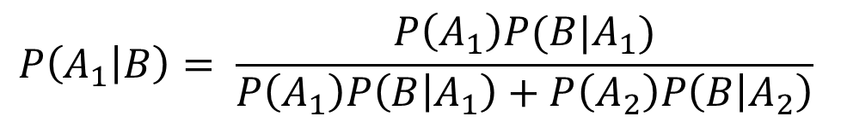
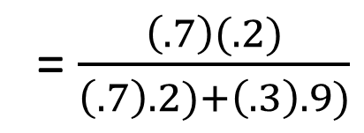
Posterior Probabilities
Example: L. S. Clothiers
Given the planning board’s recommendation not to approve the zoning change, we revise the prior probabilities as follows:
$$P\left(A_{1} | B\right)= \frac{P\left(A_{1}\right)P(B|A_{1})}{P\left(A_{1}\right)P\left(B | A_{1}\right)+P\left(A_{2}\right)P\left(B | A_{2}\right)}$$
= $\frac{\left(.7\right)(.2)}{\left(.7\right).2)+\left(.3\right).9)}$
= .34

Slide 53
Posterior Probabilities
Example: L. S. Clothiers
The planning board’s recommendation is good news for L. S. Clothiers. The posterior probability of the town council approving the zoning change is .34 compared to a prior probability of .70.

Slide 54
Bayes’ Theorem: Tabular Approach
Example: L. S. Clothiers
  Step 1
Prepare the following three columns:
Column 1 - The mutually exclusive events for which posterior probabilities are desired.
Column 2 - The prior probabilities for the events.
Column 3 - The conditional probabilities of the new information given each event.

Slide 55
Bayes’ Theorem: Tabular Approach
Example: L. S. Clothiers
  Step 1
(1)
(2)
(3)
(4)
(5)
Prior
Probabilities
P(A_{i})
Conditional
Probabilities
P(B|A_{i})
Events
A_{i}
A₁
A₂
.2
.9
.7
.3
1.0

Slide 56
Bayes’ Theorem: Tabular Approach
Example: L. S. Clothiers
  Step 2
Prepare the fourth column
Column 4
Compute the joint probabilities for each event and the new information B by using the multiplication law.
Multiply the prior probabilities in column 2 by the corresponding conditional probabilities in column 3. That is, P(A_{i} ∩ B) = P(A_{i}) P(B|A_{i}).

Slide 57
Bayes’ Theorem: Tabular Approach
Example: L. S. Clothiers
  Step 2
(1)
(2)
(3)
(4)
(5)
Prior
Probabilities
P(A_{i})
Conditional
Probabilities
P(B|A_{i})
Joint
Probabilities
P(A_{i} I B)
Events
A_{i}
A₁
A₂
.2
.9
.14 = .7(.2)
.27
.7
.3
1.0

Slide 58
Bayes’ Theorem: Tabular Approach
Example: L. S. Clothiers
  Step 2 (continued)
We see that there is a .14 probability of the town council approving the zoning change and a negative recommendation by the planning board.
There is a .27 probability of the town council disapproving the zoning change and a negative recommendation by the planning board.

Slide 59
Bayes’ Theorem: Tabular Approach
Example: L. S. Clothiers
  Step 3
Sum the joint probabilities in Column 4. The sum is the probability of the new information, P(B). The sum .14 + .27 shows an overall
probability of .41 of a negative recommendation by the planning board.

Slide 60
Bayes’ Theorem: Tabular Approach
Example: L. S. Clothiers
  Step 3
(1)
(2)
(3)
(4)
(5)
Prior
Probabilities
P(A_{i})
Conditional
Probabilities
P(B|A_{i})
Joint
Probabilities
P(A_{i} I B)
Events
A_{i}
A₁
A₂
.2
.9
.14
.27
.7
.3
1.0
P(B) = .41

Slide 61
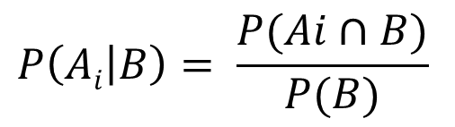
Bayes’ Theorem: Tabular Approach
Example: L. S. Clothiers
  Step 4
Prepare the fifth column:
Column 5
Compute the posterior probabilities using the basic relationship of conditional probability.
$$P\left(Ai | B\right)= \frac{P(Ai∩B)}{P(B)}$$
The joint probabilities P(A_{i} I B) are in column 4 and the probability P(B) is the sum of column 4.

Slide 62
Bayes’ Theorem: Tabular Approach
Example: L. S. Clothiers
  Step 4
(1)
(2)
(3)
(4)
(5)
Prior
Probabilities
P(A_{i})
Conditional
Probabilities
P(B|A_{i})
Joint
Probabilities
P(A_{i} I B)
Posterior
Probabilities
P(A_{i} |B)
Events
A_{i}
A₁
A₂
.2
.9
.14
.27
.7
.3
1.0
.3415 = .14/.41
.6585
1.0000
P(B) = .41

Slide 63
End of Chapter 4

