Slide 1
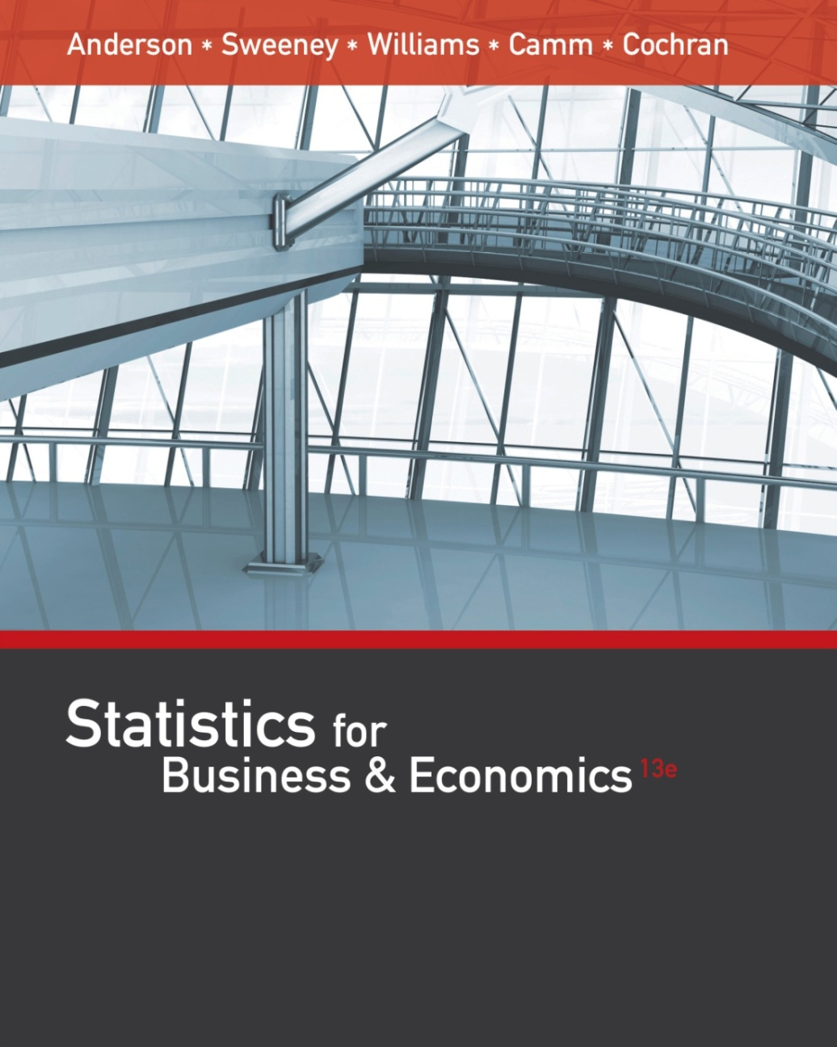
Statistics for
Business and Economics (13e)
Slides by
John
Loucks
St. Edward’s
University
Anderson, Sweeney, Williams, Camm, Cochran
© 2017 Cengage Learning
Slides by John Loucks
St. Edwards University

Slide 2
Chapter 3, Part B
Descriptive Statistics: Numerical Measures
Measures of Distribution Shape, Relative Location, and Detecting Outliers
Five-Number Summaries and Box Plots
Measures of Association Between Two Variables
Data Dashboards: Adding Numerical Measures to Improve Effectiveness

Slide 3
Measures of Distribution Shape,
Relative Location, and Detecting Outliers
Distribution Shape
z-Scores
Chebyshev’s Theorem
Empirical Rule
Detecting Outliers

Slide 4

Distribution Shape: Skewness
An important numerical measure of the shape of a distribution is called skewness.
The formula for the skewness of sample data is
Skewness = $\frac{n}{(n−1)(n−2)}\sum{{\left[\frac{x_{i}−\overline{x}}{s}\right]}^{3}}$
Skewness can be easily computed using statistical software.

Slide 5
Distribution Shape: Skewness
Symmetric (not skewed)
  Skewness is zero.
  Mean and median are equal.
Skewness = 0
.35
.30
.25
.20
Relative Frequency
.15
.10
.05
0

Slide 6
Distribution Shape: Skewness
Moderately Skewed Left
  Skewness is negative.
  Mean will usually be less than the median.
.35
Skewness = - .31
.30
.25
.20
Relative Frequency
.15
.10
.05
0

Slide 7
Distribution Shape: Skewness
Moderately Skewed Right
  Skewness is positive.
  Mean will usually be more than the median.
.35
Skewness = .31
.30
.25
.20
Relative Frequency
.15
.10
.05
0

Slide 8
Distribution Shape: Skewness
Highly Skewed Right
  Skewness is positive (often above 1.0).
  Mean will usually be more than the median.
.35
Skewness = 1.25
.30
.25
.20
Relative Frequency
.15
.10
.05
0

Slide 9
Distribution Shape: Skewness
Example: Apartment Rents
Seventy efficiency apartments were randomly sampled in a college town. The monthly rent prices for the apartments are listed below in ascending order.
525
530
530
535
535
535
535
535
540
540
540
540
540
545
545
545
545
545
550
550
550
550
550
550
550
560
560
560
565
565
565
570
570
572
575
575
575
580
580
580
580
585
590
590
590
600
600
600
600
610
610
615
625
625
625
635
649
650
670
670
675
675
680
690
700
700
700
700
715
715

Slide 10
Distribution Shape: Skewness
Example: Apartment Rents
.35
Skewness = .92
.30
.25
.20
Relative Frequency
.15
.10
.05
0

Slide 11
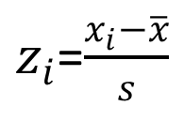
z-Scores
The z-score is often called the standardized value.
It denotes the number of standard deviations a data value x_{i} is from the mean.
$z_{i}$=$\frac{x_{i}−\overline{x}}{s}$

Slide 12
z-Scores
An observation’s z-score is a measure of the relative location of the observation in a data set.
A data value less than the sample mean will have a z-score less than zero.
A data value greater than the sample mean will have a z-score greater than zero.
A data value equal to the sample mean will have a z-score of zero.

Slide 13
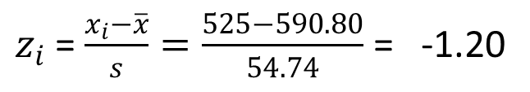
z-Scores
Example: Apartment Rents
z-Score of Smallest Value (525)
$z_{i}$ = $\frac{x_{i}−\overline{x}}{s}=\frac{525−590.80}{54.74}$ = -1.20
Standardized Values for Apartment Rents
-1.20
-1.11
-1.11
-1.02
-1.02
-1.02
-1.02
-1.02
-0.93
-0.93
-0.93
-0.93
-0.93
-0.84
-0.84
-0.84
-0.84
-0.84
-0.75
-0.75
-0.75
-0.75
-0.75
-0.75
-0.75
-0.56
-0.56
-0.56
-0.47
-0.47
-0.47
-0.38
-0.38
-0.34
-0.29
-0.29
-0.29
-0.20
-0.20
-0.20
-0.20
-0.11
-0.01
-0.01
-0.01
0.17
0.17
0.17
0.17
0.35
0.35
0.44
0.62
0.62
0.62
0.81
1.06
1.08
1.45
1.45
1.54
1.54
1.63
1.81
1.99
1.99
1.99
1.99
2.27
2.27

Slide 14
Chebyshev’s Theorem
At least (1 - 1/z²) of the data values must be within z standard deviations of the mean, where z is any value greater than 1.
Chebyshev’s theorem requires z > 1; but z need not be an integer.

Slide 15
Chebyshev’s Theorem
At least 75% of the data values must be within z = 2 standard deviations of the mean.
At least 89% of the data values must be within z = 3 standard deviations of the mean.
At least 94% of the data values must be within z = 4 standard deviations of the mean.

Slide 16
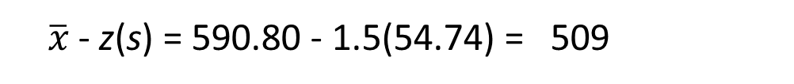
Chebyshev’s Theorem
Example: Apartment Rents
Let z = 1.5 with $\overline{x}$= 590.80 and s = 54.74
At least (1 - 1/(1.5)²) = 1 - 0.44 = 0.56 or 56%
of the rent values must be between
$\overline{x}$- z(s) = 590.80 - 1.5(54.74) = 509
and
$\overline{x}$ + z(s) = 590.80 + 1.5(54.74) = 673
(Actually, 86% of the rent values
are between 509 and 673.)

Slide 17
Empirical Rule
When the data are believed to approximate a bell-shaped distribution:
The empirical rule can be used to determine the percentage of data values that must be within a specified number of standard deviations of the mean.
The empirical rule is based on the normal distribution, which is covered in Chapter 6.

Slide 18
Empirical Rule
For data having a bell-shaped distribution:
Approximately 68% of the data values will be within one standard deviation of the mean.
Approximately 95% of the data values will be within two standard deviations of the mean.
Almost all of the data values will be within three standard deviations of the mean.

Slide 19
Empirical Rule
99.72%
95.44%
68.26%
z
μ
μ – 3σ
μ – 1σ
μ + 1σ
μ + 3σ
μ – 2σ
μ + 2σ

Slide 20
Detecting Outliers
An outlier is an unusually small or unusually large value in a data set.
A data value with a z-score less than -3 or greater than +3 might be considered an outlier.
It might be:
  an incorrectly recorded data value
  a data value that was incorrectly included in the data set
  a correctly recorded data value that belongs in the data set

Slide 21
Empirical Rule
Example: Apartment Rents
The most extreme z-scores are -1.20 and 2.27.
Using |z| > 3 as the criterion for an outlier, there are no outliers in this data set.
Standardized Values for Apartment Rents
-1.20
-1.11
-1.11
-1.02
-1.02
-1.02
-1.02
-1.02
-0.93
-0.93
-0.93
-0.93
-0.93
-0.84
-0.84
-0.84
-0.84
-0.84
-0.75
-0.75
-0.75
-0.75
-0.75
-0.75
-0.75
-0.56
-0.56
-0.56
-0.47
-0.47
-0.47
-0.38
-0.38
-0.34
-0.29
-0.29
-0.29
-0.20
-0.20
-0.20
-0.20
-0.11
-0.01
-0.01
-0.01
0.17
0.17
0.17
0.17
0.35
0.35
0.44
0.62
0.62
0.62
0.81
1.06
1.08
1.45
1.45
1.54
1.54
1.63
1.81
1.99
1.99
1.99
1.99
2.27
2.27

Slide 22
Five-Number Summaries and Box Plots
Summary statistics and easy-to-draw graphs can be used to quickly summarize large quantities of data.
Two tools that accomplish this are five-number summaries and box plots.

Slide 23
Five-Number Summary
1. Smallest Value
2. First Quartile
3. Median
4. Third Quartile
5. Largest Value

Slide 24
Five-Number Summary
Example: Apartment Rents
Lowest Value = 525
First Quartile = 545
Median = 575
Third Quartile = 625
Largest Value = 715
525
530
530
535
535
535
535
535
540
540
540
540
540
545
545
545
545
545
550
550
550
550
550
550
550
560
560
560
565
565
565
570
570
572
575
575
575
580
580
580
580
585
590
590
590
600
600
600
600
610
610
615
625
625
625
635
649
650
670
670
675
675
680
690
700
700
700
700
715
715

Slide 25
Box Plot
A box plot is a graphical display of data that is based on a five-number summary.
A key to the development of a box plot is the computation of the median and the quartiles Q₁ and Q₃.
Box plots provide another way to identify outliers.

Slide 26
Box Plot
Example: Apartment Rents
A box is drawn with its ends located at the first and third quartiles.
A vertical line is drawn in the box at the location of the median (second quartile).
500
525
550
575
600
625
650
675
700
725
Q1 = 545
Q3 = 625
Q2 = 575

Slide 27
Box Plot
Limits are located (not drawn) using the interquartile range (IQR).
Data outside these limits are considered outliers.
The location of each outlier is shown with the symbol * .

Slide 28
Box Plot
Example: Apartment Rents
The lower limit is located 1.5(IQR) below Q1.
Lower Limit: Q1 - 1.5(IQR) = 545 - 1.5(80) = 425
The upper limit is located 1.5(IQR) above Q3.
Upper Limit: Q3 + 1.5(IQR) = 625 + 1.5(80) = 745
There are no outliers (values less than 425 or greater than 745) in the apartment rent data.

Slide 29
Box Plot
Example: Apartment Rents
Whiskers (dashed lines) are drawn from the ends of the box to the smallest and largest data values inside the limits.
500
525
550
575
600
625
650
675
700
725
Smallest value
inside limits = 525
Largest value
inside limits = 715

Slide 30
Measures of Association Between Two Variables
Thus far we have examined numerical methods used to summarize the data for one variable at a time.
Often a manager or decision maker is interested in the relationship between two variables.
Two descriptive measures of the relationship between two variables are covariance and correlation coefficient.

Slide 31
Covariance
The covariance is a measure of the linear association between two variables.
Positive values indicate a positive relationship.
Negative values indicate a negative relationship.

Slide 32
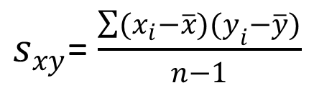
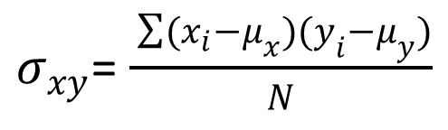
Covariance
The covariance is computed as follows:
$s_{xy}$= $\frac{\sum{(x_{i}}−\overline{x})(y_{i}−\overline{y})}{n−1}$
For samples:
$σ_{xy}$=$\frac{ \sum{(x_{i}}−μ_{x})(y_{i}−μ_{y})}{N}$
For populations:

Slide 33
Correlation Coefficient
Correlation is a measure of linear association and not necessarily causation.
Just because two variables are highly correlated, it does not mean that one variable is the cause of the other.

Slide 34
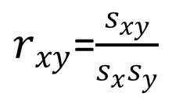
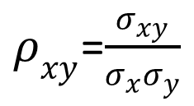
Correlation Coefficient
The correlation coefficient is computed as follows:
$r_{xy}$=$\frac{s_{xy}}{s_{x}s_{y}}$
For samples:
$ρ_{xy}$=$\frac{σ_{xy}}{σ_{x}σ_{y}}$
For populations:

Slide 35
Correlation Coefficient
The coefficient can take on values between -1 and +1.
Values near -1 indicate a strong negative linear relationship.
Values near +1 indicate a strong positive linear relationship.
The closer the correlation is to zero, the weaker the relationship.

Slide 36
Covariance and Correlation Coefficient
Example: Golfing Study
A golfer is interested in investigating the relationship, if any, between driving distance and 18-hole score.
Average Driving
Distance (yds.)
Average
18-Hole Score
277.6
259.5
269.1
267.0
255.6
272.9
69
71
70
70
71
69

Slide 37




Covariance and Correlation Coefficient
Example: Golfing Study
x
y
$(x_{i}$-$\overline{x})$
$(y_{i}$-$\overline{y})$
$(x_{i}$-$\overline{x})$
$(y_{i}$-$\overline{y})$
277.6
259.5
269.1
267.0
255.6
272.9
69
71
70
70
71
69
10.65
-7.45
2.15
0.05
-11.35
5.95
-1.0
1.0
0
0
1.0
-1.0
-10.65
-7.45
0
0
-11.35
-5.95
Average
267.0
70.0
Total
-35.40
Std. Dev.
8.2192
.8944

Slide 38
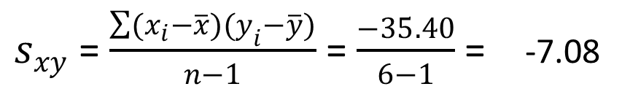
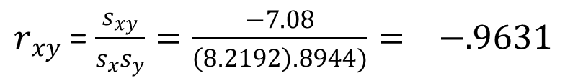
Covariance and Correlation Coefficient
Example: Golfing Study
Sample Covariance
$s_{xy}$ =$\frac{\sum{(x_{i}}−\overline{x})(y_{i}−\overline{y})}{n−1}$ = $\frac{−35.40}{6−1}$ = -7.08
Sample Correlation Coefficient
$r_{xy}$ = $\frac{s_{xy}}{s_{x}s_{y}}=\frac{−7.08}{\left(8.2192\right).8944)}= −.9631$

Slide 39
Data Dashboards:
Adding Numerical Measures to Improve Effectiveness
Data dashboards are not limited to graphical displays.
The addition of numerical measures, such as the mean and standard deviation of KPIs, to a data dashboard is often critical.
Dashboards are often interactive.
Drilling down refers to functionality in interactive dashboards that allows the user to access information and analyses at an increasingly detailed level.

Slide 40
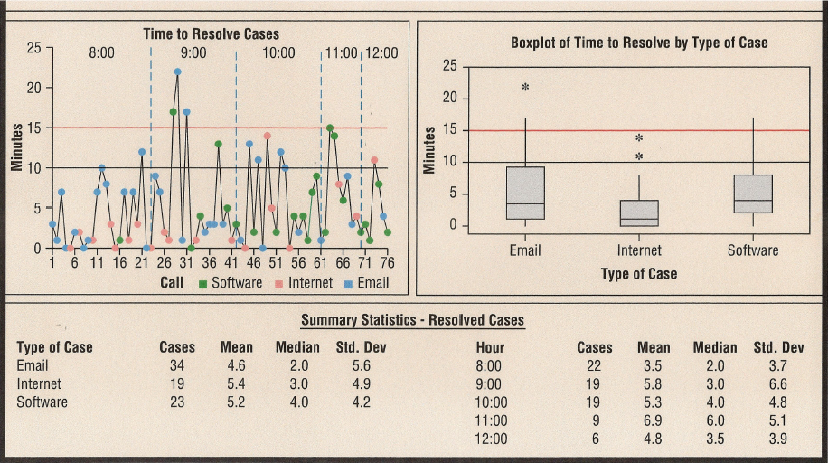
Data Dashboards:
Adding Numerical Measures to Improve Effectiveness

Slide 41
End of Chapter 3, Part B

