Slide 1
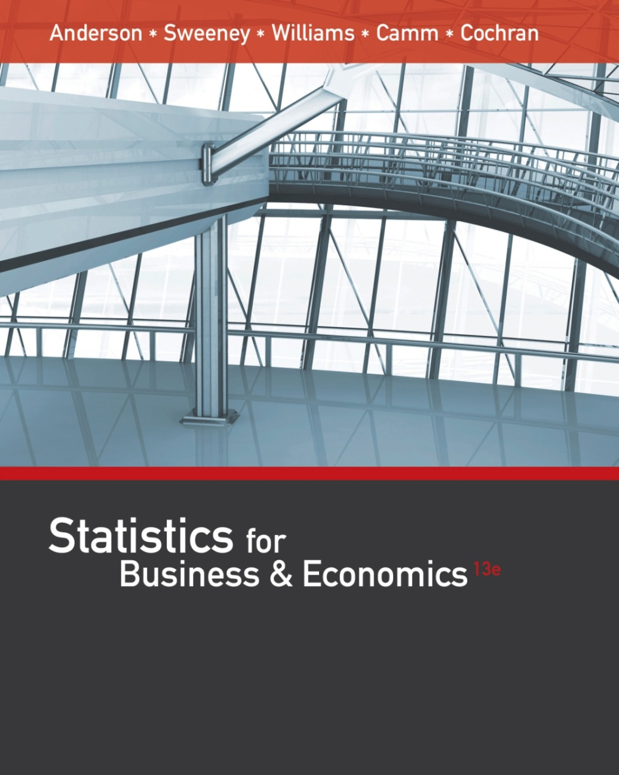
Statistics for
Business and Economics (13e)
Slides by
John
Loucks
St. Edward’s
University
Anderson, Sweeney, Williams, Camm, Cochran
© 2017 Cengage Learning
Slides by John Loucks
St. Edwards University

Slide 2
Chapter 3, Part A
Descriptive Statistics: Numerical Measures
Measures of Location
Measures of Variability

Slide 3
Numerical Measures
If the measures are computed for data from a sample, they are called sample statistics.
If the measures are computed for data from a population, they are called population parameters.
A sample statistic is referred to as the point estimator of the corresponding population parameter.

Slide 4
Measures of Location
Mean
Median
Mode
Weighted Mean
Geometric Mean
Percentiles
Quartiles

Slide 5
Mean
Perhaps the most important measure of location is the mean.
The mean provides a measure of central location.
The mean of a data set is the average of all the data values.
The sample mean $\overline{x}$ is the point estimator of the population mean µ.

Slide 6

Sample Mean $\overline{x}$
$$\overline{x}=\frac{\sum{x_{i}}}{n}$$
where: Σx_{i} = sum of the values of n observations
n = number of observations in the sample

Slide 7

Population Mean μ
$$μ=\frac{\sum{x_{i}}}{N}$$
where: Σx_{i} = sum of the values of the N observations
N= number of observations in the population

Slide 8
Sample Mean $\overline{x}$
Example: Apartment Rents
Seventy efficiency apartments were randomly sampled in a college town. The monthly rents for these apartments are listed below.
545
715
530
690
535
700
560
700
540
715
540
540
540
625
525
545
675
545
550
550
565
550
625
550
550
560
535
560
565
580
550
570
590
572
575
575
600
580
670
565
700
585
680
570
590
600
649
600
600
580
670
615
550
545
625
635
575
650
580
610
610
675
590
535
700
535
545
535
530
540

Slide 9
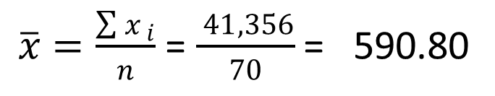
Sample Mean $\overline{x}$
Example: Apartment Rents
$\overline{x}=\frac{\sum{x_{ i}}}{n}$ = $\frac{ 41,356}{70}$ = 590.80

Slide 10
Median
The median of a data set is the value in the middle when the data items are arranged in ascending order.
Whenever a data set has extreme values, the median is the preferred measure of central location.
The median is the measure of location most often reported for annual income and property value data.
A few extremely large incomes or property values can inflate the mean.

Slide 11
Median
For an odd number of observations:
26
18
27
12
14
27
19
7 observations
12
14
18
19
26
27
27
in ascending order
The median is the middle value. Median = 19

Slide 12
Median
For an even number of observations:
26
18
27
12
14
27
30
19
8 observations
12
14
18
19
26
27
27
30
in ascending order
The median is the average of the two middle values.
Median = (19 + 26)/2 = 22.5

Slide 13
Median
Example: Apartment Rents
Averaging the 35th and 36th data values:
Median = (575 + 575)/2 = 575
525
530
530
535
535
535
535
535
540
540
540
540
540
545
545
545
545
545
550
550
550
550
550
550
550
560
560
560
565
565
565
570
570
572
575
575
575
580
580
580
580
585
590
590
590
600
600
600
600
610
610
615
625
625
625
635
649
650
670
670
675
675
680
690
700
700
700
700
715
715
Note: Data is in ascending order.

Slide 14
Trimmed Mean
Another measure, sometimes used when extreme values are present, is the trimmed mean.
It is obtained by deleting a percentage of the smallest and largest values from a data set and then computing the mean of the remaining values.
For example, the 5% trimmed mean is obtained by removing the smallest 5% and the largest 5% of the data values and then computing the mean of the remaining values.

Slide 15
Mode
The mode of a data set is the value that occurs with greatest frequency.
The greatest frequency can occur at two or more different values.
If the data have exactly two modes, the data are bimodal.
If the data have more than two modes, the data are multimodal.

Slide 16
Mode
Example: Apartment Rents
550 occurred most frequently (7 times)
Mode = 550
525
530
530
535
535
535
535
535
540
540
540
540
540
545
545
545
545
545
550
550
550
550
550
550
550
560
560
560
565
565
565
570
570
572
575
575
575
580
580
580
580
585
590
590
590
600
600
600
600
610
610
615
625
625
625
635
649
650
670
670
675
675
680
690
700
700
700
700
715
715
Note: Data is in ascending order.

Slide 17
Weighted Mean
In some instances the mean is computed by giving each observation a weight that reflects its relative importance.
The choice of weights depends on the application.
The weights might be the number of credit hours earned for each grade, as in GPA.
In other weighted mean computations, quantities such as pounds, dollars, or volume are frequently used.

Slide 18
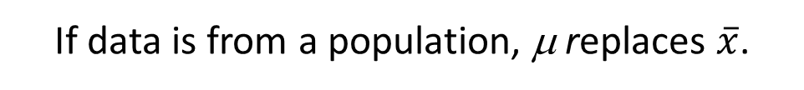
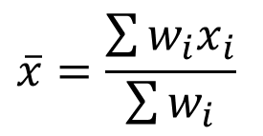
Weighted Mean
$$\overline{x}=\frac{\sum{w_{i}x_{i}}}{\sum{w_{i}}}$$
where: x_{i} = value of observation i
w_{i} = weight for observation i
Numerator: sum of the weighted data values
Denominator: sum of the weights
If data is from a population, μ replaces $\overline{x}$.

Slide 19
Weighted Mean
  Example: Construction Wages
Ron Butler, a home builder, is looking over the expenses he incurred for a house he just built. For the purpose of pricing future projects, he would like to know the average wage ($/hour) he paid the workers he employed. Listed below are the categories of workers he employed, along with their respective wage and total hours worked.

Slide 20
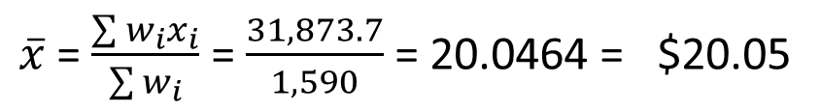
Weighted Mean
Example: Construction Wages
$\overline{x}$ = $\frac{\sum{w_{i}x_{i}}}{\sum{w_{i}}}$ = $\frac{31,873.7}{1,590}$ = 20.0464 = $20.05
FYI, equally-weighted (simple) mean = $21.21

Slide 21
Geometric Mean
The geometric mean is calculated by finding the nth root of the product of n values.
It is often used in analyzing growth rates in financial data (where using the arithmetic mean will provide misleading results).
It should be applied anytime you want to determine the mean rate of change over several successive periods (be it years, quarters, weeks, . . .).
Other common applications include: changes in populations of species, crop yields, pollution levels, and birth and death rates.

Slide 22

Geometric Mean
$${\overline{x}}_{g}= \sqrt[n]{\left(x_{1}\right)\left(x_{2}\right)…(x_{n})}$$
= [(x₁)(x₂)…(x_{n})]^{1/n}

Slide 23

Geometric Mean
Example: Rate of Return
$${\overline{x}}_{g}= \sqrt[5]{\left(.94\right).92)(.96)(1.02)(1.054)}$$
= [.89254]^{1/5} = .97752
Average growth rate per period is (.97752 - 1) (100) = -2.248%

Slide 24
Percentiles
A percentile provides information about how the data are spread over the interval from the smallest value to the largest value.
Admission test scores for colleges and universities are frequently reported in terms of percentiles.
The pth percentile of a data set is a value such that at least p percent of the items take on this value or less and at least (100 - p) percent of the items take on this value or more.

Slide 25
Percentiles
Arrange the data in ascending order.
Compute L_{p}, the location of the pth percentile.
L_{p} = (p/100)(n + 1)

Slide 26
80th Percentile
Example: Apartment Rents
L_{p} = (p/100)(n + 1) = (80/100)(70 + 1) = 56.8
(the 56th value plus .8 times the
difference between the 57th and 56th values)
80th Percentile = 635 + .8(649 – 635) = 646.2
525
530
530
535
535
535
535
535
540
540
540
540
540
545
545
545
545
545
550
550
550
550
550
550
550
560
560
560
565
565
565
570
570
572
575
575
575
580
580
580
580
585
590
590
590
600
600
600
600
610
610
615
625
625
625
635
649
650
670
670
675
675
680
690
700
700
700
700
715
715

Slide 27
80th Percentile
Example: Apartment Rents
“At least 80% of the
items take on a
value of 646.2 or less.”
“At least 20% of the
items take on a
value of 646.2 or more.”
56/70 = .8 or 80%
14/70 = .2 or 20%
525
530
530
535
535
535
535
535
540
540
540
540
540
545
545
545
545
545
550
550
550
550
550
550
550
560
560
560
565
565
565
570
570
572
575
575
575
580
580
580
580
585
590
590
590
600
600
600
600
610
610
615
625
625
625
635
649
650
670
670
675
675
680
690
700
700
700
700
715
715

Slide 28
Quartiles
Quartiles are specific percentiles.
First Quartile = 25th Percentile
Second Quartile = 50th Percentile = Median
Third Quartile = 75th Percentile

Slide 29
Third Quartile (75th Percentile)
Example: Apartment Rents
L_{p} = (p/100)(n + 1) = (75/100)(70 + 1) = 53.25
(the 53rd value plus .25 times the
difference between the 54th and 53rd values)
Third quartile = 625 + .25(625 – 625) = 625
525
530
530
535
535
535
535
535
540
540
540
540
540
545
545
545
545
545
550
550
550
550
550
550
550
560
560
560
565
565
565
570
570
572
575
575
575
580
580
580
580
585
590
590
590
600
600
600
600
610
610
615
625
625
625
635
649
650
670
670
675
675
680
690
700
700
700
700
715
715

Slide 30
Measures of Variability
It is often desirable to consider measures of variability (dispersion), as well as measures of location.
For example, in choosing supplier A or supplier B we might consider not only the average delivery time for each, but also the variability in delivery time for each.

Slide 31
Measures of Variability
Range
Interquartile Range
Variance
Standard Deviation
Coefficient of Variation

Slide 32
Range
The range of a data set is the difference between the largest and smallest data value.
Range = Largest value – Smallest value
It is the simplest measure of variability.
It is very sensitive to the smallest and largest data values.
32

Slide 33
Range
Example: Apartment Rents
Range = largest value - smallest value
Range = 715 - 525 = 190
525
530
530
535
535
535
535
535
540
540
540
540
540
545
545
545
545
545
550
550
550
550
550
550
550
560
560
560
565
565
565
570
570
572
575
575
575
580
580
580
580
585
590
590
590
600
600
600
600
610
610
615
625
625
625
635
649
650
670
670
675
675
680
690
700
700
700
700
715
715

Slide 34
Interquartile Range
The interquartile range of a data set is the difference between the third quartile and the first quartile.
It is the range for the middle 50% of the data.
It overcomes the sensitivity to extreme data values.

Slide 35
Interquartile Range (IQR)
Example: Apartment Rents
3rd Quartile (Q3) = 625
1st Quartile (Q1) = 545
IQR = Q3 - Q1 = 625 - 545 = 80
525
530
530
535
535
535
535
535
540
540
540
540
540
545
545
545
545
545
550
550
550
550
550
550
550
560
560
560
565
565
565
570
570
572
575
575
575
580
580
580
580
585
590
590
590
600
600
600
600
610
610
615
625
625
625
635
649
650
670
670
675
675
680
690
700
700
700
700
715
715

Slide 36
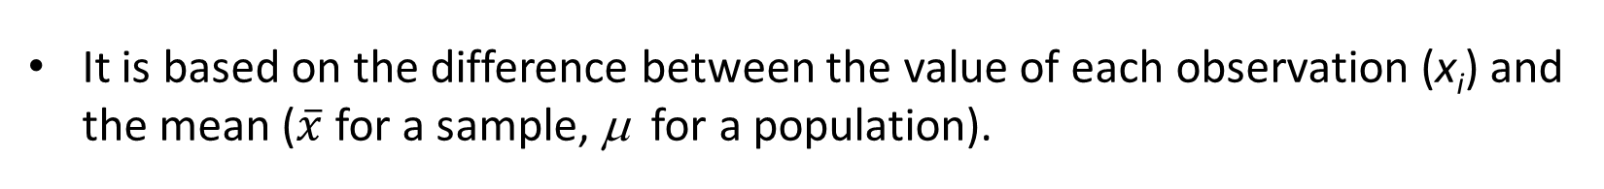
Variance
The variance is a measure of variability that utilizes all the data.
It is based on the difference between the value of each observation (x_{i}) and the mean ($\overline{x}$ for a sample, μ for a population).
The variance is useful in comparing the variability of two or more variables.

Slide 37
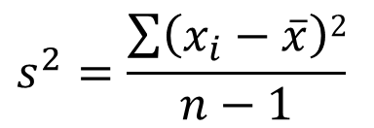
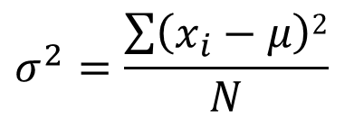
Variance
The variance is the average of the squared deviations between each data value and the mean.
The variance is computed as follows:
$$s^{2}=\frac{\sum{\left(x_{i}−\overline{x}\right)2}}{n−1}$$
$$σ^{2}=\frac{\sum{\left(x_{i}−μ\right)2}}{N}$$
for a
sample
for a
population

Slide 38
Standard Deviation
The standard deviation of a data set is the positive square root of the variance.
It is measured in the same units as the data, making it more easily interpreted than the variance.

Slide 39
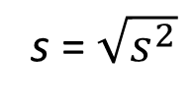
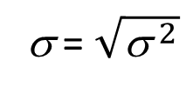
Standard Deviation
The standard deviation is computed as follows:
s = $\sqrt{s^{2}}$
σ = $\sqrt{{\text{s} }^{2}}$
for a
sample
for a
population

Slide 40
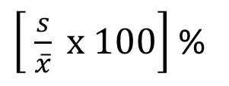
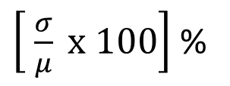
Coefficient of Variation
The coefficient of variation indicates how large the standard deviation is in relation to the mean.
The coefficient of variation is computed as follows:
$\left[ \frac{s}{\overline{x}} x 100\right]$ %
$\left[ \frac{σ}{μ} x 100\right]$ %
for a
sample
for a
population

Slide 41
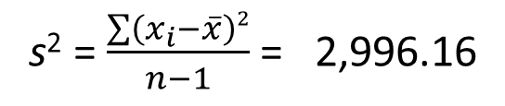
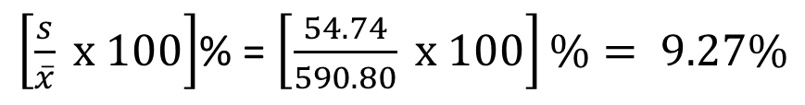
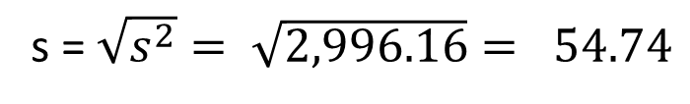
Sample Variance, Standard Deviation,
And Coefficient of Variation
Example: Apartment Rents
Variance
s² = $\frac{\sum{\left(x_{i}−\overline{x}\right)2}}{n−1}$ = 2,996.16
Standard Deviation
s = $\sqrt{s^{2}}= \sqrt{2,996.16}= 54.74$
Coefficient of Variation
$\left[\frac{s}{\overline{x}} x 100\right]$% = $\left[\frac{54.74}{590.80} x 100\right]\%= 9.27\%$

Slide 42
End of Chapter 3, Part A

