Slide 1

Essentials of
Modern Business Statistics (6e)
Slides by
John
Loucks
St. Edward’s
University
Anderson, Sweeney, Williams, Camm, Cochran
© 2017 Cengage Learning
Slides by John Loucks
St. Edwards University

Slide 2
Chapter 2, Part B
Descriptive Statistics: Tabular and Graphical Displays
Summarizing Data for Two Variables Using Tables
Summarizing Data for Two Variables Using Graphical Displays
Data Visualization: Best Practices in Creating Effective Graphical Displays

Slide 3
Summarizing Data for Two Variables sing Tables
Thus far we have focused on methods that are used to summarize the data for one variable at a time.
Often a manager is interested in tabular and graphical methods that will help understand the relationship between two variables.
Crosstabulation is a method for summarizing the data for two variables.

Slide 4
Crosstabulation
A crosstabulation is a tabular summary of data for two variables.
Crosstabulation can be used when:
  one variable is categorical and the other is quantitative,
  both variables are categorical, or
  both variables are quantitative.
The left and top margin labels define the classes for the two variables.

Slide 5
Crosstabulation
Example: Finger Lakes Homes
The number of Finger Lakes homes sold for each style and price for the past two years is shown below.
Price
Range
Home Style
Colonial Log Split A-Frame
Total
18 6 19 12
< $250,000
> $250,000
55
45
12 14 16 3
Total
30 20 35 15
100

Slide 6
Crosstabulation
Example: Finger Lakes Homes
Insights Gained from Preceding Crosstabulation
The greatest number of homes (19) in the sample are a split-level style and priced at less than $250,000.
Only three homes in the sample are an A-Frame style and priced at $250,000 or more.

Slide 7
Crosstabulation: Row or Column Percentages
Converting the entries in the table into row percentages or column percentages can provide additional insight about the relationship between the two variables.

Slide 8
Crosstabulation: Row Percentages
Example: Finger Lakes Homes
Price
Range
Home Style
Colonial Log Split A-Frame
Total
32.73 10.91 34.55 21.82
< $250,000
> $250,000
100
100
26.67 31.11 35.56 6.67
Note: row totals are actually 100.01 due to rounding.
(Colonial and > $250K)/(All > $250K) x 100 = (12/45) x 100

Slide 9
Crosstabulation: Column Percentages
Example: Finger Lakes Homes
Price
Range
Home Style
Colonial Log Split A-Frame
< $250,000
> $250,000
60.00 30.00 54.29 80.00
40.00 70.00 45.71 20.00
Total
100 100 100 100
(Colonial and > $250K)/(All Colonial) x 100 = (12/30) x 100

Slide 10
Crosstabulation: Simpson’s Paradox
Data in two or more crosstabulations are often aggregated to produce a summary crosstabulation.
We must be careful in drawing conclusions about the relationship between the two variables in the aggregated crosstabulation.
In some cases the conclusions based upon an aggregated crosstabulation can be completely reversed if we look at the unaggregated data. The reversal of conclusions based on aggregate and unaggregated data is called Simpson’s paradox.

Slide 11
Summarizing Data for Two Variables
Using Graphical Displays
In most cases, a graphical display is more useful than a table for recognizing patterns and trends.
Displaying data in creative ways can lead to powerful insights.
Scatter diagrams and trendlines are useful in exploring the relationship between two variables.

Slide 12
Scatter Diagram and Trendline
A scatter diagram is a graphical presentation of the relationship between two quantitative variables.
One variable is shown on the horizontal axis and the other variable is shown on the vertical axis.
The general pattern of the plotted points suggests the overall relationship between the variables.
A trendline provides an approximation of the relationship.

Slide 13
Scatter Diagram
A Positive Relationship
y
x

Slide 14
Scatter Diagram
A Negative Relationship
y
x

Slide 15
Scatter Diagram
No Apparent Relationship
y
x

Slide 16
Scatter Diagram
Example: Panthers Football Team
The Panthers football team is interested in investigating the relationship, if any, between interceptions made and points scored.
x = Number of
Interceptions
y = Number of
Points Scored
1
3
2
1
3
14
24
18
17
30

Slide 17
Scatter Diagram and Trendline
y
35
30
25
20
Number of Points Scored
15
10
5
0
x
0
1
2
3
4
Number of Interceptions

Slide 18
Example: Panthers Football Team
Insights Gained from the preceding Scatter Diagram
The scatter diagram indicates a positive relationship between the number of interceptions and the number of points scored.
Higher points scored are associated with a higher number of interceptions.
The relationship is not perfect; all plotted points in the scatter diagram are not on a straight line.

Slide 19
Side-by-Side Bar Chart
A side-by-side bar chart is a graphical display for depicting multiple bar charts on the same display.
Each cluster of bars represents one value of the first variable.
Each bar within a cluster represents one value of the second variable.

Slide 20
Side-by-Side Bar Chart
Finger Lake Homes
20
18
16
< $250,000
> $250,000
14
12
Frequency
10
8
6
4
2
Home Style
Colonial
Log
Split-Level
A-Frame

Slide 21
Stacked Bar Chart
A stacked bar chart is another way to display and compare two variables on the same display.
It is a bar chart in which each bar is broken into rectangular segments of a different color.
If percentage frequencies are displayed, all bars will be of the same height (or length), extending to the 100% mark.

Slide 22
Stacked Bar Chart
Finger Lake Homes
40
36
32
28
< $250,000
24
> $250,000
Frequency
20
16
12
8
4
Home Style
Colonial
Log
Split
A-Frame

Slide 23
Stacked Bar Chart
Finger Lake Homes
100
90
80
70
60
< $250,000
Percentage Frequency
> $250,000
50
40
30
20
10
Home Style
Colonial
Log
Split
A-Frame

Slide 24
Data Visualization: Best Practices
in Creating Effective Graphical Displays
Data visualization is the use of graphical displays to summarize and present information about a data set.
The goal is to communicate as effectively and clearly as possible, the key information about the data.

Slide 25
Creating Effective Graphical Displays
Creating effective graphical displays is as much art as it is science.
Here are some guidelines . . .
  Give the display a clear and concise title.
  Keep the display simple.
  Clearly label each axis and provide the units of measure.
  If colors are used, make sure they are distinct.
  If multiple colors or line types are used, provide a legend.

Slide 26
Choosing the Type of Graphical Display
Displays used to show the distribution of data:
Bar Chart to show the frequency distribution and relative frequency distribution for categorical data
Pie Chart to show the relative frequency and percent frequency for categorical data
Dot Plot to show the distribution for quantitative data over the entire range of the data
Histogram to show the frequency distribution for quantitative data over a set of class intervals
Stem-and-Leaf Display to show both the rank order and shape of the distribution for quantitative data

Slide 27
Choosing the Type of Graphical Display
Displays used to make comparisons:
Side-by-Side Bar Chart to compare two variables
Stacked Bar Chart to compare the relative frequency or percent frequency of two categorical variables

Slide 28
Choosing the Type of Graphical Display
Displays used to show relationships:
Scatter Diagram to show the relationship between two quantitative variables
Trendline to approximate the relationship of data in a scatter diagram

Slide 29
Data Dashboards
A data dashboard is a widely used data visualization tool.
It organizes and presents key performance indicators (KPIs) used to monitor an organization or process.
It provides timely summary information that is easy to read, understand, and interpret.
Some additional guidelines include . . .
Minimize the need for screen scrolling.
  Avoid unnecessary use of color or 3D displays.
  Use borders between charts to improve readability.

Slide 30
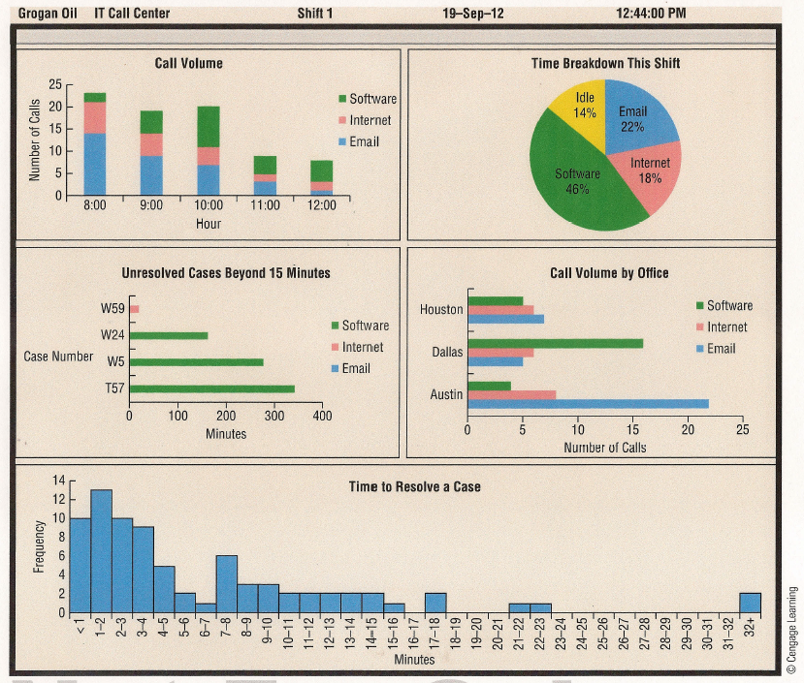
Data Dashboard Example

Slide 31
Tabular and Graphical Displays
Data
Categorical Data
Quantitative Data
Tabular
Displays
Graphical
Displays
Tabular
Displays
Graphical
Displays
Frequency
Distribution
Rel. Freq. Dist.
Percent Freq.
Distribution
Crosstabulation
Frequency Dist.
Rel. Freq. Dist.
% Freq. Dist.
Cum. Freq. Dist.
Cum. Rel. Freq. Dist.
Cum. % Freq. Dist.
Crosstabulation
Dot Plot
Histogram
Stem-and-
Leaf Display
Scatter
Diagram
Bar Chart
Pie Chart
Side-by-Side
Bar Chart
Stacked
Bar Chart

Slide 32
End of Chapter 2, Part B

