Slide 1
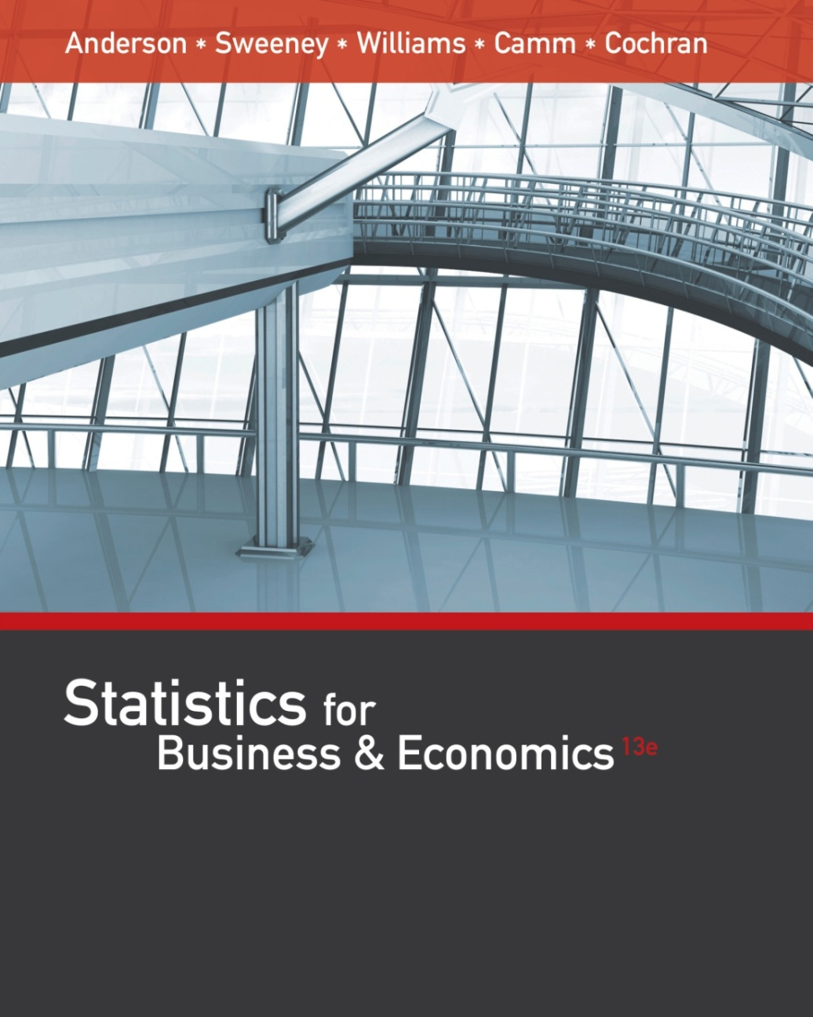
Statistics for
Business and Economics (13e)
Anderson, Sweeney, Williams, Camm, Cochran
© 2017 Cengage Learning

Slide 2
Chapter 2
Part A - Descriptive Statistics: Tabular and Graphical Displays
Summarizing Data for a Categorical Variable
  Categorical data use labels or names to identify categories of like items.
Summarizing Data for a Quantitative Variable
  Quantitative data are numerical values that indicate how much or how many.

Slide 3
Summarizing Categorical Data
Frequency Distribution
Relative Frequency Distribution
Percent Frequency Distribution
Bar Chart
Pie Chart

Slide 4
Frequency Distribution
A frequency distribution is a tabular summary of data showing the number (frequency) of observations in each of several non-overlapping categories or classes.
The objective is to provide insights about the data that cannot be quickly obtained by looking only at the original data.

Slide 5
Frequency Distribution
Example: Marada Inn
Guests staying at Marada Inn were asked to rate the quality of their accommodations as being excellent, above average, average, below average, or poor.
The ratings provided by a sample of 20 guests are:
Below Average | Average | Above Average
Above Average | Above Average | Above Average
Above Average | Below Average | Below Average
Average | Poor | Poor
Above Average | Excellent | Above Average
Average | Above Average | Average
Above Average | Average

Slide 6
Frequency Distribution
Example: Marada Inn
Rating | Frequency
Poor | 2
Below Average | 3
Average | 5
Above Average | 9
Excellent | 1
Total | 20

Slide 7
Relative Frequency Distribution
The relative frequency of a class is the fraction or proportion of the total number of data items belonging to the class.
A relative frequency distribution is a tabular summary of data showing the relative frequency for each class.
$Relative frequency of a class$ = $\frac{Frequency of the class}{n}$

Slide 8
Percent Frequency Distribution
The percent frequency of a class is the relative frequency multiplied by 100.
A percent frequency distribution is a tabular summary of a set of data showing the percent frequency for each class.

Slide 9
Relative Frequency and Percent Frequency Distributions
Example: Marada Inn
Rating | Relative Frequency | Percent Frequency
Poor | .10 | 10
Below Average | .15 | 15
Average | .25 | 25
Above Average | .45 | 45
Excellent | .05 | 5
Total | 1.00 | 100

Slide 10
Bar Chart
A bar chart is a graphical display for depicting qualitative data.
On one axis (usually the horizontal axis), we specify the labels that are used for each of the classes.
A frequency, relative frequency, or percent frequency scale can be used for the other axis (usually the vertical axis).
Using a bar of fixed width drawn above each class label, we extend the height appropriately.
  The bars are separated to emphasize the fact that each class is a separate category.

Slide 11
Bar Chart
Marada Inn Quality Ratings
10
9
8
7
6
Frequency
5
4
3
2
1
Quality
Rating
Poor
Below
Average
Average
Above
Average
Excellent

Slide 12
Pareto Diagram
In quality control, bar charts are used to identify the most important causes of problems.
When the bars are arranged in descending order of height from left to right (with the most frequently occurring cause appearing first) the bar chart is called a Pareto diagram.
This diagram is named for its founder, Vilfredo Pareto, an Italian economist.

Slide 13
Pie Chart
The pie chart is a commonly used graphical display for presenting relative frequency and percent frequency distributions for categorical data.
First draw a circle; then use the relative frequencies to subdivide the circle into sectors that correspond to the relative frequency for each class.
Since there are 360 degrees in a circle, a class with a relative frequency of .25 would consume .25(360) = 90 degrees of the circle.

Slide 14
Pie Chart
Marada Inn Quality Ratings
Excellent
5%
Poor
10%
Below
Average
15%
Above
Average
45%
Average
25%
Average
25%

Slide 15
Example: Marada Inn
Insights Gained from the Preceding Pie Chart
One-half of the customers surveyed gave Marada a quality rating of “above average” or “excellent” (looking at the left side of the pie). This might please the manager.
For each customer who gave an “excellent” rating, there were two customers who gave a “poor” rating (looking at the top of the pie). This should displease the manager.

Slide 16
Summarizing Quantitative Data
Frequency Distribution
Relative Frequency and Percent Frequency Distributions
Dot Plot
Histogram
Cumulative Distributions
Stem-and-Leaf Display

Slide 17
Frequency Distribution
Example: Hudson Auto Repair
The manager of Hudson Auto would like to gain a better understanding of the cost of parts used in the engine tune-ups performed in the shop. She examines 50 customer invoices for tune-ups. The costs of parts, rounded to the nearest dollar, are listed on the next slide.

Slide 18
Frequency Distribution
Example: Hudson Auto Repair
Sample of Parts Cost($) for 50 Tune-ups
91
78
93
57
75
52
99
80
97
62
71
69
72
89
66
75
79
75
72
76
104
74
62
68
97
105
77
65
80
109
85
97
88
68
83
68
71
69
67
74
62
82
98
101
79
105
79
69
62
73

Slide 19
Frequency Distribution
The three steps necessary to define the classes for a frequency distribution with quantitative data are:
1. Determine the number of non-overlapping classes.
2. Determine the width of each class.
3. Determine the class limits.

Slide 20
Frequency Distribution
Guidelines for Determining the Number of Classes
Use between 5 and 20 classes.
Data sets with a larger number of elements usually require a larger number of classes.
Smaller data sets usually require fewer classes.
The goal is to use enough classes to show the variation in the data, but not so many classes that some contain only a few data items.

Slide 21
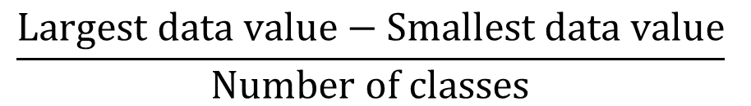

Frequency Distribution
Guidelines for Determining the Width of Each Class
Use classes of equal width.
$$Number of classes=1+3,3 log n$$
Approximate Class Width =
$$\frac{Largest data value−Smallest data value}{Number of classes}$$
Making the classes the same width reduces the chance of inappropriate interpretations.

Slide 22
oka@upj.ac.id
Subject email: tugas statistika MAN A 10FEB

Slide 23
Frequency Distribution
Note on Number of Classes and Class Width
In practice, the number of classes and the appropriate class width are determined by trial and error.
Once a possible number of classes is chosen, the appropriate class width is found.
The process can be repeated for a different number of classes.
Ultimately, the analyst uses judgment to determine the combination of the number of classes and class width that provides the best frequency distribution for summarizing the data.

Slide 24
Frequency Distribution
Guidelines for Determining the Class Limits
Class limits must be chosen so that each data item belongs to one and only one class.
The lower class limit identifies the smallest possible data value assigned to the class.
The upper class limit identifies the largest possible data value assigned to the class.
The appropriate values for the class limits depend on the level of accuracy of the data.
An open-end class requires only a lower class limit or an upper class limit.

Slide 25
Frequency Distribution
Class Midpoint
In some cases, we want to know the midpoints of the classes in a frequency distribution for quantitative data.
The class midpoint is the value halfway between the lower and upper class limits.

Slide 26
Frequency Distribution
Example: Hudson Auto Repair
If we choose six classes:
Approximate Class Width = (109 - 50)/6 = 9.83≅ 10
50-59
60-69
70-79
80-89
90-99
100-109
2
13
16
7
7
5
Total 50
Parts Cost ($)
Frequency

Slide 27
Relative Frequency and Percent Frequency Distributions
Example: Hudson Auto Repair
Parts
Cost ($)
Relative
Frequency
Percent
Frequency
50-59
60-69
70-79
80-89
90-99
100-109
.04 = 2/50
.26
.32
.14
.14
.10
Total 1.00
4 = .04(100)
26
32
14
14
10
100

Slide 28
Relative Frequency and Percent Frequency Distributions
Example: Hudson Auto Repair
Insights Gained from the Percent Frequency Distribution:
Only 4% of the parts costs are in the $50-59 class.
30% of the parts costs are under $70.
The greatest percentage (32% or almost one-third) of the parts costs are in the $70-79 class.
10% of the parts costs are $100 or more.

Slide 29
Dot Plot
One of the simplest graphical summaries of data is a dot plot.
A horizontal axis shows the range of data values.
Then each data value is represented by a dot placed above the axis.

Slide 30
Dot Plot
Example: Hudson Auto Repair
50 60 70 80 90 100 110
Tune-up Parts Cost ($)

Slide 31
Histogram
Another common graphical display of quantitative data is a histogram.
The variable of interest is placed on the horizontal axis.
A rectangle is drawn above each class interval with its height corresponding to the interval’s frequency, relative frequency, or percent frequency.
Unlike a bar graph, a histogram has no natural separation between rectangles of adjacent classes.

Slide 32
Histogram
Example: Hudson Auto Repair
18
Tune-up Parts Cost
16
14
12
10
Frequency
8
6
4
2
Parts
Cost ($)
50-59 60-69 70-79 80-89 90-99 100-110

Slide 33
Histograms Showing Skewness
Symmetric
  Left tail is the mirror image of the right tail
  Example: Heights of People
.35
.30
.25
.20
Relative Frequency
.15
.10
.05
0

Slide 34
Histograms Showing Skewness
Moderately Skewed Left
  A longer tail to the left
  Example: Exam Scores
.35
.30
.25
.20
Relative Frequency
.15
.10
.05
0

Slide 35
Histograms Showing Skewness
Moderately Right Skewed
  A Longer tail to the right
  Example: Housing Values
.35
.30
.25
.20
Relative Frequency
.15
.10
.05
0

Slide 36
Histograms Showing Skewness
Highly Skewed Right
  A very long tail to the right
  Example: Executive Salaries
.35
.30
.25
.20
Relative Frequency
.15
.10
.05
0

Slide 37
Cumulative Distributions
Cumulative frequency distribution - shows the number of items with values less than or equal to the upper limit of each class.
Cumulative relative frequency distribution – shows the proportion of items with values less than or equal to the upper limit of each class.
Cumulative percent frequency distribution – shows the percentage of items with values less than or equal to the upper limit of each class.

Slide 38
Cumulative Distributions
The last entry in a cumulative frequency distribution always equals the total number of observations.
The last entry in a cumulative relative frequency distribution always equals 1.00.
The last entry in a cumulative percent frequency distribution always equals 100.

Slide 39
Cumulative Distributions
Hudson Auto Repair
Cumulative
Relative
Frequency
Cumulative
Percent
Frequency
Cumulative
Frequency
< 59
< 69
< 79
< 89
< 99
< 109
Cost ($)
2
15 = 2+13
31
38
45
50
.04
.30 = 15/50
.62
.76
.90
1.00
4
30 = .30(100)
62
76
90
100

Slide 40
Stem-and-Leaf Display
A stem-and-leaf display shows both the rank order and shape of a distribution of data.
It is similar to a histogram on its side, but it has the advantage of showing the actual data values.
The leading digits of each data item are arranged to the left of a vertical line.
To the right of the vertical line we record the last digit for each item in rank order.
Each line (row) in the display is referred to as a stem.
Each digit on a stem is a leaf.

Slide 41
Example: Hudson Auto Repair
The manager of Hudson Auto would like to gain a better understanding of the cost of parts used in the engine tune-ups performed in the shop. She examines 50 customer invoices for tune-ups. The costs of parts, rounded to the nearest dollar, are listed on the next slide.

Slide 42
Stem-and-Leaf Display
Example: Hudson Auto Repair
Sample of Parts Cost ($) for 50 Tune-ups
91
78
93
57
75
52
99
80
97
62
71
69
72
89
66
75
79
75
72
76
104
74
62
68
97
105
77
65
80
109
85
97
88
68
83
68
71
69
67
74
62
82
98
101
79
105
79
69
62
73

Slide 43
Stem-and-Leaf Display
Example: Hudson Auto Repair
5
6
7
8
9
10
2 7
2 2 2 2 5 6 7 8 8 8 9 9 9
1 1 2 2 3 4 4 5 5 5 6 7 8 9 9 9
0 0 2 3 5 8 9
1 3 7 7 7 8 9
1 4 5 5 9
Stems Leaves

Slide 44
Stretched Stem-and-Leaf Display
If we believe the original stem-and-leaf display has condensed the data too much, we can stretch the display vertically by using two stems for each leading digit(s).
Whenever a stem value is stated twice, the first value corresponds to leaf values of 0 - 4, and the second value corresponds to leaf values of 5 - 9.

Slide 45
Stretched Stem-and-Leaf Display
Example: Hudson Auto Repair
5
5
6
6
7
7
8
8
9
9
10
10
2
7
2 2 2 2
5 6 7 8 8 8 9 9 9
1 1 2 2 3 4 4
5 5 5 6 7 8 9 9 9
0 0 2 3
5 8 9
1 3
7 7 7 8 9
1 4
5 5 9

Slide 46
Stem-and-Leaf Display
Leaf Units
A single digit is used to define each leaf.
In the preceding example, the leaf unit was 1.
  Leaf units may be 100, 10, 1, 0.1, and so on.
Where the leaf unit is not shown, it is assumed to equal 1.
The leaf unit indicates how to multiply the stem-and-leaf numbers in order to approximate the original data.

Slide 47
Example: Leaf Unit = 0.1
Stem-and-Leaf Display
If we have data with values such as
8.6 11.7 9.4 9.1 10.2 11.0 8.8
Leaf Unit = 0.1
8
9
10
11
6 8
1 4
2
0 7

Slide 48
Stem-and-Leaf Display
Example: Leaf Unit = 10
If we have data with values such as
1806 1717 1974 1791 1682 1910 1838
Leaf Unit = 10
16
17
18
19
8
1 9
0 3
1 7
The 82 in 1682 is rounded down to 80 and is represented as an 8.

Slide 49
End of Chapter 2, Part A

