Slide 1
Consumer Preferences and the Concept of Utility

Slide 2
Introduction
Supply and Demand Models (Ch. 2) are useful for analyzing economic questions concerning markets.
  How will increasing the real wage affect output?
In these models we summed each individuals demand to obtain the market demand curve.
But, how do individuals decide what to consume and how much to consume.

Slide 3
Introduction
We need to develop a model about individual or consumer behavior
Model is based on:
  Individual tastes or preferences determine the amount of pleasure people derive from goods and services. (Chapter 3)
  Consumers face constraints (budget) that limit their choices
  Consumers maximize their well-being or pleasure from consumption, subject to the constraints they face.
We want our model to be realistic so we can predict consumer behavior. But, still as simple as possible.

Slide 4
Description of Consumer Preferences
Consumer Preferences tell us how the consumer would rank any two basket of goods, assuming these allotments were available to the consumer at no cost.
baskets or bundles is a collection of goods or services that an individual might consume.

Slide 5
Properties of Consumer Preferences
The Assumptions of Consumer Behavior
1. Complete:
Preferences are complete if the consumer can rank any two baskets of goods
A strictly preferred to B (A ⎬ B )
B strictly preferred to A (B ⎬ A )
indifferent between A and B (A ≈ B)
Preferences are transitive if a consumer who prefers basket A to basket B, and basket B to basket C also prefers basket A to basket C
2. Transitive:
No illogical behavior
A ⎬ B and B ⎬ C → A ⎬ C NOT C ⎬ A

Slide 6
Properties of Consumer Preferences
Monotonic (more is better) Preferences: are monotonic if a basket with more of at least one good and no less of any good is preferred to the original basket.
– free disposal can’t be worse of with more
The more is better assumption is also known as the property of non-satiation.
It assumes are looking at what economists call a ‘good’. Something we want more of
We are not looking at a ‘bad’ i.e. pollution
We can relax this assumption it is the first two that are crucial for the analysis

Slide 7
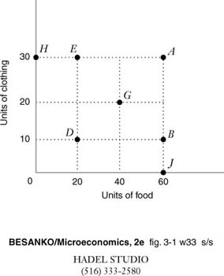
Preferences Examples
Which bundles are better because more is better?

Slide 8
Intransitivity and Age
Age | Number of Subjects | Intransitive Choices (%)
4 | 39 | 83
5 | 33 | 82
6 | 23 | 82
7 | 35 | 78
8 | 40 | 68
9 | 52 | 57
10 | 45 | 52
11 | 65 | 37
12 | 81 | 23
13 | 81 | 41
Adults | 99 | 13
Source: See Hirshleifer, Jack and D. Hirshleifer, Price Theory and Applications. Sixth Edition. Prentice Hall: Upper Saddle River, New Jersey. 1998.

Slide 9
Ordinal vs Cardinal Rankings
Ordinal Ranking: gives us information on how a consumer ranks different baskets of goods. But it does not say by how much (i.e. 2 times as much)
  This is how we view preferences.
Cardinal Rankings: Give us information on the intensity of the consumer preferences (i.e. they like basket A 10 times more than basket B).
  Would be hard to say I like eating pizza out 10.5 times more than eating bad Chinese. Putting an exact number to our preferences is hard! – this is why we use ordinal rankings for consumer preferences

Slide 10
Ordinal vs Cardinal Example
Students take an exam. After the exam, the students are ranked according to their performance.
An ordinal ranking lists the students in order of their performance (i.e., Harry did best, Joe did second best, Betty did third best, and so on).
A cardinal ranking gives the grade of the exam, based on an absolute grading standard (i.e., Harry got 50, Joe got 100, so Joe did 2 times better than Harry).

Slide 11
Utility Function
Utility Function: measures the level of satisfaction that a consumer receives from any basket of goods.
U=F(x₁,x₂,x₃, ….., x_{n}), where the x’s are quantities of n goods that might be consumed in a period
Is utility ordinal or cardinal?
Utility is an ordinal concept: the precise magnitude of the number that the function assigns has no significance.

Slide 12
Utility Functions
Difference in magnitudes of utility have no interpretation per se
utility not comparable across individuals
any transformation of a utility function that preserves the original ranking of bundles is an equally good representation of preferences.

Slide 13
Utility Function (one good in utility)
Are the assumptions on preferences meet?
U(y): total utility of muffins
U(y) = y^{.5}
1.75
C
1.5
B
1.0
A
1
2
3
y, weekly consumption of muffins
Slopes on A and C give marginal utility – each additional unit makes person happy but by less than the previous unit

Slide 14
Marginal Utility
Marginal Utility: Rate at which total utility changes as the level of consumption rises.
Each new muffin makes you happier, but makes you happier by smaller and smaller amount.

Slide 15
Marginal Utility (more than one good)
The marginal utility: of a good, x, is the additional utility that the consumer gets from consuming a little more of x when the consumption of all the other goods in the consumer’s basket remain constant.
ΔU/Δx (y held constant) = MU_{x}=∂ U/∂ x
ΔU/Δy (x held constant) = MU_{y} =∂ U/∂ y
…or…the marginal utility of x is the slope of the utility function with respect to x.
The principle of diminishing marginal utility: states that the marginal utility falls as the consumer consumes more of a good

Slide 16
Marginal Utility
MU(y): marginal utility of muffins
-If more is always better: marginal utility must always be positive.
-Diminishing marginal utility
-A positive marginal utility means you like the good. Otherwise you would get zero or perhaps negative marginal utility
1.00
.50
.25
1 2 3
y, weekly consumption of muffins

Slide 17
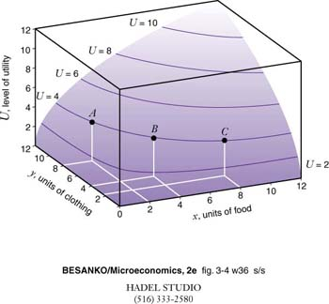
Utility Function and Indifference Curve (2 good example)
Indifference curve

Slide 18
Indifference Curve (IC)
Clothing
2 good graph (keeps it simple)
- Along curve consumer is indifferent between each of the bundles of food and clothing
Same level of utility for bundle A, B, and C
A
B
C
IC₁ for U=4
food

Slide 19
Indifference Map:
Clothing
Are indifferent to any bundle along an
indifference curve. But more is better so are better off as we move away from the origin.
Preference direction ( happier the further away from the origin)
IC₂ for U = 6
IC₁ for U=4
Food

Slide 20
Indifference Curves and Map
An Indifference Curve or Indifference Set: is the set of all baskets for which the consumer is indifferent
An Indifference Map: illustrates a set of indifference curves for a consumer, it is an ordinal ranking.

Slide 21
Properties of Indifference Maps
Monotonicity => indifference curves have negative slope …and… indifference curves are not “thick”
Transitivity => indifference curves do not cross
Completeness => each basket lies on only one indifference curve
one more assumption usually is made:
Averages preferred to extremes => indifference curves are bowed toward the origin (convex to the origin).

Slide 22
Monotonicity
Case: consumers like both goods
Clothing
To meet monotonicity: preference curve must be in the these areas
- downward sloping
Preferred to A
•
A
Less
preferred
IC₁
Food

Slide 23
MONOTONICITY
Clothing
If more is preferred to less, IC cannot be thick. B would be preferred to A, so could not be on same CI curve.
B
A
IC₁ for U=4
food

Slide 24
Indifference Curves Cannot Cross
clothing
Suppose that B preferred to A.
but..by definition of IC,
B indifferent to C
A indifferent to C => B indifferent
to A by transitivity.
Contradiction, B should be preferred
to A due to monotonicity.
IC₂
IC₁
•
B
•
A
C
•
food

Slide 25
Averages Preferred to Extremes
Clothing
A
•
(.5A, .5B)
•
IC₂
•
IC₁
B
Food

Slide 26
Example: For the indifference curves graphed below, are the underlying preferences: Complete?
Transitive?
Monotonic?
IC₁ IC₂ IC₃ IC₄
y
Preference direction
0
x

Slide 27
Example: For the indifference curves graphed below, are the underlying preferences: Complete? Yes
Transitive? Yes
Monotonic? No
IC₁ IC₂ IC₃ IC₄
y
Want as much X as possible but don’t care about Y: So same X and more Y are not better off, so not monotonic.
B
Preference direction
A
0
x

Slide 28
Marginal Rate of Substitution
The marginal rate of substitution:
A consumer’s willingness to substitute one good for another while maintaining the same level of satisfaction (i.e. slope of indifference curve remains the same).
The marginal rate of substitution of x for y (MRSx,y) is the rate at while the consumer is willing to give up y in order to get more of x, holding utility constant.
  This assumes y is on the vertical axis and x the horizontal.

Slide 29
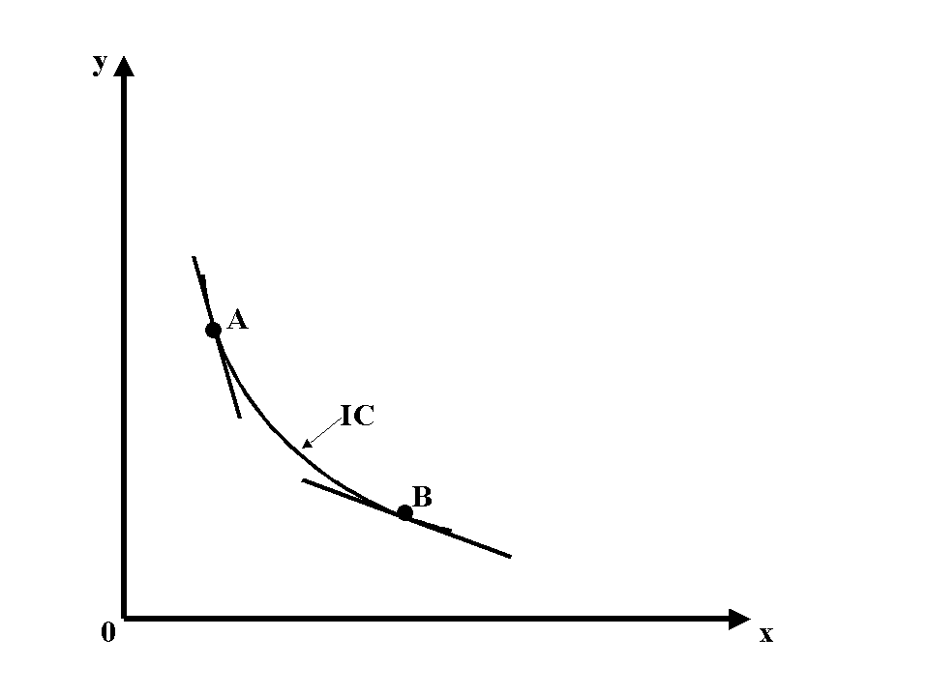
Marginal Rate of Substitution
Graphically – slope of IC
If you like both goods then both goods will have positive marginal utilities
Then indifference curve must be negatively sloped, because if you give up one good need more of the other.

Slide 30
Marginal Rate of Substitution
Mathematically
Memorize/
derive

Slide 31
Marginal Rate of Substitution
Examples
At A, slope = -5
so willing to give up 5 y, for one more X
  MRS is 5
At B, slope = -2
so so willing to give up 2 y, for one more X
  MRS=2

Slide 32
Diminishing Rate of Marginal Substitution
As move along x, MRS gets smaller (diminishes)
For most good MRS is diminishing
  Curve is flatter
Willing to give up less and less y for the same amount of x
  From A (MRS = 5) to point B (MRS = 2)
For most good MRS is diminishing
  IC are convex to origin
  Averages preferred to extremes

Slide 33
An indifference curve exhibits a diminishing rate of substitution:
if the more of good x you have, the more you are willing to give up to get a little of good y…or…
The indifference curves get flatter as we move out along the horizontal axis and steeper as we move up along the vertical axis.

Slide 34
Example: For the following indifference curves, what is the marginal rate of substitution between x and y is: 1, .5, 2, or 5? Is the MRS diminishing?
y
What type of goods are these?
Perfect substitutes
Does the MRS need to be 1 for each of these?
No could be in a ratio of 2 to 1 (2 Oreo cookies for each glass of milk
3
2
1
IC₁
IC₂
IC₃
0
1 2 3
x

Slide 35
Graphing an Indifference Curve
y
Example: Suppose U = xy, graph the utility curve if
utility is equal to 10.
5
2
10 = xy
0
2
5
x

Slide 36
y
Example: U=20
5
Preference direction
20 = xy
2
10 = xy
0
2
5
x

