Slide 2


Slide 3
Chapter 10
Liabilities
Financial Accounting, IFRS Edition
Weygandt Kimmel Kieso

Slide 4
Study Objectives
Explain a current liability, and identify the major types of current liabilities.
Describe the accounting for notes payable.
Explain the accounting for other current liabilities.
Explain why bonds are issued, and identify the types of bonds.
Prepare the entries for the issuance of bonds and interest expense.
Describe the entries when bonds are redeemed.
Describe the accounting for long-term notes payable.
Identify the methods for the presentation and analysis of non-current liabilities.

Slide 5
Liabilities
Current Liabilities
Non-Current Liabilities
Notes payable
Sales taxes payable
Unearned revenues
Current maturities of long-term debt
Statement presentation and analysis
Bond basics
Accounting for bond issues
Accounting for bond retirements
Accounting for long-term notes payable
Statement presentation and analysis

Slide 6
What is a Current Liability?
Section 1 Current Liabilities
Current liability is debt with two key features:
  Company expects to pay the debt from existing current assets or through the creation of other current liabilities.
  Company will pay the debt within one year or the operating cycle, whichever is longer.
Current liabilities include notes payable, accounts payable, unearned revenues, and accrued liabilities such as taxes payable, salaries payable, and interest payable.
SO 1 Explain a current liability, and identify the major types of current liabilities.

Slide 7
What is a Current Liability?
Question
To be classified as a current liability, a debt must be expected to be paid:
  out of existing current assets.
  by creating other current liabilities.
  within 2 years.
  both (a) and (b).
SO 1 Explain a current liability, and identify the major types of current liabilities.

Slide 8
What is a Current Liability?
Notes Payable
  Written promissory note.
  Require the borrower to pay interest.
  Issued for varying periods.
SO 2 Describe the accounting for notes payable.

Slide 9
What is a Current Liability?
Illustration: On March 1, 2011, Cole Williams borrows $100,000 from First National Bank on a 4-month, 12% note.
Instructions
  Prepare the entry on March 1.
  Prepare the adjusting entry on June 30, assuming monthly adjusting entries have not been made.
  Prepare the entry at maturity (July 1).
SO 2 Describe the accounting for notes payable.

Slide 10
What is a Current Liability?
Illustration: On March 1, 2011, Cole Williams borrows $100,000 from First National Bank on a 4-month, 12% note.
a) Prepare the entry on March 1.
Cash 100,000
Notes payable 100,000
b) Prepare the adjusting entry on June 30.
$100,000 x 12% x 4/12 = $4,000
Interest expense 4,000
Interest payable 4,000
SO 2 Describe the accounting for notes payable.

Slide 11
What is a Current Liability?
Illustration: On March 1, 2011, Cole Williams borrows $100,000 from First National Bank on a 4-month, 12% note.
c) Prepare the entry at maturity (July 1).
Notes payable 100,000
Interest payable 4,000
Cash 104,000
SO 2 Describe the accounting for notes payable.

Slide 12
What is a Current Liability?
Sales Tax Payable
  Sales taxes are expressed as a stated percentage of the sales price.
  Either rung up separately or included in total receipts.
  Retailer collects tax from the customer.
  Retailer remits the collections to the state’s department of revenue.
SO 3 Explain the accounting for other current liabilities.

Slide 13
What is a Current Liability?
Illustration: The March 25 cash register reading for Cooley Grocery shows sales of $10,000 and sales taxes of $600 (sales tax rate of 6%), the journal entry is:
Cash 10,600
Sales 10,000
Sales tax payable 600
SO 3 Explain the accounting for other current liabilities.

Slide 14
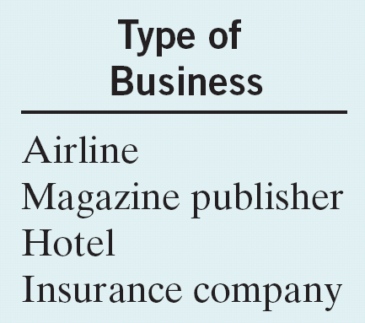
What is a Current Liability?
Unearned Revenue
Revenues that are received before the company delivers goods or provides services.
  Company debits Cash, and credits a current liability account (unearned revenue).
  When the company earns the revenue, it debits the Unearned Revenue account, and credits a revenue account.
SO 3 Explain the accounting for other current liabilities.

Slide 15
What is a Current Liability?
Illustration: Assume that Superior University sells 10,000 season football tickets at $50 each for its five-game home schedule. The university makes the following entry for the sale of season tickets:
Aug. 6
Cash 500,000
Unearned revenue 500,000
As the school completes each of the five home games, it would record the revenue earned.
Sept. 7
Unearned revenue 100,000
Ticket revenue 100,000
SO 3 Explain the accounting for other current liabilities.

Slide 16
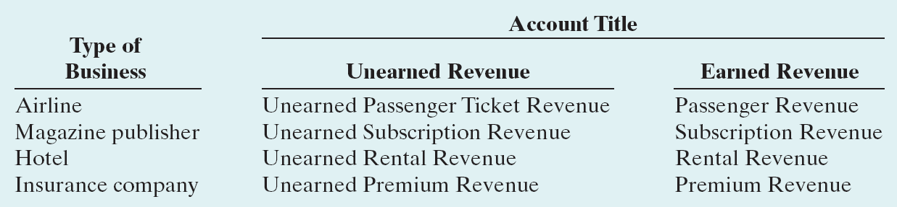
What is a Current Liability?
Unearned Revenue
Illustration 10-2
Unearned and earned
revenue accounts
SO 3 Explain the accounting for other current liabilities.

Slide 17
What is a Current Liability?
Current Maturities of Long-Term Debt
  Portion of long-term debt that comes due in the current year.
  No adjusting entry required.
SO 3 Explain the accounting for other current liabilities.

Slide 18
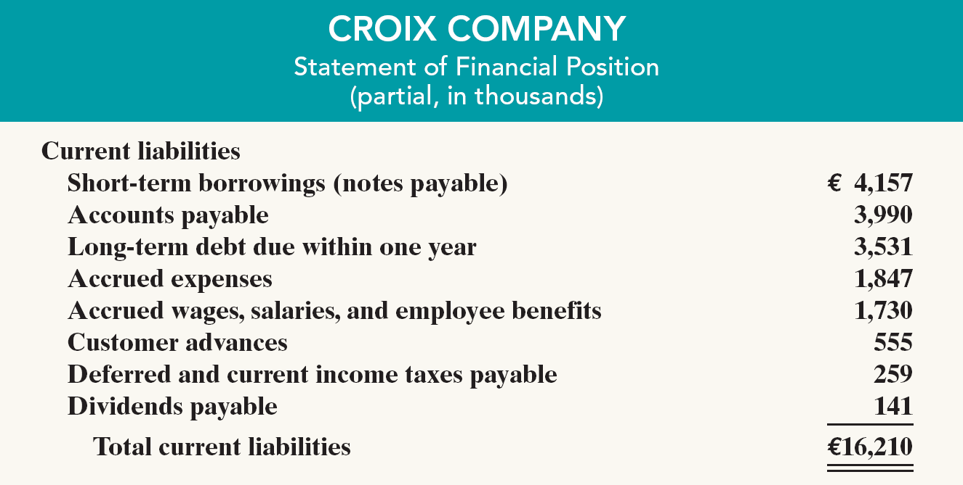
Statement Presentation and Analysis
Presentation
Illustration 10-3
Statement of financial position presentation of current liabilities (in thousands)
SO 3 Explain the accounting for other current liabilities.

Slide 19
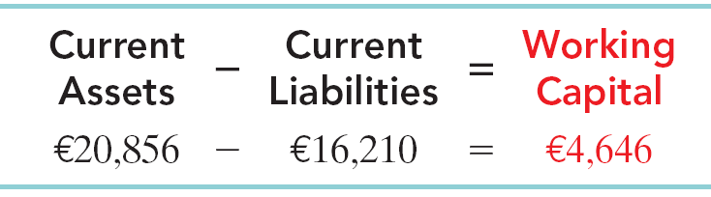
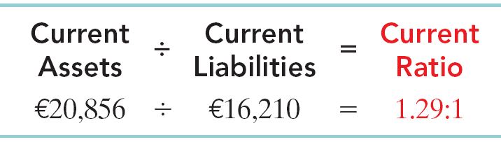
Statement Presentation and Analysis
Analysis
Illustration 10-4
Liquidity refers to the ability to pay maturing obligations and meet unexpected needs for cash.
The current ratio permits us to compare the liquidity of different-sized companies and of a single company at different times.
Illustration 10-5
SO 3 Explain the accounting for other current liabilities.

Slide 20
Statement Presentation and Analysis
Question
Working capital is calculated as:
  current assets minus current liabilities.
  total assets minus total liabilities.
  non-current liabilities minus current liabilities.
  both (b) and (c).
SO 3 Explain the accounting for other current liabilities.

Slide 21
Section 2 Non-Current Liabilities
Bond Basics
Bonds are a form of interest-bearing notes payable.
Three advantages over ordinary shares:
Stockholder control is not affected.
Tax savings result.
Earnings per share may be higher.
SO 4 Explain why bonds are issued, and identify the types of bonds.

Slide 22
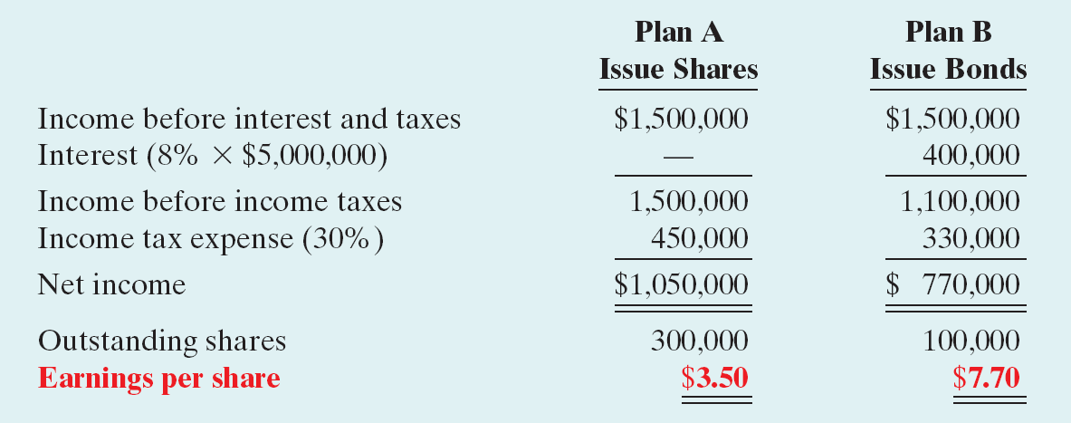
Bond Basics
Effects on earnings per share—equity vs. debt.
Illustration 10-7
SO 4 Explain why bonds are issued, and identify the types of bonds.

Slide 23
Bond Basics
Question
The major disadvantages resulting from the use of bonds are:
  that interest is not tax deductible and the principal must be repaid.
  that the principal is tax deductible and interest must be paid.
  that neither interest nor principal is tax deductible.
  that interest must be paid and principal repaid.
SO 4 Explain why bonds are issued, and identify the types of bonds.

Slide 24
Bond Basics
Types of Bonds
  Secured and Unsecured (debenture) bonds.
  Term and Serial bonds.
  Registered and Bearer (or coupon) bonds.
  Convertible and Callable bonds.
SO 4 Explain why bonds are issued, and identify the types of bonds.

Slide 25
Bond Basics
Issuing Procedures
  Bond contract known as a bond indenture.
  Represents a promise to pay:
    sum of money at designated maturity date, plus
    periodic interest at a contractual (stated) rate on the maturity amount (face value).
  Paper certificate, typically a $1,000 face value.
  Interest payments usually made semiannually.
  Generally issued when the amount of capital needed is too large for one lender to supply.
SO 4 Explain why bonds are issued, and identify the types of bonds.

Slide 26
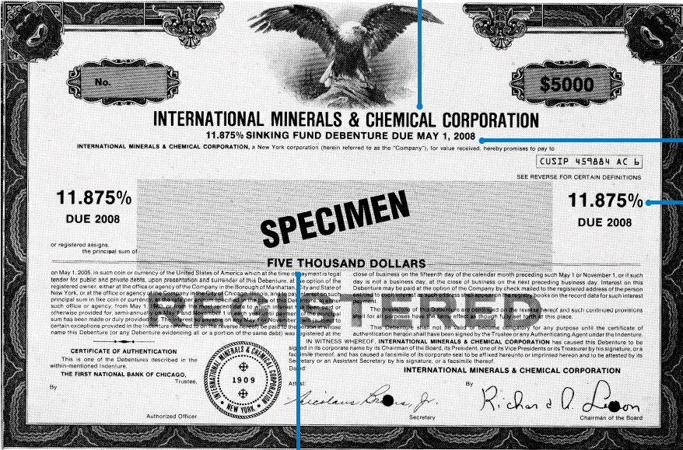
Bond Basics
Issuer of
Bonds
Illustration 10-8
Maturity
Date
2013
DUE 2013
DUE 2013
Contractual
Interest
Rate
Face or
Par Value
SO 4

Slide 27
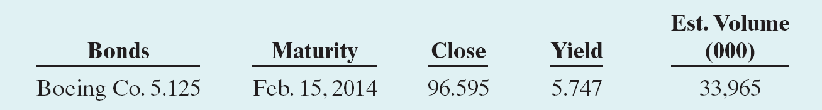
Bond Basics
Bond Trading
Bonds traded on national securities exchanges.
Newspapers and the financial press publish bond prices and trading activity daily.
Read as: Outstanding 5.125%, $1,000 bonds that mature in 2014. Currently yield a 5.747% return. On this day, $33,965,000 of these bonds were traded. Closing price was 96.595% of face value, or $965.95.
SO 4 Explain why bonds are issued, and identify the types of bonds.

Slide 28
Bond Basics
Determining the Market Value of Bonds
Market value is a function of the three factors that determine present value:
  dollar amounts to be received,
  length of time until the amounts are received, and
  market rate of interest.
The features of a bond (callable, convertible, and so on) affect the market rate of the bond.
SO 4 Explain why bonds are issued, and identify the types of bonds.

Slide 29
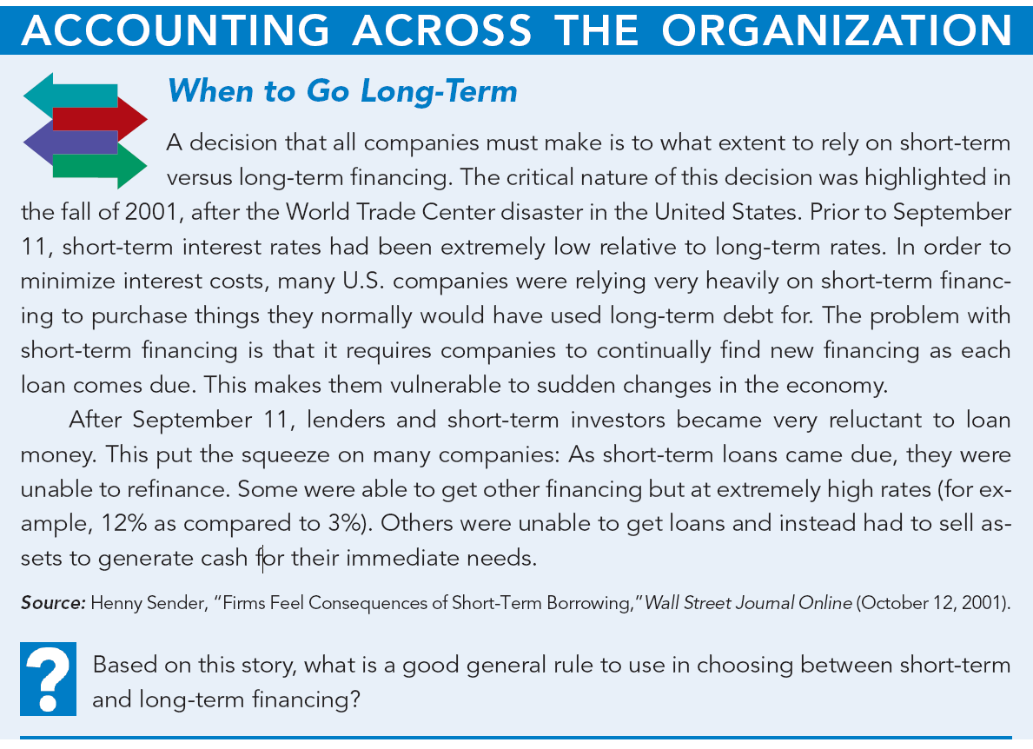

SO 4 Explain why bonds are issued, and identify the types of bonds.
Notes:
p. 447 When to Go Long-Term
Q: Based on this story, what is a good general rule to use in choosing between short-term and long-term financing?
A: In general, it is best to finance short-term assets with current liabilities and long-term assets with non-current liabilities, in order to reduce the likelihood of a liquidity crunch such as this.

