Slide 1
Plant Asset

Slide 2
Section 2 – Natural Resources
Natural resources consist of standing timber and resources extracted from the ground, such as oil, gas, and minerals.
Standing timber is considered a biological asset under IFRS.
In the years before they are harvested, the recorded
value of biological assets is adjusted to fair value each period.
SO 7 Compute periodic depletion of extractable natural resources.

Slide 3
Section 2 – Natural Resources
IFRS defines extractive industries as those businesses involved in finding and removing natural resources located in or near the earth’s crust.
Cost - price needed to acquire the resource and prepare it for its intended use.
Depletion - allocation of the cost to expense in a rational and systematic manner over the resource’s useful life.
Depletion is to natural resources as depreciation is to plant assets.
Companies generally use units-of-activity method.
Depletion generally is a function of the units extracted.
SO 7 Compute periodic depletion of extractable natural resources.

Slide 4
Section 2 – Natural Resources
Illustration: Assume that Lane Coal Company invests $5 million in a mine estimated to have 10 million tons of coal and no salvage value. In the first year, Lane extracts and sells 800,000 tons of coal. Lane computes the depletion expense as follows:
$5,000,000 ÷ 10,000,000 = $.50 depletion cost per ton
$.50 x 800,000 = $400,000 depletion expense
Journal entry:
Depletion expense 400,000
Accumulated depletion 400,000
SO 7 Compute periodic depletion of extractable natural resources.

Slide 5
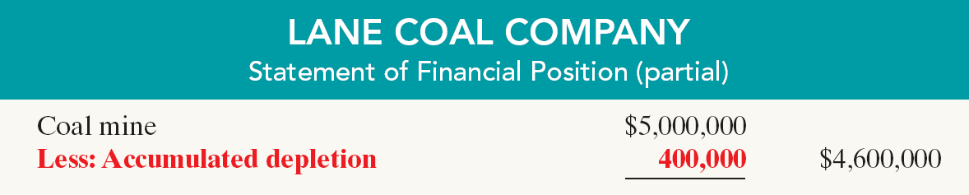
Financial Statement Presentation
Illustration 9-23
Statement presentation of accumulated depletion
Extracted resources that have not been sold are reported as inventory in the current assets section.
SO 7 Compute periodic depletion of extractable natural resources.

Slide 6
Section 3 – Intangible Assets
Intangible assets are rights, privileges, and competitive advantages that do not possess physical substance.
Intangible assets are categorized as having either a limited life or an indefinite life.
Common types of intangibles:
Patents
Copyrights
Franchises or licenses
Trademarks and trade names
Goodwill
IFRS permits revaluation of intangible assets to fair value, except for goodwill.
SO 8 Explain the basic issues related to accounting for intangible assets.

Slide 7
Types of Intangible Assets
Patents
Exclusive right to manufacture, sell, or otherwise control an invention for a specified number of years from the date of the grant.
Legal life in many countries is 20 years.
Capitalize costs of purchasing a patent and amortize over its legal life or its useful life, whichever is shorter.
Legal fees incurred successfully defending a patent are capitalized to Patent account.
SO 8 Explain the basic issues related to accounting for intangible assets.

Slide 8
Accounting for Intangible Assets
Intangible assets are typically amortized on a straight-line basis.
Illustration: Assume that National Labs purchases a patent at a cost of $60,000. National estimates the useful life of the patent to be eight years. National records the annual amortization as follows.
Amortization expense 7,500
Patent 7,500
SO 8 Explain the basic issues related to accounting for intangible assets.

Slide 9
Accounting for Intangible Assets
Copyrights
Give the owner the exclusive right to reproduce and sell an artistic or published work.
  plays, literary works, musical works, pictures, photographs, and video and audiovisual material.
Granted for the life of the creator plus a specified number of years, which can vary by country but is commonly 70 years.
Capitalize costs of acquiring and defending it.
Amortized to expense over useful life.
SO 8 Explain the basic issues related to accounting for intangible assets.

Slide 10
Accounting for Intangible Assets
Trademarks and Trade Names
Word, phrase, jingle, or symbol that identifies a particular enterprise or product.
  Wheaties, Game Boy, Frappuccino, Kleenex, Windows, Coca-Cola, and Jetta.
Registration provides a specified number of years of protection, which can vary by country, but is commonly 20 years.
Capitalize acquisition costs.
Renewed indefinitely, no amortization.
SO 8 Explain the basic issues related to accounting for intangible assets.

Slide 11
Accounting for Intangible Assets
Franchises and Licenses
Contractual arrangement between a franchisor and a franchisee.
  BP (GBR), Taco Bell (USA), or Rent-A-Wreck (USA) are franchises.
Franchise (or license) with a limited life should be amortized to expense over the life of the franchise.
Franchise with an indefinite life should be carried at cost and not amortized.
SO 8 Explain the basic issues related to accounting for intangible assets.

Slide 12
Accounting for Intangible Assets
Goodwill
Includes exceptional management, desirable location, good customer relations, skilled employees, high-quality products, etc.
Only recorded when an entire business is purchased.
Goodwill is recorded as the excess of ...
purchase price over the fair value of the identifiable net assets acquired.
Internally created goodwill should not be capitalized.
SO 8 Explain the basic issues related to accounting for intangible assets.

Slide 13
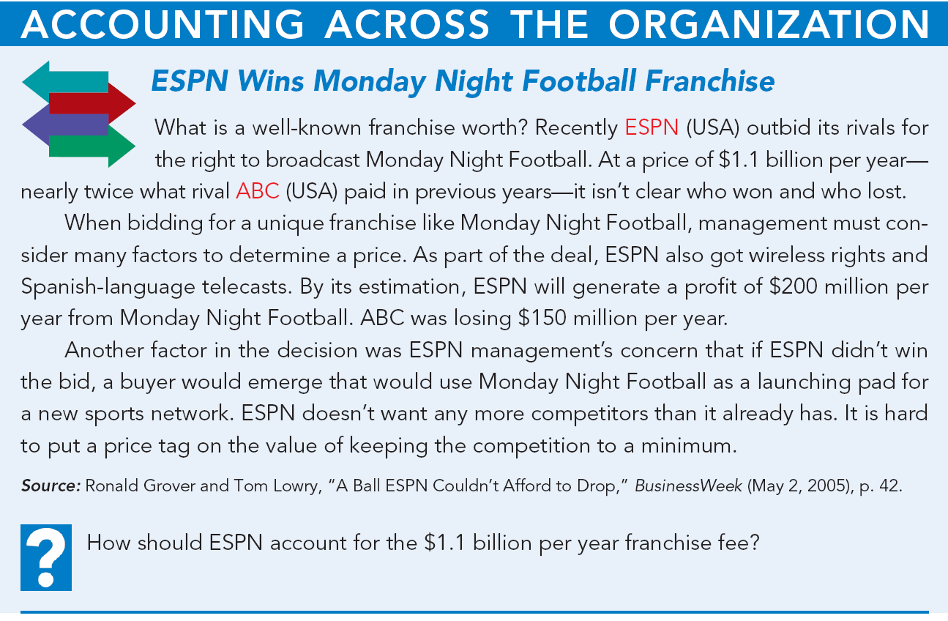
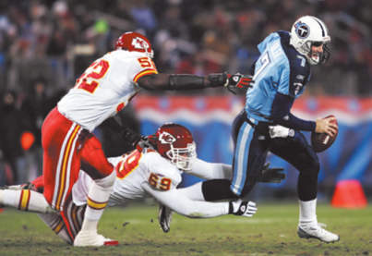
Answer on notes page
Notes:
p. 408 ESPN Wins Monday Night Football Franchise
Q: How should ESPN account for the $1.1 billion per year franchise fee?
A: Since this is an annual franchise fee, ESPN should expense it each year, rather than capitalizing and amortizing it.

Slide 14
Research and Development Costs
Frequently results in something that a company patents or copyrights such as:
new product,
process,
idea,
formula,
composition, or
literary work.
  Costs in the research phase are always expensed as incurred.
  Costs in the development phase are expensed until specific criteria are met, primarily that technological feasibility is achieved.
SO 8 Explain the basic issues related to accounting for intangible assets.

Slide 15
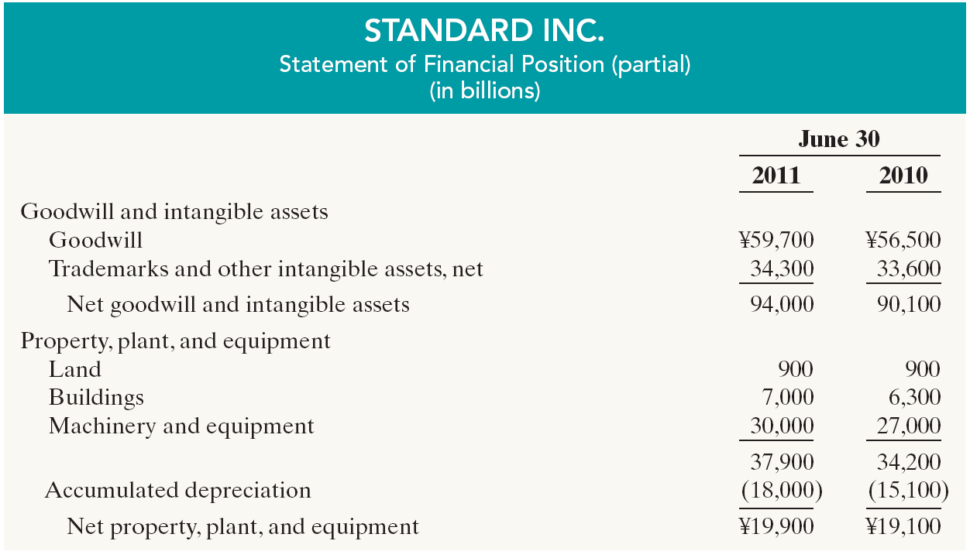
Statement Presentation and Analysis
Presentation
Illustration 9-24
SO 9 Indicate how plant assets, natural resources, and intangible assets are reported.

Slide 16
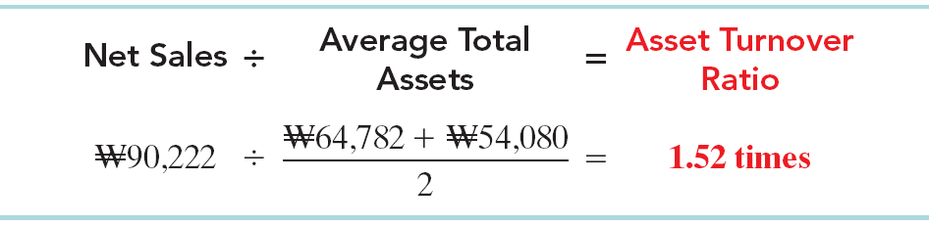

Statement Presentation and Analysis
Analysis
Illustration 9-25
Each dollar invested in assets produced in sales. If a company is using its assets efficiently, each investment in assets will create a high amount of sales.
SO 9 Indicate how plant assets, natural resources, and intangible assets are reported.

Slide 17
Understanding U.S. GAAP
Key Differences
Plant Assets, Natural Resources, and Intangible Assets
  As in IFRS, under GAAP, the costs associated with research and development are segregated into the two components. Costs in the research phase are always expensed under both IFRS and GAAP. Under GAAP, however, costs in the development phase are also always expensed. As shown in this chapter, under IFRS, development costs can be capitalized once technological feasibility is achieved.
  IFRS permits revaluation of intangible assets (except for goodwill). GAAP prohibits revaluations of intangible assets.
  GAAP does not require component depreciation.

Slide 18
Understanding U.S. GAAP
Key Differences
Plant Assets, Natural Resources, and Intangible Assets
  GAAP does not permit the use of revaluation accounting for property, plant, and equipment, which is allowed under IFRS.
  Under both GAAP and IFRS, changes in the depreciation method used and changes in useful life are handled in current and future periods. Prior periods are not affected. GAAP recently conformed to IFRS in the accounting for changes in depreciation methods.

Slide 19
Understanding U.S. GAAP
Key Differences
Plant Assets, Natural Resources, and Intangible Assets
  IFRS allows reversal of impairment losses when there has been a change in economic conditions or in the expected use of the asset. Under GAAP, impairment losses cannot be reversed for assets to be held and used; the impairment loss results in a new cost basis for the asset. IFRS and GAAP are similar in the accounting for impairments of assets held for disposal.
  The accounting for exchanges of non-monetary assets has recently converged between IFRS and GAAP.

Slide 20
Understanding U.S. GAAP
Looking to the Future
Plant Assets, Natural Resources, and Intangible Assets
  It is too early to say whether a converged conceptual framework will recommend fair value measurement (and revaluation accounting) for plant assets and intangibles. However, this is likely to be one of the more contentious issues, given the long-standing use of historical cost as a measurement basis in GAAP. The IASB and FASB have identified a project that would consider expanded recognition of internally generated intangible assets. IFRS permits more recognition of intangibles compared to GAAP. Thus, it will be challenging to develop converged standards for intangible assets, given the long-standing prohibition on capitalizing internally generated intangible assets and research and development in GAAP.

Slide 21
Exchange of Plant Assets
Appendix
Ordinarily, companies record a gain or loss on the exchange of plant assets.
The rationale for recognizing a gain or loss is that most exchanges have commercial substance.
An exchange has commercial substance if the future cash flows change as a result of the exchange.
SO 10 Explain how to account for the exchange of plant assets.

Slide 22
Exchange of Plant Assets
Illustration: Roland Co. exchanged old trucks (cost $64,000 less $22,000 accumulated depreciation) plus cash of $17,000 for a new semi-truck. The old trucks had a fair value of $26,000.
Cost of old trucks $64,000
Less: Accumulated depreciation 22,000
Book value 42,000
Fair value of old trucks 26,000
Loss on disposal $16,000
Fair value of old trucks $26,000
Cash paid 17,000
Cost of new semi-truck $43,000
Loss Treatment
SO 10 Explain how to account for the exchange of plant assets.

Slide 23
Exchange of Plant Assets
Illustration: Roland Co. exchanged old trucks (cost $64,000 less $22,000 accumulated depreciation) plus cash of $17,000 for a new semi-truck. The old trucks had a fair market value of $26,000.
Prepare the entry to record the exchange of assets by Roland Co.
Semi-truck 43,000
Accumulated depreciation 22,000
Loss on disposal 16,000
Used trucks 64,000
Cash 17,000
SO 10 Explain how to account for the exchange of plant assets.

Slide 24
Exchange of Plant Assets
Illustration: Mark Express Delivery trades its old delivery equipment (cost $40,000 less $28,000 accumulated depreciation) for new delivery equipment. The old equipment had a fair value of $19,000. Mark also paid $3,000.
Cost of old equipment $40,000
Less: Accumulated depreciation 28,000
Book value 12,000
Fair value of old equipment 19,000
Gain on disposal $ 7,000
Fair value of old equipment $19,000
Cash paid 3,000
Cost of new equipment $22,000
Gain Treatment
SO 10 Explain how to account for the exchange of plant assets.

Slide 25
Exchange of Plant Assets
Illustration: Mark Express Delivery trades its old delivery equipment (cost $40,000 less $28,000 accumulated depreciation) for new delivery equipment. The old equipment had a fair value of $19,000. Mark also paid $3,000.
Prepare the entry to record the exchange of assets by Mark Express.
Delivery equipment (new) 22,000
Accumulated depreciation 28,000
Delivery equipment (used) 40,000
Gain on disposal 7,000
Cash 3,000
SO 10 Explain how to account for the exchange of plant assets.

Slide 26
Exchange of Plant Assets
Review Question
In exchanges of assets in which the exchange has commercial substance:
a. neither gains nor losses are recognized immediately.
b. gains, but not losses, are recognized immediately.
c. losses, but not gains, are recognized immediately.
d. both gains and losses are recognized immediately.
SO 10 Explain how to account for the exchange of plant assets.

Slide 27
Copyright
“Copyright © 2011 John Wiley & Sons, Inc. All rights reserved. Reproduction or translation of this work beyond that permitted in Section 117 of the 1976 United States Copyright Act without the express written permission of the copyright owner is unlawful. Request for further information should be addressed to the Permissions Department, John Wiley & Sons, Inc. The purchaser may make back-up copies for his/her own use only and not for distribution or resale. The Publisher assumes no responsibility for errors, omissions, or damages, caused by the use of these programs or from the use of the information contained herein.”

