Slide 1
WILEY
IFRS EDITION
Prepared by
Coby Harmon
University of California, Santa Barbara
Westmont College

Slide 2
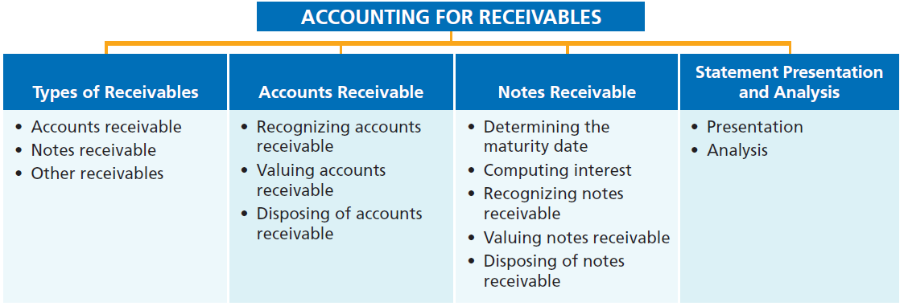
PREVIEW OF CHAPTER 8
Financial Accounting
IFRS 3rd Edition
Weygandt ● Kimmel ● Kieso

Slide 3
CHAPTER
8
Accounting for Receivables
LEARNING OBJECTIVES
After studying this chapter, you should be able to:
Identify the different types of receivables.
Explain how companies recognize accounts receivable.
Distinguish between the methods and bases companies use to value accounts receivable.
Describe the entries to record the disposition of accounts receivable.
Compute the maturity date of and interest on notes receivable.
Explain how companies recognize notes receivable.
Describe how companies value notes receivable.
Describe the entries to record the disposition of notes receivable.
Explain the statement presentation and analysis of receivables.

Slide 4
Types of Receivables
Learning Objective 1
Identify the different types of receivables.
Amounts due from individuals and companies that are expected to be collected in cash.
Amounts customers owe on account that result from the sale of goods and services.
Written promise (formal instrument) for amount to be received. Also called trade receivables.
Nontrade receivables such as interest, loans to officers, advances to employees, and income taxes refundable.
Accounts Receivable
Notes Receivable
Other Receivables
LO 1

Slide 5
TYPES OF RECEIVABLES
Amounts due from individuals and companies that are expected to be collected in cash.
Illustration 8-1
Receivables as a percentage of assets
LO 1

Slide 6
TYPES OF RECEIVABLES
Question
Receivables are frequently classified as:
accounts receivable, company receivables, and other receivables.
accounts receivable, notes receivable, and employee receivables.
accounts receivable and general receivables.
accounts receivable, notes receivable, and other receivables.
LO 1

Slide 7
Accounts Receivable
Learning Objective 2
Explain how companies recognize accounts receivable.
Recognizing Accounts Receivable
Service organization records a
receivable when it performs service on account.
Merchandiser records accounts receivable at the point of sale of merchandise on account.
Seller may offer a discount to encourage early payment.
Buyer might return goods found to be unacceptable.
Sales returns reduce receivables.
LO 2

Slide 8
Recognizing Accounts Receivable
Illustration: Assume that Hennes & Mauritz (SWE) Co. on July 1, 2017, sells merchandise on account to Polo Company for $1,000 terms 2/10, n/30. Prepare the journal entry to record this transaction on the books of Hennes & Mauritz.
Jul. 1
Accounts Receivable 1,000
Sales Revenue 1,000
LO 2

Slide 9
Recognizing Accounts Receivable
Illustration: On July 5, Polo returns merchandise worth $100 to Hennes & Mauritz.
Jul. 5
Sales Returns and Allowances 100
Accounts Receivable 100
Illustration: On July 11, Hennes & Mauritz receives payment from Polo Company for the balance due.
Jul. 11
Cash ($900 - $18) 882
Sales Discounts ($900 x .02) 18
Accounts Receivable 900
LO 2

Slide 10
Recognizing Accounts Receivable
Illustration: Some retailers issue their own credit cards. Assume that you use your JCPenney Company credit card to purchase clothing with a sales price of $300.
Accounts Receivable 300
Sales Revenue 300
Assume that you owe $300 at the end of the month, and JCPenney charges 1.5% per month on the balance due.
Accounts Receivable 4.50
Interest Revenue 4.50
LO 2

Slide 11
ANATOMY OF A FRAUD
Tasanee was the accounts receivable clerk for a large non-profit foundation that provided performance and exhibition space for the performing and visual arts. Her responsibilities included activities normally assigned to an accounts receivable clerk, such as recording revenues from various sources that included donations, facility rental fees, ticket revenue, and bar receipts. However, she was also responsible for handling all cash and checks from the time they were received until the time she deposited them, as well as preparing the bank reconciliation. Tasanee took advantage of her situation by falsifying bank deposits and bank reconciliations so that she could steal cash from the bar receipts. Since nobody else logged the donations or matched the donation receipts to pledges prior to Tasanee receiving them, she was able to offset the cash that was stolen against donations that she received but didn’t record. Her crime was made easier by the fact that her boss, the company’s controller, only did a very superficial review of the bank reconciliation and thus didn’t notice that some numbers had been cut out from other documents and taped onto the bank reconciliation.
Total take: $1.5 million
The Missing Controls
Segregation of duties. The foundation should not have allowed an accounts receivable clerk, whose job was to record receivables, to also handle cash, record cash, make deposits, and especially prepare the bank reconciliation.
Independent internal verification. The controller was supposed to perform a thorough review of the bank reconciliation. Because he did not, he was terminated from his position.
LO 2

Slide 12
>
DO IT!
On May 1, Wilton sold merchandise on account to Bates for €50,000 terms 3/15, net 45. On May 4, Bates returns merchandise with a sales price of €2,000. On May 16, Wilton receives payment from Bates for the balance due. Prepare journal entries to record the May transactions on Wilton’s books. (Ignore cost of goods sold entries.)
May 1
Accounts Receivable—Bates 50,000
Sales Revenue 50,000
4
Sales Returns and Allowances 2,000
Accounts Receivable—Bates 2,000
16
Cash (€48,000 - €1,440) 46,560
Sales Discounts (€48,000 x .03) 1,440
Accounts Receivable—Bates 48,000
LO 2

Slide 13
Valuing Accounts Receivable
Learning Objective 3
Distinguish between the methods and bases companies use to value accounts receivable.
Current asset.
Valuation (net realizable value).
Uncollectible Accounts Receivable
Sales on account raise the possibility of accounts not being collected.
Seller records losses that result from extending credit as Bad Debt Expense.
LO 3

Slide 14
Valuing Accounts Receivable
Methods of Accounting for Uncollectible Accounts
Direct Write-Off
Theoretically undesirable:
No matching.
Receivable not stated at amount expect to be received.
Not acceptable for financial reporting.
Allowance Method
Losses are estimated:
Better matching.
Receivable stated at cash (net) realizable value.
Required by IFRS.
LO 3

Slide 15
Accounts Receivable
How are these accounts presented on the Statement of Financial Position?
Allowance for Doubtful Accounts
Accounts Receivable
Beg. 500
25 Beg.
End. 500
25 End.
LO 3

Slide 16
Accounts Receivable
LO 3

Slide 17
Accounts Receivable
Alternate Presentation
LO 3

Slide 18
Accounts Receivable
Journal entry for credit sale of €100.
Accounts Receivable 100
Sales 100
Allowance for Doubtful Accounts
Accounts Receivable
Beg. 500
25 Beg.
End. 500
25 End.
LO 3

Slide 19
Accounts Receivable
Journal entry for credit sale of €100.
Accounts Receivable 100
Sales 100
Allowance for Doubtful Accounts
Accounts Receivable
Beg. 500
25 Beg.
Sale 100
End. 600
25 End.
LO 3

Slide 20
Accounts Receivable
Collected €333 on account.
Cash 333
Accounts Receivable 333
Allowance for Doubtful Accounts
Accounts Receivable
Beg. 500
25 Beg.
Sale 100
End. 600
25 End.
LO 3

Slide 21
Accounts Receivable
Collected €333 on account.
Cash 333
Accounts Receivable 333
Allowance for Doubtful Accounts
Accounts Receivable
Beg. 500
25 Beg.
Sale 100
333 Coll.
End. 267
25 End.
LO 3

Slide 22
Accounts Receivable
Adjustment of €15 for estimated bad debts.
Bad Debt Expense 15
Allowance for Doubtful Accounts 15
Allowance for Doubtful Accounts
Accounts Receivable
Beg. 500
25 Beg.
Sale 100
333 Coll.
End. 267
25 End.
LO 3

Slide 23
Accounts Receivable
Adjustment of €15 for estimated bad debts.
Bad Debt Expense 15
Allowance for Doubtful Accounts 15
Allowance for Doubtful Accounts
Accounts Receivable
Beg. 500
25 Beg.
Sale 100
333 Coll.
15 Est.
End. 267
40 End.
LO 3

Slide 24
Accounts Receivable
Write-off of uncollectible accounts for €10.
Allowance for Doubtful Accounts 10
Accounts Receivable 10
Allowance for Doubtful Accounts
Accounts Receivable
Beg. 500
25 Beg.
Sale 100
333 Coll.
15 Est.
End. 267
40 End.
LO 3

Slide 25
Accounts Receivable
Write-off of uncollectible accounts for €10.
Allowance for Doubtful Accounts 10
Accounts Receivable 10
Allowance for Doubtful Accounts
Accounts Receivable
Beg. 500
25 Beg.
Sale 100
333 Coll.
15 Est.
10 W/O
W/O 10
End. 257
30 End.
LO 3

Slide 26
Accounts Receivable
LO 3

Slide 27
DIRECT WRITE-OFF METHOD FOR UNCOLLECTIBLE ACCOUNTS
Illustration: Assume that Warden Ltd. writes off M. E. Doran’s HK$1,600 balance as uncollectible on December 12. Warden’s entry is:
Bad Debt Expense 1,600
Accounts Receivable—M. E. Doran 1,600
Theoretically undesirable:
No matching.
Receivable not stated at cash realizable value.
Not acceptable for financial reporting.
LO 3

Slide 28
ALLOWANCE METHOD FOR UNCOLLECTIBLE ACCOUNTS
Companies estimate uncollectible accounts receivable.
Debit Bad Debt Expense and credit Allowance for Doubtful Accounts (a contra-asset account).
Companies debit Allowance for Doubtful Accounts and credit Accounts Receivable at the time the specific account is written off as uncollectible.
LO 3

Slide 29
ALLOWANCE METHOD
RECORDING ESTIMATED UNCOLLECTIBLES
Illustration: Hampson Furniture has credit sales of €1,200,000 in 2017, of which €200,000 remains uncollected at December 31. The credit manager estimates that €12,000 of these sales will prove uncollectible.
Dec. 31
Bad Debt Expense 12,000
Allowance for Doubtful Accounts 12,000
LO 3

Slide 30
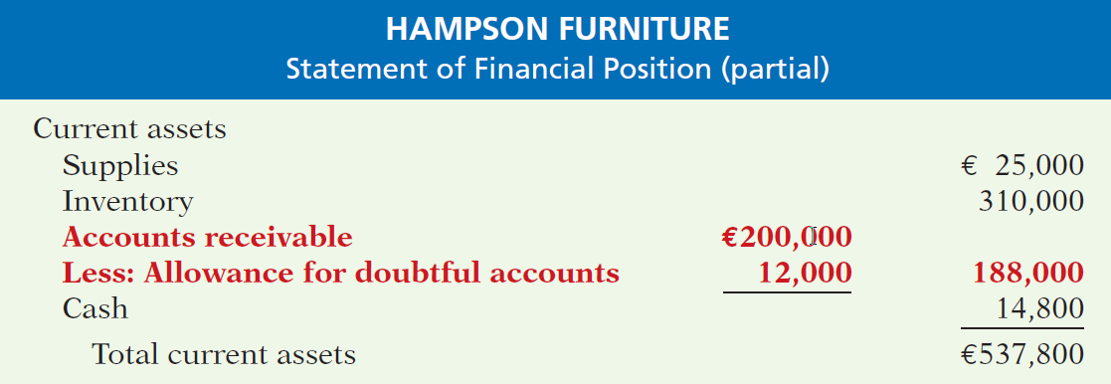
Allowance Method for Uncollectibles
Illustration 8-3
Presentation of allowance for doubtful accounts
LO 3

Slide 31
Allowance Method for Uncollectibles
WRITE-OFF OF AN UNCOLLECTIBLE ACCOUNT
Illustration: The vice-president of finance of Hampson Furniture on March 1, 2018, authorizes a write-off of the €500 balance owed by R. A. Ware. The entry to record the write-off is:
Mar. 1
Allowance for Doubtful Accounts 500
Accounts Receivable—R. A. Ware 500
Illustration 8-4
General ledger balances after write-off
LO 3

Slide 32
Allowance Method for Uncollectibles
WRITE-OFF OF AN UNCOLLECTIBLE ACCOUNT
Illustration: The vice-president of finance of Hampson Furniture on March 1, 2018, authorizes a write-off of the €500 balance owed by R. A. Ware. The entry to record the write-off is:
Mar. 1
Allowance for Doubtful Accounts 500
Accounts Receivable—R. A. Ware 500
Illustration 8-5
Cash realizable value comparison
LO 3

Slide 33
Allowance Method for Uncollectibles
RECOVERY OF AN UNCOLLECTIBLE ACCOUNT
Illustration: On July 1, R. A. Ware pays the €500 amount that Hampson Furniture had written off on March 1. Hampson makes these entries:
July 1
Accounts Receivable—R. A. Ware 500
Allowance for Doubtful Accounts 500
1
Cash 500
Accounts Receivable—R. A. Ware 500
LO 3

Slide 34
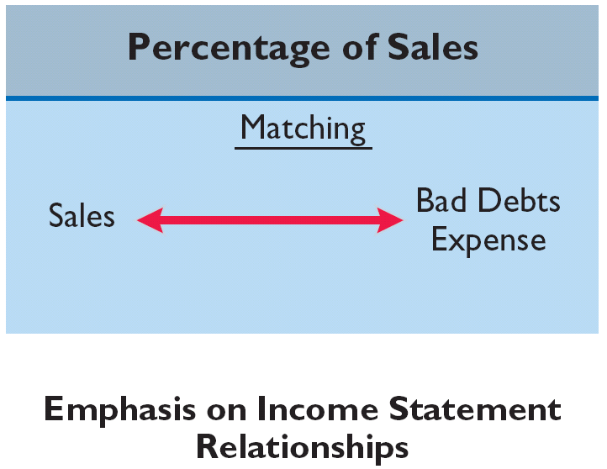
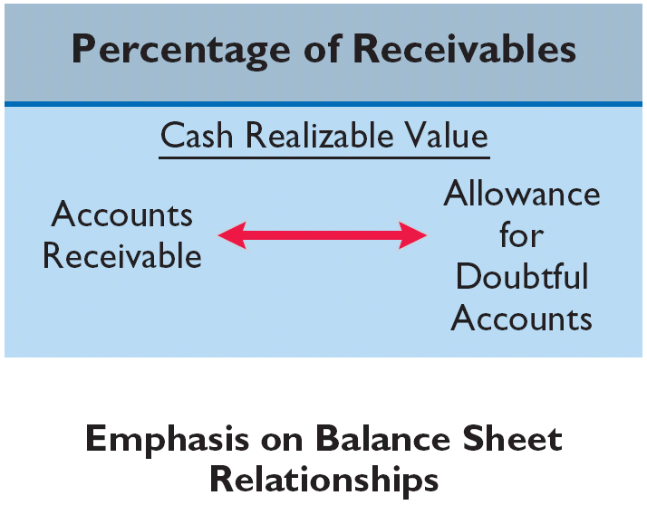
Allowance Method for Uncollectibles
ESTIMATING THE ALLOWANCE
Illustration 8-6
Comparison of bases for
estimating uncollectibles
Emphasis on Income Statement Relationships
Emphasis on Statement of Financial Position Relationships
LO 3

Slide 35
Allowance Method for Uncollectibles
ESTIMATING THE ALLOWANCE
Illustration 8-6
Management estimates what percentage of credit sales will be uncollectible. This percentage is based on past experience and anticipated credit policy.
Emphasis on Income Statement Relationships
LO 3

Slide 36
Allowance Method for Uncollectibles
Percentage-of-Sales
Illustration: Assume that Gonzalez SA elects to use the percentage-of-sales basis. It concludes that 1% of net credit sales will become uncollectible. If net credit sales for 2017 are €800,000, the adjusting entry is:
Dec. 31
Bad Debt Expense 8,000
*
Allowance for Doubtful Accounts 8,000
* €800,000 x 1%
LO 3

Slide 37
Allowance Method for Uncollectibles
Percentage-of-Sales
Emphasizes matching of expenses with revenues.
Adjusting entry to record bad debts disregards the existing balance in Allowance for Doubtful Accounts.
Illustration 8-7
Bad debt accounts after posting
LO 3

Slide 38
Allowance Method for Uncollectibles
ESTIMATING THE ALLOWANCE
Illustration 8-6
Management establishes a percentage relationship between the amount of receivables and expected losses from uncollectible accounts.
Emphasis on Statement of Financial Position Relationships
LO 3

Slide 39
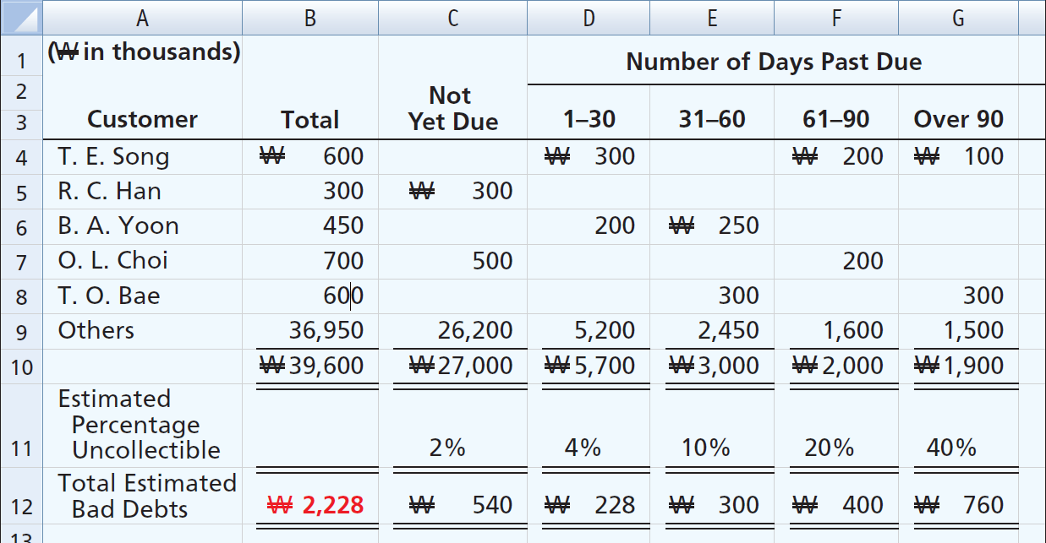
Allowance Method for Uncollectibles
Aging the accounts receivable - customer balances are classified by the length of time they have been unpaid.
Illustration 8-8
Aging schedule

Slide 40
Allowance Method for Uncollectibles
Percentage-of-Receivables
(₩ in thousands)
Illustration: Assume the unadjusted trial balance shows Allowance for Doubtful Accounts with a credit balance of ₩528. Prepare the adjusting entry assuming ₩2,228 is the estimate of uncollectible receivables from the aging schedule.
Dec. 31
Bad Debt Expense 1,700
Allowance for Doubtful Accounts 1,700
Illustration 8-9 Bad debt accounts after posting
LO 3

Slide 41
>
DO IT!
Brule Co. has been in business five years. The ledger at the end of the current year shows:
Accounts Receivable $30,000 Dr.
Sales Revenue $180,000 Cr.
Allowance for Doubtful Accounts $2,000 Dr.
Bad debts are estimated to be 10% of receivables. Prepare the entry to adjust Allowance for Doubtful Accounts.
Solution:
Bad Debt Expense 5,000
*
Allowance for Doubtful Accounts 5,000
* [(0.1 x $30,000) + $2,000]
LO 3

Slide 42
Allowance Method for Uncollectibles
Question
Which of the following approaches for bad debts is best described as a statement of financial position method?
Percentage-of-receivables basis.
Direct write-off method.
Percentage-of-sales basis.
Both percentage-of-receivables basis and direct write-off method.
LO 3

Slide 43
Disposing of Accounts Receivables
Learning Objective 4
Describe the entries to record the disposition of accounts receivable.
SALE OF RECEIVABLES
Finance company or bank.
Buys receivables from businesses and then collects the payments directly from the customers.
Typically charges a commission to the company that is selling the receivables.
Fee ranges from 1% to 3% of the receivables purchased.
LO 4

Slide 44
SALE OF RECEIVABLES
Illustration: Assume that Tsai Furniture factors NT$600,000 of receivables to Federal Factors. Federal Factors assesses a service charge of 2% of the amount of receivables sold. The journal entry to record the sale by Tsai Furniture is as follows.
(NT$600,000 x 2% = NT$12,000)
Cash 588,000
Service Charge Expense 12,000
Accounts Receivable 600,000
LO 4

Slide 45
Disposing of Accounts Receivables
CREDIT CARD SALES
Retailer pays card issuer a fee of 2 to 6% of the invoice price for its services.
Recorded the same as cash sales.
Advantages to retailer:
Issuer does credit investigation of customer.
Issuer maintains customer accounts.
Issuer undertakes collection and absorbs losses.
Receives cash more quickly.
LO 4

Slide 46
CREDIT CARD SALES
Illustration: Lee Co. purchases NT$6,000 of music downloads for its restaurant from Yang Music Co., using a Visa First Bank Card. First Bank charges a service fee of 3%. The entry to record this transaction by Yang Music is as follows.
Cash 5,820
Service Charge Expense 180
Sales Revenue 6,000
LO 4

Slide 47
ACCOUNTING ACROSS THE ORGANIZATION
How Does a Credit Card Work?
Suppose that you use a Visa card to purchase some new ties at PPR (FRA). The salesperson swipes your card, which allows the information on the magnetic strip on the back of the card to be read. The salesperson then enters in the amount of the purchase. The machine contacts the Visa computer, which routes the call back to the bank that issued your Visa card. The issuing bank verifies that the account exists, that the card is not stolen, and that you have not exceeded your credit limit. At this point, the slip is printed, which you sign. Visa acts as the clearing agent for the transaction. It transfers funds from the issuing bank to PPR’s bank account. Generally this transfer of funds, from sale to the receipt of funds in the merchant’s account, takes two to three days. In the meantime, Visa puts a pending charge on your account for the amount of the tie purchase; that amount counts immediately against your available credit limit. At the end of the billing period, Visa sends you an invoice (your credit card bill) which shows the various charges you made, and the amounts that Visa expended on your behalf, for the month. You then must “pay the piper” for your stylish new ties.
LO 4

Slide 48
>
DO IT!
Mehl Wholesalers NV needs to raise €120,000 in cash to safely cover next Friday’s employee payroll. Mehl has reached its debt ceiling. Mehl’s balance of outstanding receivables totals €750,000. Mehl decides to factor €125,000 of its receivables on September 7, 2017, to alleviate this cash crunch. Record the entry that Mehl would make when it raises the needed cash. (Assume a 1% service charge.)
Solution
Cash 123,750
Service Charge Expense 1,250
*
Accounts Receivable 125,000
* (1% x €125,000)
LO 4

Slide 49
Notes Receivable
Learning Objective 5
Compute the maturity date of and interest on notes receivable.
Companies may grant credit in exchange
for a promissory note. A promissory note
is a written promise to pay a specified amount of money on demand or at a definite time.
Promissory notes may be used
when individuals and companies lend or borrow money,
when amount of transaction and credit period exceed normal limits, or
in settlement of accounts receivable.
LO 5

Slide 50
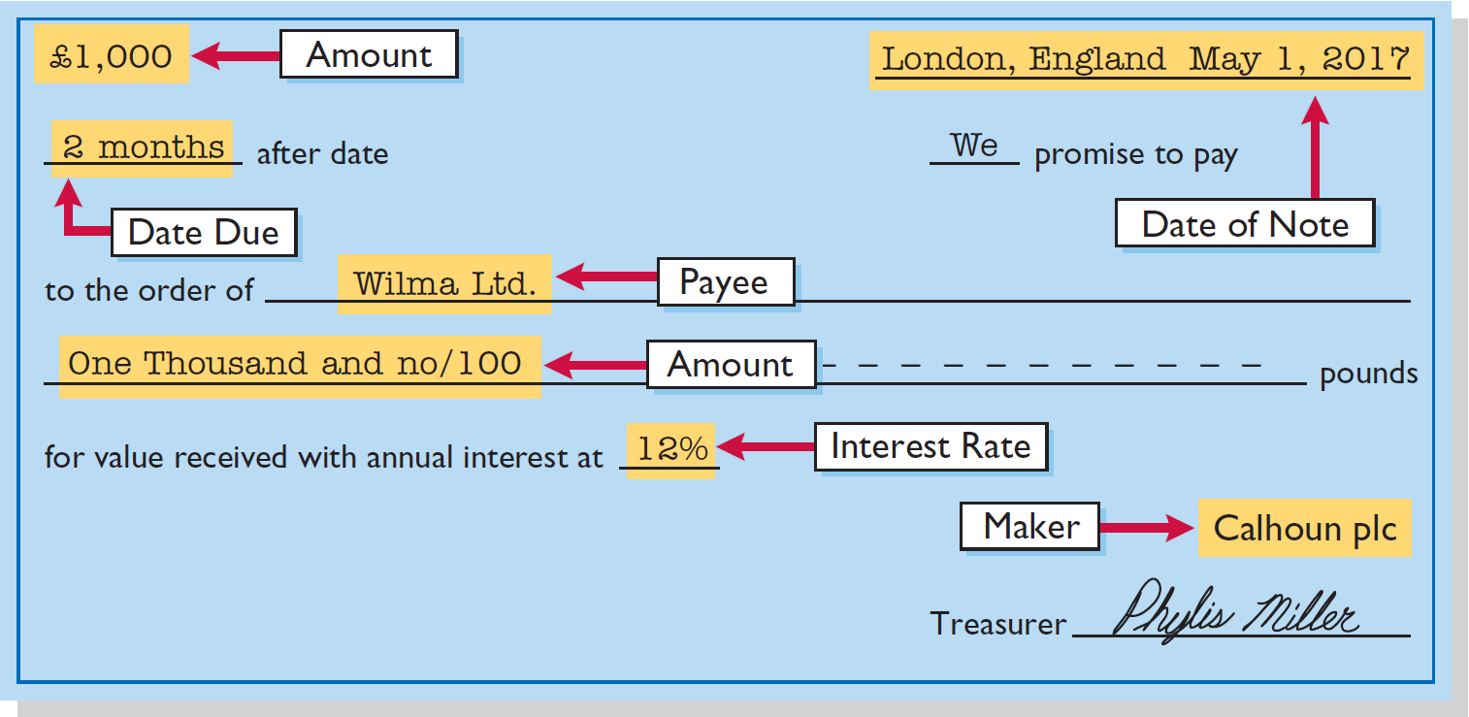
Notes Receivable
To the payee, the promissory note is a note receivable.
To the maker, the promissory note is a note payable.
Illustration 8-11
Promissory note
LO 5

Slide 51
Determining the Maturity Date
Maturity date of a promissory note may be stated in one of three ways:
On demand.
On a stated date.
At the end of a stated period of time.
Note terms are expressed in:
Months
Days
LO 5

Slide 52
Computing Interest
Illustration 8-14
Formula for computing interest
When counting days, omit the date the note is issued, but include the due date.
Illustration 8-15
Computation of interest
LO 5

Slide 53
Notes Receivable
Question
One of the following statements about promissory notes is incorrect. The incorrect statement is:
The party making the promise to pay is called the maker.
The party to whom payment is to be made is called the payee.
A promissory note is not a negotiable instrument.
A promissory note is often required from high-risk customers.
LO 5

Slide 54
Recognizing Notes Receivable
Learning Objective 6
Explain how companies recognize notes receivable.
Illustration: Calhoun Company wrote a ₤1,000,
two-month, 12% promissory note dated May 1,
to settle an open account. Prepare entry would
Wilma Company makes for the receipt of the note.
May 1
Notes Receivable 1,000
Accounts Receivable—Calhoun plc 1,000
LO 6

Slide 55
Valuing Notes Receivable
Learning Objective 7
Describe how companies value notes receivable.
Report short-term notes receivable at
their cash (net) realizable value.
Estimation of cash realizable value and recording bad debt expense and related allowance are similar to accounts receivable.
Allowance for Doubtful Accounts is used.
LO 7

Slide 56
Global Insight
Can Fair Value Be Unfair?
The IASB and the Financial Accounting Standards Board (FASB) are considering proposals for how to account for financial instruments. The FASB has proposed that loans and receivables be accounted for at their fair value (the amount they could currently be sold for), as are most investments. The FASB believes that this would provide a more accurate view of a company’s financial position. It might be especially useful as an early warning when a bank is in trouble because of poor-quality loans. But, banks argue that fair values are difficult to estimate accurately. They are also concerned that volatile fair values could cause large swings in a bank’s reported net income. As a result, the IASB issued a standard that instead accounts for loans at amortized cost.
Source: David Reilly, “Banks Face a Mark-to-Market Challenge,” Wall Street Journal Online (March 15, 2010).
LO 7

Slide 57
Disposing of Notes Receivable
Learning Objective 8
Describe the entries to record the disposition of notes receivable.
Notes may be held to their maturity date.
Maker may default and payee must make
an adjustment to the account.
Holder speeds up conversion to cash by selling the note receivable.
LO 8

Slide 58
Disposing of Notes Receivable
HONOR OF NOTES RECEIVABLE
A note is honored when its maker pays it in full at its maturity date.
DISHONOR OF NOTES RECEIVABLE
A dishonored note is not paid in full at maturity. Dishonored note receivable is no longer negotiable.
LO 8

Slide 59
HONOR OF NOTES RECEIVABLE
Illustration: Wolder Co. lends Higley Inc. €10,000 on June 1, accepting a five-month, 9% interest note. If Wolder presents the note to Higley Inc. on November 1, the maturity date, Wolder’s entry to record the collection is:
Nov. 1
Cash 10,375
Notes Receivable 10,000
Interest Revenue 375
(€10,000 x 9% x 5/12 = €375)
LO 8

Slide 60
ACCRUAL OF INTEREST RECEIVABLE
Illustration: Suppose instead that Wolder Co. prepares financial statements as of September 30. The adjusting entry by Wolder is for four months ending Sept. 30.
Illustration 8-16
Timeline of interest earned
Sept. 30
Interest Receivable 300
Interest Revenue 300
(€10,000 x 9% x 4/12 = € 300)
LO 8

Slide 61
ACCRUAL OF INTEREST RECEIVABLE
Illustration: Prepare the entry Wolder’s would make to record the honoring of the Higley note on November 1.
Nov. 1
Cash 10,375
Notes Receivable 10,000
Interest Receivable 300
Interest Revenue (€10,000 × 9% × 1/12) 75
LO 8

Slide 62
DISHONOR OF NOTES RECEIVABLE
Illustration: Assume that Higley Co. on November 1 indicates that it cannot pay at the present time. If Wolder Co. does expect eventual collection, it would make the following entry at the time the note is dishonored (assuming no previous accrual of interest).
Nov. 1
Accounts Receivable 10,375
Notes Receivable 10,000
Interest Revenue 375
LO 8

Slide 63
ACCOUNTING ACROSS THE ORGANIZATION
Filling a Lending Void
After the global financial crisis, many banks were slow to extend business loans. Companies that needed financing were forced to look to alternative sources. For example, those with significant receivables were sometimes able to use those as a mechanism to get funding. One company, Trafalgar Capital Advisors (GBR), has an investment fund that extends financing supported by receivables, especially on long-term contracts. Examples have included, “suppliers with a large order from a large supermarket chain such as Walmart or Carrefour, which may account for 30 percent of their annual revenue, companies supplying systems to Thomson Reuters on ‘non-cancellable’ contracts, contractors selling to the UK’s Ministry of Defence (‘they never get paid on time’), and an organiser of international golf tournaments with long-term contracts but lumpy revenue streams.” The company does not like to lend on “intangible” collateral, such as that of biotech or software companies.
Source: Steve Johnson, “Few Fund Managers Filling Bank Lending Void,” Financial Times Online (FT.com) (January 9, 2011).
LO 8

Slide 64
>
DO IT!
Gambit Stores accepts from Leonard SpA a €3,400, 90-day, 6% note dated May 10 in settlement of Leonard’s overdue open account. The note matures on August 8. What entry does Gambit make at the maturity date, assuming Leonard pays the note and interest in full at that time?
Solution
Interest payable at maturity date = €3,400 × 6% × 90/360 = €51
Cash 3,451
Notes Receivable 3,400
Interest Revenue 51
LO 8

Slide 65
Statement Presentation and Analysis
Learning Objective 9
Explain the statement presentation and analysis of receivables.
Presentation
Identify in the statement of financial
position or in the notes each major type of receivable.
Report short-term receivables as current assets.
Report both gross amount of receivables and allowance for doubtful account.
Report bad debt expense and service charge expense as selling expenses.
Report interest revenue under “Other income and expense.”
SFP
IS
LO 9

Slide 66
Statement Presentation and Analysis
Analysis
Illustration: In a recent year Lenovo Group (CHN) (which reported in U.S. dollars) had net sales of $38,707 million for the year. It had a beginning accounts receivable (net) balance of $2,885 million and an ending accounts receivable (net) balance of $3,171 million. Assuming that Lenovo’s sales were all on credit, its accounts receivable turnover is computed as follows.
$2,885 + $3,171
$38,707
÷
=
12.8 times
2
Illustration 8-17
Accounts receivable turnover and computation
LO 9

Slide 67
Statement Presentation and Analysis
Analysis
Illustration: Variant of the accounts receivable turnover ratio is average collection period in terms of days.
Illustration 8-17
$2,885 + $3,171
$38,707
÷
=
12.8 times
2
Illustration 8-18
365 days
÷
12.8 times
=
28.5 days
LO 9

Slide 68
>
DO IT!
In 2017, Rafael Nadal SA had net credit sales of €923,795 for the year. It had a beginning accounts receivable (net) balance of €38,275 and an ending accounts receivable (net) balance of €35,988. Compute Rafael Nadal SA’s accounts receivable turnover and average collection period in days.
LO 9

Slide 69
Statement Presentation and Analysis
Question
Accounts and notes receivable are reported in the current assets section of the statement of financial position at:
cash (net) realizable value.
net book value.
lower-of-cost-or-net realizable value.
invoice cost.
LO 9

Slide 70
A Look at U.S. GAAP
Learning Objective 10
Compare the accounting for receivables under IFRS and U.S. GAAP.
Key Points
Similarities
GAAP and IFRS account for bad debts in a similar fashion. Both account for short-term receivables at amortized cost, adjusted for allowances for doubtful accounts.
Differences
IFRS and GAAP differ in the criteria used to derecognize (generally through a sale or factoring) a receivable. IFRS uses a combination approach focused on risks and rewards and loss of control. GAAP uses loss of control as the primary criterion. In addition, IFRS permits partial derecognition; GAAP does not.
IFRS specifies a two-step process for determining the impairment of receivables for a period. This process starts by identifying individual impairments of specific receivables and then estimating impairments of groups of receivables. GAAP does not specify a similar approach.
LO 10

Slide 71
A Look at U.S. GAAP
Looking to the Future
It appears likely that the question of recording fair values for financial instruments will continue to be an important issue to resolve as the Boards work toward convergence. Both the IASB and the FASB have indicated that they believe that financial statements would be more transparent and understandable if companies recorded and reported all financial instruments at fair value. That said, in IFRS 9, which was issued in 2009, the IASB created a split model, where some financial instruments are recorded at fair value, but other financial assets, such as loans and receivables, can be accounted for at amortized cost if certain criteria are met. Critics say that this can result in two companies with identical securities accounting for those securities in different ways. A proposal by the FASB would require that practically all equity instruments be reported at fair value and that debt instruments may or may not be reported at fair value, depending on whether certain criteria are met. It has been suggested that IFRS 9 will likely be changed or replaced as the FASB and IASB continue to deliberate the best treatment for financial instruments.
LO 10

Slide 72
A Look at U.S. GAAP
A Look at IFRS
GAAP Self-Test Questions
Under GAAP, receivables are reported on the balance sheet at:
amortized cost.
amortized cost less allowance for doubtful accounts.
historical cost.
replacement cost.
LO 10

Slide 73
A Look at U.S. GAAP
A Look at IFRS
GAAP Self-Test Questions
Which of the following statements is false?
Receivables include equity securities purchased by the company.
Receivables include credit card receivables.
Receivables include amounts owed by employees as a result of company loans to employees.
Receivables include amounts resulting from transactions with customers.
LO 10

Slide 74
A Look at U.S. GAAP
A Look at IFRS
GAAP Self-Test Questions
In recording a factoring transaction:
IFRS focuses on loss of control.
GAAP focuses on loss of control and risks and rewards.
IFRS and GAAP allow partial derecognition.
IFRS allows partial derecognition.
LO 10

Slide 75
Copyright
“Copyright © 2016 John Wiley & Sons, Inc. All rights reserved. Reproduction or translation of this work beyond that permitted in Section 117 of the 1976 United States Copyright Act without the express written permission of the copyright owner is unlawful. Request for further information should be addressed to the Permissions Department, John Wiley & Sons, Inc. The purchaser may make back-up copies for his/her own use only and not for distribution or resale. The Publisher assumes no responsibility for errors, omissions, or damages, caused by the use of these programs or from the use of the information contained herein.”

