Slide 1



WILEY
IFRS EDITION
Prepared by
Coby Harmon
University of California, Santa Barbara
Westmont College

Slide 2
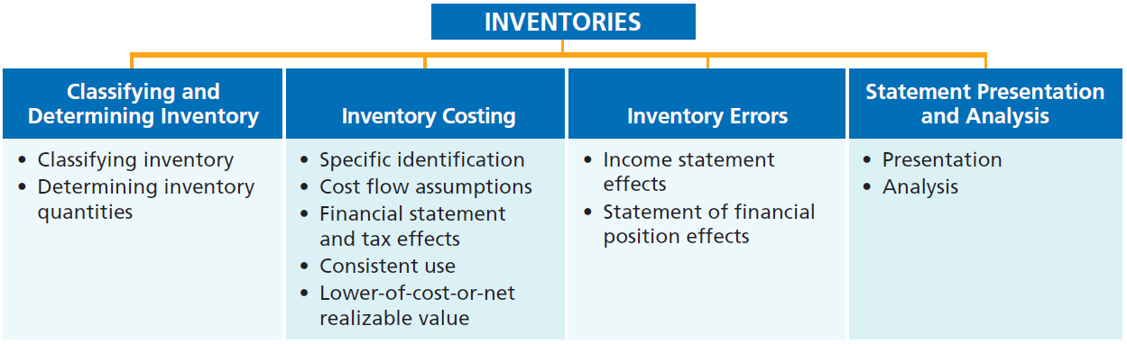
PREVIEW OF CHAPTER 6
Financial Accounting
IFRS 3rd Edition
Weygandt ● Kimmel ● Kieso

Slide 3
CHAPTER
6
Inventories
LEARNING OBJECTIVES
After studying this chapter, you should be able to:
Discuss how to classify and determine inventory.
Explain the accounting for inventories and apply the inventory cost flow methods.
Explain the financial effects of the inventory cost flow assumptions.
Explain the lower-of-cost-or-net realizable value basis of accounting for inventories.
Indicate the effects of inventory errors on the financial statements.
Discuss the presentation and analysis of inventory.

Slide 4
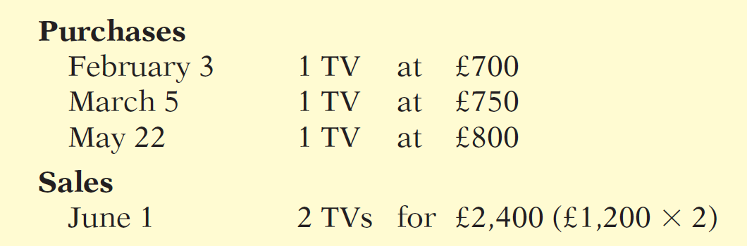
Inventory Costing
Illustration: Crivitz TV Company purchases three identical 50-inch TVs on different dates at costs of £700, £750, and £800. During the year Crivitz sold two sets at £1,200 each. These facts are summarized below.
Illustration 6-3
Data for inventory costing example
LO 2

Slide 5
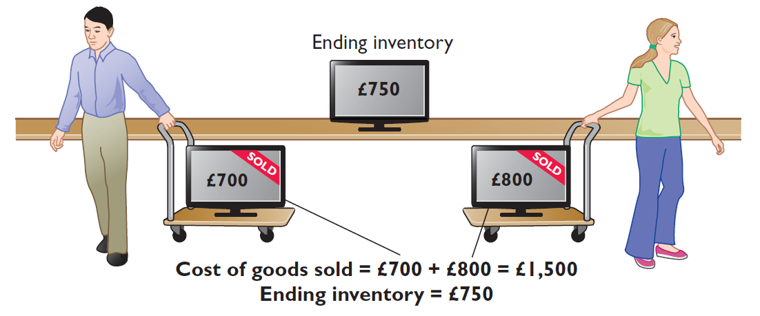
Specific Identification
If Crivitz sold the TVs it purchased on February 3 and May 22, then its cost of goods sold is £1,500 (£700 + £800), and its ending inventory is £750.
Illustration 6-4
Specific identification method
LO 2

Slide 6
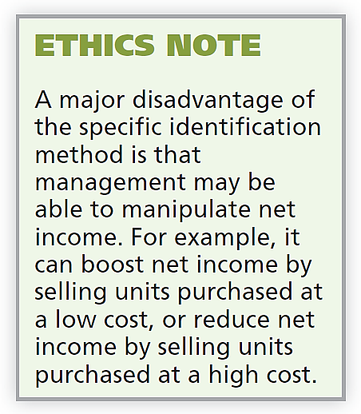
Specific Identification
Actual physical flow costing method in which items still in inventory are specifically costed to arrive at the total cost of the ending inventory.
  Practice is relatively rare.
  Most companies make assumptions (cost flow assumptions) about which units were sold.
LO 2

Slide 7
Cost Flow Assumptions
There are two assumed cost flow methods:
  First-in, first-out (FIFO)
  Average-cost
Cost flow does not need be consistent with the physical movement of the goods.
LO 2

Slide 8
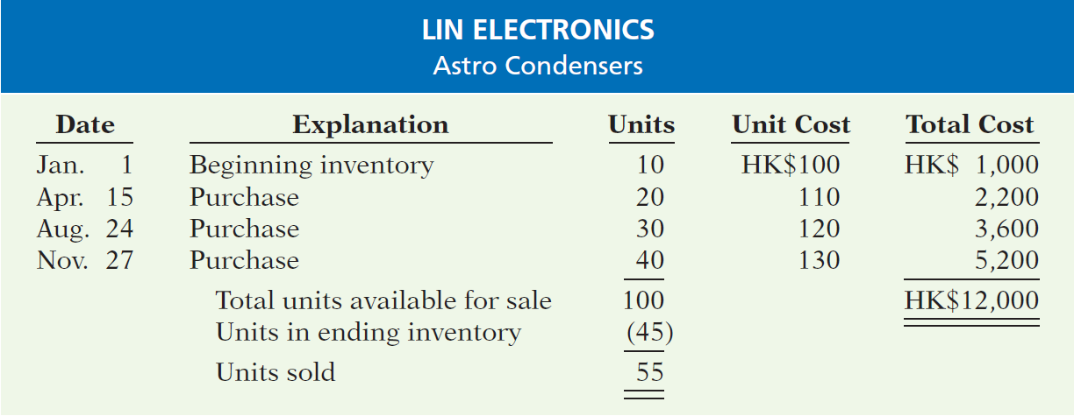
Cost Flow Assumptions
Data for Lin Electronics’ Astro condensers.
Illustration 6-5
(Beginning Inventory + Purchases) - Ending Inventory = Cost of Goods Sold
LO 2

Slide 9
Cost Flow Assumptions
FIRST-IN, FIRST-OUT (FIFO)
  Costs of the earliest goods purchased are the first to be recognized in determining cost of goods sold.
  Often parallels actual physical flow of merchandise.
  Companies obtain the cost of the ending inventory by taking the unit cost of the most recent purchase and working backward until all units of inventory have been costed.
LO 2

Slide 10
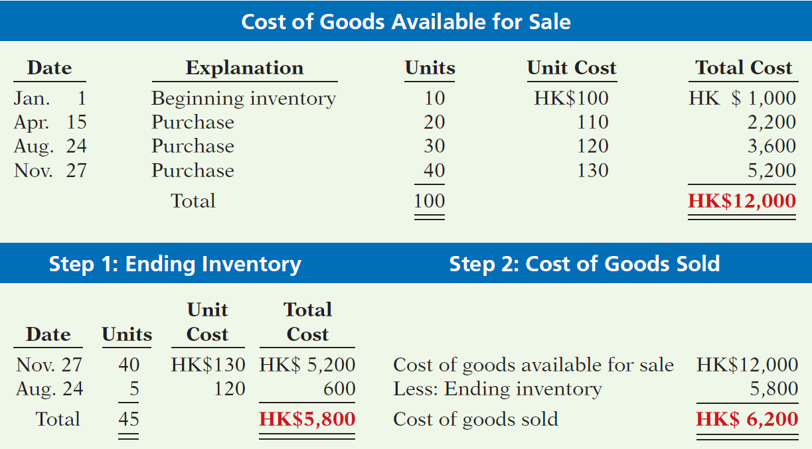
FIRST-IN, FIRST-OUT (FIFO)
Illustration 6-6
Allocation of costs—FIFO method
LO 2

Slide 11
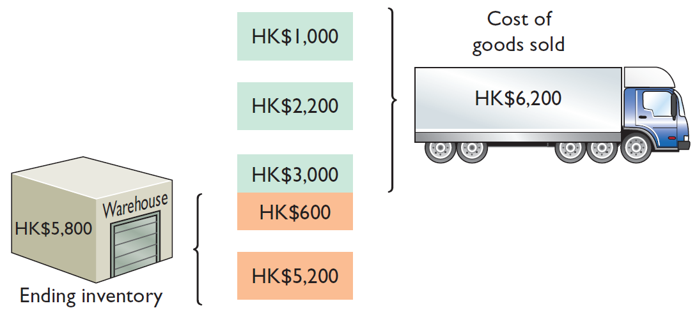
FIRST-IN, FIRST-OUT (FIFO)
• HELPFUL HINT
Another way of thinking about the calculation of FIFO ending inventory is the LISH assumption—last in still here.
Illustration 6-6
Allocation of costs—FIFO method
LO 2

Slide 12
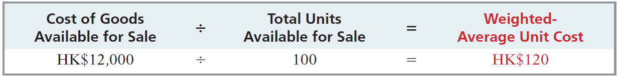
Cost Flow Assumptions
AVERAGE-COST
  Allocates cost of goods available for sale on the basis of weighted-average unit cost incurred.
  Applies weighted-average unit cost to the units on hand to determine cost of the ending inventory.
Illustration 6-8
Formula for weighted-average unit cost
LO 2

Slide 13
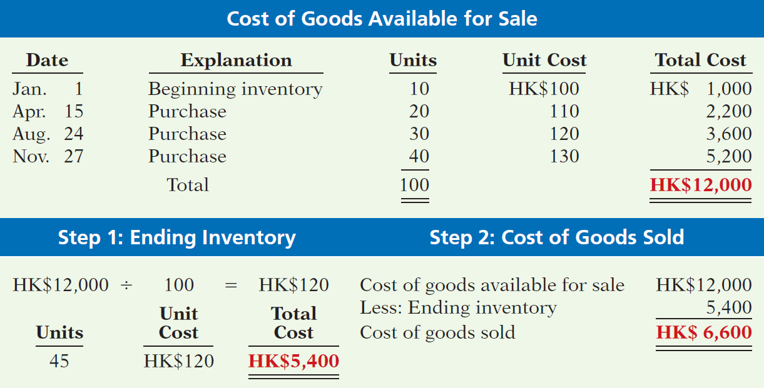
AVERAGE-COST
Illustration 6-9
Allocation of costs—average-cost method
LO 2

Slide 14
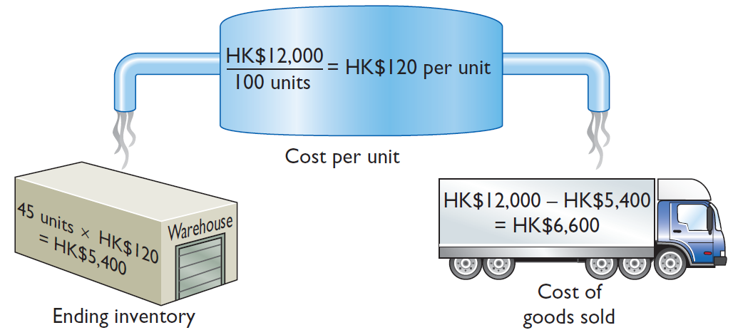
AVERAGE-COST
Illustration 6-11
Illustration 6-9
Allocation of costs—average-cost method
LO 2

Slide 15
>
DO IT!
The accounting records of Shumway Ag Implement show the following.
Beginning inventory 4,000 units at £ 3
Purchases 6,000 units at £ 4
Sales 7,000 units at £12
Determine the cost of goods sold during the period under a periodic inventory system using (a) the FIFO method and (b) the average-cost method.
Solution
Cost of goods available for sale = (4,000 × £3) + (6,000 × £4) = £36,000
Ending inventory = 10,000 − 7,000 = 3,000 units
(a) FIFO: £36,000 − (3,000 × £4) = £24,000
(b) Average cost per unit: [(4,000 × £3) + (6,000 × £4)] ÷ 10,000 = £3.60 Average-cost: £36,000 − (3,000 × £3.60) = £25,200
LO 2

Slide 16
Financial Statement and Tax Effects of Cost Flow Methods
Learning Objective 3
Explain the financial effects of the inventory cost flow assumptions.
  Either of the two cost flow assumptions
  is acceptable for use. For example,
  adidas (DEU) and Lenovo (CHN) use the average-cost method, whereas
  Syngenta Group (CHE) and Nokia (FIN) use FIFO.
  A recent survey of IFRS companies, approximately
  60% use the average-cost method,
  40% use FIFO, and
  23% use both for different parts of their inventory.
LO 3

Slide 17
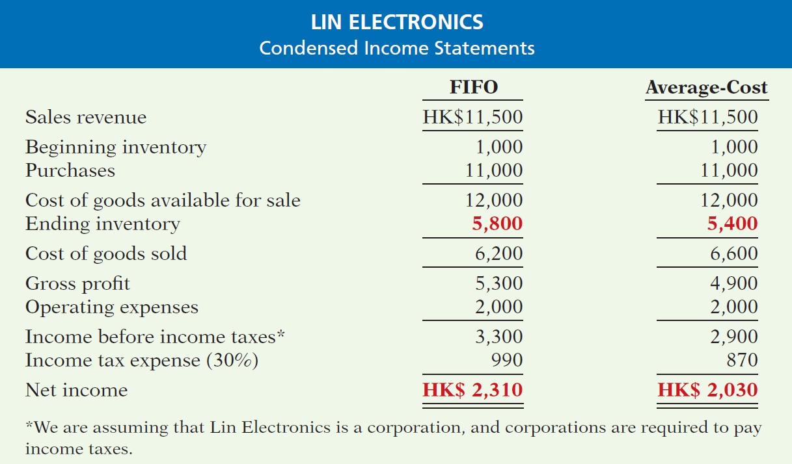

INCOME STATEMENT EFFECTS
Illustration 6-10
Comparative effects of cost flow methods
LO 3

Slide 18
STATEMENT OF FINANCIAL POSITION EFFECTS
  A major advantage of the FIFO method is that in a period of inflation, the costs allocated to ending inventory will approximate their current cost.
  A major shortcoming of the average-cost method is that in a period of inflation, the costs allocated to ending inventory may be understated in terms of current cost.
LO 3

Slide 19
TAX EFFECTS
  Both inventory and net income are higher when companies use FIFO in a period of inflation.
  Average-cost results in the lower income taxes (because of lower net income) during times of rising prices.
LO 3

Slide 20
Using Cost Flow Methods Consistently
  Method should be used consistently, enhances comparability.
  Although consistency is preferred, a company may change its inventory costing method.
LO 3

Slide 21
Cost Flow Assumptions
Question
In periods of rising prices, average-cost will produce:
  higher net income than FIFO.
  the same net income as FIFO.
  lower net income than FIFO.
  net income equal to the specific identification method.
LO 3
Notes:
Answer = A

Slide 22
Cost Flow Assumptions
Question
Factors that affect the selection of an inventory costing method do not include:
  tax effects.
  statement of financial position effects.
  income statement effects.
  perpetual vs. periodic inventory system.
LO 3
Notes:
Answer = B

Slide 23
GLOBAL INSIGHT
Is LIFO Fair?
ExxonMobil Corporation (USA), like many U.S. companies, uses a cost flow assumption called last-in, first-out (LIFO) to value its inventory for financial reporting and tax purposes. In one recent year, this resulted in a cost of goods sold figure that was $5.6 billion higher than under FIFO. By increasing cost of goods sold, ExxonMobil reduces net income, which reduces taxes. Critics say that LIFO provides an unfair “tax dodge.” As the U.S. Congress looks for more sources of tax revenue, some lawmakers favor the elimination of LIFO. Supporters of LIFO argue that the method is conceptually sound because it matches current costs with current revenues. In addition, they point out that this matching provides protection against inflation. International accounting standards do not allow the use of LIFO. As a result, the net income of foreign oil companies, such as BP (GBR) and Royal Dutch Shell (GBR and NLD), are not directly comparable to U.S. companies, which makes analysis difficult.
Source: David Reilly, “Big Oil’s Accounting Methods Fuel Criticism,” Wall Street Journal (August 8, 2006), p. C1.
LO 3

Slide 24
Lower-of-Cost-or-Net Realizable Value
Learning Objective 4
Explain the lower-of-cost-or-net realizable value
basis of accounting for
inventories.
When the value of inventory is lower
than its cost
  companies must “write down” the inventory to its net realizable value.
  Net realizable value: Amount that a company expects to realize (receive from the sale of inventory).
LO 4

Slide 25
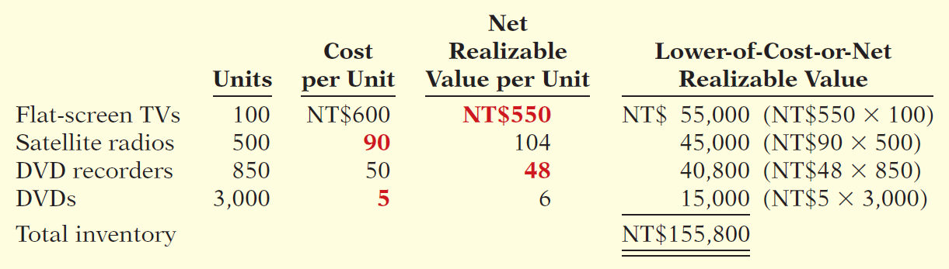
Lower-of-Cost-or-Net Realizable Value
Illustration: Assume that Gao TV has the following lines of merchandise with costs and market values as indicated.
Illustration 6-11
Computation of lower-of-cost-or-net realizable value
LO 4

Slide 26
Inventory Errors
Learning Objective 5
Indicate the effects of inventory errors on the financial statements.
Common Causes:
  Failure to count or price inventory correctly.
  Not properly recognizing the transfer of legal title to goods in transit.
  Errors affect both the income statement and statement of financial position.
LO 5

Slide 27
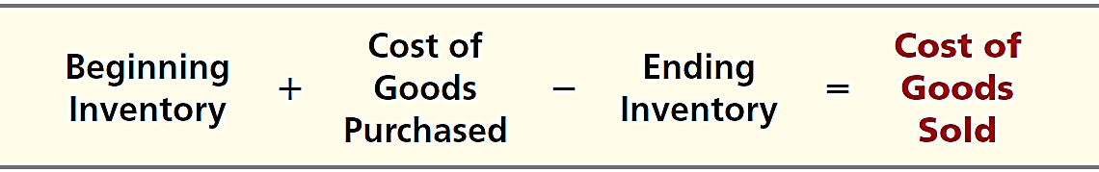
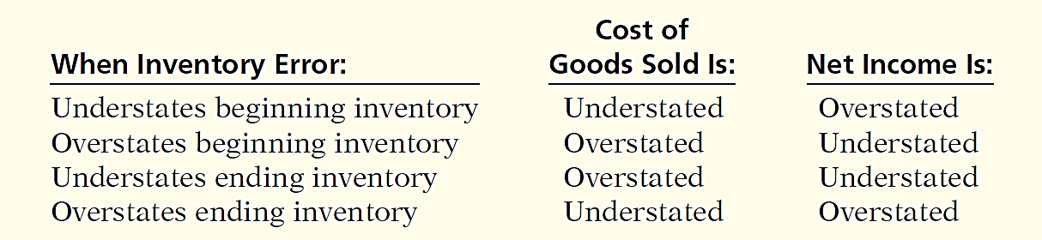
Income Statement Effects
Inventory errors affect the computation of cost of goods sold and net income in two periods.
Illustration 6-12
Formula for cost of goods sold
Illustration 6-13
Effects of inventory errors on current year’s income statement
LO 5

Slide 28
Income Statement Effects
Inventory errors affect the computation of cost of goods sold and net income in two periods.
  An error in ending inventory of the current period will have a reverse effect on net income of the next accounting period.
  Over the two years, the total net income is correct because the errors offset each other.
  Ending inventory depends entirely on the accuracy of taking and costing the inventory.
LO 5

Slide 29
Income Statement Effects
Illustration 6-14
Effects of inventory errors on two years’ income statements
Combined income for
2-year period is correct.
(€3,000)
Net income understated
€3,000
Net income overstated
LO 5

Slide 30
Income Statement Effects
Question
Atlantis Company’s ending inventory is understated NT$122,000. The effects of this error on the current year’s cost of goods sold and net income, respectively, are:
  understated, overstated.
  overstated, understated.
  overstated, overstated.
  understated, understated.
LO 5

Slide 31
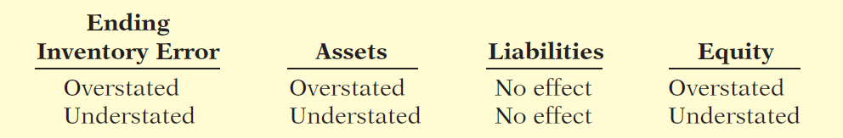
Statement of Financial Position Effects
Effect of inventory errors on the statement of financial position is determined by using the basic accounting equation: Assets = Liabilities + Equity.
Errors in the ending inventory have the following effects.
Illustration 6-15
Effects of ending inventory errors on statement of financial position
LO 5

Slide 32
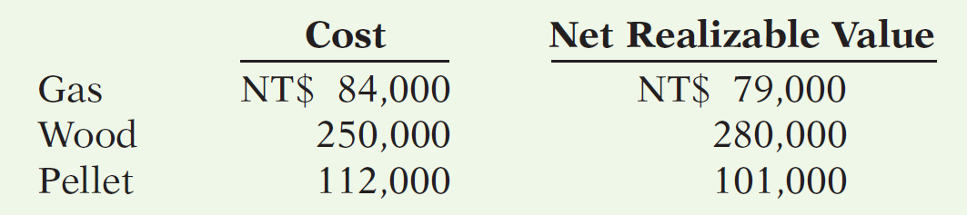
>
DO IT!
LCNRV Basis; Inventory Errors
(a) Tracy Company sells three different types of home heating stoves (wood, gas, and pellet). The cost and net realizable value of its inventory of stoves are as follows.
Determine the value of the company’s inventory under the lower-of-cost-or-net realizable value approach.
Total inventory value is the sum of these amounts, NT$430,000.
LO 5

Slide 33
>
DO IT!
LCNRV Basis; Inventory Errors
Visual Company overstated its 2016 ending inventory by NT$22,000. Determine the impact this error has on ending inventory, cost of goods sold, and equity in 2016 and 2017.
2016
2017
Ending inventory NT$22,000 overstated No effect
Cost of goods sold NT$22,000 understated NT$22,000 overstated
Equity NT$22,000 overstated No effect
Ending inventory
Cost of goods sold
Equity
LO 5

Slide 34
Statement Presentation and Analysis
Learning Objective 6
Discuss the presentation and analysis of inventory.
Presentation
Statement of Financial Position - Inventory classified as current asset.
Income Statement - Cost of goods sold is subtracted from sales.
There also should be disclosure of the
  major inventory classifications,
  basis of accounting (cost or LCNRV), and
  costing method (specific identification, FIFO, or average-cost).
LO 6

Slide 35
Statement Presentation and Analysis
Analysis
Inventory management is a double-edged sword
  High Inventory Levels - may incur high carrying costs (e.g., investment, storage, insurance, obsolescence, and damage).
  Low Inventory Levels – may lead to stock-outs and lost sales.
LO 6

Slide 36
Analysis
Inventory turnover measures the number of times on average the inventory is sold during the period.
Cost of Goods Sold
Inventory Turnover
=
Average Inventory
Days in inventory measures the average number of days inventory is held.
Days in Year (365)
Days in Inventory
=
Inventory Turnover
LO 6

Slide 37
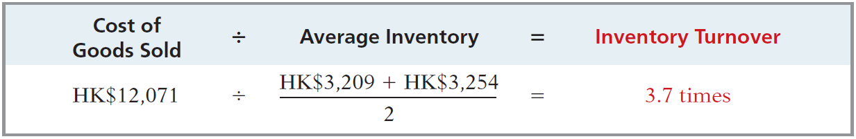
Analysis
Illustration: Esprit Holdings (HKG) reported in a recent annual report a beginning inventory of HK$3,209 million, an ending inventory of HK$3,254 million, and cost of goods sold for the year ended of HK$12,071 million. The inventory turnover formula and computation for Esprit Holdings are shown below.
Illustration 6-17
Inventory turnover formula and computation for Esprit Holdings (in millions)
Days in Inventory: Inventory turnover of 3.7 times divided into 365 is approximately 99 days. This is the approximate time that it takes a company to sell the inventory.
LO 6

Slide 38
ACCOUNTING ACROSS THE ORGANIZATION
Improving Inventory Control with RFID
Many large retailers have improved their inventory control with the introduction of radio frequency identification (RFID). Much like bar codes, which tell a retailer the number of boxes of a specific product it has, RFID goes an additional step, helping to distinguish one box of a specific product from another. RFID uses technology similar to that used by keyless remotes that unlock car doors. Companies currently use RFID to track shipments from supplier to distribution center to store. Other potential uses include monitoring product expiration dates and acting quickly on product recalls. Many companies also anticipate faster returns and warranty processing using RFID. This technology will further assist managers in their efforts to ensure that their store has just the right type of inventory, in just the right amount, in just the right place.
LO 6

Slide 39
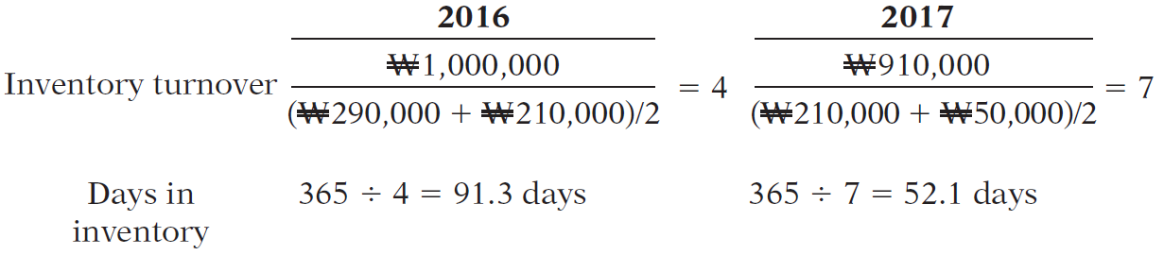
>
DO IT!
Early in 2017, Seoul Company switched to a just-in-time inventory system. Its sales, cost of goods sold, and inventory amounts for 2016 and 2017 are shown below.
2016 2017
Sales revenue ₩2,000,000 ₩1,800,000
Cost of goods sold 1,000,000 910,000
Beginning inventory 290,000 210,000
Ending inventory 210,000 50,000
Determine the inventory turnover and days in inventory for 2016 and 2017.
2016
2017
LO 6

Slide 40
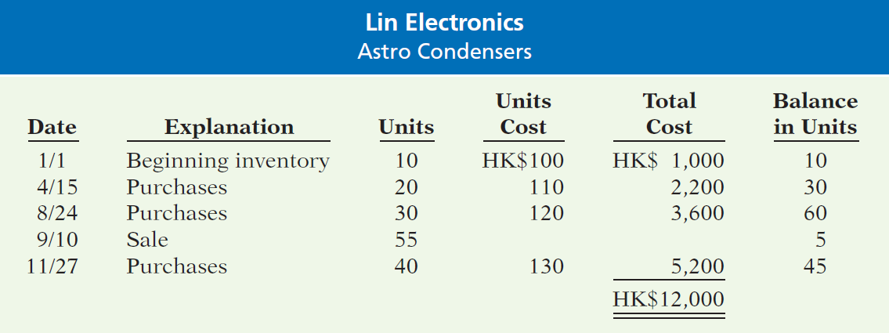
APPENDIX 6A
Perpetual Inventory System
Learning Objective 7
Apply the inventory cost
flow methods to perpetual
inventory records.
Illustration 6A-1
Inventoriable units and costs
Assuming the Perpetual Inventory System, compute Cost of Goods Sold and Ending Inventory under FIFO and average-cost.
LO 7

Slide 41
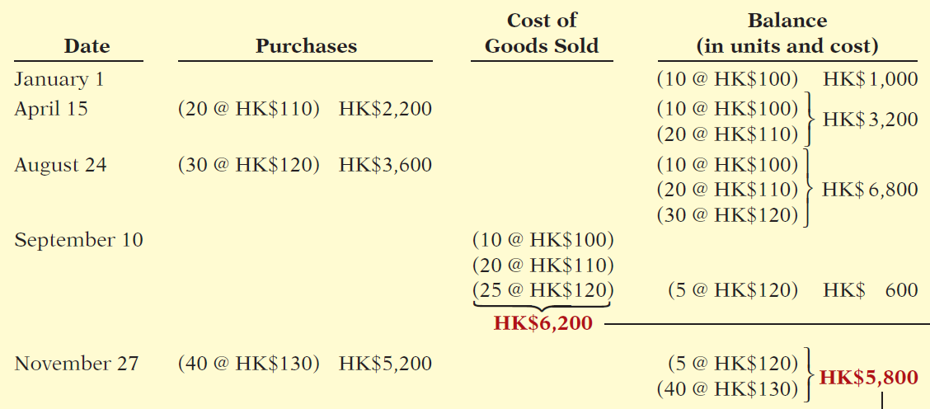
First-In-First-Out (FIFO)
Illustration 6A-2
Perpetual system—FIFO
Cost of Goods Sold
Ending Inventory
LO 7

Slide 42
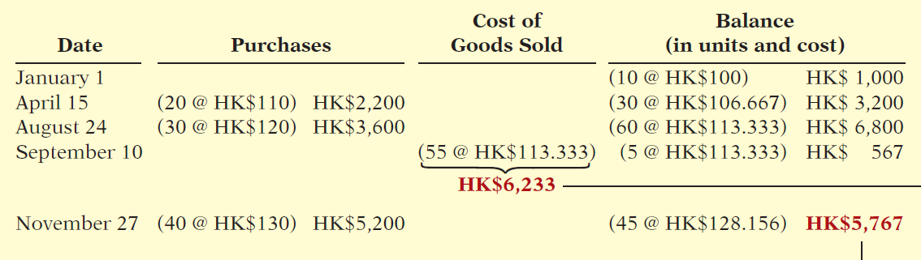
Average-Cost
Illustration 6A-3
Perpetual system—
average-cost method
Cost of Goods Sold
Ending Inventory
LO 7

Slide 43
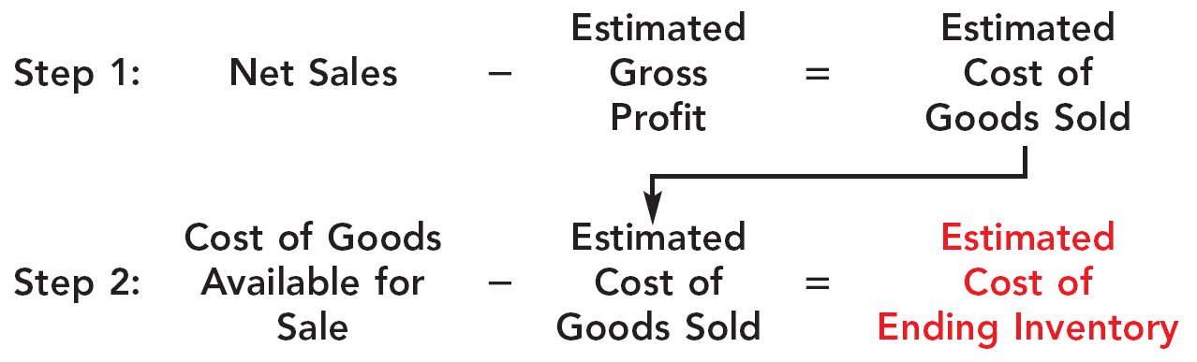
APPENDIX 6B
Estimating Inventories
Learning Objective 8
Describe the two methods of estimating inventories.
Gross Profit Method
Estimates the cost of ending inventory by applying a gross profit rate to net sales.
Illustration 6B-1
Gross profit method formulas
LO 8

Slide 44
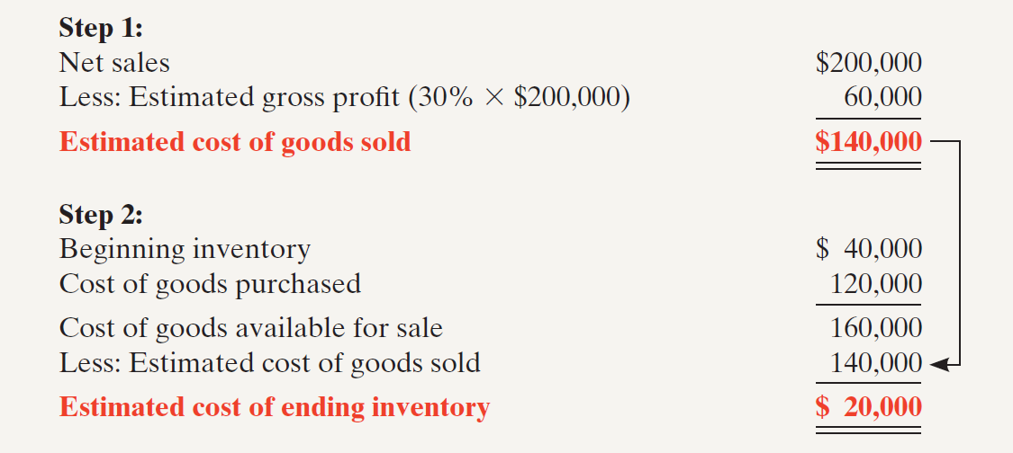
Gross Profit Method
Illustration: Kishwaukee Company’s records for January show net sales of $200,000, beginning inventory $40,000, and cost of goods purchased $120,000. The company expects to earn a 30% gross profit rate. Compute the estimated cost of the ending inventory at January 31 under the gross profit method.
Illustration 6B-2
Example of gross profit method

Slide 45
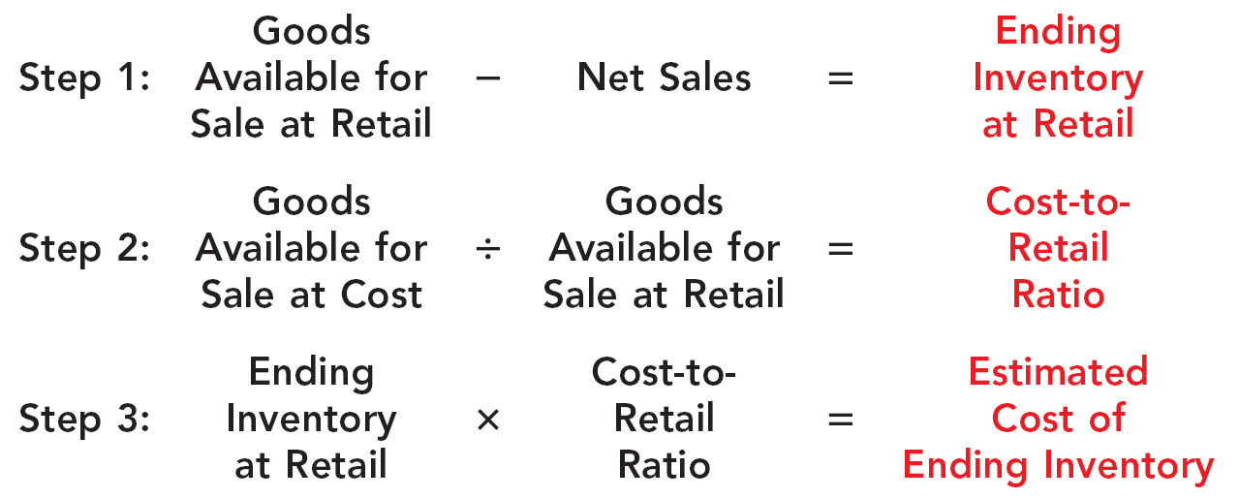
Retail Inventory Method
Company applies the cost-to-retail percentage to ending inventory at retail prices to determine inventory at cost.
Illustration 6B-3
Retail inventory method formulas
LO 8

Slide 46
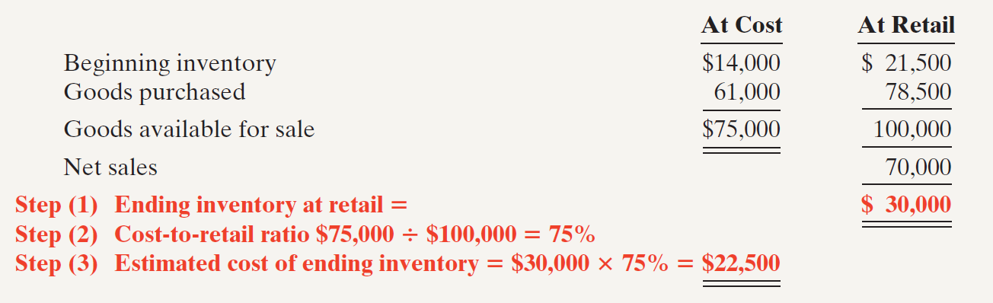
Retail Inventory Method
Illustration:
Illustration 6B-4
Application of retail inventory method
Note that it is not necessary to take a physical inventory to estimate the cost of goods on hand at any given time.
LO 8

Slide 47
APPENDIX 6C
LIFO Inventory Method
Learning Objective 9
Apply the LIFO inventory costing method.
Last-In-First-Out (LIFO)
  Under IFRS, LIFO is not permitted for financial reporting purposes.
  Assumes latest goods purchased are first to be sold.
  Seldom coincides with actual physical flow of merchandise, except for goods stored in piles, such as coal or hay.
LO 9

Slide 48
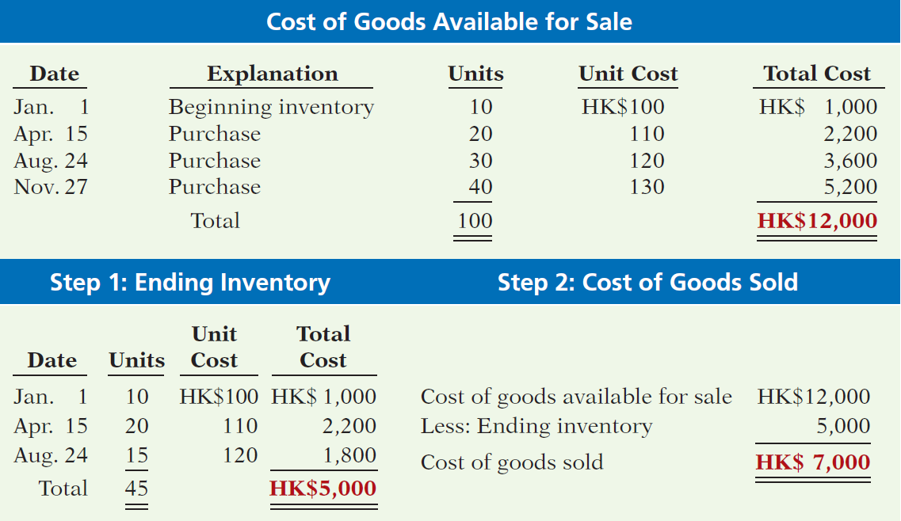
Last-In-First-Out (LIFO)
Illustration 6C-1
Allocation of costs—LIFO method
LO 9

Slide 49
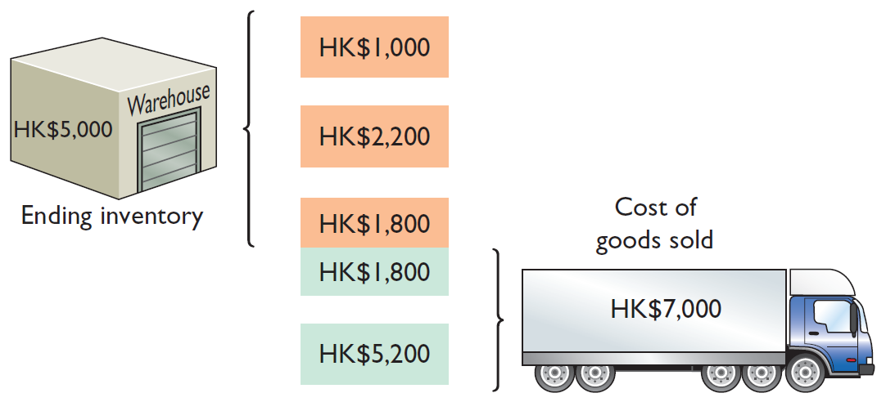
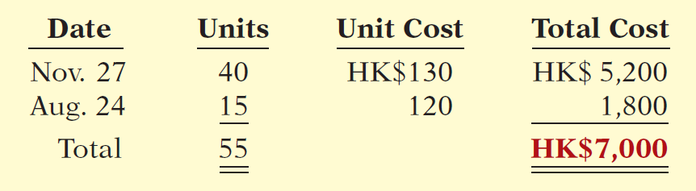
Last-In-First-Out (LIFO)
Illustration 6C-1
Allocation of costs—LIFO method
Illustration 6C-2
Proof of COGS
LO 9

Slide 50
A Look at U.S. GAAP
Learning Objective 10
Compare the accounting for inventories under IFRS and U.S. GAAP.
Key Points
The requirements for accounting for and reporting inventories are more principles-based under IFRS. That is, GAAP provides more detailed guidelines in inventory accounting.
IFRS requires companies to use the same cost flow assumption for all goods of a similar nature. GAAP has no specific requirement in this area.
Similarities
  The definitions for inventory are essentially similar under GAAP and IFRS. Both define inventory as assets held-for-sale in the ordinary course of business, in the process of production for sale (work in process), or to be consumed in the production of goods or services (e.g., raw materials).
  Who owns the goods—goods in transit or consigned goods—as well as the costs to include in inventory, are accounted for the same under GAAP and IFRS.
LO 10

Slide 51
A Look at U.S. GAAP
Key Points
Differences
Both GAAP and IFRS permit specific identification where appropriate. IFRS actually requires that the specific identification method be used where the inventory items are not interchangeable (i.e., can be specifically identified). If the inventory items are not specifically identifiable, a cost flow assumption is used. GAAP does not specify situations in which specific identification must be used.
A major difference between IFRS and GAAP relates to the LIFO cost flow assumption. GAAP permits the use of LIFO for inventory valuation. IFRS prohibits its use. FIFO and average-cost are the only two acceptable cost flow assumptions permitted under IFRS.
LO 10

Slide 52
A Look at U.S. GAAP
Key Points
Differences
  When testing to see if the value of inventory has fallen below its cost, IFRS defines market as net realizable value. Net realizable value is the estimated selling price in the ordinary course of business, less the estimated costs to complete and sell. In other words, net realizable value is the best estimate of the net amounts that inventories are expected to realize. GAAP, on the other hand, defines market as essentially replacement cost. The GAAP method of inventory valuation is often referred to as the lower-of-cost-or-market (LCM).
LO 10

Slide 53
A Look at U.S. GAAP
Key Points
Differences
  Under GAAP, if inventory is written down under the lower-of-cost-or-market valuation, the new basis is now considered its cost. As a result, the inventory may not be written back up to its original cost in a subsequent period. Under IFRS, the write-down may be reversed in a subsequent period up to the amount of the previous write-down. Both the write-down and any subsequent reversal should be reported on the income statement.
  IFRS generally requires pre-harvest inventories of agricultural products (e.g., growing crops and farm animals) to be reported at fair value less cost of disposal. GAAP generally requires these items to be recorded at cost.
LO 10

Slide 54
A Look at U.S. GAAP
Looking to the Future
  One convergence issue that will be difficult to resolve relates to the use of the LIFO cost flow assumption. As indicated, IFRS specifically prohibits its use. Conversely, the LIFO cost flow assumption is widely used in the United States because of its favorable tax advantages. In addition, many argue that LIFO from a financial reporting point of view provides a better matching of current costs against revenue and, therefore, enables companies to compute a more realistic income.
LO 10

Slide 55
A Look at U.S. GAAP
A Look at IFRS
GAAP Self-Test Questions
Which of the following should not be included in the inventory of a company using GAAP?
  Goods held on consignment from another company.
  Goods shipped on consignment to another company.
  Goods in transit from another company shipped FOB shipping point.
  None of the above.
LO 10

Slide 56
A Look at U.S. GAAP
A Look at IFRS
GAAP Self-Test Questions
Which method of inventory costing is prohibited under IFRS?
  Specific identification.
  FIFO.
  LIFO.
  Average-cost.
LO 10

Slide 57
A Look at U.S. GAAP
A Look at IFRS
GAAP Self-Test Questions
Specific identification:
  must be used under IFRS if the inventory items are not interchangeable.
  cannot be used under IFRS.
  cannot be used under GAAP.
  must be used under IFRS if it would result in the most conservative net income.
LO 10

Slide 58
Copyright
“Copyright © 2016 John Wiley & Sons, Inc. All rights reserved. Reproduction or translation of this work beyond that permitted in Section 117 of the 1976 United States Copyright Act without the express written permission of the copyright owner is unlawful. Request for further information should be addressed to the Permissions Department, John Wiley & Sons, Inc. The purchaser may make back-up copies for his/her own use only and not for distribution or resale. The Publisher assumes no responsibility for errors, omissions, or damages, caused by the use of these programs or from the use of the information contained herein.”

