Slide 1


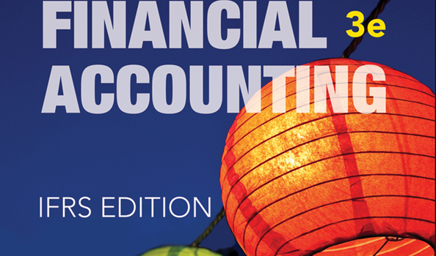
WILEY
IFRS EDITION
Prepared by
Coby Harmon
University of California, Santa Barbara
Westmont College

Slide 2
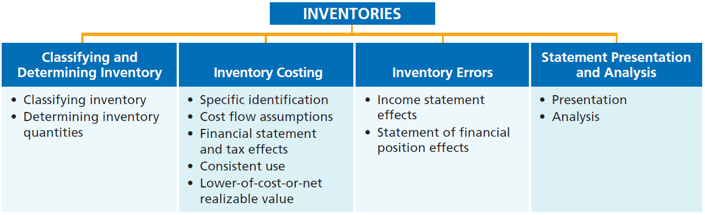
PREVIEW OF CHAPTER 6
Financial Accounting
IFRS 3rd Edition
Weygandt ● Kimmel ● Kieso

Slide 3
CHAPTER
6
Inventories
LEARNING OBJECTIVES
After studying this chapter, you should be able to:
Discuss how to classify and determine inventory.
Explain the accounting for inventories and apply the inventory cost flow methods.
Explain the financial effects of the inventory cost flow assumptions.
Explain the lower-of-cost-or-net realizable value basis of accounting for inventories.
Indicate the effects of inventory errors on the financial statements.
Discuss the presentation and analysis of inventory.

Slide 4
Classifying and Determining Inventory
Learning Objective 1
Discuss how to classify and determine inventory.
Classifying Inventory
Merchandising Company
Manufacturing Company
One Classification:
  Inventory
Three Classifications:
  Raw Materials
  Work in Process
  Finished Goods
• HELPFUL HINT
Regardless of the classification, companies report all inventories under Current Assets on the statement of financial position.
LO 1

Slide 5
ACCOUNTING ACROSS THE ORGANIZATION
A Big Hiccup
JIT can save a company a lot of money, but it isn’t without risk. An unexpected disruption in the supply chain can cost a company a lot of money. Japanese automakers experienced just such a disruption when a 6.8-magnitude earthquake caused major damage to the company that produces 50% of their piston rings. The rings themselves cost only $1.50, but you cannot make a car without them. No other supplier could quickly begin producing sufficient quantities of the rings to match the desired specifications. As a result, the automakers were forced to shut down production for a few days—a loss of tens of thousands of cars.
Source: Amy Chozick, “A Key Strategy of Japan’s Car Makers Backfires,” Wall Street Journal (July 20, 2007).
LO 1

Slide 6
Determining Inventory Quantities
Physical Inventory taken for two reasons:
Perpetual System
  Check accuracy of inventory records.
  Determine amount of inventory lost due to wasted raw materials, shoplifting, or employee theft.
Periodic System
  Determine the inventory on hand.
  Determine the cost of goods sold for the period.
LO 1

Slide 7
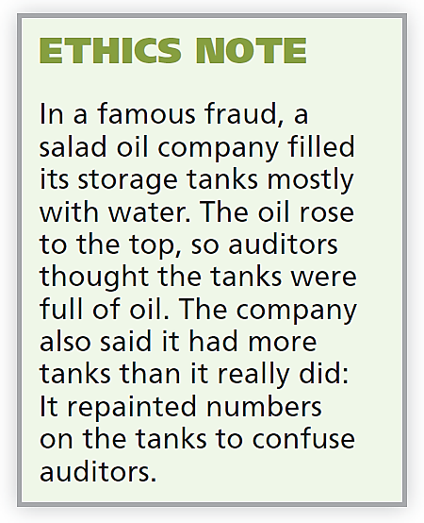
Determining Inventory Quantities
TAKING A PHYSICAL INVENTORY
Involves counting, weighing, or measuring each kind of inventory on hand.
Companies often “take inventory”
  when the business is closed or
  business is slow.
  at the end of the accounting period.
LO 1

Slide 8
ETHICS INSIGHT
Falsifying Inventory to Boost Income
Managers at a women’s apparel maker were convicted of falsifying inventory records to boost net income—and consequently to boost management bonuses. In another case, executives at an electronics manufacturer were accused of defrauding lenders by manipulating inventory records. The indictment said the company classified “defective goods as new or refurbished” and claimed that it owned certain shipments “from overseas suppliers” when, in fact, the company either did not own the shipments or the shipments
did not exist.
LO 1

Slide 9
Determining Inventory Quantities
DETERMINING OWNERSHIP OF GOODS
GOODS IN TRANSIT
  Purchased goods not yet received.
  Sold goods not yet delivered.
Goods in transit should be included in the inventory of the company that has legal title to the goods. Legal title is determined by the terms of sale.
LO 1

Slide 10
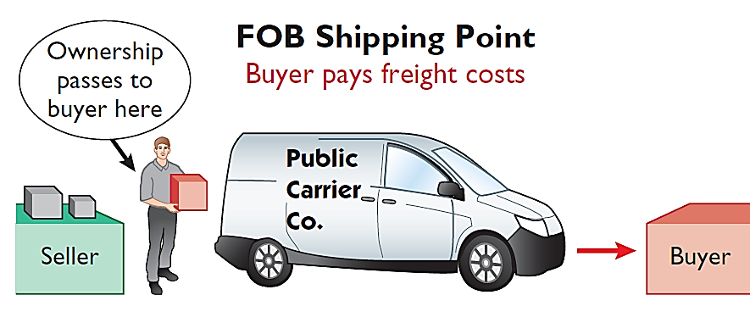
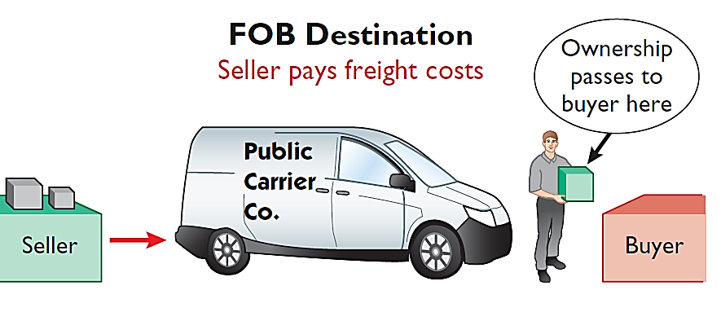
DETERMINING OWNERSHIP OF GOODS
GOODS IN TRANSIT
Illustration 6-2 Terms of sale
Ownership of the goods passes to the buyer when the public carrier accepts the goods from the seller.
Ownership of the goods remains with the seller until the goods reach the buyer.
LO 1

Slide 11
Determining Ownership of Goods
Question
Goods in transit should be included in the inventory of the buyer when the:
  public carrier accepts the goods from the seller.
  goods reach the buyer.
  terms of sale are FOB destination.
  terms of sale are FOB shipping point.
LO 1
Notes:
Answer = A

Slide 12
Determining Ownership of Goods
CONSIGNED GOODS
To hold the goods of other parties and try to sell the goods for them for a fee, but without taking ownership of the goods.
Many car, boat, and antique dealers sell goods on consignment, why?
LO 1

Slide 13
ANATOMY OF A FRAUD
Ted Nickerson, CEO of clock manufacturer Dally Industries, was feared by all of his employees. Ted also had expensive tastes. To support this habit, Ted took out large loans, which he collateralized with his ordinary shares of Dally Industries. If the price of Dally’s shares fell, he was required to provide the bank with more ordinary shares. To achieve target net income figures and thus maintain the share price, Ted coerced employees in the company to alter inventory figures. Inventory quantities were manipulated by changing the amounts on inventory control tags after the year-end physical inventory count. For example, if a tag said there were 20 units of a particular item, the tag was changed to 220. Similarly, the unit costs that were used to determine the value of ending inventory were increased from, for example, $125 per unit to $1,250. Both of these fraudulent changes had the effect of increasing the amount of reported ending inventory. This reduced cost of goods sold and increased net income.
Total take: $245,000
The Missing Control
Independent internal verification. The inventory records should have been spot-checked periodically, verifying that the number of units agreed with the amount on hand and that the unit costs agreed with vendor price sheets.
LO 1

Slide 14
>
DO IT!
Deng Yaping Company completed its inventory count. It arrived at a total inventory value of ¥200,000. You have been given the information listed below. Discuss how this information affects the reported cost of inventory.
1. Deng Yaping included in the inventory goods held on consignment for Falls Co., costing ¥15,000.
2. The company did not include in the count purchased goods of ¥10,000, which were in transit (terms: FOB shipping point).
3. The company did not include in the count inventory that had been sold with a cost of ¥12,000, which was in transit (terms: FOB shipping point).
Solution
1. Goods of ¥15,000 held on consignment should be deducted from the inventory count.
2. The goods of ¥10,000 purchased FOB shipping point should be added to the inventory count.
3. Item 3 was treated correctly.
Inventory should be ¥195,000 (¥200,000 - ¥15,000 + ¥10,000).
LO 1

