Slide 1



WILEY
IFRS EDITION
Prepared by
Coby Harmon
University of California, Santa Barbara
Westmont College

Slide 2
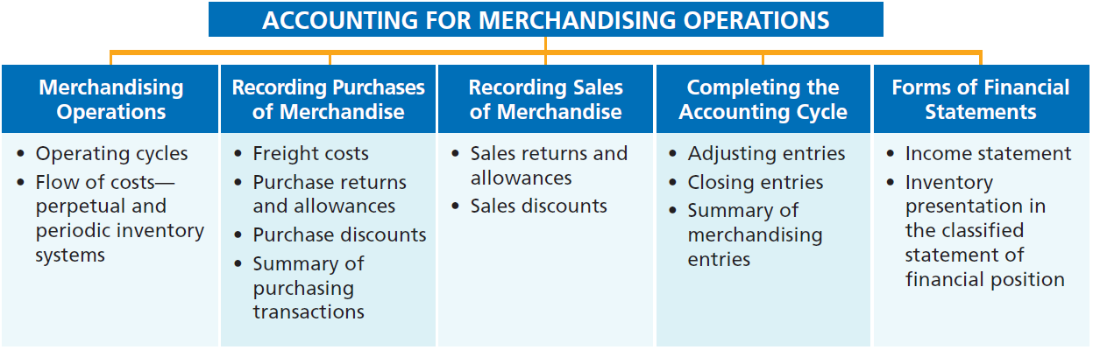
PREVIEW OF CHAPTER 5
Financial Accounting
IFRS 3rd Edition
Weygandt ● Kimmel ● Kieso

Slide 3
CHAPTER
5
Accounting for Merchandising Operations
LEARNING OBJECTIVES
After studying this chapter, you should be able to:
Identify the differences between service and merchandising companies.
Explain the recording of purchases under a perpetual inventory system.
Explain the recording of sales revenues under a perpetual inventory system.
Explain the steps in the accounting cycle for a merchandising company.
Prepare an income statement for a merchandiser.

Slide 4


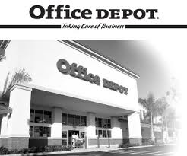


Merchandising Operations
Learning Objective 1
Identify the differences between service and merchandising companies.
Merchandising Companies
Buy and Sell Goods
Retailer
Wholesaler
Consumer
The primary source of revenues is referred to as sales revenue or sales.
LO 1

Slide 5
Merchandising Operations
Income Measurement
Sales
Revenue
Not used in a Service business.
Less
Illustration 5-1
Income measurement process for a merchandising company
Cost of
Goods Sold
Equals
Gross
Profit
Less
Operating
Expenses
Net
Income
(Loss)
Cost of goods sold is the total cost of merchandise sold during the period.
Equals
LO 1

Slide 6
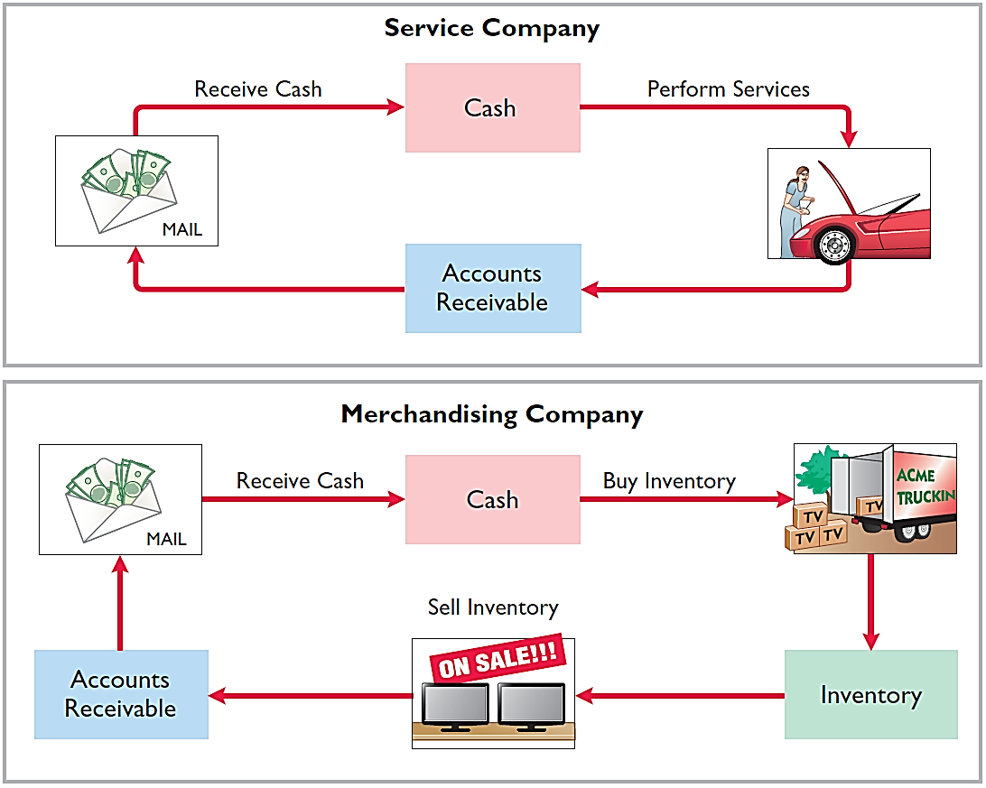
Operating Cycles
The operating cycle of a merchandising company ordinarily is longer than that of a service company.
Illustration 5-2
Illustration 5-3
LO 1

Slide 7
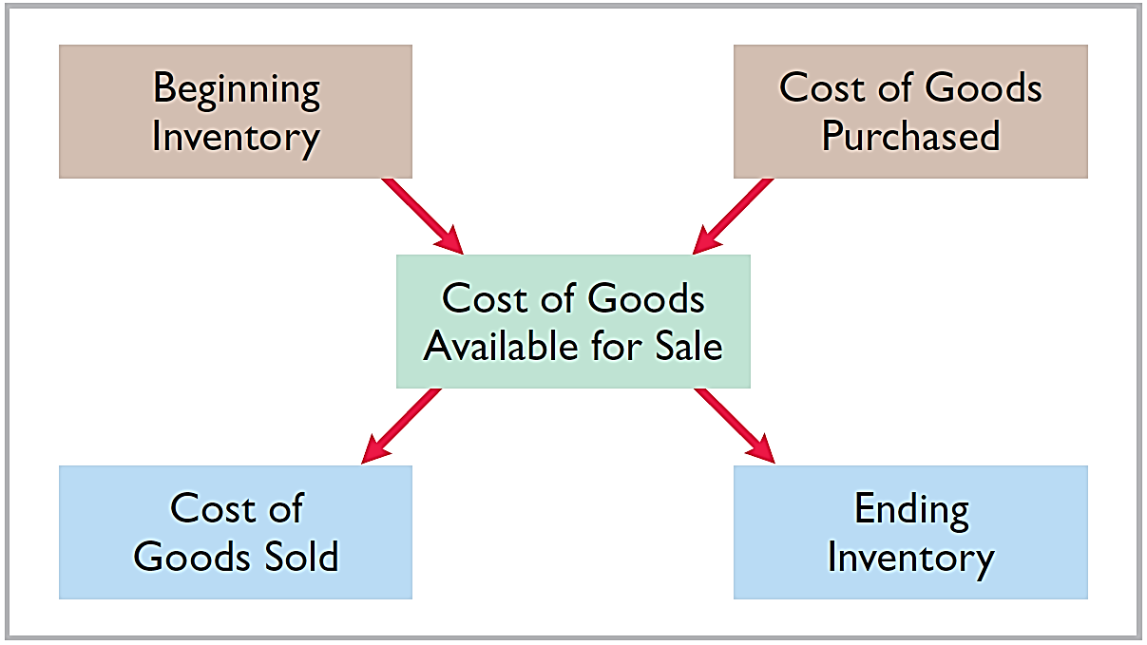
Flow of Costs
Illustration 5-4
Companies use either a perpetual inventory system or a periodic inventory system to account for inventory.
LO 1

Slide 8
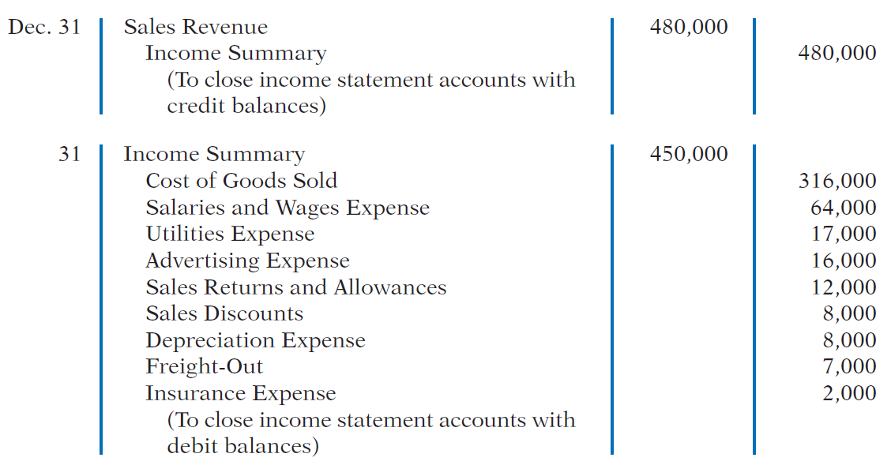
Closing Entries
LO 4

Slide 9
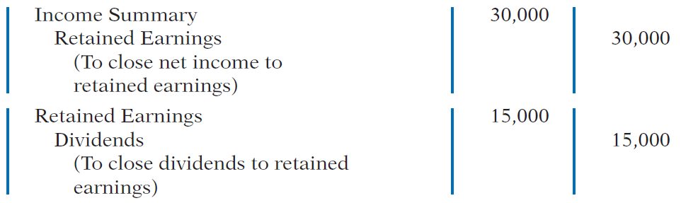
Closing Entries
LO 4

Slide 10
>
DO IT!
The trial balance of Celine’s Sports Wear Shop at December 31 shows Inventory €25,000, Sales Revenue €162,400, Sales Returns and Allowances €4,800, Sales Discounts €3,600, Cost of Goods Sold $110,000, Rent Revenue €6,000, Freight-Out €1,800, Rent Expense €8,800, and Salaries and Wages Expense €22,000. Prepare the closing entries for the above accounts.
Dec. 31
Sales Revenue 162,400
Rent Revenue 6,000
Income Summary 168,400
LO 4

Slide 11
The trial balance of Celine’s Sports Wear Shop at December 31 shows Inventory €25,000, Sales Revenue €162,400, Sales Returns and Allowances €4,800, Sales Discounts €3,600, Cost of Goods Sold €110,000, Rent Revenue €6,000, Freight-Out €1,800, Rent Expense €8,800, and Salaries and Wages Expense €22,000. Prepare the closing entries for the above accounts.
Dec. 31
Income Summary 151,000
Cost of Goods Sold 110,000
Sales Returns and Allowances 4,800
Sales Discounts 3,600
Freight-Out 1,800
Rent Expense 8,800
Salaries and Wages Expense 22,000
LO 4

Slide 12
Forms of Financial Statements
Learning Objective 5
Prepare an income statement for a merchandiser.
Income Statement
Primary source of information for evaluating a company’s performance.
Format is designed to differentiate between the various sources of income and expense.
LO 5

Slide 13
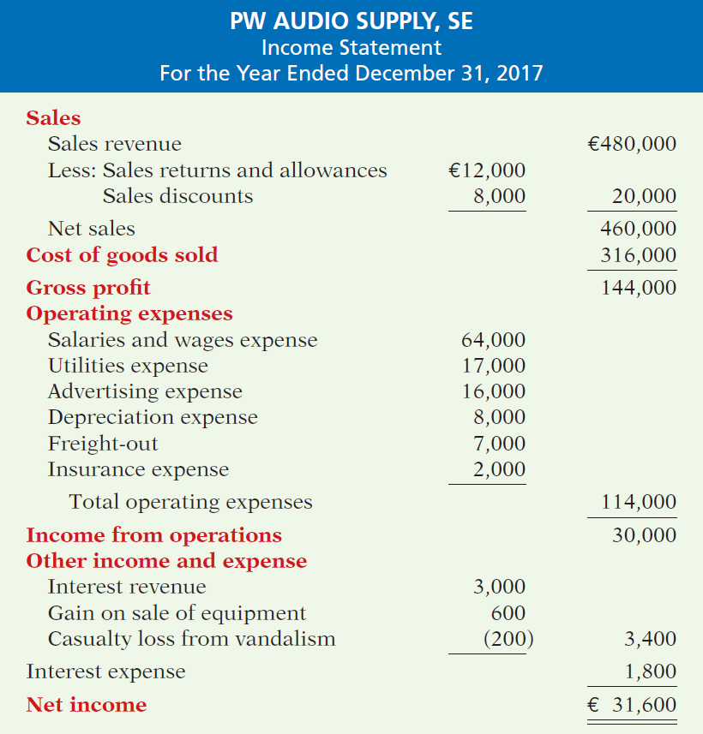
Income Statement
The income statement is a primary source of information for evaluating a company’s
performance.
Illustration 5-14
LO 5

Slide 14
Income Statement
Key Items:
Net sales
Illustration 5-14
LO 5

Slide 15
Income Statement
Key Items:
Net sales
Gross profit
Illustration 5-14
LO 5

Slide 16
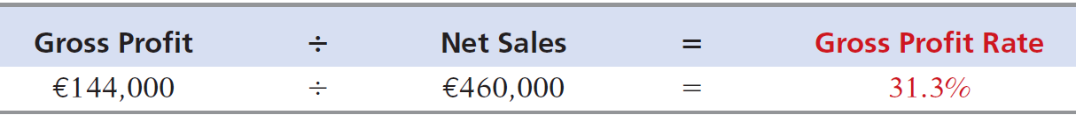
Income Statement
Key Items:
Net sales
Gross profit
Illustration 5-11
Gross profit rate formula
and computation
Illustration 5-14
LO 5

Slide 17
Income Statement
Key Items:
Net sales
Gross profit
Operating expenses
Illustration 5-14
LO 5

Slide 18
Income Statement
Key Items:
Net sales
Gross profit
Operating expenses
Other income and expense
Illustration 5-14
LO 5

Slide 19
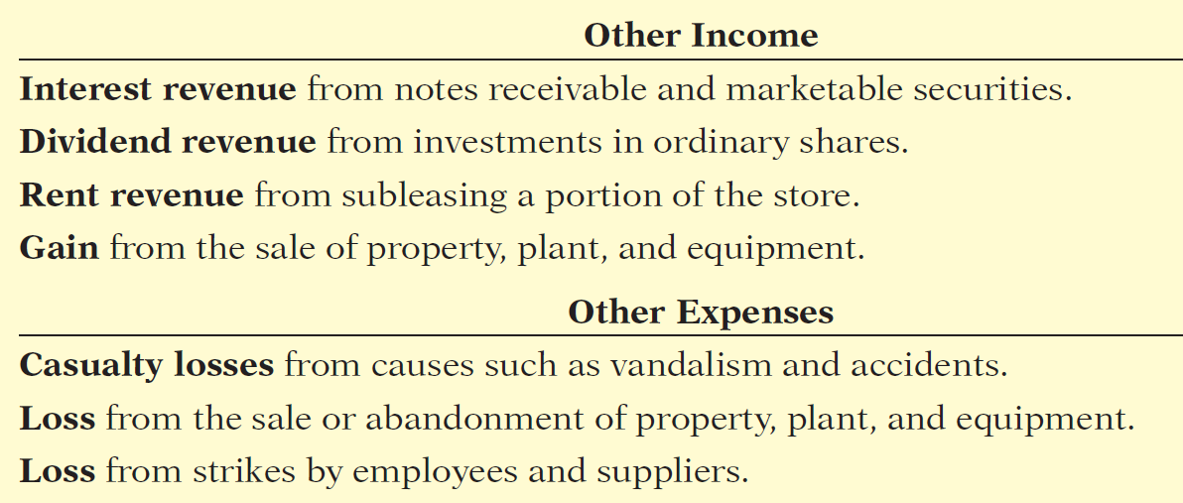
Income Statement
Key Items:
Net sales
Gross profit
Operating expenses
Other income and expense
Illustration 5-14
LO 5

Slide 20
Income Statement
Key Items:
Net sales
Gross profit
Operating expenses
Other income and expense
Interest expense
Illustration 5-14
LO 5

Slide 21
Income Statement
Key Items:
Net sales
Gross profit
Operating expenses
Other income and expense
Interest expense
Net income
Illustration 5-14
LO 5

Slide 22
Income Statement
Question
The income statement for a merchandiser shows each of the following features except:
  gross profit.
  cost of goods sold.
  a sales section.
  investing activities section.
LO 5

Slide 23
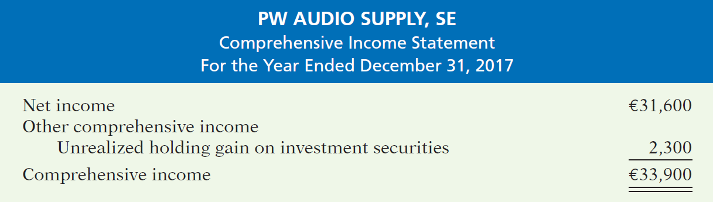
COMPREHENSIVE INCOME
Includes certain adjustments to pension plan assets, gains and losses on foreign currency translation, and unrealized gains and losses on certain types of investments.
Illustration 5-15
Separate statement of net
income and comprehensive
income
Reported in a combined statement of net income and comprehensive income, or in a separate schedule that reports only comprehensive income.
LO 5

Slide 24
ACCOUNTING ACROSS THE ORGANIZATION
Online Sales Stall in India
India is well known for its large pool of excellent software engineers. Therefore, it may come as a surprise that online merchandise sales are only starting to take hold in this country. The reason for the delay compared to many other countries is that, until recently, consistent Internet access was limited to a small portion of the Indian population. But, experts predict that by 2015 up to 200 million Indians will have Internet access. To take advantage of this, two software engineers started the online merchandising company Flipkart (IND). Their goal is “to be the Amazon. com of India.” Sales hit $20 million in a recent year, but the company faces many barriers to both growth and profitability. First, few Indians have credit cards, so many transactions must be done in cash. And, while the company has a book catalog of over 100 million titles, it is very difficult to deliver those books (or anything else) over India’s poorly maintained roads. As a consequence, even if Internet access improves rapidly, online merchandisers need to see improvements in the banking and transportation systems in India for sales to really take off.
Source: Amol Sharma, “Dot-Coms Begin to Blossom in India,” Wall Street Journal (April 12, 2011).
LO 5

Slide 25
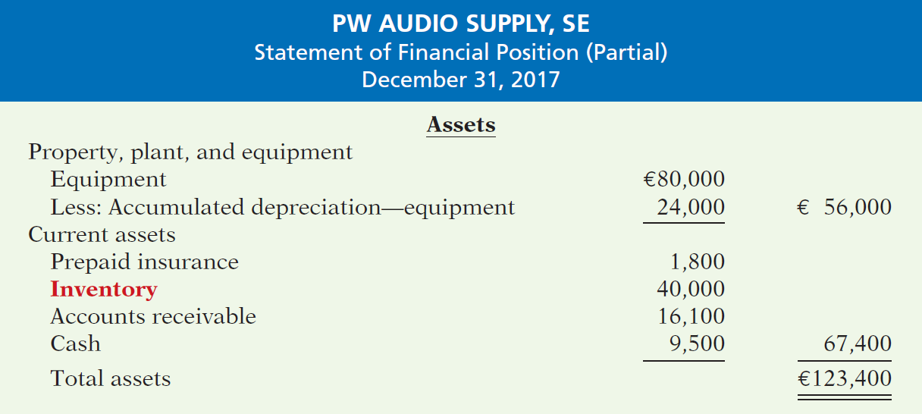
Inventory Presentation in the Classified Statement of Financial Position
Illustration 5-16
Assets section of a classified statement of financial position
LO 5

Slide 26
>
DO IT!
You are presented with the following list of accounts from the adjusted trial balance for merchandiser Gorman Company. Indicate in which financial statement and under what classification each of the following would be reported.
Financial Statement
Account
Classification
Accounts payable
SFP
Current liabilities
Accounts receivable
SFP
Current assets
Accumulated Depreciation-Buildings
SFP
Property, plant, and equipment
Accumulated Depreciation-Equipment
SFP
Property, plant, and equipment
Advertising Expense
IS
Operating expenses
Buildings
SFP
Property, plant, and equipment
Cash
SFP
Current assets
Depreciation Expense
IS
Operating expenses
Dividends
RES
Deduction section
LO 5

Slide 27
>
DO IT!
You are presented with the following list of accounts from the adjusted trial balance for merchandiser Gorman Company. Indicate in which financial statement and under what classification each of the following would be reported.
Financial Statement
Account
Classification
Equipment
SFP
Property, plant, and equipment
Freight-Out
IS
Operating expenses
Gain on Disposal of Plant Assets
IS
Other income and expense
Insurance Expense
IS
Operating expenses
Interest Expense
IS
Interest expense
Interest Payable
SFP
Current liabilities
Inventory
SFP
Current assets
Land
SFP
Property, plant, and equipment
Notes Payable (due in 3 years)
SFP
Non-current liabilities
LO 5

Slide 28
>
DO IT!
You are presented with the following list of accounts from the adjusted trial balance for merchandiser Gorman Company. Indicate in which financial statement and under what classification each of the following would be reported.
Financial Statement
Account
Classification
Property Taxes Payable
SFP
Current liabilities
Salaries and Wages Expense
IS
Operating expenses
Salaries and Wages Payable
SFP
Current liabilities
Sales Returns and Allowances
IS
Sales
Sales Revenue
IS
Sales
Share Capital—Ordinary
SFP
Equity
Utilities Expense
IS
Operating expenses
LO 5

Slide 29
APPENDIX 5A
Worksheet for a Merchandising Company
Learning Objective 6
Prepare a worksheet for a merchandising company.
Using a Worksheet
As indicated in Chapter 4, a worksheet enables
companies to prepare financial statements before they journalize and post adjusting entries. The steps in preparing a worksheet for a merchandising company are the same as for a service company. Illustration 5A-1 shows the worksheet for PW Audio Supply (excluding nonoperating items). The unique accounts for a merchandiser using a perpetual inventory system are in red.
LO 6

Slide 30
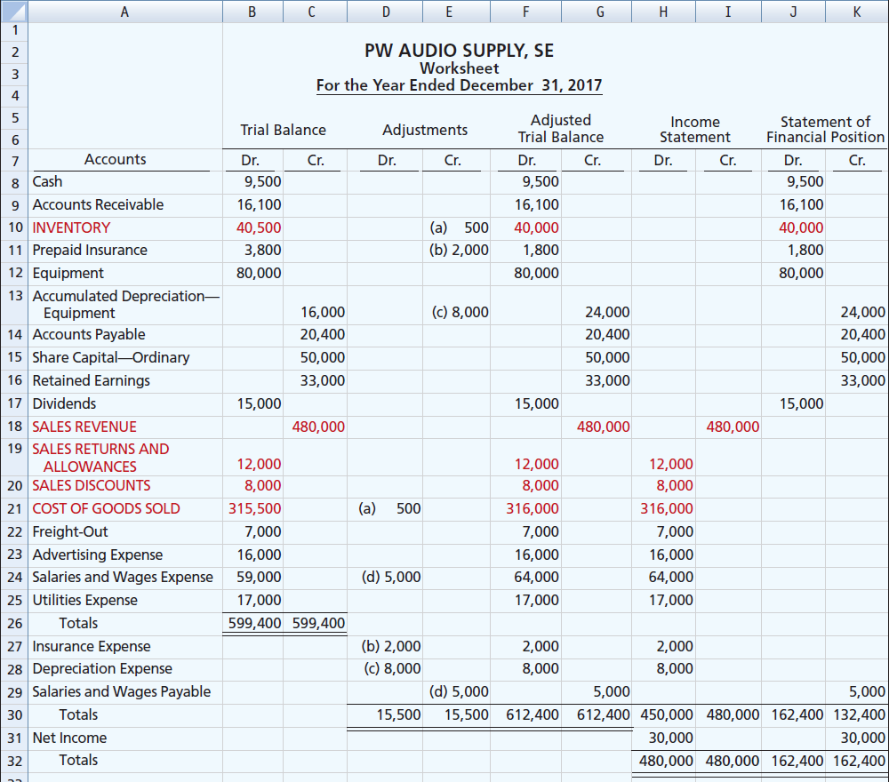
Illustration 5A-1
Worksheet for merchandising company
LO 6

Slide 31
APPENDIX 5B
Periodic Inventory System
Learning Objective 7
Explain the recording of purchases and sales of inventory under a periodic inventory system.
Determining Cost of Goods Sold Under a Periodic System
No running account of changes in
inventory.
Ending inventory determined by physical count.
Cost of goods sold not determined until the end of the period.
LO 7

Slide 32
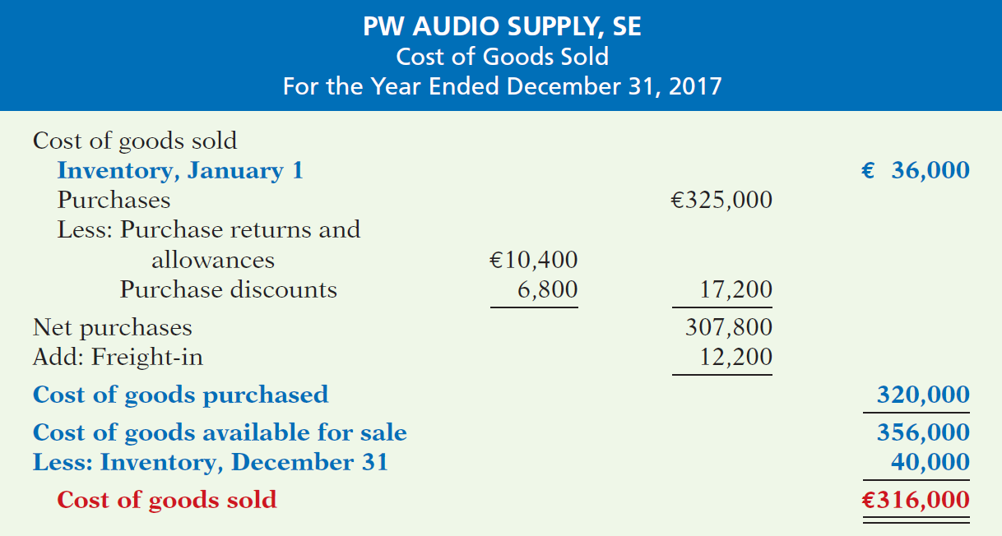
Determining Cost of Goods Sold Under a Periodic System
Illustration 5B-2
Cost of goods sold for a
merchandiser using a periodic
inventory system
Illustration 5B-2
LO 7

Slide 33
Recording Merchandise Transactions
Record revenues when sales are made.
Do not record cost of merchandise sold on the date of sale.
Physical inventory count determines:
  Cost of merchandise on hand and
  Cost of merchandise sold during the period.
Record purchases in Purchases account.
Purchase returns and allowances, Purchase discounts, and Freight costs are recorded in separate accounts.
LO 7

Slide 34
Recording Purchases of Merchandise
Illustration: On the basis of the sales invoice (Illustration 5-6) and receipt of the merchandise ordered from PW Audio Supply, Sauk Stereo records the €3,800 purchase as follows.
May 4
Purchases 3,800
Accounts Payable 3,800
LO 7

Slide 35
Recording Purchases of Merchandise
FREIGHT COSTS
Illustration: If Sauk pays Public Freight Company €150
for freight charges on its purchase from PW Audio Supply on May 6, the entry on Sauk’s books is:
May 6
Freight-In (Transportation-In) 150
Cash 150
LO 7

Slide 36
Recording Purchases of Merchandise
PURCHASE RETURNS AND ALLOWANCES
Illustration: Sauk Stereo returns €300 of goods to PW Audio Supply and prepares the following entry to recognize the return.
May 8
Accounts Payable 300
Purchase Returns and Allowances 300
LO 7

Slide 37
Recording Purchases of Merchandise
PURCHASE DISCOUNTS
Illustration: On May 14 Sauk Stereo pays the balance due on account to PW Audio Supply, taking the 2% cash discount allowed by PW Audio for payment within 10 days. Sauk
Stereo records the payment and discount as follows.
May 14
Accounts Payable 3,500
Purchase Discounts 70
Cash 3,430
LO 7

Slide 38
Recording Sales of Merchandise
Illustration: PW Audio Supply, records the sale of €3,800 of merchandise to Sauk Stereo on May 4 (sales invoice No. 731, Illustration 5-6) as follows.
May 4
Accounts Receivable 3,800
Sales Revenue 3,800
No entry is recorded for cost of goods sold at the time of the sale under a periodic system.
LO 7

Slide 39
Recording Sales of Merchandise
SALES RETURNS AND ALLOWANCES
Illustration: To record the returned goods received from Sauk Stereo on May 8, PW Audio Supply records the €300 sales return as follows.
May 8
Sales Returns and Allowances 300
Accounts Receivable 300
LO 7

Slide 40
Recording Sales of Merchandise
SALES DISCOUNTS
Illustration: On May 14, PW Audio Supply receives payment of €3,430 on account from Sauk Stereo. PW Audio honors the 2% cash discount and records the payment of Sauk’s account receivable in full as follows.
May 14
Cash 3,430
Sales Discounts 70
Accounts Receivable 3,500
LO 7

Slide 41
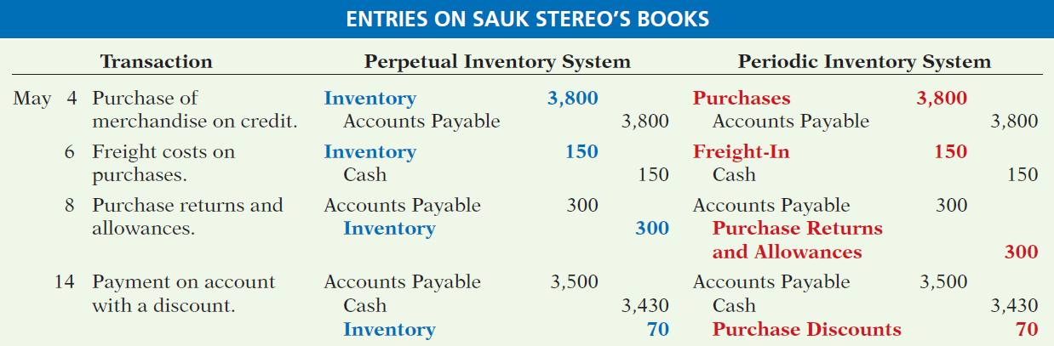
Recording Sales of Merchandise
COMPARISON OF ENTRIES
Illustration 5B-3
Comparison of entries for perpetual and periodic inventory systems
LO 7

Slide 42
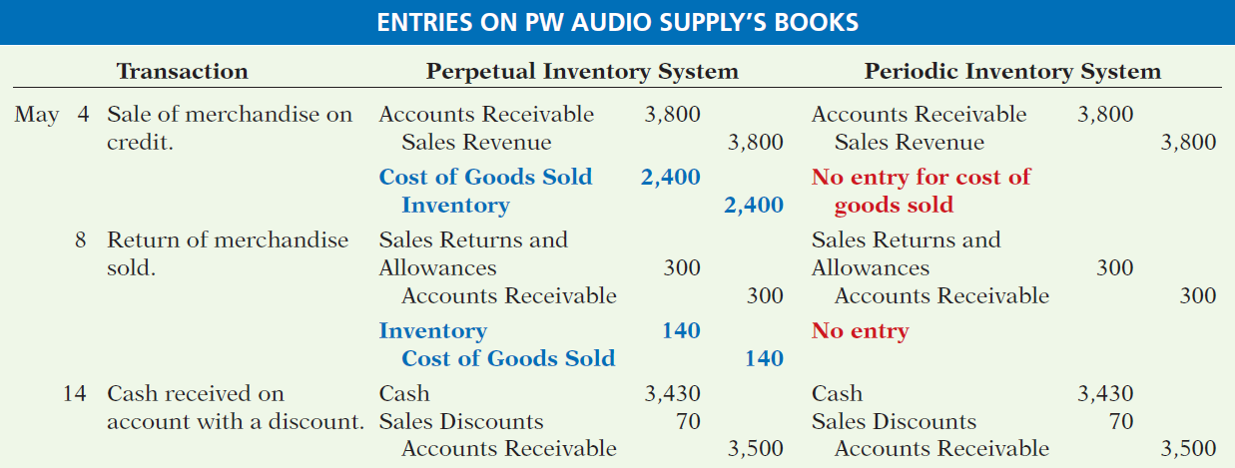
Recording Sales of Merchandise
COMPARISON OF ENTRIES
Illustration 5B-3
Comparison of entries for perpetual and periodic inventory systems
LO 7

Slide 43
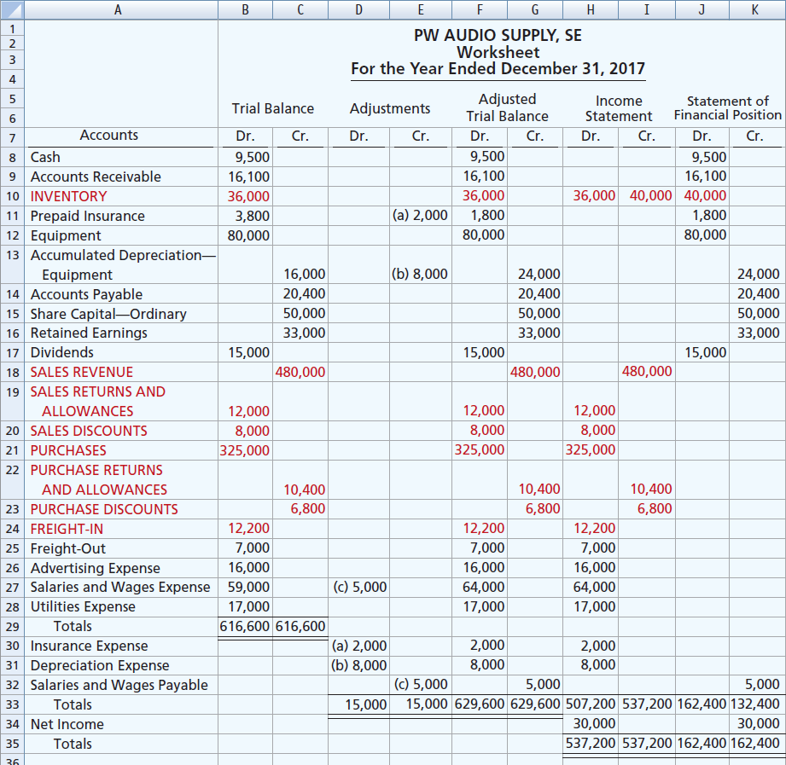
Illustration 5B-5
Worksheet for merchandising
company—periodic inventory system
LO 7

Slide 44
A Look at U.S. GAAP
Learning Objective 8
Compare the accounting for merchandising under IFRS and U.S. GAAP.
Key Points
Similarities
Under both GAAP and IFRS, a company can choose to use either a perpetual or a periodic system.
Inventories are defined by IFRS as held-for-sale in the ordinary course of business, in the process of production for such sale, or in the form of materials or supplies to be consumed in the production process or in the performing of services. The definition under GAAP is essentially the same.
Similar to GAAP, comprehensive income under IFRS includes unrealized gains and losses (such as those on non-trading securities) that are not included in the calculation of net income.
LO 8

Slide 45
A Look at U.S. GAAP
Key Points
Differences
Under GAAP, companies generally classify income statement items by function. Classification by function leads to descriptions like administration, distribution, and manufacturing. Under IFRS, companies must classify expenses by either nature or by function. Classification by nature leads to descriptions such as the following: salaries, depreciation expense, and utilities expense. If a company uses the functional-expense method on the income statement, disclosure by nature is required in the notes to the financial statements.
Presentation of the income statement under GAAP follows either a single-step or multiple-step format. IFRS does not mention a single-step or multiple-step approach.
LO 8

Slide 46
A Look at U.S. GAAP
Key Points
Differences
Under IFRS, revaluation of land, buildings, and intangible assets is permitted. The initial gains and losses resulting from this revaluation are reported as adjustments to equity, often referred to as other comprehensive income. The effect of this difference is that the use of IFRS instead of GAAP results in more transactions affecting equity (other comprehensive income) but not net income.
IFRS requires that two years of income statement information be presented, whereas GAAP requires three years.
LO 8

Slide 47
A Look at U.S. GAAP
Looking to the Future
  The IASB and FASB are working on a project that would rework the structure of financial statements. Specifically, this project will address the issue of how to classify various items in the income statement. A main goal of this new approach is to provide information that better represents how businesses are run. In addition, this approach draws attention away from just one number—net income. It will adopt major groupings similar to those currently used by the statement of cash flows (operating, investing, and financing), so that numbers can be more readily traced across statements. For example, the amount of income that is generated by operations would be traceable to the assets and liabilities used to generate the income. Finally, this approach would also provide detail, beyond that currently seen in most statements (either GAAP or IFRS), by requiring that line items be presented both by function and by nature. The new financial statement format was heavily influenced by suggestions from financial analysts.
LO 8

Slide 48
A Look at U.S. GAAP
A Look at IFRS
GAAP Self-Test Questions
Which of the following would not be included in the definition of inventory under GAAP?
  Photocopy paper held for sale by an office-supply store.
  Stereo equipment held for sale by an electronics store.
  Used office equipment held for sale by the human relations department of a plastics company.
  All of the above would meet the definition.
LO 8

Slide 49
A Look at U.S. GAAP
A Look at IFRS
IFRS Self-Test Questions
Which of the following would not be a line item of a company reporting costs by nature?
  Depreciation expense.
  Interest expense.
  Salaries and wages expense.
  Manufacturing expense.
LO 8

Slide 50
A Look at U.S. GAAP
A Look at IFRS
IFRS Self-Test Questions
Which of the following statements is false?
  GAAP specifically requires use of a multiple-step income statement.
  Under GAAP, companies can use either a perpetual or periodic system.
  The proposed new format for financial statements was heavily influenced by the suggestions of financial statement analysts.
  The new income statement format will try to de-emphasize the focus on the “net income” line item.
LO 8

Slide 51
Copyright
“Copyright © 2016 John Wiley & Sons, Inc. All rights reserved. Reproduction or translation of this work beyond that permitted in Section 117 of the 1976 United States Copyright Act without the express written permission of the copyright owner is unlawful. Request for further information should be addressed to the Permissions Department, John Wiley & Sons, Inc. The purchaser may make back-up copies for his/her own use only and not for distribution or resale. The Publisher assumes no responsibility for errors, omissions, or damages, caused by the use of these programs or from the use of the information contained herein.”

