Slide 1



WILEY
IFRS EDITION
Prepared by
Coby Harmon
University of California, Santa Barbara
Westmont College

Slide 2
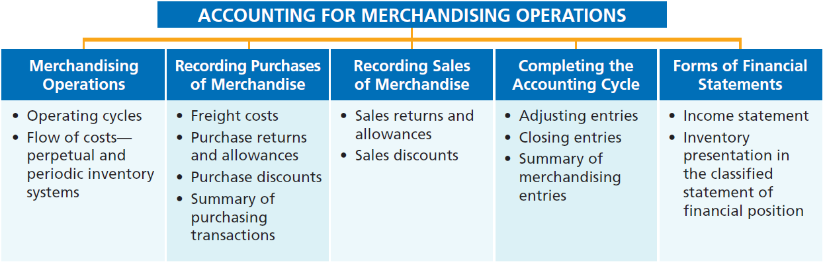
PREVIEW OF CHAPTER 5
Financial Accounting
IFRS 3rd Edition
Weygandt ● Kimmel ● Kieso

Slide 3
CHAPTER
5
Accounting for Merchandising Operations
LEARNING OBJECTIVES
After studying this chapter, you should be able to:
Identify the differences between service and merchandising companies.
Explain the recording of purchases under a perpetual inventory system.
Explain the recording of sales revenues under a perpetual inventory system.
Explain the steps in the accounting cycle for a merchandising company.
Prepare an income statement for a merchandiser.

Slide 4

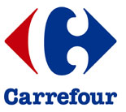
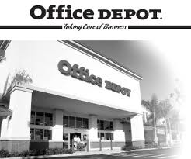
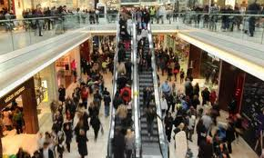

Merchandising Operations
Learning Objective 1
Identify the differences between service and merchandising companies.
Merchandising Companies
Buy and Sell Goods
Retailer
Wholesaler
Consumer
The primary source of revenues is referred to as sales revenue or sales.
LO 1

Slide 5
Merchandising Operations
Income Measurement
Sales
Revenue
Not used in a Service business.
Less
Illustration 5-1
Income measurement process for a merchandising company
Cost of
Goods Sold
Equals
Gross
Profit
Less
Operating
Expenses
Net
Income
(Loss)
Cost of goods sold is the total cost of merchandise sold during the period.
Equals
LO 1

Slide 6
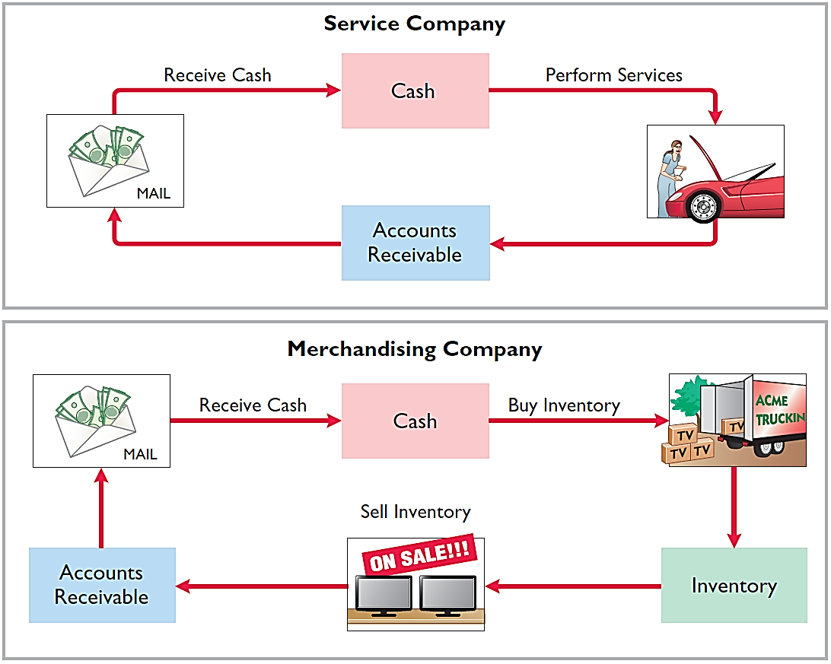
Operating Cycles
The operating cycle of a merchandising company ordinarily is longer than that of a service company.
Illustration 5-2
Illustration 5-3
LO 1

Slide 7
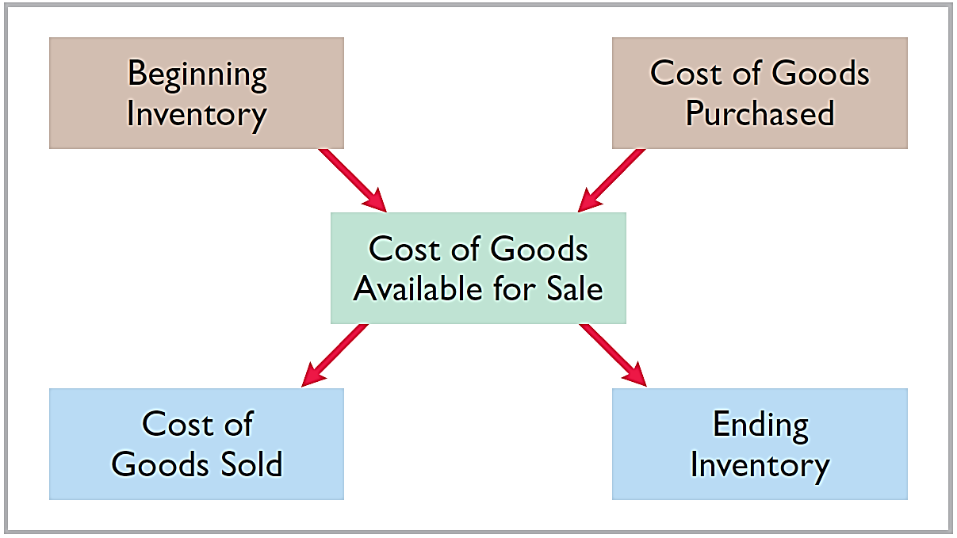
Flow of Costs
Illustration 5-4
Companies use either a perpetual inventory system or a periodic inventory system to account for inventory.
LO 1

Slide 8
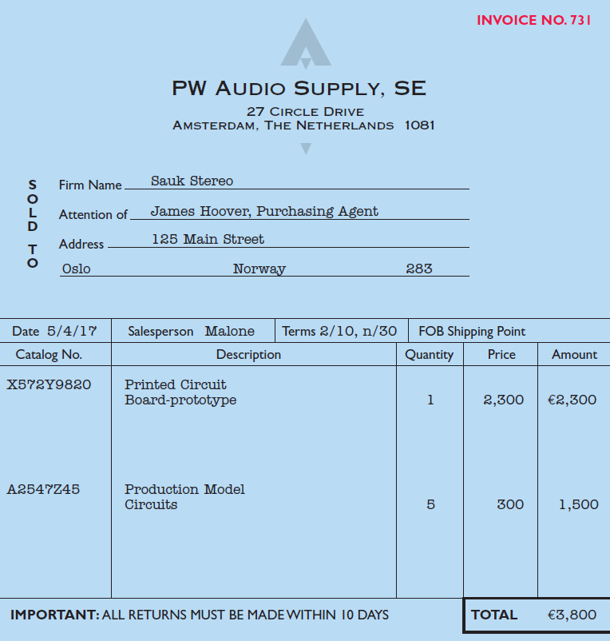
Recording Sales of Merchandise
Learning Objective 3
Explain the recording of sales revenue under a perpetual inventory system.
Made using cash or credit (on account).
Sales revenue, like service revenue, is recorded when the performance obligation is satisfied.
Performance obligation is satisfied when the goods are transferred from the seller to the buyer.
Sales invoice should support each credit sale.
Illustration 5-6
LO 3

Slide 9
Recording Sales of Merchandise
Journal Entries to Record a Sale
#1
Cash or Accounts Receivable XXX
Selling Price
Sales Revenue XXX
#2
Cost of Goods Sold XXX
Cost
Inventory XXX
LO 3

Slide 10
Recording Sales of Merchandise
Illustration: PW Audio Supply records the sale of €3,800 on May 4 to Sauk Stereo on account (Illustration 5-6) as follows (assume the merchandise cost PW Audio Supply €2,400).
May 4
Accounts Receivable 3,800
Sales Revenue 3,800
4
Cost of Goods Sold 2,400
Inventory 2,400
LO 3

Slide 11
ANATOMY OF A FRAUD
Holly Harmon was a cashier at a national superstore for only a short while when she began stealing merchandise using three methods. Under the first method, her husband or friends took UPC labels from cheaper items and put them on more expensive items. Holly then scanned the goods at the register. Using the second method, Holly scanned an item at the register but then voided the sale and left the merchandise in the shopping cart. A third approach was to put goods into large plastic containers. She scanned the plastic containers but not the goods within them. One day, Holly did not call in sick or show up for work. In such instances, the company reviews past surveillance tapes to look for suspicious activity by employees. This enabled the store to observe the thefts and to identify the participants.
Total take: $12,000
The Missing Controls
Human resource controls. A background check would have revealed Holly’s previous criminal record. She would not have been hired as a cashier.
LO 3

Slide 12
ANATOMY OF A FRAUD
Holly Harmon was a cashier at a national superstore for only a short while when she began stealing merchandise using three methods. Under the first method, her husband or friends took UPC labels from cheaper items and put them on more expensive items. Holly then scanned the goods at the register. Using the second method, Holly scanned an item at the register but then voided the sale and left the merchandise in the shopping cart. A third approach was to put goods into large plastic containers. She scanned the plastic containers but not the goods within them. One day, Holly did not call in sick or show up for work. In such instances, the company reviews past surveillance tapes to look for suspicious activity by employees. This enabled the store to observe the thefts and to identify the participants.
Total take: $12,000
The Missing Controls
Physical controls. Software can flag high numbers of voided transactions or a high number of sales of low-priced goods. Random comparisons of video records with cash register records can ensure that the goods reported as sold on the register are the same goods that are shown being purchased on the video recording. Employees should be aware that they are being monitored.
LO 3

Slide 13
Sales Returns and Allowances
“Flip side” of purchase returns and allowances.
Contra-revenue account to Sales Revenue (debit).
Sales not reduced (debited) because:
  Would obscure importance of sales returns and allowances as a percentage of sales.
  Could distort comparisons.
LO 3

Slide 14
Sales Returns and Allowances
Illustration: Prepare the entry PW Audio Supply would make to record the credit for returned goods that had a €300 selling price (assume a €140 cost). Assume the goods were not defective.
May 8
Sales Returns and Allowances 300
Accounts Receivable 300
8
Inventory 140
Cost of Goods Sold 140
LO 3

Slide 15
Sales Returns and Allowances
Illustration: Assume the returned goods were defective and had a scrap value of €50, PW Audio would make the following entries:
May 8
Sales Returns and Allowances 300
Accounts Receivable 300
8
Inventory 50
Cost of Goods Sold 50
LO 3

Slide 16
Sales Returns and Allowances
Question
The cost of goods sold is determined and recorded each time a sale occurs in:
  periodic inventory system only.
  a perpetual inventory system only.
  both a periodic and perpetual inventory system.
  neither a periodic nor perpetual inventory system.
LO 3

Slide 17
ACCOUNTING ACROSS THE ORGANIZATION
Merchandiser’s Accounting Causes Alarm
Accounting for merchandising transactions is not always as easy as it might first appear. Recently, Tesco (GBR) announced that it had overstated profits by £263 million over a three-year period. The error related to how Tesco accounted for amounts received from suppliers for promotional activities of those companies’ products. When a retailer runs advertisements promoting a particular product, the producer of that product shares part of the advertising cost. Typically, the producer pays the merchandiser its share of the advertising cost as much as a year before the advertisement is run. The questions become, how should these amounts be reported by the merchandiser at the time it receives the funds, and when should these amounts affect income? The scandal surrounding this accounting treatment was serious enough that it caused the company’s chairman to resign, and an outside auditing firm was brought in to investigate. One analyst commentated that “we can never recall a period so damaging to the reputation of the company.”
Source: Jenny Anderson, “Tesco Chairman to Step Down as Overstatement of Profit Grows,” The New York Times Online (October 23, 2014).
LO 3

Slide 18
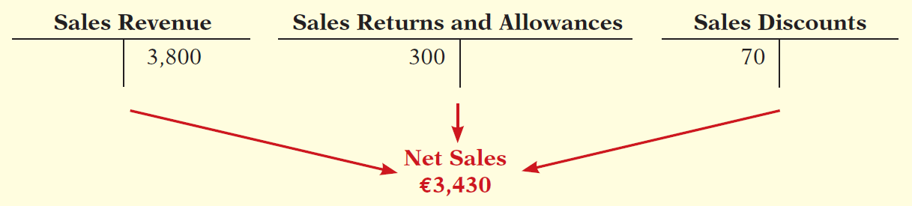
Sales Discount
Offered to customers to promote prompt payment of the balance due.
Contra-revenue account (debit) to Sales Revenue.
LO 3

Slide 19
Sales Discount
Illustration: Assume Sauk Stereo pays the balance due of €3,500 (gross invoice price of €3,800 less purchase returns and allowances of €300) on May 14, the last day of the discount period. Prepare the journal entry PW Audio Supply makes to record the receipt on May 14.
May 14
Cash 3,430
Sales Discounts 70
*
Accounts Receivable 3,500
* [(€3,800 – €300) X 2%]
LO 3

Slide 20
>
DO IT!
On September 5, Zhu Company buys merchandise on account from Gao Company. The selling price of the goods is ¥15,000, and the cost to Gao Company was ¥8,000. On September 8, Zhu returns defective goods with a selling price of ¥2,000 and the fair value of ¥300. Record the transactions on the books of Gao Company.
Sept. 5
Accounts Receivable 15,000
Sales Revenue 15,000
Cost of Goods Sold 8,000
Inventory 8,000
Sept. 5
LO 3

Slide 21
>
DO IT!
On September 5, Zhu Company buys merchandise on account from Gao Company. The selling price of the goods is ¥15,000, and the cost to Gao Company was ¥8,000. On September 8, Zhu returns defective goods with a selling price of ¥2,000 and the fair value of ¥300. Record the transactions on the books of Gao Company.
Sept. 8
Sales Returns and Allowances 2,000
Accounts Receivable 2,000
Inventory 300
Cost of Goods Sold 300
Sept. 8
LO 3

Slide 22
Recording Sales of Merchandise
Learning Objective 4
Explain the steps in the accounting cycle for a merchandising company.
Adjusting Entries
Generally the same as a service company.
One additional adjustment to make the records agree with the actual inventory on hand.
Involves adjusting Inventory and Cost of Goods Sold.
LO 4

Slide 23
Adjusting Entries
Illustration: Suppose that PW Audio Supply has an unadjusted balance of €40,500 in Merchandise Inventory. Through a physical count, PW Audio determines that its actual merchandise inventory at year-end is €40,000. The company would make an adjusting entry as follows.
Cost of Goods Sold 500
Inventory 500
LO 4

