Slide 1
WILEY
IFRS EDITION
Prepared by
Coby Harmon
University of California, Santa Barbara
Westmont College

Slide 2
PREVIEW OF CHAPTER 3
Financial Accounting
IFRS 3rd Edition
Weygandt ● Kimmel ● Kieso

Slide 3
CHAPTER
3
Adjusting the Accounts
LEARNING OBJECTIVES
After studying this chapter, you should be able to:
Explain the time period assumption.
Explain the accrual basis of accounting.
Explain the reasons for adjusting entries.
Identify the major types of adjusting entries.
Prepare adjusting entries for deferrals.
Prepare adjusting entries for accruals.
Describe the nature and purpose of an adjusted trial balance.

Slide 4
Types of Adjusting Entries
Learning Objective 4 Identify the major types of adjusting entries.
Deferrals
Accruals
1. Prepaid Expenses. Expenses paid in cash before they are used or consumed.
1. Accrued Revenues. Revenues for services performed but not yet received in cash or recorded.
2. Unearned Revenues.
Cash received before services are performed.
2. Accrued Expenses. Expenses incurred but not yet paid in cash or recorded.
Illustration 3-2
Categories of adjusting entries
LO 4

Slide 5
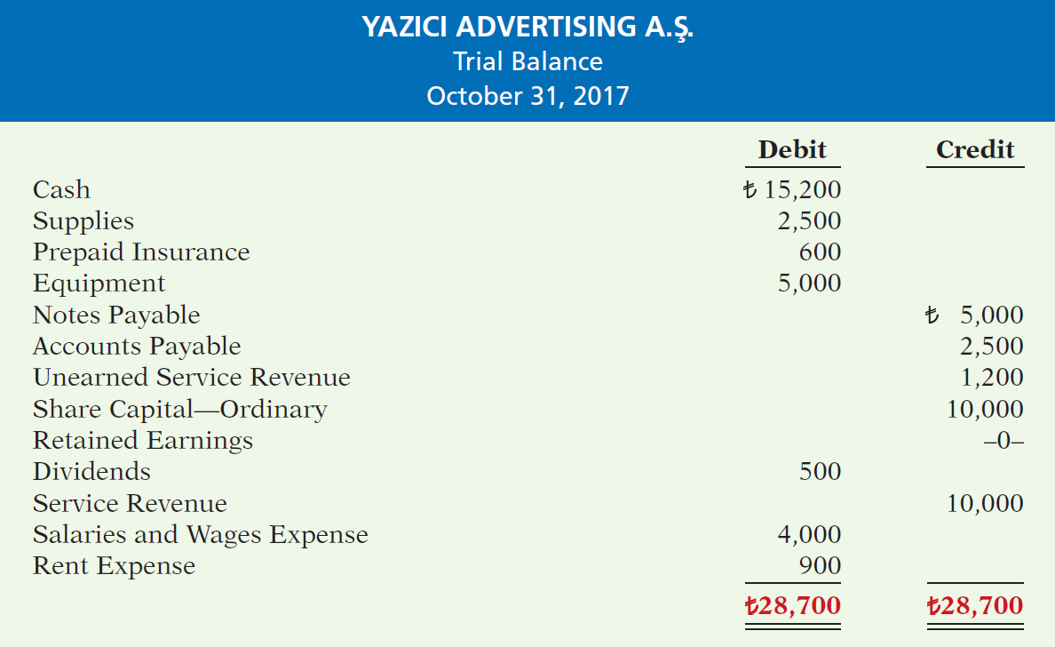
Illustration 3-3
Trial balance
Each account is analyzed to determine whether it is complete and up-to-date for financial statement purposes.
LO 4

Slide 6
Adjusting Entries for Accruals
Learning Objective 6 Prepare adjusting entries for accruals.
Accruals are made to record
Revenues for services performed but not
yet recorded at the statement date
(accrued revenues).
OR
Expenses incurred but not yet paid or recorded at the statement date (accrued expenses).
LO 6

Slide 7
ACCRUED REVENUES
Revenues for services performed but not yet received in cash or recorded.
Revenue Recorded
BEFORE
Cash Receipt
Accrued revenues often occur in regard to:
Rent
Interest
Services performed
LO 6

Slide 8
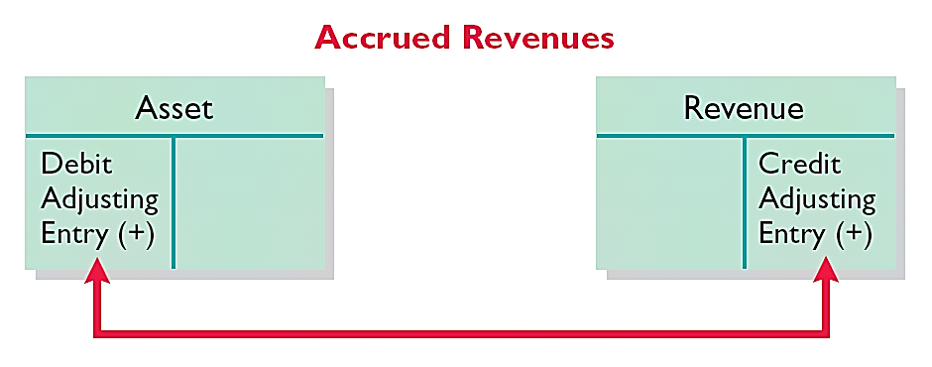
ACCRUED REVENUES
Adjusting entry records the receivable that exists and records the revenues for services performed.
Adjusting entry:
Increases (debits) an asset account and
Increases (credits) a revenue account.
Illustration 3-13
Adjusting entries for accrued
revenues
LO 6

Slide 9
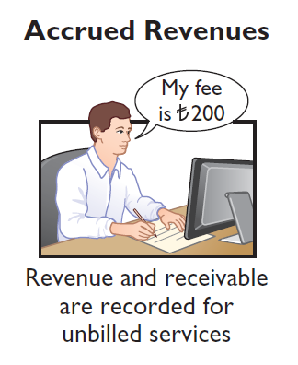
ACCRUED REVENUES
Illustration: In October, Yazici Advertising Inc. performed services worth ₺200 that were not billed to clients in October.
Oct. 31
Accounts Receivable
200
Service Revenue
200
On November 10, Yazici receives cash of ₺200 for the services performed.
Nov. 10
Cash
200
Accounts Receivable
200
LO 6

Slide 10
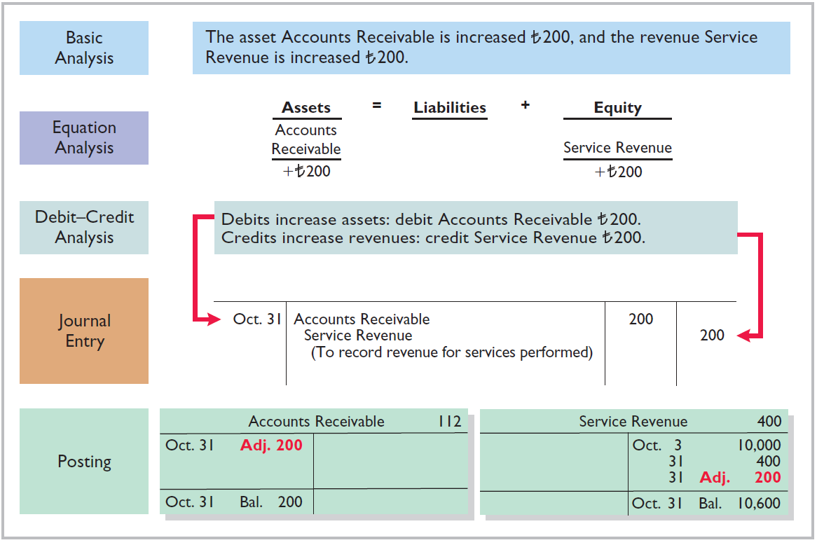
Illustration 3-14
Adjustment for accrued revenue
LO 6

Slide 11
ACCRUED REVENUES
Illustration 3-15
Accounting for accrued revenues
LO 6

Slide 12
ACCRUED EXPENSES
Expenses incurred but not yet paid in cash or recorded.
Expense Recorded
BEFORE
Cash Payment
Accrued expenses often occur in regard to:
Interest
Taxes
Salaries
LO 6

Slide 13
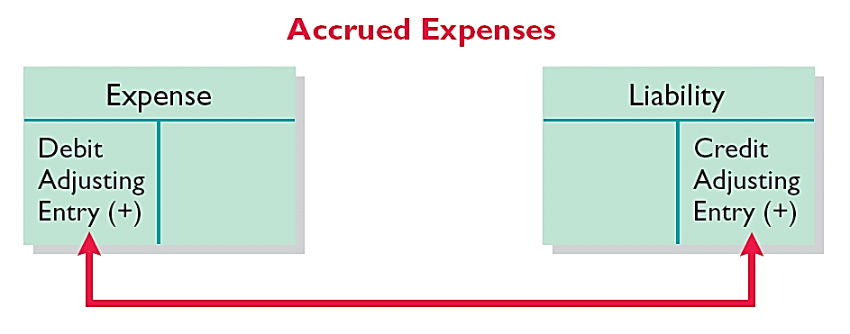
ACCRUED EXPENSES
Adjusting entry records the obligation and recognizes the expense.
Adjusting entry:
Increase (debit) an expense account and
Increase (credit) a liability account.
Illustration 3-16
Adjusting entries for accrued expenses
LO 6

Slide 14
ACCRUED INTEREST
Illustration: Yazici Advertising Inc. signed a three-month note payable in the amount of ₺5,000 on October 1. The note requires Yazici to pay interest at an annual rate of 12%.
Illustration 3-17
Formula for computing interest
Oct. 31
Interest Expense
50
Interest Payable
50
LO 6

Slide 15
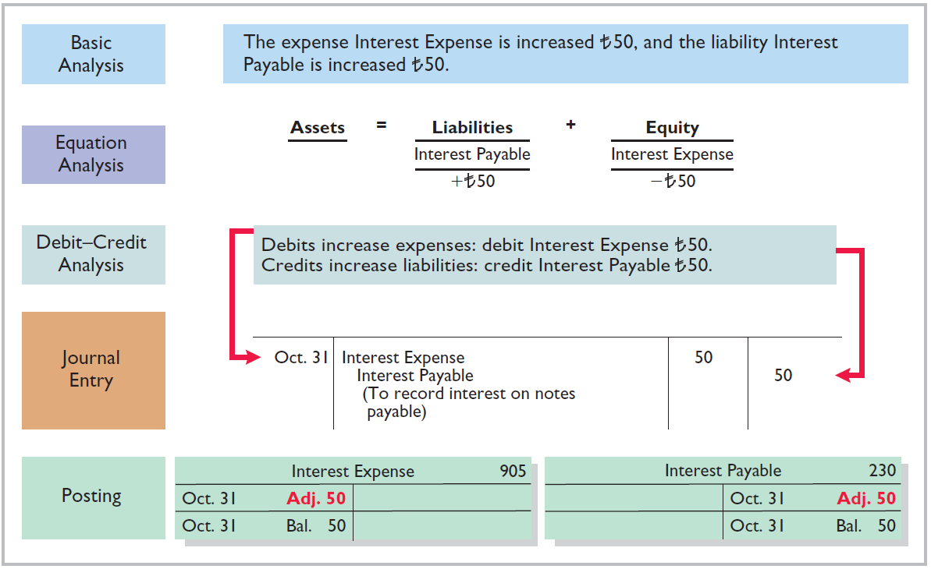
Illustration 3-18
Adjustment for accrued interest
LO 6

Slide 16
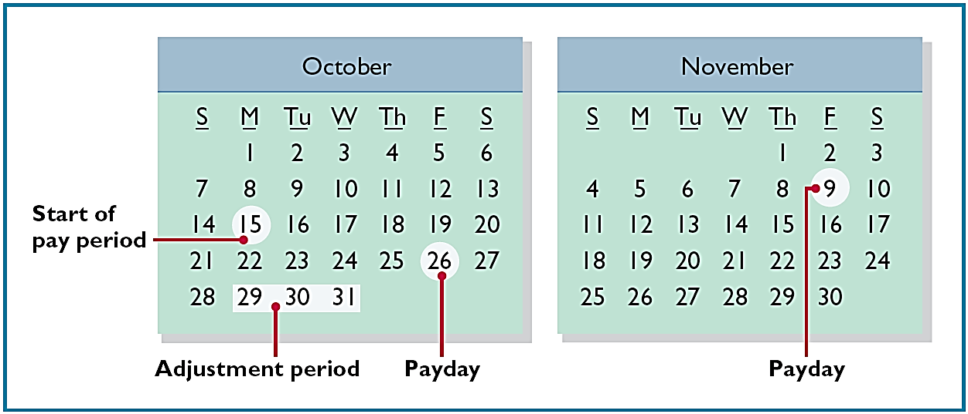
ACCRUED SALARIES AND WAGES
Illustration: Yazici paid salaries and wages on October 26; the next payment of salaries will not occur until November 9. The employees receive total salaries of ₺2,000 for a five-day work week, or ₺400 per day. Thus, accrued salaries at October 31 are ₺1,200 (₺400 x 3 days).
Illustration 3-19
Calendar showing Yazici’s pay
periods
LO 6

Slide 17
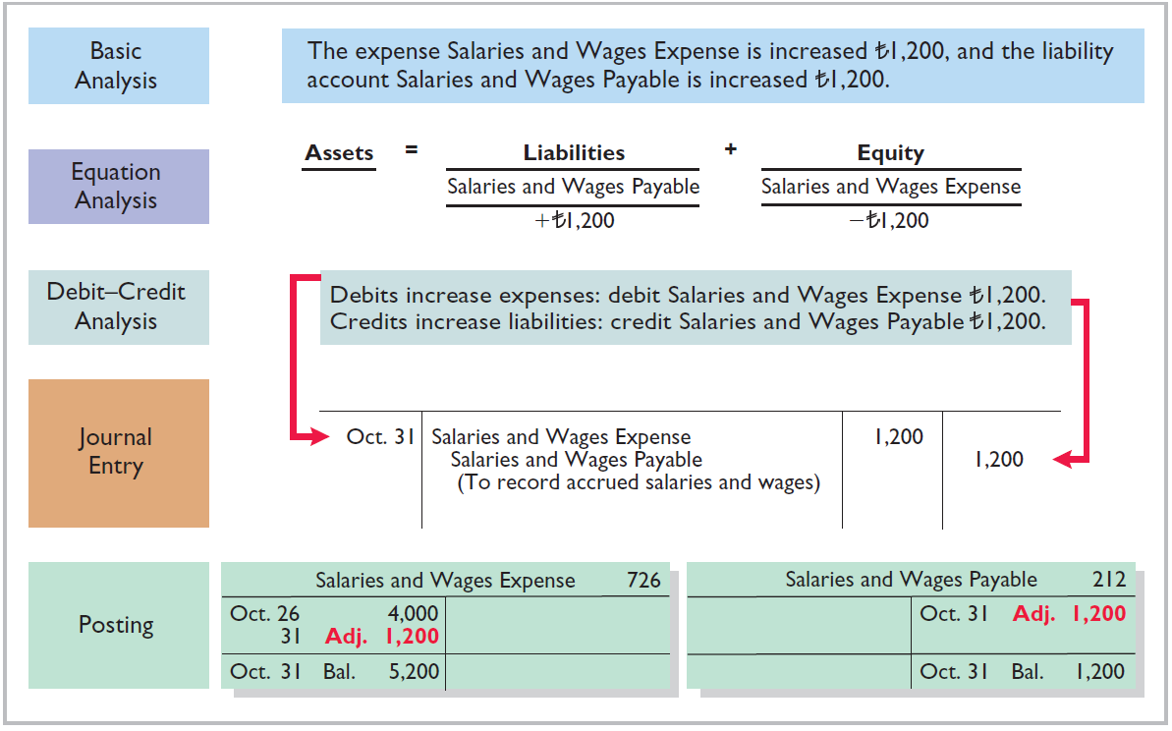
Illustration 3-20
Adjustment for accrued salaries and wages
LO 6

Slide 18
ACCRUED EXPENSES
Illustration 3-21
Accounting for accrued expenses
LO 6

Slide 19
People, Plant, and Profit Insight
Got Junk?
Do you have an old computer or two that you no longer use? How about an old TV that needs replacing? Many people do. Approximately 163,000 computers and televisions become obsolete each day. Yet, estimates indicate that only 11% of computers are recycled and 75% of all computers ever sold are sitting in storage somewhere, waiting to be disposed of. Each of these old TVs and computers is loaded with lead, cadmium, mercury, and other toxic chemicals. If you have one of these electronic gadgets, you have a responsibility, and a probable cost, for disposing of it. Companies have the same problem, but their discarded materials may include lead paint, asbestos, and other toxic chemicals.
LO 6

Slide 20
>
DO IT!
Micro Computer Services began operations on August 1, 2017. At the end of August 2017, management prepares monthly financial statements. The following information relates to August.
At August 31, the company owed its employees ¥8,000 in salaries and wages that will be paid on September 1.
On August 1, the company borrowed ¥300,000 from a local bank on a 15-year mortgage. The annual interest rate is 10%.
Revenue for services performed but unrecorded for August totaled ¥11,000.
Prepare the adjusting entries needed at August 31, 2017.
LO 6

Slide 21
>
DO IT!
Prepare the adjusting entries needed at August 31, 2017.
At August 31, the company owed its employees ¥8,000 in salaries and wages that will be paid on September 1.
On August 1, the company borrowed ¥300,000 from a local bank on a 15-year mortgage. The annual interest rate is 10%.
Revenue for services performed but unrecorded for August totaled ¥11,000.
Salaries and Wages Expense 8,000
Salaries and Wages Payable 8,000
Interest Expense 2,500
Interest Payable 2,500
Accounts Receivable 11,000
Service Revenue 11,000
LO 6

Slide 22
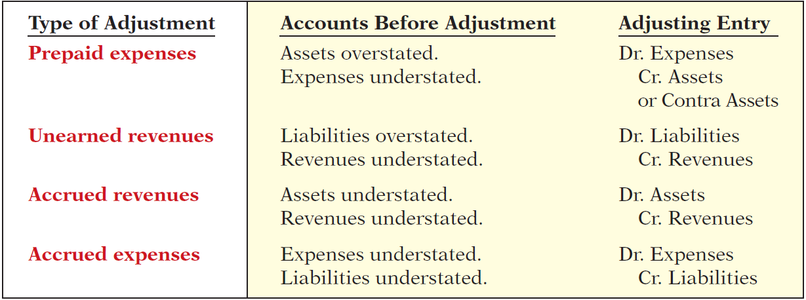
Summary of Basic Relationships
Illustration 3-22
Summary of adjusting entries
LO 6

Slide 23
The Adjusted Trial Balance and Financial Statements
Learning Objective 7
Describe the nature and purpose of an
adjusted trial balance.
Preparing the Adjusted Trial Balance
Prepared after all adjusting entries are
journalized and posted.
Purpose is to prove the equality of debit balances and credit balances in the ledger.
Is the primary basis for the preparation of financial statements.
LO 7

Slide 24
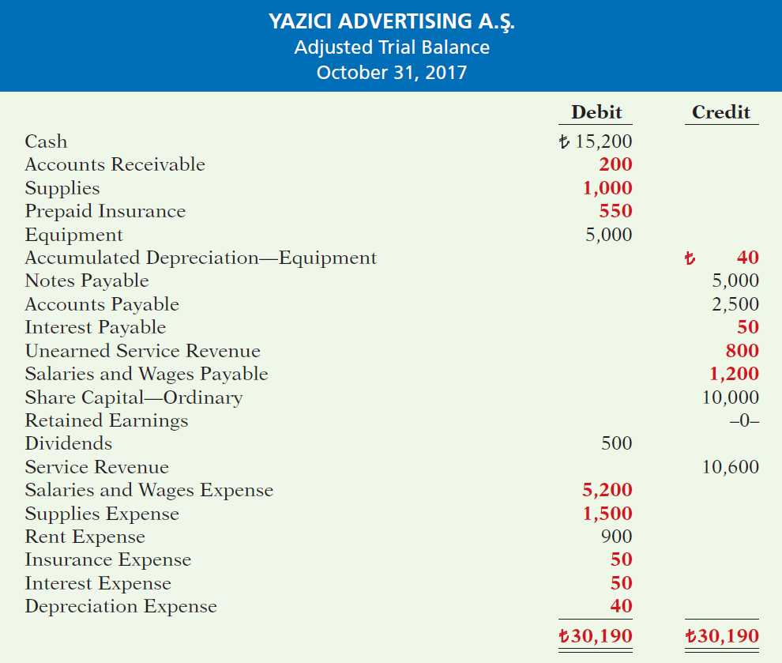
Illustration 3-25
Adjusted trial balance
LO 7

Slide 25
Preparing the Adjusted Trail Balance
Question
Which of the following statements is incorrect concerning the adjusted trial balance?
(a) An adjusted trial balance proves the equality of the total debit balances and the total credit balances in the ledger after all adjustments are made.
The adjusted trial balance provides the primary basis for the preparation of financial statements.
The adjusted trial balance lists the account balances segregated by assets and liabilities.
The adjusted trial balance is prepared after the adjusting entries have been journalized and posted.
LO 7

Slide 26
Preparing Financial Statements
Financial Statements are prepared directly from the Adjusted Trial Balance.
Income Statement
Retained Earnings Statement
Statement of Financial Position
LO 7

Slide 27
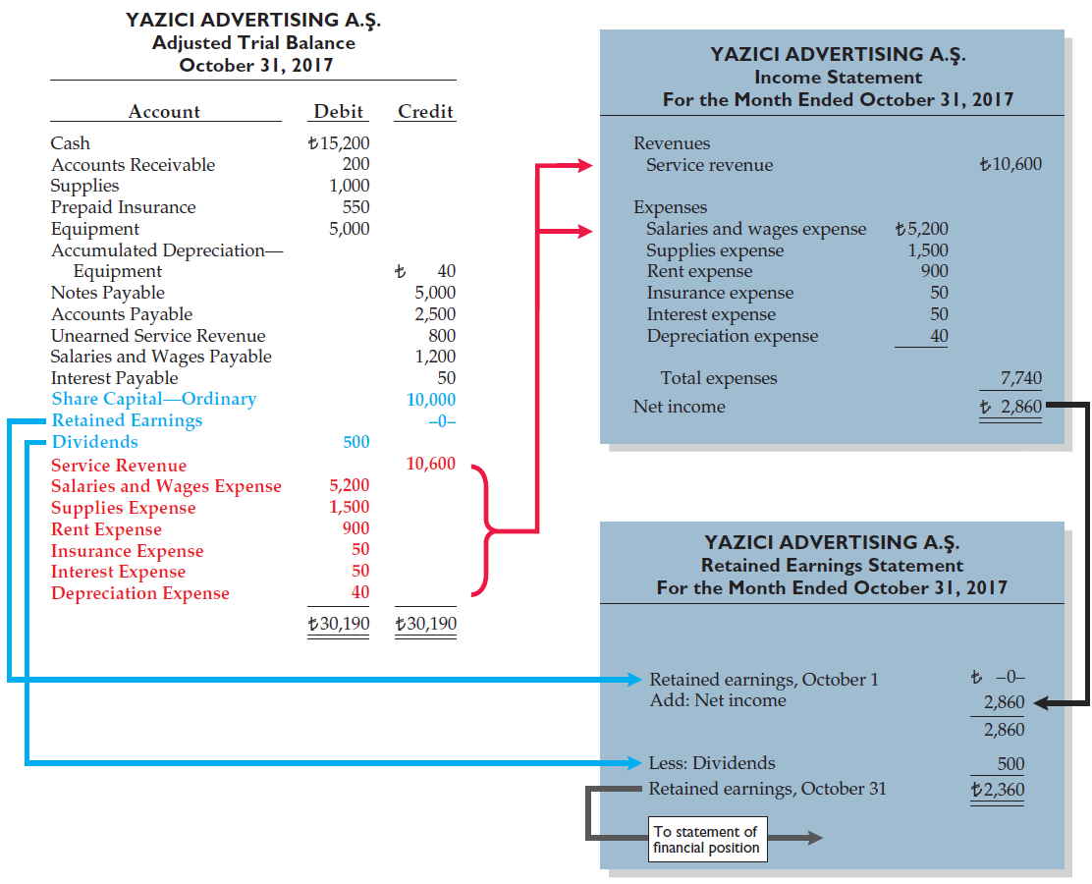
Illustration 3-26
Preparation of the income statement and retained earnings statement from the adjusted trial balance
LO 7

Slide 28
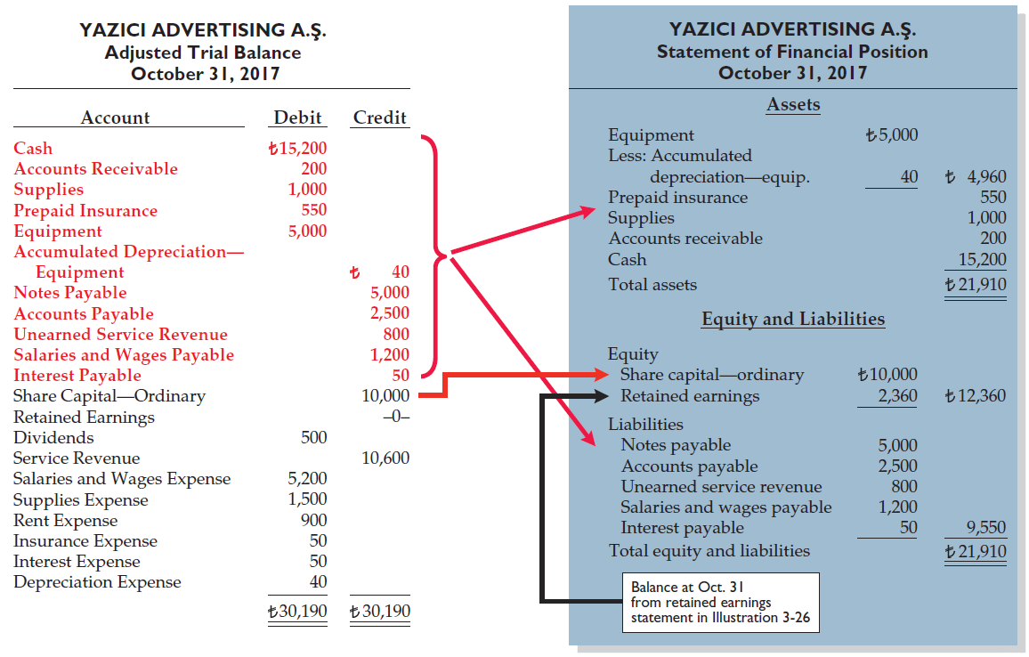
Illustration 3-27
Preparation of the statement of financial position from the adjusted trial balance
LO 7

Slide 29
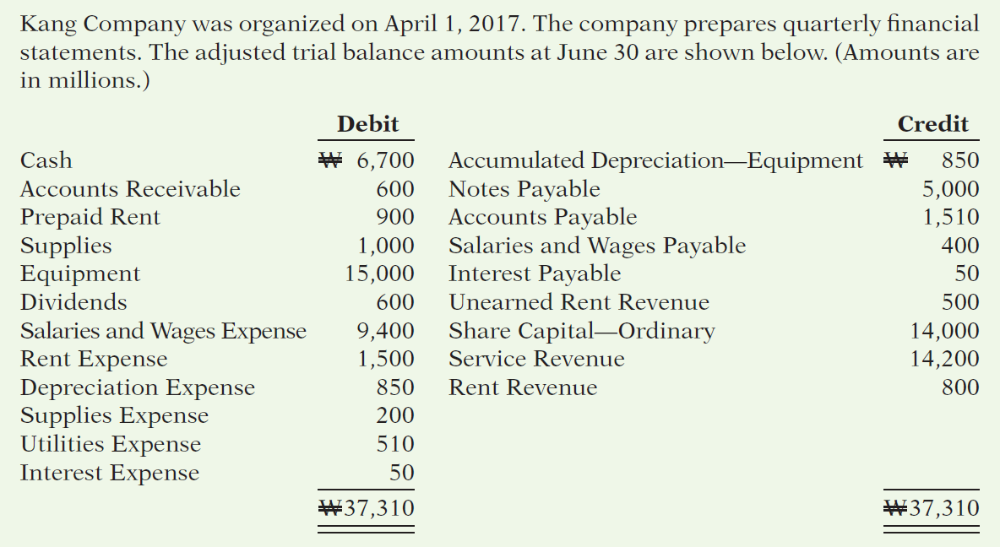
>
DO IT!
LO 7

Slide 30
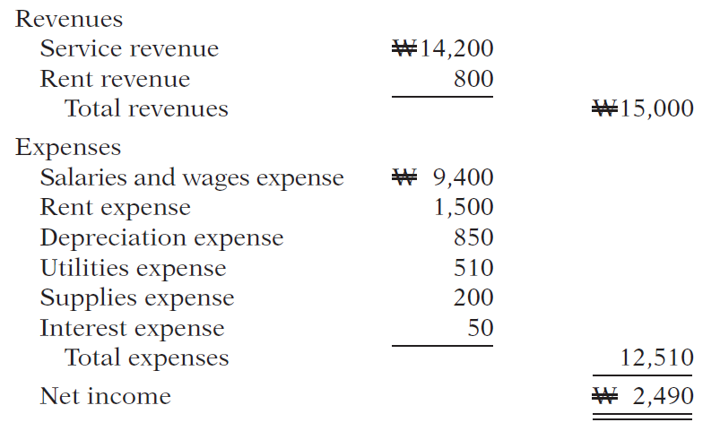
>
DO IT!
(a) Determine the net income for the quarter April 1 to June 30.
LO 7

Slide 31
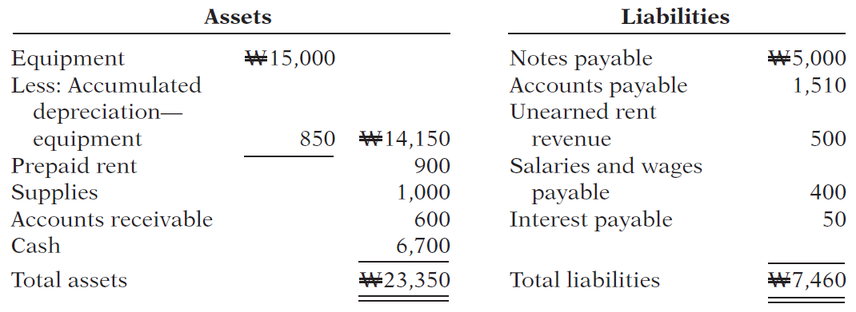
>
DO IT!
Determine the total assets and total liabilities at June 30, 2017, for Skolnick Co.
LO 7

Slide 32
>
DO IT!
Determine the amount that appears for retained earnings at June 30, 2017.
LO 7

Slide 33
APPENDIX 3A
Alternative Treatment of Prepaid Expenses and Unearned Revenues
Learning Objective 8
Prepare adjusting entries for the alternative
treatment of deferrals.
Alternate Treatment
When a company prepays an expense, it debits that amount to an expense account.
When it receives payment for future services, it credits the amount to a revenue account.
LO 8

Slide 34
Prepaid Expenses
Company may choose to debit (increase) an expense account rather than an asset account. This alternative treatment is simply more convenient.
Illustration 3A-2
Adjustment approaches—a comparison
LO 8

Slide 35
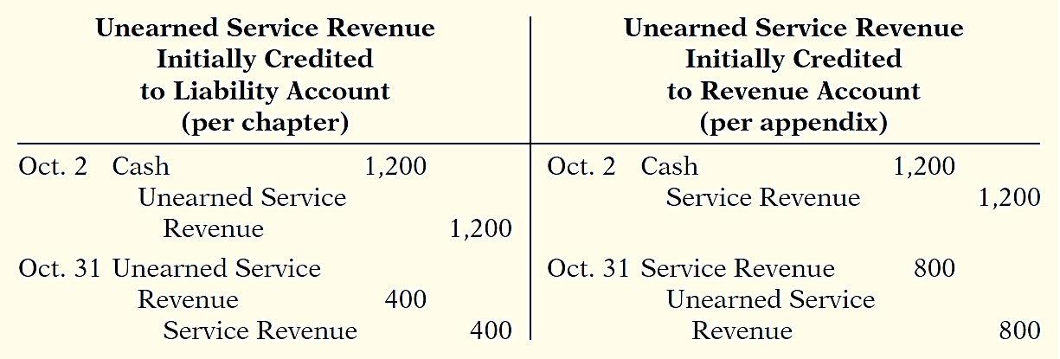
Unearned Revenues
Company may credit (increase) a revenue account when they receive cash for future services.
Illustration 3A-5
Adjustment approaches—a comparison
LO 8

Slide 36
Summary of Additional Adjustments Relationships
Illustration 3A-7
Summary of basic relationships for deferrals
LO 8

Slide 37
APPENDIX 3B
Concepts in Action
Learning Objective 9
Discuss financial reporting concepts.
Qualities of Useful Information
Two fundamental qualities, relevance and
faithful representation.
Relevance
Make a difference in a business decision.
Provides information that has predictive value and confirmatory value.
Materiality is a company-specific aspect of relevance.
An item is material when its size makes it likely to influence the decision of an investor or creditor.
LO 9

Slide 38
Qualities of Useful Information
Two fundamental qualities, relevance and faithful representation.
Faithful Representation
Information accurately depicts what really happened.
Information must be
complete (nothing important has been omitted),
neutral (is not biased toward one position or another), and
free from error.
LO 9

Slide 39
Qualities of Useful Information
ENHANCING QUALITIES
Comparability results when different companies use the same accounting principles.
Information is verifiable if independent
observers, using the same methods, obtain similar results.
Information has the quality of understandability
if it is presented in a clear and concise fashion.
Consistency means that a company uses the same accounting
principles and methods from year to year.
For accounting information to have relevance, it must be timely.
LO 9

Slide 40
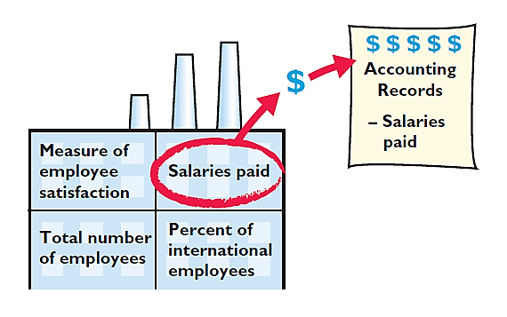
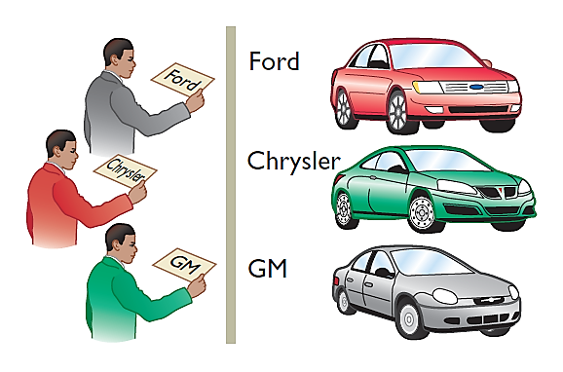
Assumptions in Financial Reporting
Monetary Unit
Economic Entity
Requires that only those things that can be expressed in money are included in the accounting records.
States that every economic entity can be separately identified and accounted for.
Illustration 3B-2
Key assumptions in financial reporting
LO 9

Slide 41
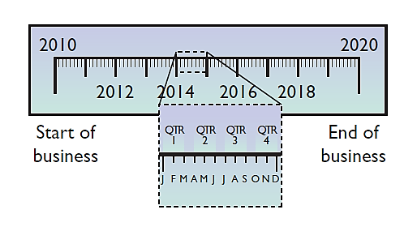
Assumptions in Financial Reporting
Time Period
Going Concern
States that the life of a business can be divided into artificial time periods.
The business will remain in operation for the foreseeable future.
Illustration 3B-2
Key assumptions in financial reporting
LO 9

Slide 42
Principles of Financial Reporting
MEASUREMENT PRINCIPLES
Historical Cost
Fair Value
Or cost principle, dictates that companies record assets at their cost.
Indicates that assets and liabilities should be reported at fair value (the price received to sell an asset or settle
a liability).
LO 9

Slide 43
Principles of Financial Reporting
REVENUE RECOGNITION PRINCIPLE
EXPENSE RECOGNITION PRINCIPLE
FULL DISCLOSURE PRINCIPLE
Requires that companies recognize revenue in the accounting period in which the performance obligation is satisfied.
Dictates that efforts (expenses) be matched with results (revenues). Thus, expenses follow revenues.
Requires that companies disclose all circumstances
and events that would make a difference to financial statement users.
LO 9

Slide 44
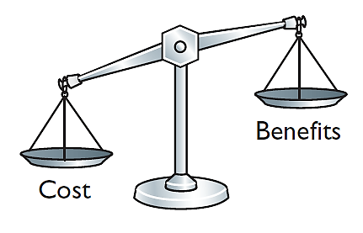
Cost Constraint
Cost Constraint
Accounting standard-setters weigh the cost that companies will incur to provide the information against the benefit that financial statement users will gain from having the information available.
LO 9

Slide 45
A Look at U.S. GAAP
Learning Objective 10
Compare the procedures for the adjusting entries under IFRS and U.S. GAAP.
Key Points
Similarities
Like IFRS, companies applying GAAP use
accrual-basis accounting to ensure that they record transactions that change a company’s financial statements in the period in which events occur.
Similar to IFRS, cash-basis accounting is not in accordance with GAAP.
GAAP also divides the economic life of companies into artificial time periods. Under both GAAP and IFRS, this is referred to as the time period assumption. GAAP requires that companies present a complete set of financial statements, including comparative information annually.
The form and content of financial statements are very similar under GAAP and IFRS. Any significant differences will be discussed in those chapters that address specific financial statements.
Revenue recognition fraud is a major issue in U.S. financial reporting. The same situation exists for most other countries as well.
LO 10

Slide 46
A Look at U.S. GAAP
Key Points
Differences
Prior to the issuance of a new joint revenue recognition standard by the IASB and the FASB, GAAP had more than 100 rules dealing with revenue recognition. Many of these rules were industry-specific. Revenue recognition under IFRS was determined primarily by a single standard, IAS 18. Despite this large disparity in the detailed guidance devoted to revenue recognition, the general revenue recognition principles required by IFRS were similar to those under GAAP.
Internal controls are a system of checks and balances designed to detect and prevent fraud and errors. The Sarbanes-Oxley Act requires U.S. companies to enhance their systems of internal control. However, many foreign companies do not have this requirement.
LO 10

Slide 47
A Look at U.S. GAAP
Key Points
Differences
Under IFRS, revaluation to fair value of items such as land and buildings is permitted. This is not permitted under GAAP.
Under IFRS, the term “income” includes both revenues, which arise during the normal course of operating activities, and gains, which arise from activities outside of the normal sales of goods and services. The term income is not used this way under GAAP. Instead, under GAAP income refers to the net difference between revenues and expenses. Expenses under IFRS include both those costs incurred in the normal course of operations, as well as losses that are not part of normal operations. This is in contrast to GAAP, which defines each separately.
LO 10

Slide 48
A Look at U.S. GAAP
Looking to the Future
In May 2014, the IASB and FASB completed a joint project on revenue recognition. The purpose of this project was to develop comprehensive guidance on when to recognize revenue. This approach focuses on changes in assets and liabilities as the basis for revenue recognition. It is hoped that this approach will lead to more consistent accounting in this area.
LO 10

Slide 49
A Look at U.S. GAAP
A Look at IFRS
IFRS Self-Test Questions
GAAP:
provides the same type of guidance as IFRS for revenue recognition.
provides only general guidance on revenue recognition, compared to the detailed guidance provided by IFRS.
allows revenue to be recognized when a customer makes an order.
requires that revenue not be recognized until cash is received.
LO 10

Slide 50
A Look at U.S. GAAP
A Look at IFRS
IFRS Self-Test Questions
Which of the following statements is false?
GAAP employs the time period assumption.
GAAP employs accrual accounting.
GAAP requires that revenues and costs must be capable of being measured reliably.
GAAP uses the cash basis of accounting.
LO 10

Slide 51
A Look at U.S. GAAP
A Look at IFRS
IFRS Self-Test Questions
Which of the following statements is false?
Under IFRS, the term income describes both revenues and gains.
Under IFRS, the term expenses includes losses.
Under IFRS, firms do not engage in the closing process.
IFRS has fewer standards than GAAP that address revenue recognition.
LO 10

Slide 52
Copyright
“Copyright © 2016 John Wiley & Sons, Inc. All rights reserved. Reproduction or translation of this work beyond that permitted in Section 117 of the 1976 United States Copyright Act without the express written permission of the copyright owner is unlawful. Request for further information should be addressed to the Permissions Department, John Wiley & Sons, Inc. The purchaser may make back-up copies for his/her own use only and not for distribution or resale. The Publisher assumes no responsibility for errors, omissions, or damages, caused by the use of these programs or from the use of the information contained herein.”

