Slide 1
Vertical Analysis

Slide 2
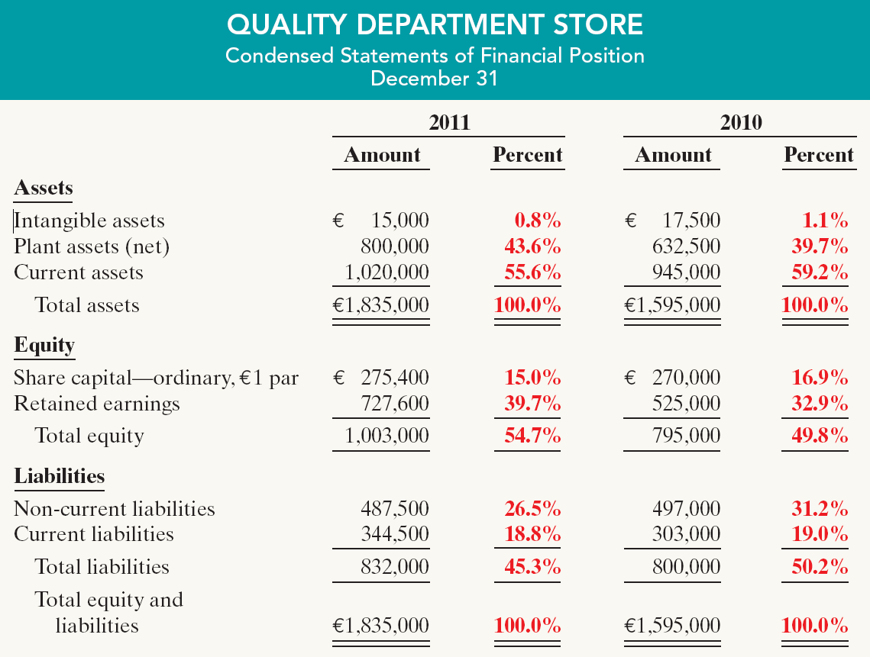
Vertical Analysis
Statement of Financial Position
These results reinforce the earlier observations that Quality is choosing to finance its growth through retention of earnings rather than through issuing additional debt.
Illustration 14-8
SO 4 Describe and apply vertical analysis.

Slide 3
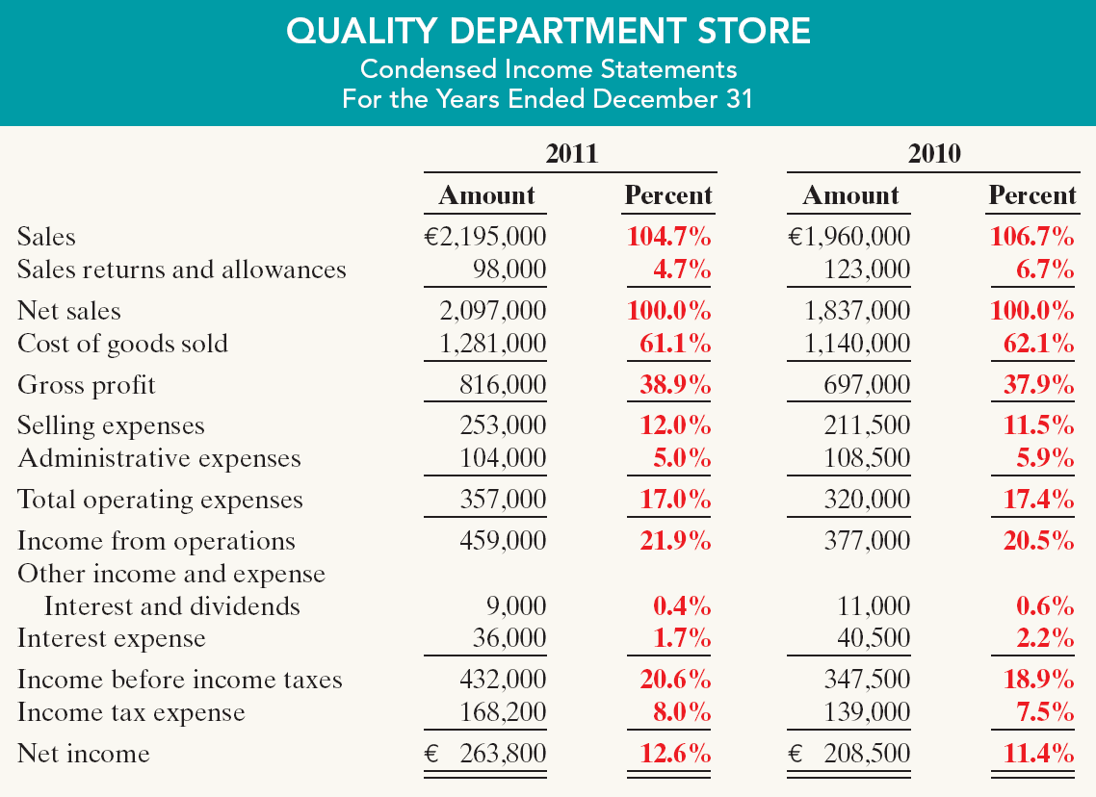
Vertical Analysis
Income Statement
Quality appears
to be a profitable enterprise that is becoming even more successful.
Illustration 14-9
SO 4 Describe and apply vertical analysis.

Slide 4
Vertical Analysis
Enables a comparison of companies of different sizes.
Illustration 14-10
Intercompany income statement comparison
Park Street earned net income more than 4,208 times larger than Quality’s, Park Street’s net income as a percent of each sales euro (5.6%) is only 44% of Quality’s (12.6%).
SO 4 Describe and apply vertical analysis.

