Slide 1
Profitability Ratios

Slide 2
Ratio Analysis
Profitability Ratios
Measure the income or operating success of a company for a given period of time.
Income, or the lack of it, affects the company’s ability to obtain debt and equity financing, liquidity position, and the ability to grow.
Ratios include the profit margin, asset turnover, return on assets, return on ordinary shareholders’ equity, earnings per share, price-earnings, and payout ratio.
SO 5 Identify and compute ratios used in analyzing a firm’s liquidity, profitability, and solvency.

Slide 3
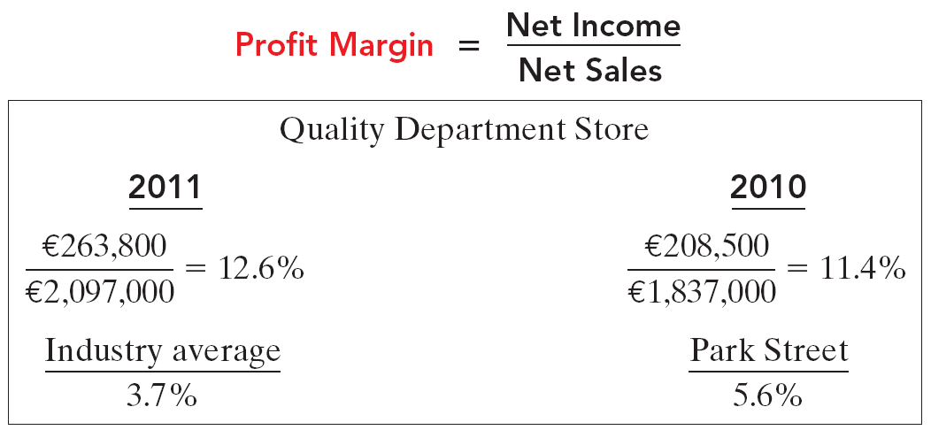
Profitability Ratios
Ratio Analysis
Measures the percentage of each dollar of sales that results in net income.
SO 5 Identify and compute ratios used in analyzing a firm’s liquidity, profitability, and solvency.

Slide 4
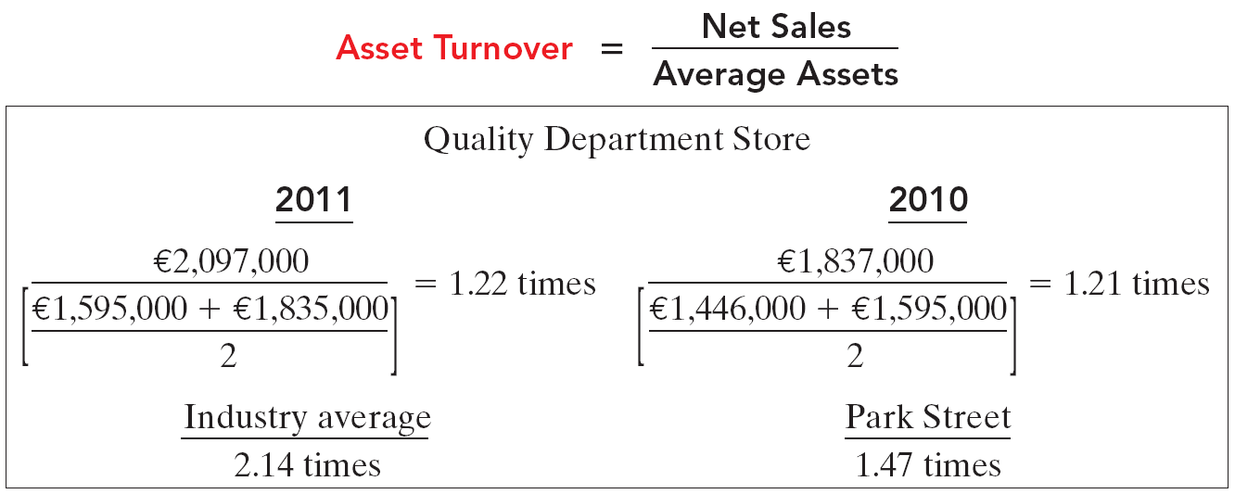
Profitability Ratios
Ratio Analysis
Measures how efficiently a company uses its assets to generate sales.
SO 5 Identify and compute ratios used in analyzing a firm’s liquidity, profitability, and solvency.

Slide 5
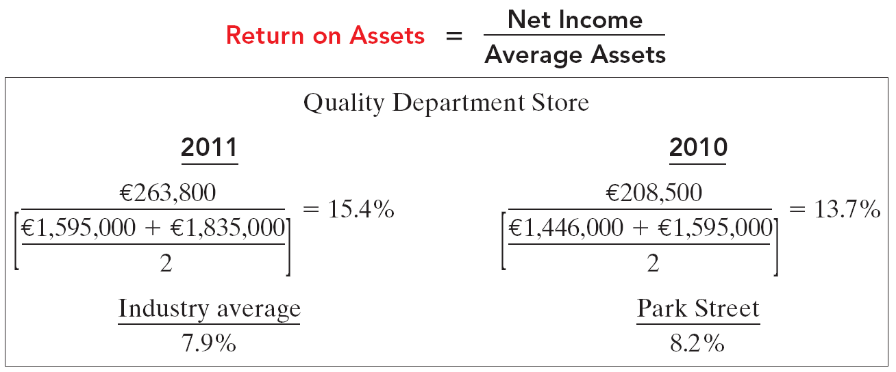
Profitability Ratios
Ratio Analysis
An overall measure of profitability.
SO 5 Identify and compute ratios used in analyzing a firm’s liquidity, profitability, and solvency.

Slide 6
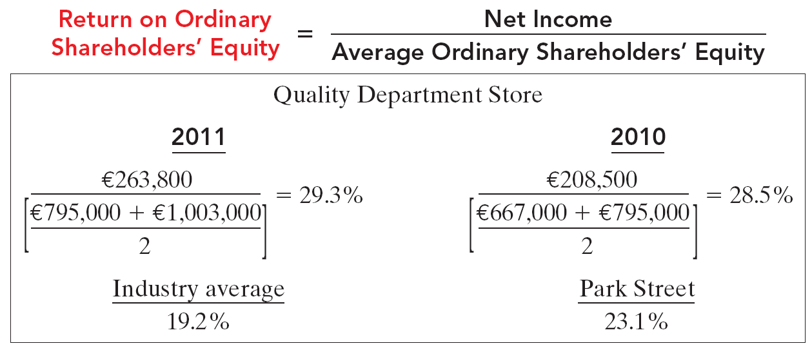
Profitability Ratios
Ratio Analysis
Shows how many euros of net income the company earned for each dollar invested by the owners.
SO 5 Identify and compute ratios used in analyzing a firm’s liquidity, profitability, and solvency.

Slide 7
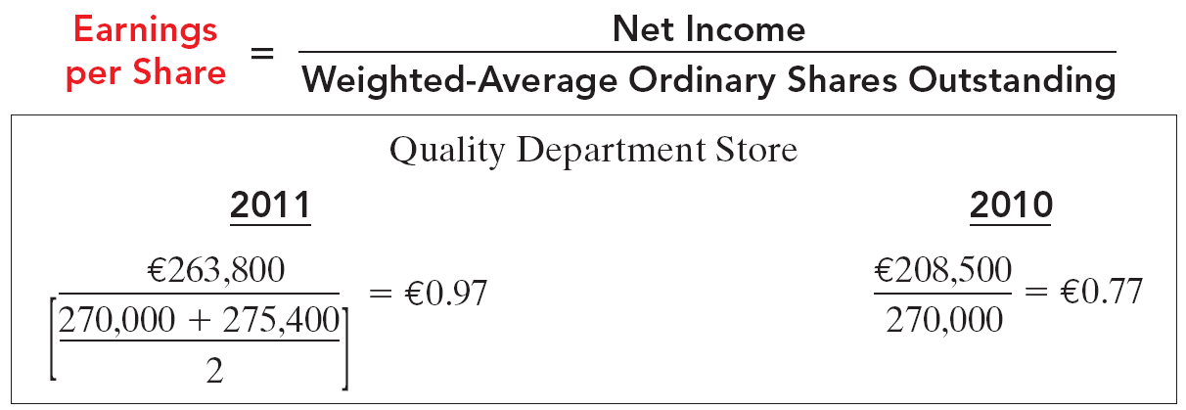
Profitability Ratios
Ratio Analysis
A measure of the amount of net income applicable to each ordinary share.
SO 5 Identify and compute ratios used in analyzing a firm’s liquidity, profitability, and solvency.

Slide 8
Profitability Ratios
Ratio Analysis
The price-earnings (PE) ratio reflects investors’ assessments of a company’s future earnings.
SO 5 Identify and compute ratios used in analyzing a firm’s liquidity, profitability, and solvency.

Slide 9
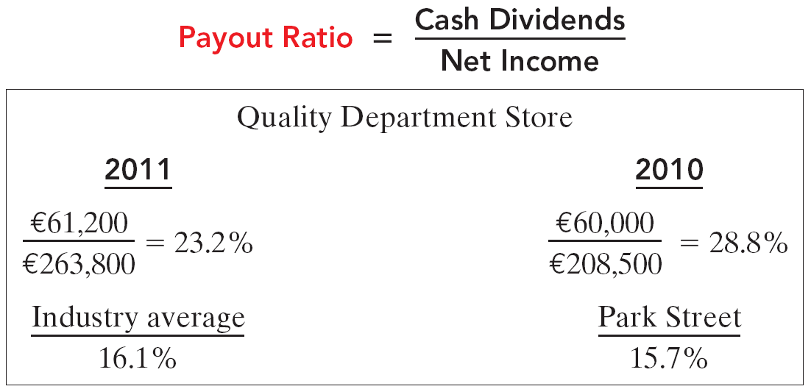
Profitability Ratios
Ratio Analysis
Measures the percentage of earnings distributed in the form of cash dividends.
SO 5 Identify and compute ratios used in analyzing a firm’s liquidity, profitability, and solvency.

Slide 10
Profitability Ratios
Ratio Analysis
Illustration 14-27
Summary of profitability ratios
SO 5 Identify and compute ratios used in analyzing a firm’s liquidity, profitability, and solvency.

