Slide 1
Liquidity Ratios

Slide 2
Liquidity Ratios
Ratio Analysis
Compute the Acid-Test Ratio for 2011.
Illustration 14-13
SO 5 Identify and compute ratios used in analyzing a firm’s liquidity, profitability, and solvency.

Slide 3
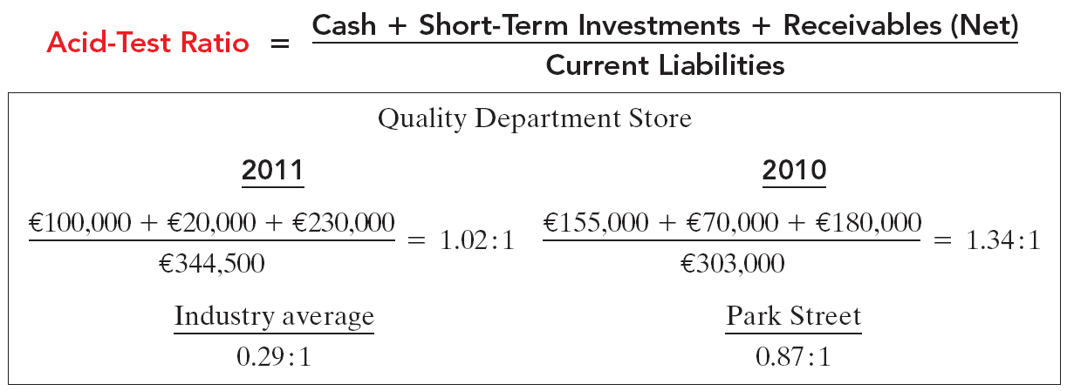
Ratio Analysis
Liquidity Ratios
The acid-test ratio measures immediate liquidity.
SO 5 Identify and compute ratios used in analyzing a firm’s liquidity, profitability, and solvency.

Slide 4
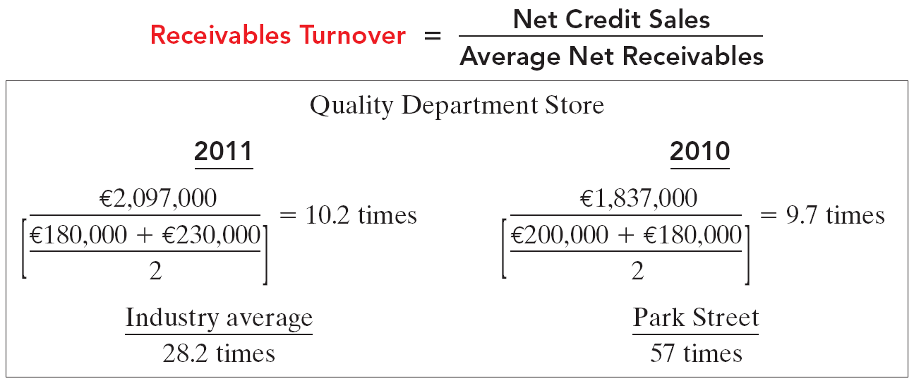
Liquidity Ratios
Ratio Analysis
It measures the number of times, on average, the company collects receivables during the period.
SO 5 Identify and compute ratios used in analyzing a firm’s liquidity, profitability, and solvency.

Slide 5
Liquidity Ratios
Ratio Analysis
A variant of the receivables turnover ratio is to convert it to an average collection period in terms of days.
365 days / 10.2 times = every 35.78 days
This means that receivables are collected on average every 36 days.
SO 5 Identify and compute ratios used in analyzing a firm’s liquidity, profitability, and solvency.

Slide 6
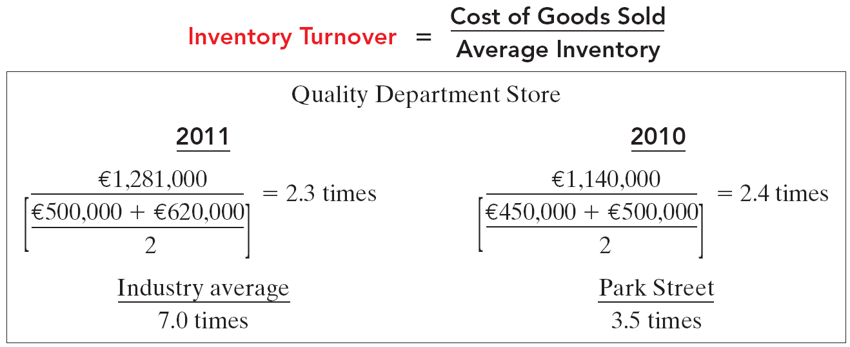
Liquidity Ratios
Ratio Analysis
Inventory turnover measures the number of times, on average, the inventory is sold during the period.
SO 5 Identify and compute ratios used in analyzing a firm’s liquidity, profitability, and solvency.

Slide 7
Liquidity Ratios
Ratio Analysis
A variant of inventory turnover is the days in inventory.
365 days / 2.3 times = every 159 days
Inventory turnover ratios vary considerably among industries.
SO 5 Identify and compute ratios used in analyzing a firm’s liquidity, profitability, and solvency.

Slide 8
Liquidity Ratios
Ratio Analysis
Illustration 14-27
Summary of liquidity ratios
SO 5 Identify and compute ratios used in analyzing a firm’s liquidity, profitability, and solvency.

