Slide 1
Horizontal Analysis

Slide 2
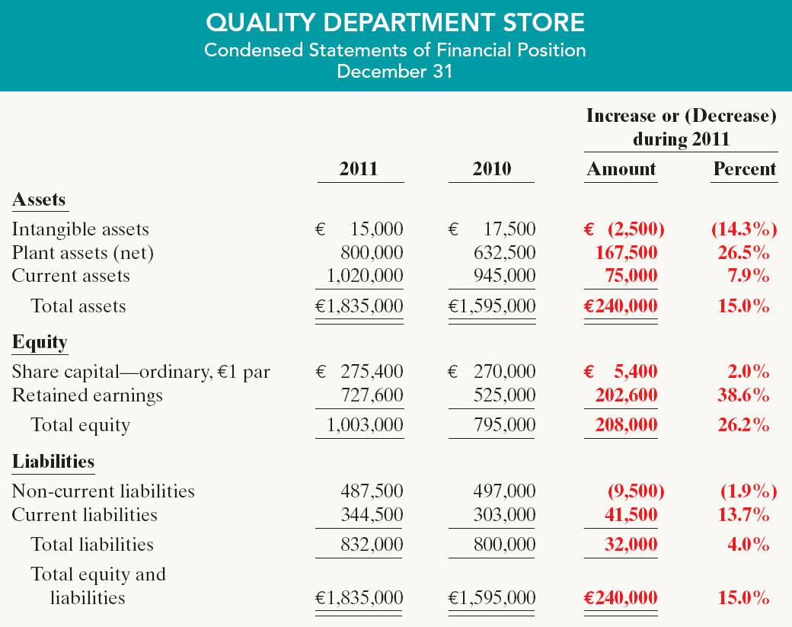
Horizontal Analysis
Statement of Financial Position
These changes suggest that the company expanded its asset base during 2011 and financed this expansion primarily by retaining income rather than assuming additional long-term debt.
Illustration 14-5
SO 3 Explain and apply horizontal analysis.

Slide 3
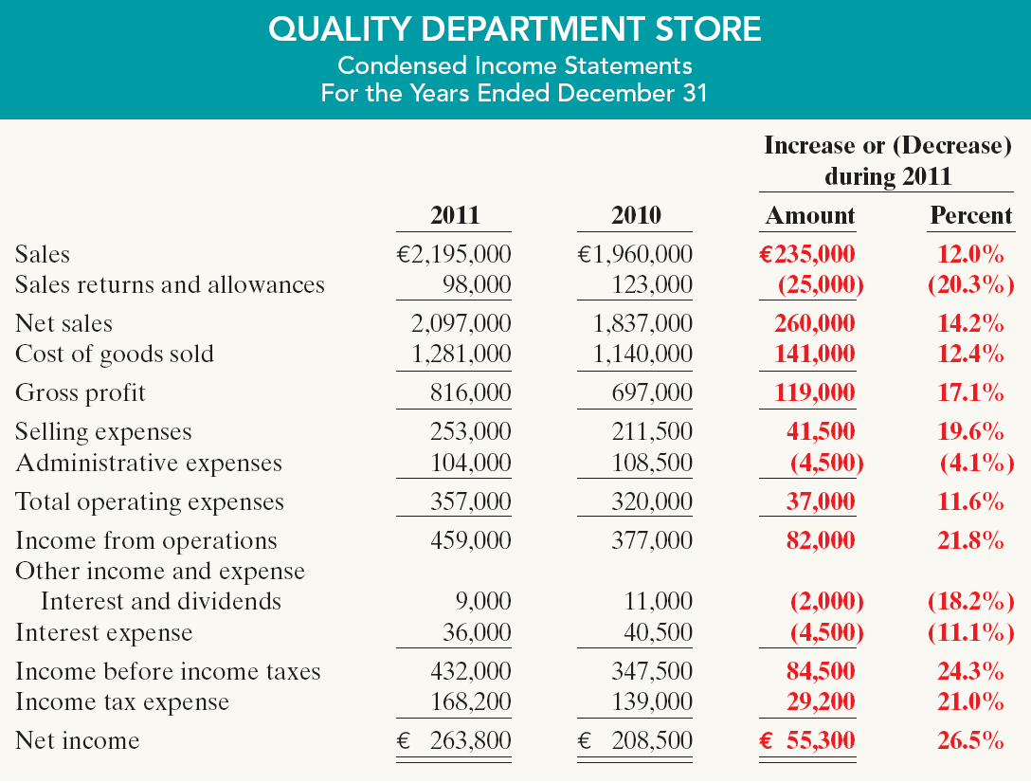
Horizontal Analysis
Income Statement
Overall, gross profit and net income were up substantially. Gross profit increased
17.1%, and net income, 26.5%. Quality’s profit trend appears favorable.
Illustration 14-6
SO 3 Explain and apply horizontal analysis.

Slide 4
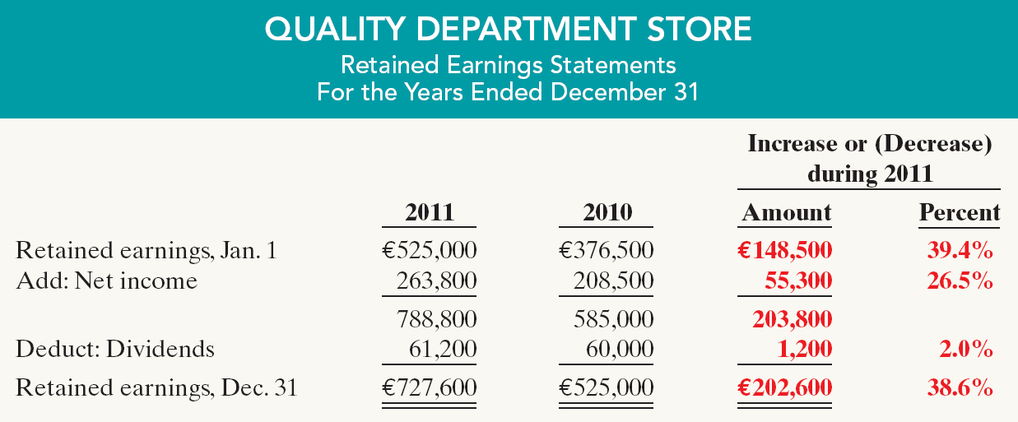
Horizontal Analysis
Retained Earnings Statement
Illustration 14-7
We saw in the horizontal analysis of the statement of financial position that ending retained earnings increased 38.6%. As indicated earlier, the company retained a significant portion of net income to finance additional plant facilities.
SO 3 Explain and apply horizontal analysis.

Slide 5

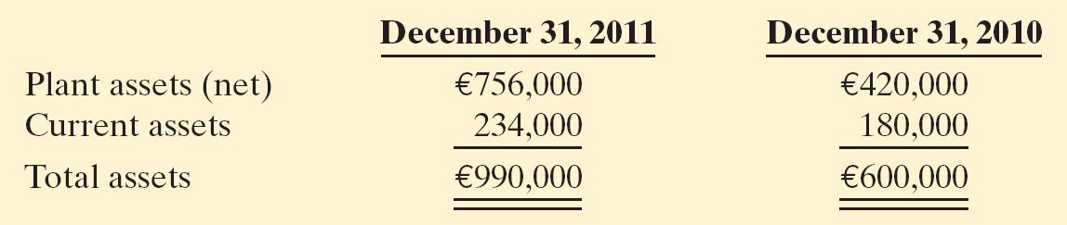
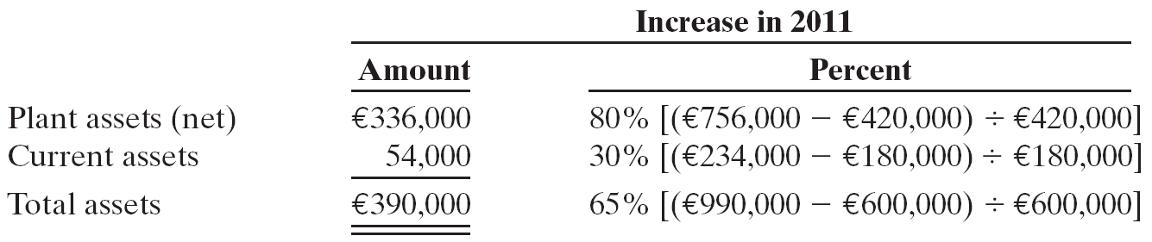
Horizontal Analysis
Illustration: Summary financial information for Rosepatch Company is as follows.
Compute the amount and percentage changes in 2011 using horizontal analysis, assuming 2010 is the base year.
Solution
SO 4 Describe and apply horizontal analysis.

