Slide 1
Multinational Accounting: Issues in Financial Reporting and Translation of Foreign Entity Statements
Chapter 12
Notes:
Note: Students sometimes like to print slides as “handouts” with 1, 2, 3, 4, 6, or 9 slides per page for taking notes in class. It is sometimes best to print them using the “pure black and white” option on the color/gray scale dropdown menu to avoid dark boxes that are not conducive to note taking. Be aware that many instructors will only cover a sub-set of the slides available in this file. Also note that we have removed slides containing solutions to group or individual in-class exercises. You may want to print some slides (such as worksheets or slides with a large quantity of calculations) as a full page slide to facilitate working the exercise in class.

Slide 2
Learning Objective 1
Understand and explain differences between U.S. GAAP and international financial reporting standards (IFRS) and the expected timeline to global convergence.

Slide 3
General Overview
Accountants preparing financial statements for multinationals must consider:
Differences in accounting standards across countries and jurisdictions
Differences in currencies used to measure the foreign entity’s operations
Notes:
3

Slide 4
Differences in Accounting Principles
Methods used to measure economic activity differ around the world
Benefits of adoption of a single set of globally accepted accounting standards
Expansion of capital markets across borders
Help investors to better evaluate opportunities across borders
Reduce reporting costs for companies accessing capital in other countries
Increased confidence for users
Notes:
4

Slide 5
Differences in Accounting Principles
International Financial Reporting Standards (IFRS)
Standards published by the International Accounting Standards Board (IASB)
Widely accepted
Mandated or permitted in over 100 countries
FASB is working with the IASB to improve the quality of standards and to “converge” their two sets of standards
Notes:
5

Slide 6
Differences in Accounting Principles
New SEC rules
Allow foreign private issuers to file statements prepared in accordance with IFRS as issued by the IASB without reconciliation to U.S. GAAP (January 4, 2008)
Next steps:
Allow U.S. issuers to choose between IFRS and U.S. GAAP
Require U.S. issuers to use IFRS
Notes:
6

Slide 7
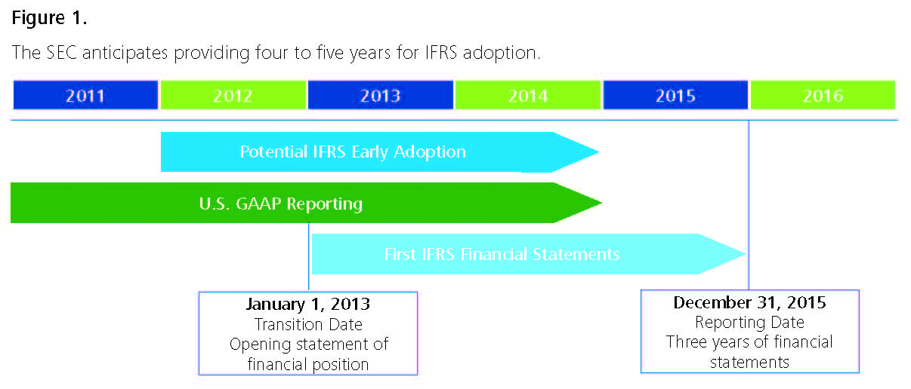
Differences in Accounting Principles
The financial crisis has postponed the SEC Roadmap, but they now have a new “working plan.”
Notes:
7

Slide 8
Practice Quiz Question #1
What major change did the SEC allow in 2008 with respect to IFRS?
a. U.S. registrants are required to use IFRS.
b. Foreign registrants are now required to use U.S. GAAP if their shares are traded in the U.S.
c. U.S. registrants may use IFRS without reconciliation to U.S. GAAP.
d. Foreign registrants may use IFRS without reconciliation to U.S. GAAP.

Slide 9
Learning Objective 2
Determine the functional currency and understand the ramifications of different functional currency designations.

Slide 10
Determining the Functional Currency
Two major issues that must be addressed when financial statements are translated from a foreign currency into U.S. dollars:
Which exchange rate should be used to translate foreign currency balances to domestic currency?
How should translation gains and losses be accounted for? Should they be included in income?
Notes:
10

Slide 11
Determining the Functional Currency
Exchange rates that may be used in converting foreign currency values to the U.S. dollar:
The current rate
The historical rate
The average rate for the period
Notes:
11

Slide 12
Determining the Functional Currency
Functional currency
“The currency of the primary economic environment in which the entity operates; normally that is the currency of the environment in which an entity primarily generates and receives cash”
Used to differentiate between foreign operations that are self-contained and integrated into a local environment, and those that are an extension of the parent and integrated with the parent
Notes:
12

Slide 13
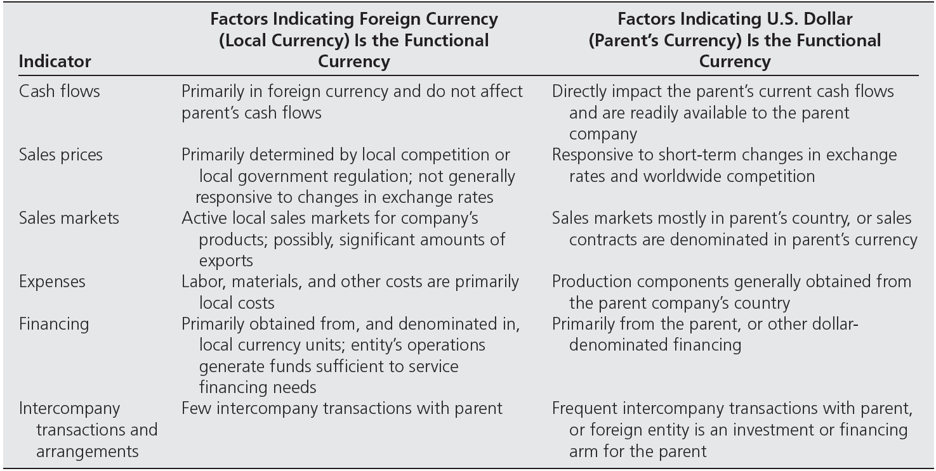
Functional Currency Indicators
Notes:
13

Slide 14
Functional Currency Indicators
Functional currency designation in highly inflationary economies
The volatility of hyperinflationary currencies distorts the financial statements if the local currency is used as the foreign entity’s functional currency
In such cases, the reporting currency of the U.S. parent—the U.S. dollar—should be used as the foreign entity’s functional currency
Notes:
14

Slide 15
Practice Quiz Question #2
Which of the following is NOT an indicator that a U.S. parent’s currency should be the functional currency?
a. Sales contracts denominated in U.S dollars.
b. Raw materials purchased from vendors in the U.S.
c. Sales contracts denominated in subsidiary’s currency.
d. Labor costs of factory workers in the U.S. producing inventory.

Slide 16
Learning Objective 3
Understand and explain the differences between translation and remeasurement.

Slide 17
Big Picture: Foreign Currencies
Assumptions:
Pepper is a U.S.-based company
Salt is based in Italy and the functional currency is the Euro.
In order to “add them up,” they need to be stated in the same currency.
Objective:
Convert oranges to apples.
Notes:
17

Slide 18
Translation Versus Remeasurement of Foreign Financial Statements
Methods used to restate foreign entity statements to U.S. dollars:
The translation of the foreign entity’s functional currency statements into U.S. dollars
The remeasurement of the foreign entity’s statements into the functional currency of the entity
After remeasurement, the statements must then be translated if the functional currency is not the U.S. dollar.
No additional work is needed if the functional currency is the U.S. dollar
Notes:
18

Slide 19
Translation Versus Remeasurement
Translation is the most common method used
Applied when the local currency is the foreign entity’s functional currency
The current rate is used to convert local currency asset and liability accounts into U.S. dollars
Historical rates are used to convert equity accounts into U.S. dollars
Revenues and expenses are translated using the average rate for the reporting period
Any translation adjustment that occurs is a component of comprehensive income
This method is called the current rate method
Notes:
19

Slide 20
Translation Versus Remeasurement
Remeasurement is the restatement of the foreign entity’s financial statements from the local currency that the entity used into the foreign entity’s functional currency
Required only when the functional currency is different from the currency used to maintain the books and records of the foreign entity
The method used is called the temporal method
Notes:
20

Slide 21
Translation Versus Remeasurement
Example: A U.S. company owns 100% of the stock of an Argentinian company. The local currency in Argentina is the peso.
Scenario 1: The company pays employees, buys inventory, and conducts most of its operations in pesos. Thus, its functional currency is the peso.
Translate the financial statements to U.S. dollars
Scenario 2: The company pays buys and sells most of its inventory in southern Brazil. It also pays many of its employees in Brazilian reias. Thus, its functional currency is the Brazilian real.
Remeasure the financial statements to reais.
Then, translate them back to U.S. dollars.
Notes:
21

Slide 22
Translation Versus Remeasurement
LC = Local Currency
FC = Functional Currency
Summary for U.S. Parent Companies:
If LC = FC ➔ Translate to U.S. Dollars
If LC ≠ FC ➔ Remeasure to FC
If FC = U.S. dollars, no further work is needed (this is the case for subsidiaries in countries with hyperinflationary currencies)
If FC ≠ U.S. dollars ➔ Translate to U.S. Dollars (this is the case for Scenario 2 of the Argentinian company in the previous example)
Notes:
22

Slide 23
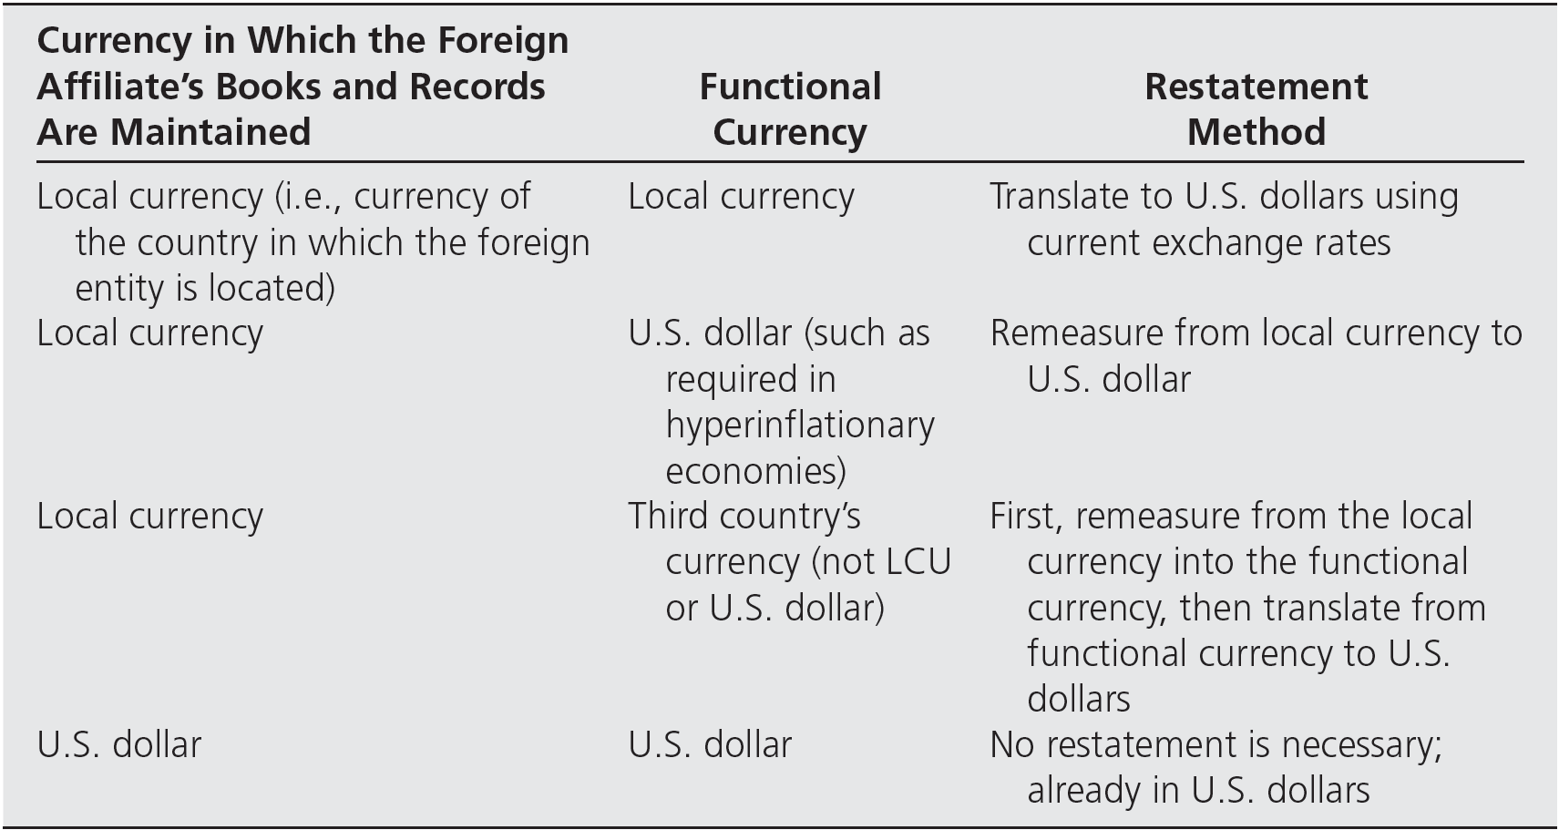
Translation Versus Remeasurement
An overview of the methods a U.S. company would use to restate a foreign affiliate’s financial statements in U.S. dollars.
Notes:
23

Slide 24
Translation Versus Remeasurement
Remeasurement
Monetary balance sheet items are remeasured using the current rate
Nonmonetary balance sheet items are remeasured using historical rates
Revenues and expenses are remeasured using:
The average rate for items related to monetary items (e.g., the gain on the sale of a fixed asset)
Historical rates for income statement items related to nonmonetary items (e.g., depreciation)
Any imbalance flows through the income statement as a remeasurement gain or loss.
Notes:
24

Slide 25
Practice Quiz Question #3
Which of the following statements is false?
a. Translation is always into U.S dollars.
b. Remeasurement results in a change of accounting principle.
c. After remeasurement into the functional currency, it is sometimes necessary to translate to U.S. dollars if the functional currency is not the U.S. dollar.
Translation is more common than remeasurement.
e. Translation uses the current rate method.

Slide 26
Learning Objective 4
Make calculations and translate financial statements of a foreign subsidiary.

Slide 27
Translation
Generally, the translation is made as follows:
Note: Retained Earnings is unique (with a mix of average and historical rates).
Net income is translated using the average exchange rate
Dividends are translated using the historical rate on the date of declaration.
 | Functional Currency | Rate | U.S. $
Retained Earnings 1/1 |  | Mixed
+ Net Income |  | Average
- Dividends |  | Historical
Retained Earnings 12/31 |  | Mixed
Notes:
27

Slide 28
Translation
Generally, the translation is made as follows:
Because various rates are used, the trial balance debits and credits after translation generally are not equal
The balancing item to make the translated trial balance debits equal the credits is called the translation adjustment
It by-passes the income statement as part of “other comprehensive income.”
Notes:
28

Slide 29
Translation
Financial statement presentation
The translation adjustment is part of the entity’s comprehensive income for the period
Comprehensive income includes net income and “other comprehensive income”
Income Statement
Statement of
Comprehensive Income
Sales
Cost of Goods sold
Gross Profit
Operating Expenses
Income from Continuing Operations
Extraordinary Items
Discontinued Operations
Net Income
Net Income
+/- OCI Items
Comprehensive Income
Notes:
29

Slide 30
Translation
Financial statement presentation
Major items comprising the other comprehensive income:
Foreign currency translation adjustments
Unrealized gains/losses on available-for-sale securities
Revaluation of cash flow hedges
Adjustments in the minimum pension liability item
Sales
Cost of Goods sold
Gross Profit
Operating Expenses
Income from Continuing Operations
Extraordinary Items
Discontinued Operations
Net Income
Net Income
+/- OCI Items
Comprehensive Income
Notes:
30

Slide 31
Translation
Each period’s other comprehensive income (OCI) is closed to accumulated other comprehensive income (AOCI)
An appropriate title, such as “Accumulated Other Comprehensive Income,” is used to describe this stockholders’ equity item
Notes:
31

Slide 32
Practice Quiz Question #4
Which of the following statements is false?
a. Income statement items are generally translated at the average rate for the year.
b. Assets and liabilities are normally translated at the current rate on the balance sheet date.
c. Equity accounts are usually translated at historical rates.
d. After translated all items, the trial balance must balance by definition.

Slide 33
Learning Objective 5
Prepare consolidated financial statements including a foreign subsidiary after translation.

Slide 34
Group Exercise 1: Translation
On 1/2/X7, Padre Corp. (a U.S. based company) formed a new subsidiary in Honduras, Sucursal Inc., with an initial investment of 150,000 Honduras Lempiras (HNL).
Assume Sucursal:
Purchases inventory evenly throughout 20X7. The ending inventory is purchased 11/30/X7.
Uses straight-line depreciation on fixed assets.
Declares and pays dividends on 11/30/X7.
Purchased the fixed assets on 4/1/X7.
Uses Lempiras as the functional currency.
REQUIRED
Prepare a schedule to translate Sucursal’s financial statements on 12/31/X7 to U.S. dollars.

Slide 35
Group Exercise 1: Translation

Slide 36
Learning Objective 6
Make calculations and remeasure financial statements of a foreign subsidiary.

Slide 37
Remeasurement
Remeasurement is similar to translation in that its goal is to obtain equivalent U.S. dollar values for the foreign affiliate’s accounts so they may be combined or consolidated with the U.S. company’s statements
The exchange rates used are different from those used for translation
Notes:
37

Slide 38
Remeasurement
The process produces the same end result as if the foreign entity’s transactions had been initially recorded in dollars
Because of the variety of rates used, the debits and credits of the U.S. dollar–equivalent trial balance will probably not be equal
The balancing item is a remeasurement gain or loss, which is included in the period’s income statement.
Notes:
38

Slide 39
Remeasurement
Statement presentation
Remeasurement gain or loss is included in the current period income statement, usually under “Other Income”
Upon completion of the remeasurement process, the foreign entity’s financial statements are presented as they would have been had the U.S. dollar been used to record the transactions in the local currency as they occurred
Notes:
39

Slide 40
Monetary Accounts
Monetary ➔ Related to “Money”
By definition:
Monetary accounts are those that have their amounts “fixed” in terms of the units of currency.
They represent amounts that will be received or paid in a fixed number of monetary units.
Generally, they include:
Cash and cash equivalents
Receivables (short- and long-term)
Payables (short- and long-term)

Slide 41
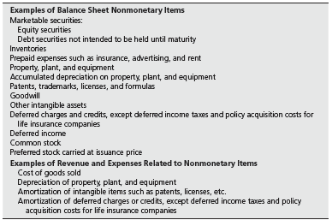
Nonmonetary Accounts

Slide 42
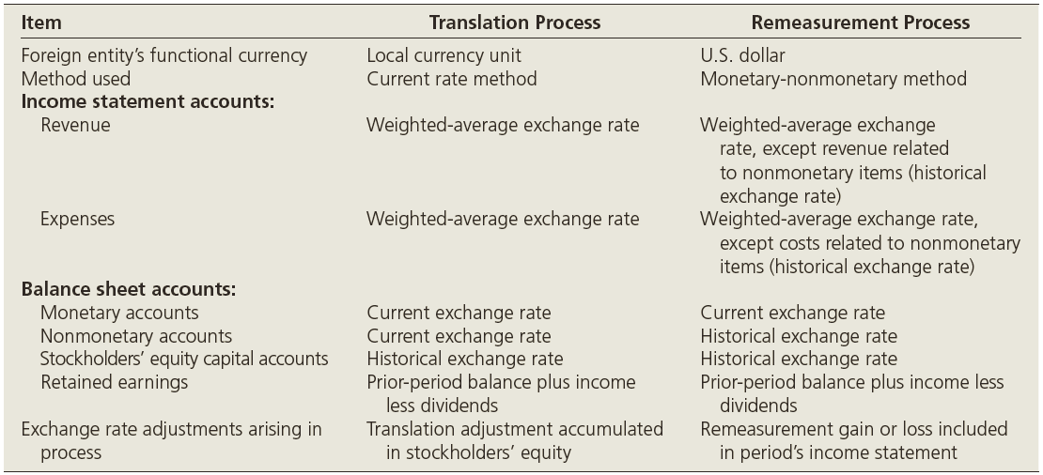
Summary of the Translation and Remeasurement Processes
Notes:
42

Slide 43
Practice Quiz Question #5
Which of the following statements is false?
a. Exchange rates used for remeasurement differ from those used in translation.
b. The only difference in exchange rates between remeasurement and translation of the balance sheet is for the non-monetary accounts.
c. The rates used to remeasure the income statement are all the same as those used in translation.
d. After remeasuring all items, the trial balance usually won’t balance.

Slide 44
Learning Objective 7
Prepare consolidated financial statements including a foreign subsidiary after remeasurement.

Slide 45
Group Exercise 2: Remeasurement
On 1/2/X7, Padre Corp. (a U.S. based company) formed a new subsidiary in Honduras, Sucursal Inc., with an initial investment of 150,000 Honduras Lempiras (HNL).
Assume Sucursal:
Purchases inventory evenly throughout 20X7. The ending inventory is purchased 11/30/X7.
Uses straight-line depreciation on fixed assets.
Declares and pays dividends on 11/30/X7.
Purchased the fixed assets on 4/1/X7.
Uses the U.S. dollar as the functional currency.
REQUIRED:
Prepare a schedule to remeasure Sucursal’s financial statements on 12/31/X7 to U.S. dollars.

Slide 46
Group Exercise 2: Remeasurement

Slide 47
Group Exercise 2: Remeasurement

Slide 48
Learning Objective 8
Understand the issues related to foreign operations including the hedging of a net investment in a foreign subsidiary.

Slide 49
Foreign Investments and Unconsolidated Subsidiaries
A parent company consolidates a foreign subsidiary, except when it is unable to exercise economic control:
Restrictions on foreign exchange in the foreign country
Restrictions on transfers of property in the foreign country
Other governmentally imposed uncertainties
Notes:
49

Slide 50
Foreign Investments and Unconsolidated Subsidiaries
An unconsolidated foreign subsidiary is reported as an investment on the U.S. parent company’s balance sheet
The U.S. company must use the equity method if it has the ability to exercise “significant influence”
When the equity method is used, the investee’s financial statements are either remeasured or translated, depending on the determination of the functional currency
If the equity method cannot be applied, the cost method is used
Notes:
50

Slide 51
Foreign Investments and Unconsolidated Subsidiaries
Liquidation of a foreign investment
The translation adjustment account is directly related to a company’s investment in a foreign entity
If the investor sells a substantial portion of its stock investment, FASB Interpretation No. 37 requires that the pro rata portion of the accumulated translation adjustment account attributable to that investment be included in computing the gain or loss on the disposition of the investment
Notes:
51

Slide 52
Hedge of a Net Investment in a Foreign Subsidiary
FASB 133 permits hedging of a net investment in foreign subsidiaries
The gain or loss on the effective portion of a hedge of a net investment is taken to other comprehensive income as part of the translation adjustment
The amount of offset to comprehensive income is limited to the translation adjustment for the net investment
Any excess must be recognized currently in earnings
Notes:
52

Slide 53
Disclosure Requirements
FASB 52 requires the aggregate foreign transaction gain or loss included in income to be separately disclosed in the income statement or in an accompanying note
If not disclosed as a one-line item on the income statement, this disclosure is usually a one-sentence footnote summarizing the foreign operations
Notes:
53

Slide 54
Additional Considerations
Proof of remeasurement exchange gain or loss
The analysis primarily involves the monetary items, because they are remeasured from the exchange rate at the beginning of the period, or on the date of the generating transaction to the current exchange rate at the end of the period
Notes:
54

Slide 55
Additional Considerations
Statement of Cash Flows
Accounts reported in the statement of cash flows should be restated in U.S. dollars using the same rates as used for balance sheet and income statement purposes
Notes:
55

Slide 56
Additional Considerations
Lower-of-cost-or-market inventory valuation under remeasurement
The historical cost of inventories must be remeasured using historical exchange rates to determine the functional currency historical cost value
These remeasured costs are compared with the inventory market value translated using the current rate
The final step is to compare the cost and market and to recognize any appropriate write-downs to market
Notes:
56

Slide 57
Additional Considerations
Intercompany transactions
Assume that a U.S. company has a foreign currency–denominated receivable from its foreign subsidiary
The U.S. company would first revalue the receivable to its U.S. dollar equivalent value as of the date of the financial statements
After the foreign affiliate’s statements have been translated or remeasured, the receivable should be at the same U.S. dollar value and can be eliminated
Notes:
57

Slide 58
Additional Considerations
Intercompany transactions
FASB 52 provides an exception when the intercompany foreign currency transactions will not be settled within the foreseeable future
These transactions may be considered part of the net investment in the foreign entity
The translation adjustments on these are deferred and accumulated as part of the cumulative translation account
Notes:
58

Slide 59
Additional Considerations
Income taxes
Interperiod tax allocation is required whenever temporary differences exist in the recognition of revenue and expenses for income statement purposes and for tax purposes
Exchange gains and losses from foreign currency transactions require the recognition of a deferred tax if they are included in income but not recognized for tax purposes in the same period
A deferral is required for the portion of the translation adjustment related to the subsidiary’s undistributed earnings that are included in the parent’s income
Notes:
59

Slide 60
Additional Considerations
Income taxes
Deferred taxes need not be recognized if the undistributed earnings will be indefinitely reinvested in the subsidiary
If the parent expects eventually to receive the presently undistributed earnings of a foreign subsidiary, deferred tax recognition is required, and the tax entry would be:
Notes:
60

Slide 61
Additional Considerations
Translation when a third currency is the functional currency
If the entity’s books and records are not expressed in its functional currency, the following two-step process must be used:
Remeasure the subsidiary’s financial statements into the functional currency
The statements expressed in the functional currency are then translated into U.S. dollars
Notes:
61

Slide 62
Practice Quiz Question #6
Which of the following statements is true?
a. Foreign subsidiaries are always consolidated.
b. U.S. GAAP does not allow for the complete liquidation of foreign investments.
c. U.S. GAAP permits the hedging of a net investment in foreign subsidiaries.
The statement of cash flows is always translated at historical costs.
e. Translated intercompany transactions are not eliminated like normal intercompany transactions

Slide 63
Conclusion
The End

