Slide 1
Multinational
Accounting:
Foreign Currency
Transactions and
Financial Instruments
Chapter 11
Notes:
Note: Students sometimes like to print slides as “handouts” with 1, 2, 3, 4, 6, or 9 slides per page for taking notes in class. It is sometimes best to print them using the “pure black and white” option on the color/gray scale dropdown menu to avoid dark boxes that are not conducive to note taking. Be aware that many instructors will only cover a sub-set of the slides available in this file. Also note that we have removed slides containing solutions to group or individual in-class exercises.

Slide 2
Learning Objective 1
Understand how to make calculations using foreign currency exchange rates.

Slide 3
The Accounting Issues
Foreign currency transactions of a U.S. company denominated in other currencies must be restated to their U.S. dollar equivalents before they can be recorded in the U.S. company’s books and included in its financial statements.
  Translation: The process of restating foreign currency transactions to their U.S. dollar equivalent values
Notes:
3

Slide 4
The Accounting Issues
Many U.S. corporations have multinational operations
  The foreign subsidiaries prepare their financial statements in the currency of their countries.
  The foreign currency amounts in these financial statements have to be translated into their U.S. dollar equivalents before they can be consolidated with the U.S. parent’s financial statements.
P
U.S.
S
Foreign
Notes:
4

Slide 5
Foreign Currency Exchange Rates
Foreign currency exchange rates between currencies are established daily by foreign exchange brokers who serve as agents for individuals or countries wishing to deal in foreign currencies.
  Some countries maintain an official fixed rate of currency exchange
Notes:
5

Slide 6
Foreign Currency Exchange Rates
Determination of exchange rates
  Exchange rates change because of a number of economic factors affecting the supply of and demand for a nation’s currency.
  Factors causing fluctuations are a nation’s
    Level of inflation
    Balance of payments
    Changes in a country’s interest rate
    Investment levels
    Stability and process of governance
Notes:
6

Slide 7
Foreign Currency Exchange Rates
Direct Exchange Rate (DER) is the number of local currency units (LCUs) needed to acquire one foreign currency unit (FCU)
  From the viewpoint of a U.S. entity:
  Example: Assume a U.S. based company can purchase one Euro for $1.40.
U.S. dollar–equivalent value
1 FCU
DER =
$1.40
€1
DER =
= 1.40 $/€
Notes:
7

Slide 8
Foreign Currency Exchange Rates
Indirect Exchange Rate (IER) is the reciprocal of the direct exchange rate
  From the viewpoint of a U.S. entity:
  Example: Assume a U.S. based company can purchase one Euro for $1.40.
1 FCU
U.S. dollar–equivalent value
IER =
€1
$1.40
IER =
= 0.7143 €/$
Notes:
8

Slide 9
Foreign Currency Exchange Rates
DER is identified as American terms
  To indicate that it is U.S. dollar–based and represents an exchange rate quote from the perspective of a person in the United States
IER is identified as European terms
  To indicate the direct exchange rate from the perspective of a person in Europe, which means the exchange rate shows the number of units of the European’s local currency units per one U.S. dollar
Notes:
9

Slide 10
Foreign Currency Exchange Rates
Changes in exchange rates
  Strengthening of the U.S. dollar—direct exchange rate decreases, implies:
    Taking less U.S. currency to acquire one FCU
    One U.S. dollar acquiring more FCUs
    Example: DER decreases from $1.40/€ to $1.30/€
  Weakening of the U.S. dollar—direct exchange rate increases, implies:
    Taking more U.S. currency to acquire one FCU
    One U.S. dollar acquiring fewer FCUs
    Example: DER increases from $1.40/€ to $1.50/€
Notes:
10

Slide 11
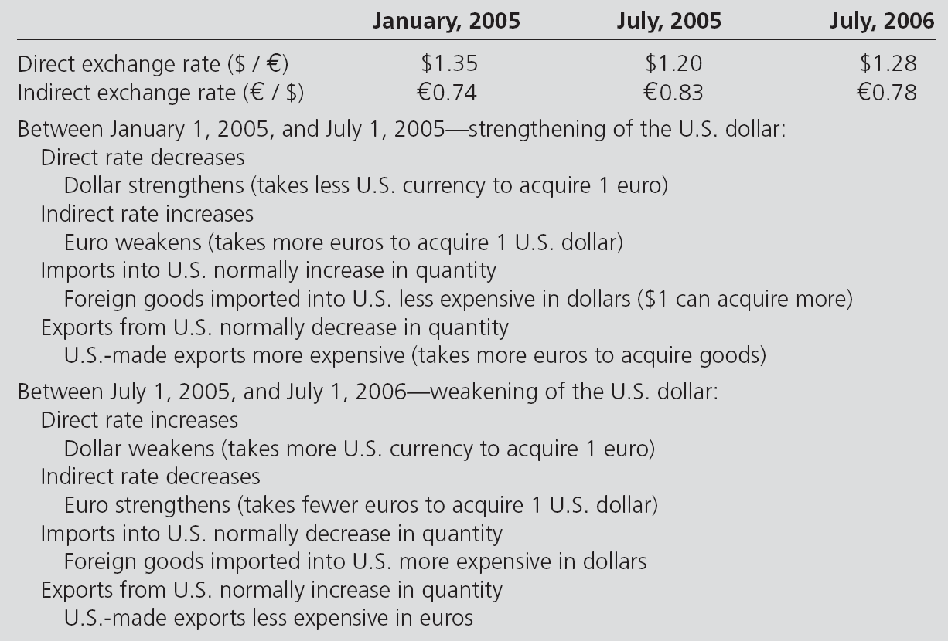
Relationships between Currencies and Exchange Rates
Notes:
11

Slide 12
Foreign Currency Exchange Rates
Spot Rates versus Current Rates
  The spot rate is the exchange rate for immediate delivery of currencies.
  The current rate is defined simply as the spot rate on the entity’s balance sheet date.
Notes:
12

Slide 13
Foreign Currency Exchange Rates
Forward Exchange Rates
  The forward rate on a given date is not the same as the spot rate on the same date.
  Expectations about the relative value of currencies are built into the forward rate.
  The Spread:
    The difference between the forward rate and the spot rate on a given date.
    Gives information about the perceived strengths or weaknesses of currencies
Notes:
13

Slide 14
Foreign Currency Exchange Rates
Forward Exchange Rates Example:
  Assume a U.S.-based company purchases inventory for €1,000 on 3/31 and the contract requires payment on 9/30.
180-day
Forward rate = $1.40/€
Spread = $0.05/€
Spot rate = $1.35/€
3/31
9/30
Notes:
14

Slide 15
Practice Quiz Question #1
Which of the following statements is false?
  a. Most currency exchange rates are determined by brokers on a daily basis.
  b. Economic factors rarely affect exchange rates.
  c. Some countries maintain control over their exchange rates.
  d. When the U.S. dollar strengthens, it has greater buying power overseas and can buy more units of foreign currencies.
  e. A spot rate is the exchange rate for immediate delivery of a currency.

Slide 16
Learning Objective 2
Understand the accounting implications of and be able to make calculations related to foreign currency transactions.

Slide 17
Foreign Currency Transactions
Foreign currency transactions are economic activities denominated in a currency other than the entity’s recording currency.
These include:
    Purchases or sales of goods or services (imports or exports), the prices of which are stated in a foreign currency
    Loans payable or receivable in a foreign currency
    Purchase or sale of foreign currency forward exchange contracts
    Purchase or sale of foreign currency units
Notes:
17

Slide 18
Foreign Currency Transactions
For financial statement purposes, transactions denominated in a foreign currency must be translated into the currency the reporting company uses
At each balance sheet date, account balances denominated in a currency other than the entity’s reporting currency must be adjusted to reflect changes in exchange rates during the period
  The adjustment in equivalent U.S . dollar values is a foreign currency transaction gain or loss for the entity when exchange rates have changed
Notes:
18

Slide 19
Example: Foreign Currency Transactions
Assume that a U.S. company acquires €5,000 from its bank on January 1, 20X1, for use in future purchases from German companies. The direct exchange rate is $1.20 = €1; thus, the company pays the bank $6,000 for €5,000, as follows:
U.S. dollar equivalent value = Foreign currency units x Direct exchange rate
$6,000 = €5,000 x $1.20
The following entry records this exchange of currencies:
On July 2, 20X1, the exchange rate is $1.100 = €1. The following adjusting entry is required in preparing financial statements on July 1:

Slide 20
Foreign Currency Transactions
Foreign currency import and export transactions – Required accounting overview (assuming the company does not use forward contracts)
  Transaction date:
    Record the purchase or sale transaction at the U.S. dollar–equivalent value using the spot direct exchange rate on this date
Notes:
20

Slide 21
Foreign Currency Transactions
Foreign currency import and export transactions – Required accounting overview (assuming the company does not use forward contracts)
  Balance sheet date:
    Adjust the payable or receivable to its U.S. dollar–equivalent, end-of-period value using the current direct exchange rate
    Recognize any exchange gain or loss for the change in rates between the transaction and balance sheet dates
Notes:
21

Slide 22
Foreign Currency Transactions
Foreign currency import and export transactions – Required accounting overview (assuming the company does not use forward contracts)
  Settlement date:
    Adjust the foreign currency payable or receivable for any changes in the exchange rate between the balance sheet date (or transaction date) and the settlement date, recording any exchange gain or loss as required.
    Record the settlement of the foreign currency payable or receivable
Notes:
22

Slide 23
Foreign Currency Transactions
The two-transaction approach
  Views the purchase or sale of an item as a separate transaction from the foreign currency commitment.
  The FASB established that foreign currency exchange gains or losses resulting from the revaluation of assets or liabilities denominated in a foreign currency must be recognized currently in the income statement of the period in which the exchange rate changes.
Notes:
23

Slide 24
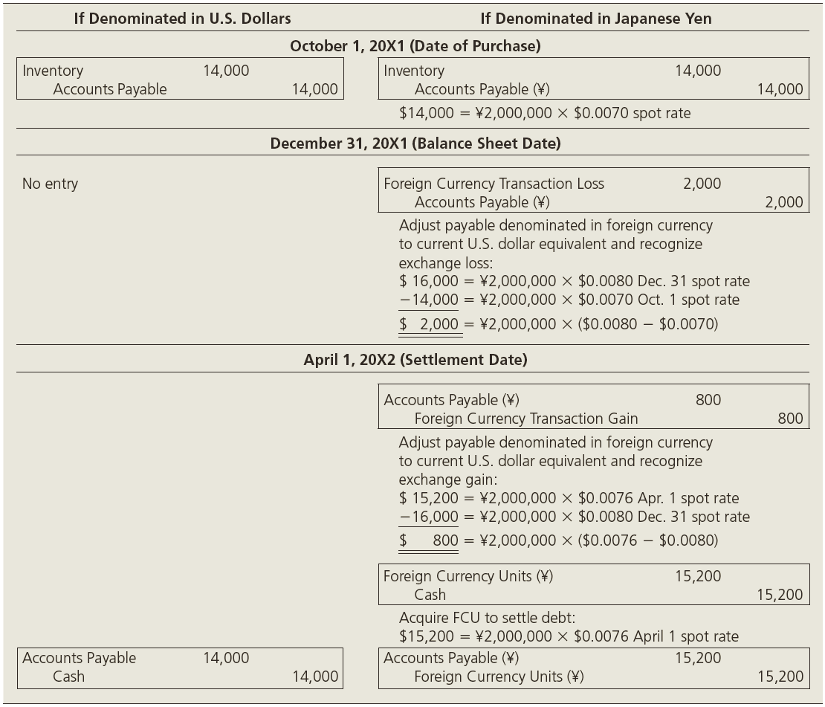
Comparative U.S. Company Journal Entries for Foreign Purchase Transaction Denominated in Dollars versus Foreign Currency Units
Notes:
24

Slide 25
Practice Quiz Question #2
Which of the following statements is true?
  Foreign currency transactions of a U.S. Firm involve the exchange of goods from a foreign country denominated in $ U.S.
  The purchase or sale of an item is a separate transaction from the foreign currency commitment under the two transaction approach.
  Foreign currency exchange gains or losses from the revaluation of assets or liabilities denominated in a foreign currency must be recognized in the period when the exchange rate changes

Slide 26
Learning Objective 3
Understand how to hedge international currency risk using foreign currency forward exchange financial instruments.

Slide 27
Managing International Currency Risk with Foreign Currency Forward Exchange Financial Instruments
The accounting for derivatives and hedging activities is guided by three standards:
Notes:
27

Slide 28
Managing International Currency Risk with Foreign Currency Forward Exchange Financial Instruments
A financial instrument is cash, evidence of ownership, or a contract that both:
  imposes on one entity a contractual obligation to deliver cash or another instrument, and
  conveys to the second entity that contractual right to receive cash or another financial instrument.
A derivative is a financial instrument or other contract whose value is “derived from” some other item that has a variable value over time.
Notes:
28

Slide 29
Managing International Currency Risk with Foreign Currency Forward Exchange Financial Instruments
Characteristics of derivatives:
  The financial instrument must contain one or more underlyings and one or more notional amounts, which specify the terms of the financial instrument.
  The financial instrument/ contract requires no initial net investment or an initial net investment that is smaller than required for other types of contracts expected to have a similar response to changes in market factors.
Notes:
29

Slide 30
Managing International Currency Risk with Foreign Currency Forward Exchange Financial Instruments
Characteristics of derivatives:
  The contract terms:
    Require or permit net settlement
    Provide for the delivery of an asset that puts the recipient in an economic position not substantially different from net settlement, or
    Allow for the contract to be readily settled net by a market or other mechanism outside the contract
Notes:
30

Slide 31
Derivatives Designated as Hedges
Two criteria to be met for a derivative instrument to qualify as a hedging instrument:
  Sufficient documentation must be provided at the beginning of the hedge term to identify the objective and strategy of the hedge, the hedging instrument and the hedged item, and how the hedge’s effectiveness will be assessed on an ongoing basis.
Notes:
31

Slide 32
Derivatives Designated as Hedges
Two criteria to be met for a derivative instrument to qualify as a hedging instrument:
  The hedge must be highly effective throughout its term
    Effectiveness is measured by evaluating the hedging instrument’s ability to generate changes in fair value that offset the changes in value of the hedged item.
Notes:
32

Slide 33
Derivatives Designated as Hedges
Fair value hedges are designated to hedge the exposure to potential changes in the fair value of:
  a recognized asset or liability such as available-for-sale investments, or
  an unrecognized firm commitment for which a binding agreement exists.
The net gains and losses on the hedged asset or liability and the hedging instrument are recognized in current earnings on the income statement.
Notes:
33

Slide 34
Derivatives Designated as Hedges
Cash flow hedges
  Designated to hedge the exposure to potential changes in the anticipated cash flows, either into or out of the company, for
    a recognized asset or liability such as future interest payments on variable-interest debt, or
    a forecasted cash transaction such as a forecasted purchase or sale.
Notes:
34

Slide 35
Derivatives Designated as Hedges
Cash flow hedges
  Changes in the fair market value are separated into an effective portion and an ineffective portion
    The net gain or loss on the effective portion of the hedging instrument should be reported in other comprehensive income
    The gain or loss on the ineffective portion is reported in current earnings on the income statement.
Notes:
35

Slide 36
Derivatives Designated as Hedges
Foreign currency hedges are hedges in which the hedged item is denominated in a foreign currency
  A fair value hedge of a firm commitment to enter into a foreign currency transaction
  A cash flow hedge of a forecasted foreign currency transaction
  A hedge of a net investment in a foreign operation.
Notes:
36

Slide 37
Forward Exchange Contracts
Forward Exchange Contracts
  Contracted through a dealer, usually a bank
  Possibly customized to meet contracting company’s terms and needs
  Typically no margin deposit required
  Must be completed either with the underlying’s future delivery or net cash settlement
Notes:
37

Slide 38
Forward Exchange Contracts
FASB 133 establishes a basic rule of fair value for accounting for forward exchange contracts
  Changes in the fair value are recognized in the accounts, but the specific accounting for the change depends on the purpose of the hedge
  For forward exchange contracts, the basic rule is to use the forward exchange rate to value the forward contract
Notes:
38

Slide 39
Case 1: Forward Exchange Contracts
Managing an Exposed Foreign Currency Net Asset or Liability Position: Not a Designated Hedging Instrument
This case presents the most common use of foreign currency forward contracts, which is to manage a part of the foreign currency exposure from accounts payable or accounts receivable denominated in a foreign currency.
Note that the company has entered into a foreign currency forward contract but that the contract does not qualify for or the company does not designate the forward contract as a hedging instrument.

Slide 40
Case 2: Forward Exchange Contracts
Hedging an Unrecognized Foreign Currency Firm Commitment: A Foreign Currency Fair Value Hedge
This case presents the accounting for an unrecognized firm commitment to enter into a foreign currency transaction, which is accounted for as a fair value hedge.
A firm commitment exists because of a binding agreement for the future transaction that meets all requirements for a firm commitment.
The hedge is against the possible changes in fair value of the firm commitment from changes in the foreign currency exchange rates.

Slide 41
Case 3: Forward Exchange Contracts
Hedging a Forecasted Foreign Currency Transaction: A Foreign Currency Cash Flow Hedge
This case presents the accounting for a forecasted foreign currency-denominated transaction, which is accounted for as a cash flow hedge of the possible changes in future cash flows.
The forecasted transaction is probable but not a firm commitment. Thus, the transaction has not yet occurred nor is it assured; the company is anticipating a possible future foreign currency transaction.
Because the foreign currency hedge is against the impact of changes in the foreign currency exchange rates used to predict the possible future foreign currency-denominated cash flows, it is accounted for as a cash flow hedge.

Slide 42
Case 4: Forward Exchange Contracts
Speculation in Foreign Currency Markets
This case presents the accounting for foreign currency forward contracts used to speculate in foreign currency markets. These transactions are not hedging transactions.
The foreign currency forward contract is revalued periodically to its fair value using the forward exchange rate for the remainder of the contract term.
The gain or loss on the revaluation is recognized currently in earnings on the income statement.

Slide 43
Practice Quiz Question #3
Which of the following is NOT one of the criteria for a hedge to be considered effective?
  The hedge is based on an effective interest rate.
  Documentation of the objective, strategy, and effectiveness of the hedge.
  The hedge must be highly effective through its term.
  The effectiveness of the hedge is assessed on an ongoing basis

Slide 44
Learning Objective 4
Understand how to measure hedge effectiveness, make interperiod tax allocations for foreign currency transactions, and hedge net investments in a foreign entity.

Slide 45
Additional Considerations
Measuring hedge effectiveness
  Effectiveness: There will be an approximate offset, within the range of 80 to 125 percent, of the changes in the fair value of the cash flows or changes in fair value to the risk being hedged
  Must be assessed at least every three months and when the company reports financial statements or earnings
  Intrinsic value and Time value
Notes:
45

Slide 46
Additional Considerations
Interperiod tax allocation for foreign currency gains (losses)
  Temporary differences in the recognition of foreign currency gains or losses between tax accounting and GAAP accounting require interperiod tax allocation
  The temporary difference is recognized in accordance with FASB Statement No. 109
Notes:
46

Slide 47
Additional Considerations
Hedges of a net investment in a foreign entity
  A number of balance sheet management tools are available for a U.S. company to hedge its net investment in a foreign affiliate.
  FASB 133 specifies that for derivative financial instruments designated as a hedge of the foreign currency exposure of a net investment in a foreign operation, the portion of the change in fair value equivalent to a foreign currency transaction gain or loss should be reported in other comprehensive income.
Notes:
47

Slide 48
Practice Quiz Question #4
Which of the following is the appropriate test of hedge effectiveness?
  The hedge offsets between 80-100% of the cash flows or risk of the item hedged.
  The hedge offsets between 100-125% of the cash flows or risk of the item hedged.
  The hedge offsets between 80-125% of the cash flows or risk of the item hedged.
  The hedge offsets between 80-150% of the cash flows or risk of the item hedged.

Slide 49
Conclusion
The End

