Slide 1
Additional Consolidation Reporting Issues
Chapter 10
Notes:
Note: Students sometimes like to print slides as “handouts” with 1, 2, 3, 4, 6, or 9 slides per page for taking notes in class. It is sometimes best to print them using the “pure black and white” option on the color/gray scale dropdown menu to avoid dark boxes that are not conducive to note taking. Be aware that many instructors will only cover a sub-set of the slides available in this file. Also note that we have removed slides containing solutions to group or individual in-class exercises.

Slide 2
General Overview
This chapter discusses the following general financial reporting topics as they relate to consolidated financial statements:
  The consolidated statement of cash flows
  Consolidation following an interim acquisition
  Consolidation tax considerations
  Consolidated earnings per share
Notes:
2

Slide 3
Learning Objective 1
Prepare a consolidated statement of cash flows.

Slide 4
Consolidated Statement of Cash Flows
A consolidated statement of cash flows is similar to a statement of cash flows prepared for a single-corporate entity and is prepared in basically the same manner
Preparation
  Typically prepared after the consolidated income statement, retained earnings statement, and balance sheet
  Prepared from the information in the other three statements
Notes:
4

Slide 5
Consolidated Statement of Cash Flows
Preparation
  Requires only a few adjustments (such as those for depreciation and amortization resulting from the write-off of a differential) beyond those used in preparing a cash flow statement for an individual company
  All transfers between affiliates should be eliminated
  Noncontrolling interest typically does not cause any special problems
Notes:
5

Slide 6
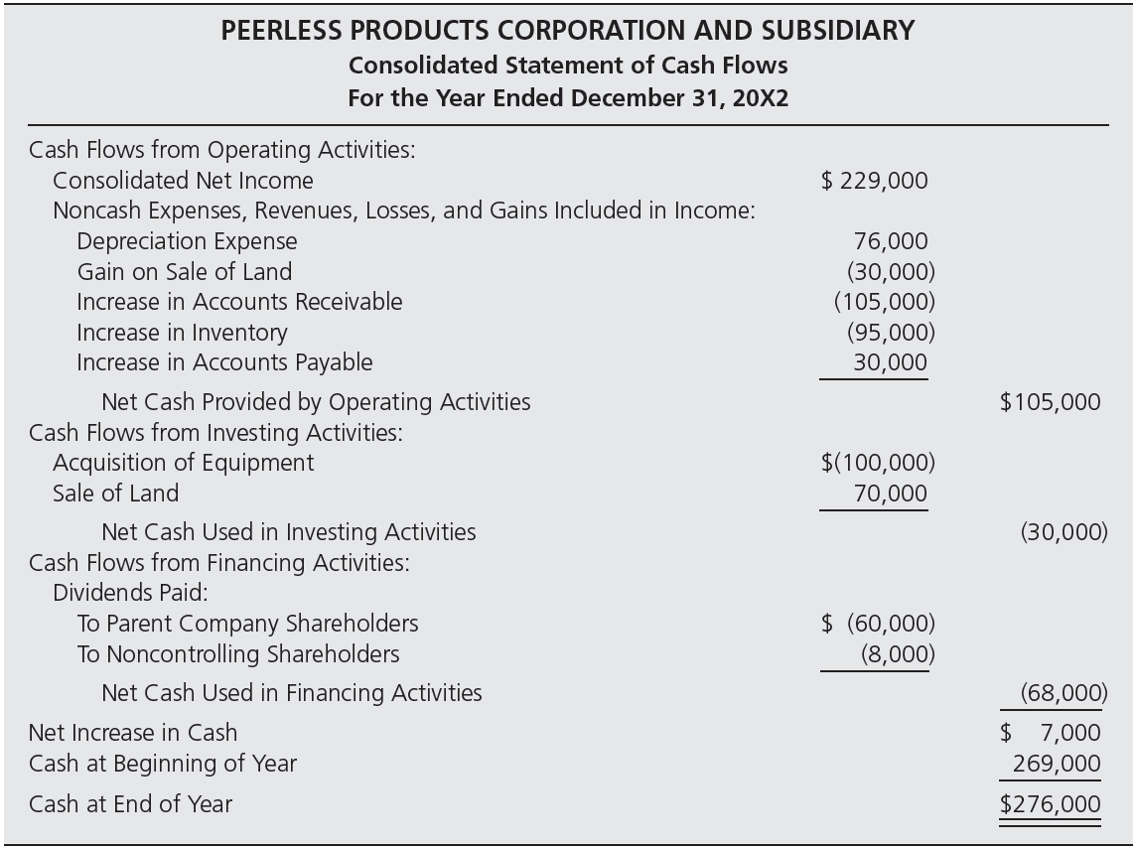
Consolidated Statement of Cash Flows for the Year Ended December 31, 20X2 (Figure10–2)
Notes:
6

Slide 7
Consolidated Statement of Cash Flows
Consolidated cash flow statement—direct method
  Nearly all major companies use the indirect method
  Critics have argued that the direct method is less confusing and more useful
Notes:
7

Slide 8
Consolidated Statement of Cash Flows
The only section affected by the difference in approaches is the operating activities section.
  Under the indirect approach, the operating activities section starts with net income and, to derive cash provided by operating activities, adjusts for all items affecting cash and net income differently.
  Under the direct approach, the operating activities section of the statement shows the actual cash flows.
Notes:
8

Slide 9
Consolidated Statement of Cash Flows
  Direct approach: As an example, the only cash flows related to operations are
  The remainder of the cash flow statement is the same under both approaches except that a separate reconciliation of operating cash flows and net income is required under the direct approach.
Cash Flows from Operating Activities:
Cash Received from Customers $615,000)
Cash Paid to Suppliers (510,000)
Net Cash Provided by Operating Activities $105,000)
Notes:
9

Slide 10
Practice Quiz Question #1
Which of the following statements is true?
  a. After the consolidated income statement and balance sheet have been prepared, the statement of cash flows is calculated in the same way as for a single company.
  b. The preparation of a consolidated statement of cash flows requires procedures that are unique to consolidated companies.
  c. A consolidated statement of cash flows is not required under U.S. GAAP.
  d. The consolidated statement of cash flows is calculated from the subsidiary’s financial statements alone.

Slide 11
Learning Objective 2
Make calculations and record journal and worksheet entries related to an interim acquisition.

Slide 12
Consolidation Following an Interim Acquisition
When a subsidiary is acquired during a fiscal period, the results of the subsidiary’s operations are included in the consolidated statements only for the portion of the year that the stock is owned by the parent.
Notes:
12

Slide 13
Consolidation Following an Interim Acquisition: Illustration
Peanut purchases 75% of Snoopy’s outstanding common stock on on July 1, 20X1 for an amount equal to 75% of the book value of Snoopy’s net assets. Prior to the acquisition, Snoopy had earned net income of $35,000 and declared $8,000 of dividends. The income and dividends for the year are summarized in the following table:
 | 1/1 to 6/30 | 7/1 to 12/31
Sales | 125,000 | 250,000
Less: COGS | 50,000 | 110,000
Less: Depreciation Expense | 25,000 | 50,000
Less: Other Expenses | 15,000 | 30,000
Net Income | 35,000 | 60,000
Dividends | 8,000 | 20,000
Notes:
13

Slide 14
Consolidation Following an Interim Acquisition: Illustration
Parent Company Entries
Peanut records the purchase of Snoopy stock with the following entry:
July 1, 20X1
Investment in Snoopy Stock 320,250
Cash 320,250
Record purchase of Snoopy stock.
During the second half of 20X1, Peanut records its share of Snoopy’ income and dividends under the equity method:
Investment in Snoopy Stock 45, 000
Income from Snoopy 45, 000
Record equity-method income: $60,000 x 0.75.
Cash 15,000
Investment in Snoopy Stock 15,000
Record dividends from Snoopy: $20,000 x 0.75.
Notes:
14

Slide 15
Consolidation Following an Interim Acquisition: Illustration
Pre-acquisition income and dividend elimination entry:
Sales 125,000
  COGS 50,000
  Depreciation Expense 25,000
  Other Expense 15,000
  Dividends Declared 8,000
  Retained Earnings 27,000
Close pre-acquisition sales to RE
Close pre-acquisition COGS to RE
Close pre-acquisition depr. exp. To RE
Close pre-acquisition other expenses to RE
Close pre-acquisition dividends to RE
Pre-acquisition net increase in RE
After making this worksheet entry to close the pre-acquisition earnings and dividends to the Retained Earnings account, the beginning balance in Retained Earnings as of the date of acquisition is $117,000.
Retained Earnings
90,000
27,000
117,000
Balance 1/1/20X1
Balance 6/30/20X1

Slide 16
Consolidation Following an Interim Acquisition: Illustration
Based on this acquisition date beginning balance, we calculate the post-acquisition changes in book value as follows:
Book Value Calculations:
NCI Peanut Common Retained
25% 75% Stock Earnings
+
=
+
July 1, 20X1, balances 106,750) 320,250) 250,000 177,000)
+ Net Income 15,000) 45,000) 60,000)
Dividends (5,000) (15,000) (20,000)
December 31, 20X1, balances 116,750) 350,250) 250,000 217,000)
This leads to the basic elimination entry, following the normal procedure (but based on post-acquisition earnings and dividends):
Basic Elimination Entry
Common Stock
Retained Earnings
Income from Snoopy
NCI in NI of Snoopy
  Dividends Declared
  Investment in Snoopy
  NCI in NA of Snoopy
Original amount invested (100%)
Beginning balance in RE
    Peanut’ share of reported NI
    NCI’s share of reported NI
    100% of Sub’s dividends declared
    Net amount of BV left in inv. acct.
    NCI’s share of net book value

Slide 17
Consolidation Following an Interim Acquisition: Illustration
The following T-accounts illustrate how the basic elimination entry zeros out the balances in the Investment in Snoopy and Income from Snoopy accounts:
Investment in Snoopy
Income from Snoopy
  Acquisition 320,250
75% Net Income 45,000
Balance 12/31/X1 350,250
0
15,000 75% Dividends
350,250 Basic 45,000
45,000 75% Net Income
45,000 Balance 12/31/X1
0
Again, we include the normal accumulated depreciation elimination entry based on the balance in accumulated depreciation on Snoopy’s books on the acquisition date. Assume that this amount is 65,000 on the acquisition date.
Optional accumulated depreciation elimination entry:
Accumulated Depreciation 65,000
Building and Equipment 65,000
Notes:
17

Slide 18
Learning Objective 3
Make calculations and journal entries related to income taxes in the consolidated financial statements.

Slide 19
Consolidation Income Tax Issues
A parent company and its subsidiaries may file a consolidated income tax return, or they may choose to file separate returns
  For a subsidiary to be eligible to be included in a consolidated tax return, at least 75 percent of its stock must be held by the parent company or another company included in the consolidated return
Notes:
19

Slide 20
Consolidation Income Tax Issues
Filing a consolidated return: advantages
  The losses of one company may be offset against the profits of another
  Dividends and other transfers between the affiliated companies are not taxed
  May make it possible to avoid limits on the use of certain items such as foreign tax credits and charitable contributions
Notes:
20

Slide 21
Consolidation Income Tax Issues
Filing a consolidated return: limitations
  Once an election is made to include a subsidiary in the consolidated return, the company cannot file separate tax returns in the future unless it receives IRS approval
  The subsidiary’s tax year also must be brought into conformity with the parent’s tax year
  Can become quite difficult when numerous companies are involved and complex ownership arrangements exist
Notes:
21

Slide 22
Consolidation Income Tax Issues
Allocation of tax expense when a consolidated return is filed
  Portrays the companies included in the return as if they actually were a single legal entity
  All intercorporate transfers of goods and services and intercompany dividends are eliminated and a single income tax figure is assessed
Notes:
22

Slide 23
Consolidation Income Tax Issues
Allocation of tax expense when a consolidated return is filed
  Because only a single income tax amount is determined, income tax expense must be assigned to the individual companies
  The method of tax allocation can affect the amounts reported in the income statements of both the separate companies and the consolidated entity
Notes:
23

Slide 24
Consolidation Income Tax Issues
Allocation of tax expense when a consolidated return is filed
  When a subsidiary is less than 100 percent owned, tax expense assigned to the subsidiary reduces proportionately the income assigned to the parent and the noncontrolling interest
  The more tax expense assigned to the subsidiary, the less is assigned to the parent; the income attributed to the controlling interest then becomes greater
Notes:
24

Slide 25
Consolidation Income Tax Issues
Unrealized profits when a consolidated return is filed
  Intercompany transfers are eliminated in computing both consolidated net income and taxable income
  Because profits are taxed in the same period they are recognized for financial reporting purposes, no temporary differences arise, and no additional tax accruals are needed in preparing the consolidated financial statements
Notes:
25

Slide 26
Consolidation Income Tax Issues
Unrealized profits when separate returns are filed
  The companies are taxed individually on the profits from intercompany sales
  No consideration is given to whether the intercompany profits are realized from a consolidated viewpoint
Notes:
26

Slide 27
Consolidation Income Tax Issues
Unrealized profits when separate returns are filed
  The tax expense on the unrealized intercompany profit must be eliminated when the unrealized intercompany profit is eliminated in preparing consolidated financial statements
  This difference in timing of the tax expense recognition results in the recording of deferred income taxes
Notes:
27

Slide 28
Consolidation Income Tax Issues
Assume that Peanut acquired 75% of Snoopy’s common stock. Peanut acquired the stock when the book value of Snoopy’s common stock was $250,000 and retained earnings were $150,000. During the year, Snoopy reports net income of $60,000 and declares $20,000 of dividends. In addition, during 20X1 Snoopy sold inventory costing $75,000 to Peanut for $100,000. $60,000 of this inventory was resold by year end. Assume the two companies elect to file a consolidated tax return for 20X1. Both Peanut and Snoopy are subject to a 40% tax rate.
Notes:
28

Slide 29
Consolidation Income Tax Issues
Snoopy sells inventory costing $75,000 to Peanut Products for $100,000, and resold $60,000 of this inventory before year-end. Assume 40 percent tax rate.
 | Total | = | Re-sold | + | Ending Inventory
Sales | 100,000 |  | 60,000 |  | 40,000
COGS | 75,000 |  | 36,000 |  | 30,000
Gross Profit | 25,000 |  | 15,000 |  | 10,000
Gross Profit % | 25.00%
Sales 100,000
Cost of Goods Sold 90,000
Inventory 10,000
Eliminate intercompany upstream sale of inventory.
With a 40 percent income tax rate, the following eliminating entry adjusts income tax expense of the consolidated entity downward by $4,000 ($10,000 x 0.40) to reflect the reduction of reported profits:
Deferred Tax Asset 4,000
Income Tax Expense 4,000
Eliminate tax expense on unrealized intercompany profit.
Notes:
29

Slide 30
Unrealized Profit in Separate Tax Return Illustrated
If Peanut accounts for its investment in Snoopy using the fully adjusted equity method, Peanut would make the following journal entries on its books:
Investment in Snoopy 27,000
Income from Snoopy 27,000
Record Peanut’ 75 percent share of Snoopy’ 20X1 reported income.
Cash 15,000
Investment in Snoopy 15,000
Record Peanut’ 75 percent share of Snoopy’ 20X1 dividend.
Peanut also defers its 75% share of the unrealized profit on intercompany upstream sales (net of taxes). Thus, the $10,000 of unrealized profit ($40,000 − $30,000) net of 40% taxes is $6,000 ($10,000 x 0.60). Thus, the deferral of Peanut’ relative share of the unrealized gross profit is $4,500 ($6,000 x 0.75).
Income from Snoopy 4,500
Investment in Snoopy 4,500
Eliminate unrealized gross profit on inventory purchases from Snoopy.
In order to prepare the basic elimination entry, we first analyze the book value of Snoopy’ equity accounts and the related 75% share belonging to Peanut and the 25% share belonging to the NCI shareholders:
Notes:
30

Slide 31
Unrealized Profit in Separate Tax Return Illustrated
Book Value Calculations:
NCI Peanut Common Retained
25% 75% Stock Earnings
+
=
+
Original book value 100,000) 300,000) 250,000 150,000)
+ Net Income 9,000) 27,000) 36,000)
Dividends (5,000) (15,000) (20,000)
Ending book value 104,000) 312,000) 250,000 166,000)
We note that the book value calculations form the basis for the basic elimination entry, but Peanut’ share of income and its investment account must be adjusted for the equity-method entry previously made for $4,500. In addition, the NCI share of income and net assets is adjusted for the 25% share of the unrealized gross profit (net of 40 percent taxes), $625.
Basic Elimination Entry
Common Stock
Retained Earnings
Income from Snoopy
NCI in NI of Snoopy
  Dividends Declared
  Investment in Snoopy
  NCI in NA of Snoopy
Original amount invested (100%)
Beginning balance in RE
    Peanut’ % of NI – 75% of Def. GP (net of tax)
    NCI % of NI – 25% of Def. GP (net of tax)
    100% of Sub’s dividends declared
    Net BV – 75% of Def. GP (net of tax)
    NCI % of BV – 25% of Def. GP (net of tax)

Slide 32
Subsequent Profit Realization When Separate Returns Are Filed
If income taxes were ignored, the following eliminating entry would be used in preparing consolidated statements as of December 31, 20X2, assuming that Snoopy had $10,000 of unrealized inventory profit on its books on January 1, 20X2, and the inventory was resold in 20X2:
Investment in Snoopy 7,500
NCI in NI of Snoopy 2,500
Cost of Goods Sold 10,000
Eliminate beginning inventory profit.
On the other hand, if the 40 percent tax rate is considered, the eliminating entry would be modified as follows:
Investment in Snoopy 4,500
NCI in NI of Snoopy 1,500
Income Tax Expense 4,000
Cost of Goods Sold 10,000
Notes:
32

Slide 33
Learning Objective 4
Make calculations related to consolidated earnings per share.

Slide 34
Consolidated Earnings Per Share
Basic consolidated EPS is calculated by deducting income to the noncontrolling interest and any preferred dividend requirement of the parent company from consolidated net income
  The resulting amount is then divided by the weighted-average number of the parent’s common shares outstanding during the period
  While consolidated net income is viewed from an entity perspective, consolidated earnings per share follows a parent company approach and clearly is aimed at the stockholders of the parent company
Notes:
34

Slide 35
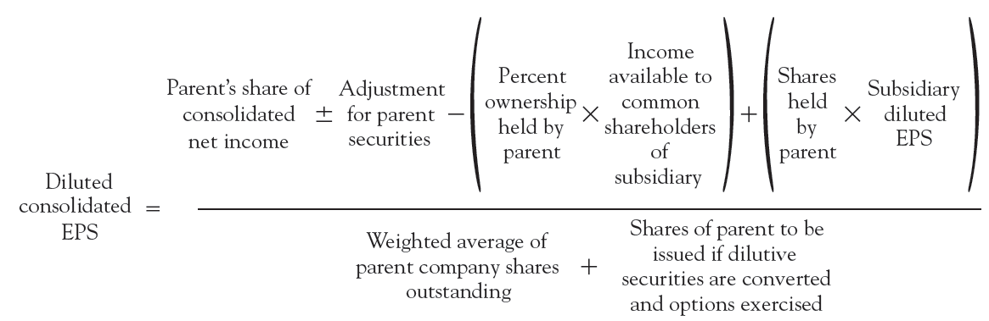
Consolidated Earnings Per Share
Computation of diluted consolidated earnings per share
Notes:
35

Slide 36
Consolidated Earnings Per Share
Diluted consolidated earnings per share
  The parent’s share of consolidated net income normally is the starting point in the computation of diluted consolidated EPS
  It then is adjusted for the effects of parent and subsidiary dilutive securities
Notes:
36

Slide 37
Practice Quiz Question #2
Consolidated EPS is calculated:
  a. as the sum of the subsidiary’s and the parent’s individual EPS numbers.
  b. by adding the subsidiary’s and the parent’s net income numbers and dividing by the subsidiary’s shares owned by the parent.
c. by deducting the NCI in net income and preferred dividends from consolidated net income and dividing by the parent’s weighted-average shares.
  d. as the parent’s net income divided by the combined weighted shares outstanding of the parent and subsidiary.

Slide 38
Conclusion
The End

