Slide 1
Chapter 12
The Revenue Cycle: Sales to Cash Collections

Slide 2
Learning Objectives
Describe the basic business activities and related information processing operations performed in the revenue cycle.
Discuss the key decisions that need to be made in the revenue cycle, and identify the information needed to make those decisions.
Identify major threats in the revenue cycle, and evaluate the adequacy of various control procedures for dealing with those threats.

Slide 3
The Revenue Cycle
Tujuan Siklus Pendapatan (Revenue Cycle):
Penyediaan barang dan jasa ke para pelanggan
Penagihan kas sebagai pembayaran dari penjualan-penjualan tersebut
Primary Objective:
  Provide the right product
  In the right place
  At the right time for the right price
  Produk yang tepat (waktu dan tempat) dengan harga yang sesuai

Slide 4
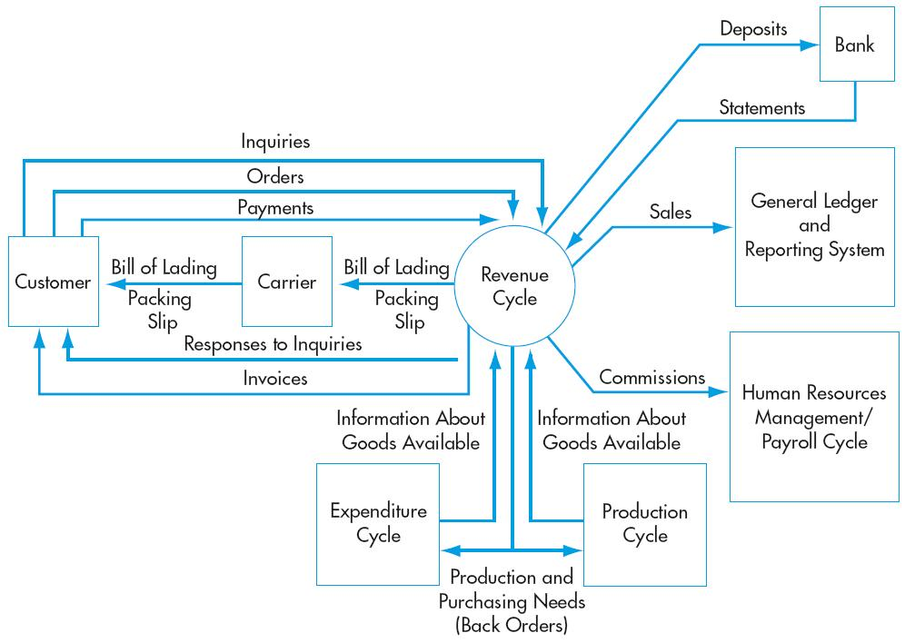
The Revenue Cycle

Slide 5
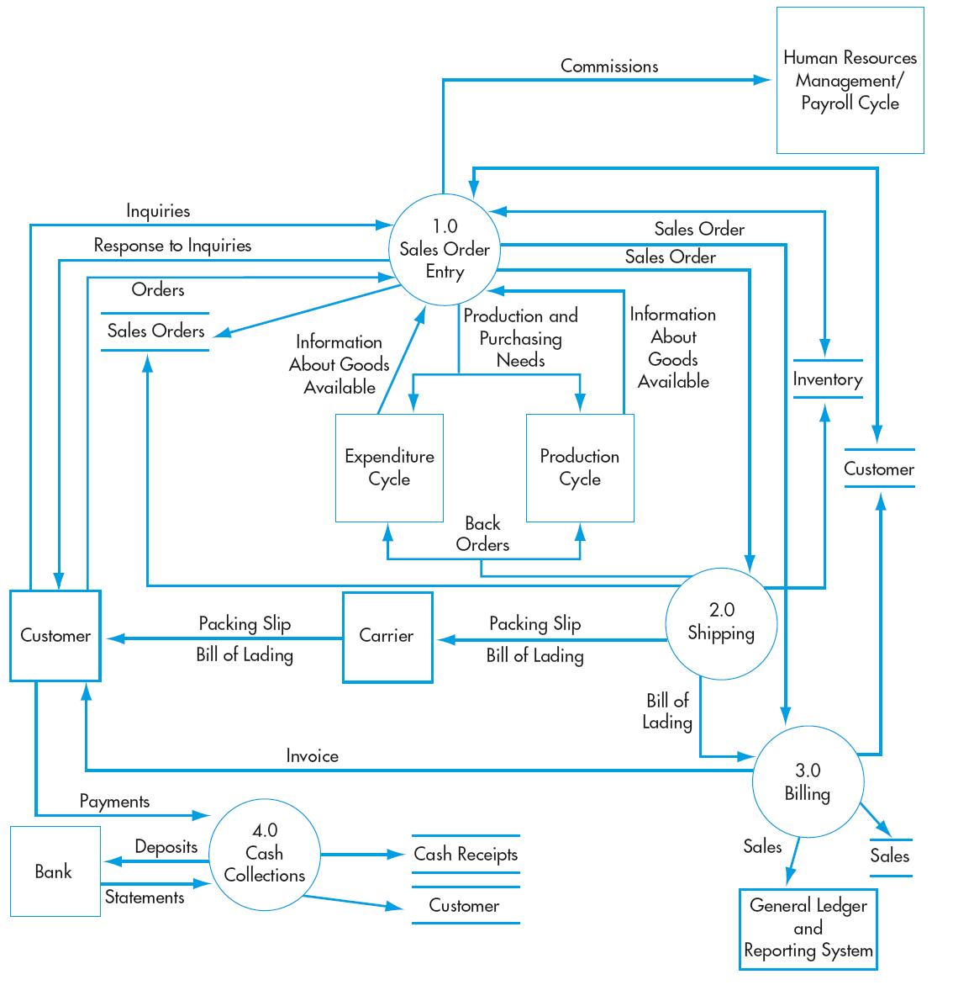
Revenue Cycle Activities
Sales order entry
Shipping
Billing
Cash collections

Slide 6
General Revenue Cycle Threats
Inaccurate or invalid master data
Unauthorized disclosure of sensitive information
Loss or destruction of master data (kehilangan data)
Poor performance : sales analysis report, slow moving product

Slide 7
General Revenue Cycle Controls
Data processing integrity controls
Restriction of access to master data
Review of all changes to master data
Access controls
Encryption
Backup and disaster recovery procedures
Managerial reports

Slide 8
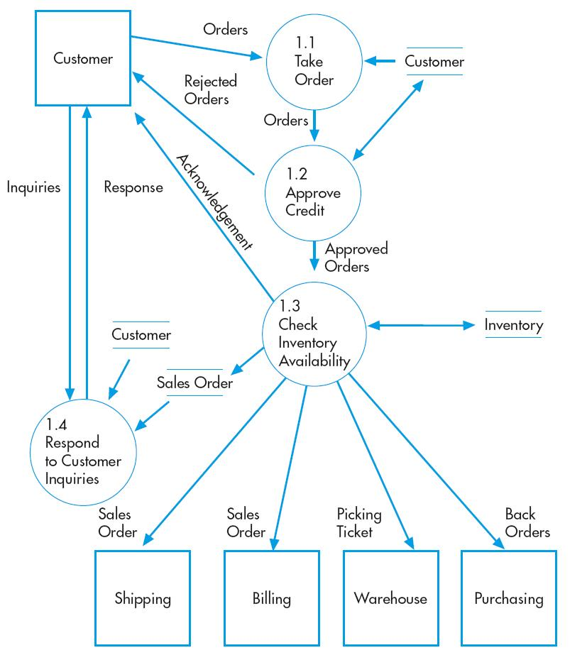
Sales Order Entry
Take order
Check and approve credit
Check inventory availability

Slide 9
Sales Order Threats
Pesanan pelanggan yang tidak lengkap / tidak akurat
Invalid orders
Uncollectible accounts : : penjualan secara kredit kepada pelanggan yang memiliki reputasi kredit yang buruk
Habisnya persediaan (Stockouts or excess inventory )

Slide 10
Sales Order Entry Controls
Data entry edit controls (see Chapter 10)
Restriction of access to master data
Digital signatures or written signatures
Credit limits
Specific authorization to approve sales to new customers or sales that exceed a customer’s credit limit
Aging of accounts receivable
Use of bar-codes or RFID
Training
Periodic physical counts of inventory
Sales forecasts and activity reports
CRM systems, self-help Web sites, and proper evaluation of customer service ratings

Slide 11
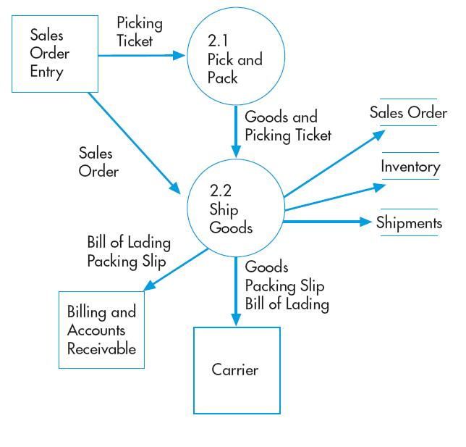
Shipping
Picking and packing the order
Shipping the order

Slide 12
Shipping Threats
Pengepakan barang yang salah atau kuantitas yang salah
Pencurian persediaan
Kesalahan pengiriman :
  Barang yang salah
  Jumlah barang (quantity) yang salah

Slide 13
Shipping Controls
Rekonsiliasi pesanan penjualan dengan packing slip
Pembatasan akses fisik ke gudang persediaan
Documentation of all inventory transfers
Bar-code technology
Perhitungan fisik persediaan secara periodik
Data entry edit controls (if shipping data entered on terminals)
Configuration of ERP system to prevent duplicate shipments

Slide 14
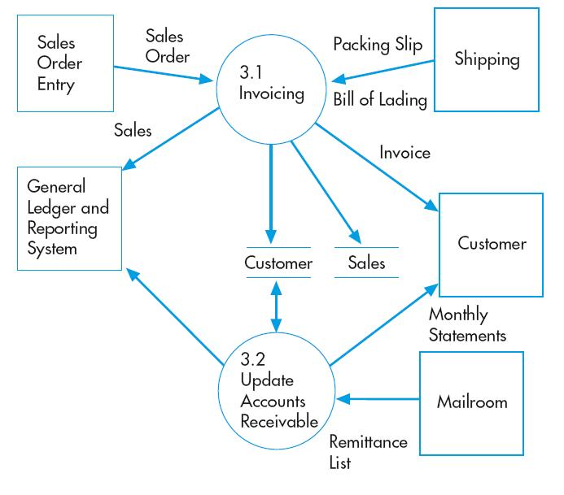
Billing
Invoicing
Updating accounts receivable

Slide 15
Billing Threats
Kegagalan penagihan ke pada pelanggan
  faktur yang belum dibuat
Kesalahan penagihan
  kesalahan memberikan harga
  Penagihan untuk barang-barang yang tidak dikirim ke pelanggan
Posting errors in accounts receivable
  No rekening pelanggan salah
  Field check

Slide 16
Billing Controls
Separation of billing and shipping functions
Periodic reconciliation of invoices with sales orders, picking tickets, and shipping documents
Configuration of system to automatically enter pricing data
Restriction of access to pricing master data
Data entry edit controls
Reconciliation of shipping documents (picking tickets, bills of lading, and packing list) to sales orders
Data entry controls
Reconciliation of batch totals
Mailing of monthly statements to customers
Reconciliation of subsidiary accounts to general ledger

Slide 17
Cash Collections Threats
Theft of cash
  Fungsi yang harus dipisahkan:
Menangani kas atau cek dan update data rekening pelanggan
  Potensi : lapping
Membuat credit memo dan update rekening pelanggan
  Potensi : Dapat menghapus jumlah tidak tertagih dari rekan-rekannya
Cash flow problems

Slide 18
Cash Collection Controls
Separation of cash handling function from accounts receivable and credit functions
Regular reconciliation of bank account with recorded amounts by someone independent of cash collections procedures
Use of EFT (pengiriman uang secara elektronis ke bank perusahaan), FEDI (Financial Electronic Data Interchange), and lockboxes to minimize handling of customer payments by employees
Having two people open all mail likely to contain customer payments
Use of cash registers
Daily deposit of all cash receipts
Lockbox arrangements, EFT, or credit cards
Discounts for prompt payment by customers
Cash flow budgets

