Slide 1

Metodologi Desain
Desi Dwi Kristanto

Slide 2
No. | Materi
1. | Penjelasan RPS, dan Pengantar Metodologi Desain.
2. | Sejaran & Perkembangan Desain
3. | Konsep Desain
4. | Tinjauan Terhadap Metode Pendesainan Baru
5. | Designers Creativity as Blackbox
6. | Designer Rationality as Glassbox
7. | Desainer sebagai system pengendali proses
8. | Ujian Tengah Semester
9. | Metode Pengambilan Keputusan dalam Desain
10. | Metode Analisis untuk Evaluasi dan Eksplorasi
11. | Pengarah Bentuk
12. | Strategi Desain
13. | Design Problems
14. | Penjelasan mengenai contoh urutan dan tahapan proses desain, dan penjelasan format tugas akhir semester.
15. | Konsultasi Tugas Akhir.
16. | Minggu Tenang
17. | Ujian Akhir Semester

Slide 3
PROTOTYPING

Slide 5
CRITICAL FUNCTION PROTOTYPE
Critical Function prototypes aim to address one particular critical user issue. Needs and insights, discovered during the design space exploration, are transferred into critical functions -a verb, noun or action - to define what the prototype should do or include e.g. “to enable grip”. Critical Function prototypes aim to capture a specific question essential to further explore an interesting part of the design space. These prototypes focus on the tangible creation of an experience or physical thing that helps the design team to learn from watching people use and experience it.

Slide 6
DARK HORSE PROTOTYPE
The Dark Horse prototype challenges previously made assumptions and seems from the outside perspective, unlikely to develop into the final solution. By exploring REJECTED IDEAS that seemed unacceptable, too risky or impossible, these prototypes allow to broaden the team‟s perspective once more and gives permission to think bigger.
Visionary and crazy ideas get translated into tangible prototypes and visionary role plays help to visualize future scenarios. Reframing earlier assumptions encourages the team to reach for the impossible and avoids narrowing potential solutions too early in the design process. The solution space is kept as broad as possible, which is essential for coming up with ideas leading to radical innovations.

Slide 7
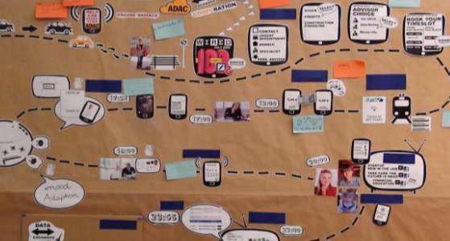
FUNKY PROTOTYPE
The Funky prototype aims to integrate and combine promising elements of previously developed prototypes into a holistic concept or vision statement that acts as the point ofreference for the final design process. This prototype phase consolidates customer feedback from previous testing and merges insights from user observations and interviews. Personas ensures the most relevant needs, values, behaviors, requirements and critical functions crucial for the final prototype are kept.
Funky prototypes enable the design team to develop their vision of where the journey is finally heading.

Slide 8
FUNCTIONAL PROTOTYPE
The Functional prototype elaborates 2-3 significant elements from funky prototypes and gives a preview on how the final prototype may look like. This phase marks the first converging milestone where the design team defines the scope of what will be delivered at the end of the project.
Moreover, the functional prototype creates a first feel „looks like / works like‟ feel of the final prototype. Core ideas are summarized and presented in an experiencable proof of concept prototype. This prototype helps the team to clarify major technical issues and encourages them to develop a specific development plan of the final prototype.

Slide 9
X-is-FINISHED PROTOTYPE
The X-is-Finished prototype has the goal of developing one key functionality or feature as it will be experiencable in the final prototype. This milestone helps the design team to better estimate and manage the required efforts to fully develop the final solution by having one feature or functionality finalized. By testing this prototype the user feedback helps to identify and optimize last technical issues in order to optimize the user experience of the finalprototype.

Slide 10
FINAL PROTOTYPE
At the very end of the Design Thinking process, the design team presents their high-resolution prototype. The final prototype consists of previous tested prototype functions that are finally combined together and integrated into the final prototype. This prototype embodies all key functions essential to deliver the full customer experience. It conveys a clear message of the ideas behind the prototype and allows interaction without explanation. The individual functions of the final prototype are elaborated and documented in detail so that the implementation team which will continue to work on the solution can get started to work on the actual implementation.

Slide 11
