Slide 1
Achievement, Careers, and Work
Puti Fajar Amanda - 2015041007
Prissa Lusiani - 2015041041
Bunga Karuni (FLO) - 2016031010

Slide 2
Intrinsic and Extrinsic Motivation
Intrinsik
Motivasi yang berdasarkan faktor internal tanpa ada paksaan atau dorongan dari orang lain untuk menentukan nasib, rasa keingintahuan, tantangan atau usaha
Ekstrinsik
Motivasi berdasarkan pengaruh dari luar diri individu karena adanya unsur paksaan atau keinginan tertentu

Slide 3
Goal Setting, Planning, and Monitoring
Suatu proses menetapkan sasaran utama bagi individu. Goal yang lebih terinci dan berada di bawah kendali kita cenderung memunculkan usaha yang lebih besar

Slide 4
Time Management

Slide 5
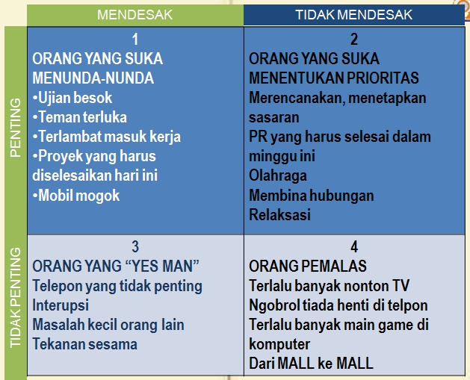
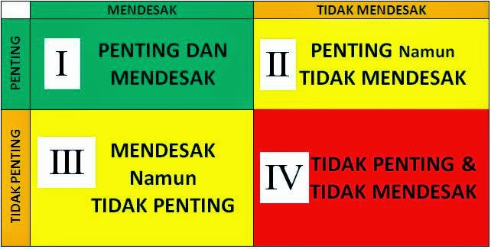
Plan and Set Priorities

Slide 6
Create and Monitor Time Plans
Dapat membantu individu untuk terlebih dahulu membuat perencanaan waktu setiap hari dan mengevaluasinya. Hal tersebut dapat menentukan kegiatan apa yang paling penting agar dapat mengalokasikan waktu yang cukup baginya

Slide 7
Some Obstacles to Achievement
Procrastination (Permasalahan dalam mengalosikan waktu/ menunda-nunda)
Perfectionism (Individu mengejar kesempurnaan)
Protecting Self-Worth by Avoiding Failure
Nonperformance
Sham effort
Procrastination
Setting unreachable goals

Slide 8
Self-handicapping strategies

Slide 9
Careers and Jobs
Subtitle

Slide 10
Career Development Across the Life Span
Eli Ginzberg (1972) dan Donald Super (1976) percaya bahwa seorang individu melalui beberapa tahapan dalam perkembangan karirnya

Slide 11
Kategori | Usia
Fantasy | dari lahir sampai 11 tahun
Tentative | 11 sampai 17 tahun
Realistic | 18 sampai 25 tahun
Menurut Ginzberg terdapat 3 tahapan :
Menurut Donald Super terdapat 5 tahapan :
Kategori | Usia
Growth | Dari lahir sampai 14 tahun
Exploration | 15 sampai 24 tahun
Establishment | 25 sampai 44 tahun
Maintenance | 45 sampai 64 tahun
Decline | Awal usia 65 tahun

Slide 12
Skills and Personality Traits
Realistis
Penyelidikan
Artistik
Sosial
Giat
Konvensional
Teori Personality menurut Holland’s :

Slide 13
Knowledge, Goals, and Careers
Memiliki pengetahuan tentang karir
Menetapkan tujuan akhir

Slide 14
Getting a Job
Menyadari apa yang diinginkan oleh atasan
Melakukan pencarian pekerjaan secara menyeluruh
Membuat resume : - Kronologi - Fungsi - Prestasi
Belajar bagaimana caranya untuk memiliki interview pekerjaan yang hebat

Slide 15
Strategies for having a great Job Interview (Yate, 2005):
Membuat resume yang sangat baik
Manfaatkan waktu yang ada saat interview
Bersiaplah untuk memberikan contoh positif dari pengalaman kerja masa lalu anda
Mengantisipasi pertanyaan yang akan ditanyakan kepada anda dalam interview
Menanyakan pekerjaan terkait dengan pertanyaan sendiri
Tetap tenang
Setelah interview selesai, memutuskan apakah anda menginginkan pekerjaan tersebut
Secepatnya setelah interview, melakukan follow-up

Slide 16
Work
The Role of Works In People’s Lives
Work During College
Work and Retirement
Leisure

Slide 17
The Role of Works In People’s Lives
Workaholics
Dual-Career Couples
Diversity in the Workplace
Unemployment

Slide 18
Dual-career couples
U.S. husbands are taking increased responsibility for maintaining the home. Men in dual-career families do about 45% of the housework.
U.S. women are taking increased responsibility for breadwinning. In about one-third of two-earner couples, wives earn as much or more than their husbands.
U.S. men are showing greater interest in their families and parenting. Young adults men are reporting that family is at least as important to them as work. Among men with egalitarian attitudes toward gender roles, fatherhood is linked with a decreas of nine hours per week at work ; among men with more traditional views about gender roles, fatherhood is associated with an increase of almost eleven hours per week

Slide 19
Unemployment
Unemployment produces stress regardless of whether the job loss is temporary, cyclical, or permanent (Hoyer&Roodin, 2003).

Slide 20
Working during college
80% of U.S. undergraduate students worked during the 1999-2000 academic year (National Center of Education Statistics, 2002).

Slide 21
Work and retirement

Slide 22
Retiring Part-Time
80% of baby boomers said they expect to work during their retirement years (Roper Strach Worldwide, 2000)
Part-time work for interest or enjoyment 35%
Income 23%
The desire to start a business 17&
The desire to try a different field of work 5%
70% of current emloyees said they expect to work for pay once their retire, mainly because they enjoy working and want to stay active and involved
Adjusting to Retirement

Slide 23
Leisure
As adults, we must learn not only how to work well but also how to relax and enjoy leisure. (Strain& others, 2002; van Eijick & Mommas, 2004)

