Slide 1
Adult Lifestyles Chapter 9
Kelompok 5 :
Lusiana Yulinda
Maharani Savitri
Bimo Ajie

Slide 2
Learning Goals
The diversity of Adult Lifestyles
The family life cycle
Parenting

Slide 3
THE DIVERSITY OF ADULT LIFESTYLES
Di Amerika Serikat orang dewasa memiliki banyak gaya hidup diantaranya mereka hidup sendiri, berhubungan seks tanpa menikah, menikah, lalu bercerai, kemudian menikah lagi, atau hidup dengan seseorang dari jenis kelamin yang sama.

Slide 4
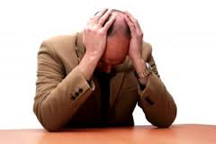
SINGLE ADULTS LIVING ALONE
Advantages:
explore new places Having me time Freedom You can sleep quietly
Disadvantages:
Desperate Suicide Feeling lonely

Slide 5
Cohabiting Adults
“Cohabitation refers to living together in a sexual relationship without being married, Many couples view their cohabitation not as a precursor to marriage but as an ongoing lifestyle. in same cases older adults cohabit because of poverty.“

Slide 6
Married Adults
How older Adults look in their partner? how they relate to their partner? and how they deal with the varied challenges of marriage?
Finding a partner
Marital Expectations and Myths
What makes Marriage work
Dealing with conflict
The benefits of a good marriage

Slide 7
Divorced adults

Slide 8
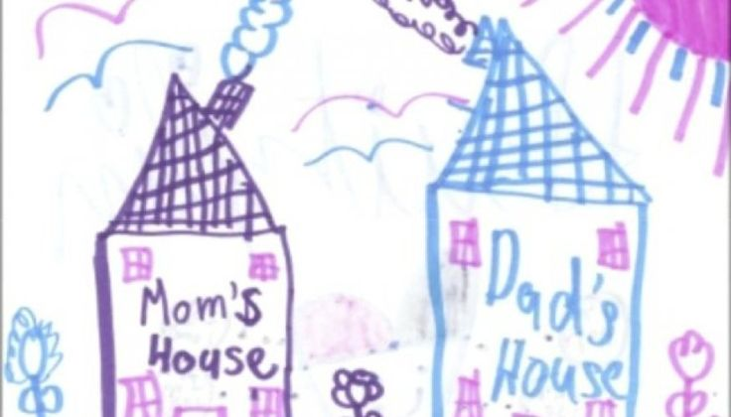
The Timing of Divorce
The Stresses of Divorce
Coping with Divorce
Diversity of postdivorce pathways

Slide 9
Coping with Divorce
Social maturity
Autonomy
Internal locus of control
Religiosity
Work
Social support
A new intimate relationship

Slide 10
Strategic Divorced
Melihat perceraian sebagai kesempatan pribadi untuk berkembang.
Berpikir hati – hati tentang pilihan anda.
Fokuslah pada masa depan
Ambillah kesempatan pada kekuatan dan sumber yang tersedia untuk anda.
Jangan berekspetasi menjadi sukses dan bahagia pada setiap hal yang dikerjakan.
Anda tidak terjebak hanya pada satu jalan.

Slide 11
Remarried Adults
“Many remarry not for love but financial reasons, for help rearing children, and reduce lonelliness. They also might carry into the stepfamily negative patterns that produced failure in an earlier marriage.”

Slide 12
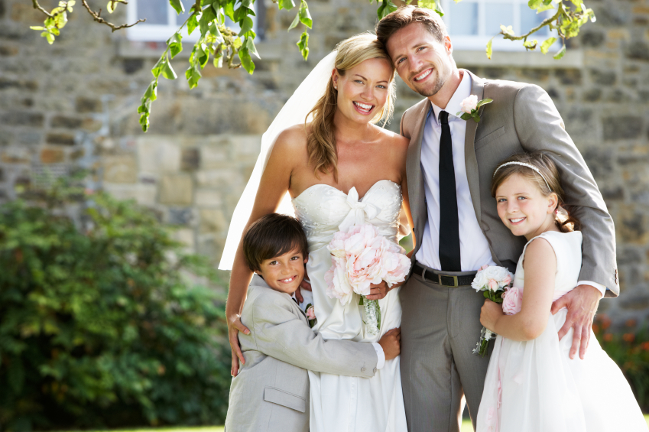
Strategies Remarried Adults
Memiliki pemikiran realistis
Membangun hubungan positif dengan keluarga
Mempunyai waktu sendiri
Belajar dari pernikahan pertama
Jangan memikirkan mendapatkan cinta secara instan dari anak tiri

Slide 13
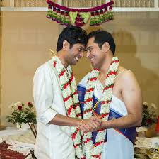
ag
Gay and lesbian relationships

Slide 14
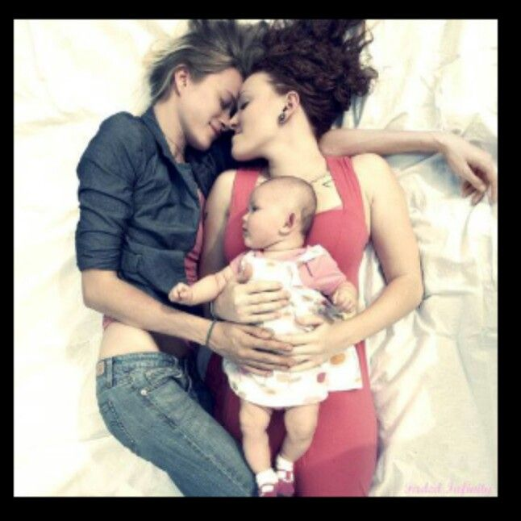
Pasangan gay dan lesbian perlu menemukan keseimbangan keromantisan cinta, kasih sayang, otonomi dan kesetaraan yang dapat diterima oleh kedua pasangan. Pasangan gay dan lesbian ingin menciptakan keluarga yang memiliki keturunan.

Slide 15
Leaving Home
“Leaving home and becoming a single adult is a very first stage in the family cycle, and it involves launching. Launching is a time to formulate life goals, to develop an identity, and become more independent.”

Slide 16
The New Couple
Pernikahan menjadi tahap kedua. biasanya digambarkan sebagai penyatuan dua individu tetapi juga melibatkan penyatuan dua seluruh sistem keluarga.

Slide 17
Becoming a Family with Children
Menjadi orangtua bagi anak-anak dalam keluarga adalah tahap ketiga dalam siklus kehidupan keluarga, dimana orang dewasa naik satu generasi menjadi pengasuh ke generasi berikutnya, dan orang tua melibatkan banyak penyesuaian.

Slide 18
The Family with Adolescents
Keluarga dengan remaja adalah tahap keempat dalam siklus kehidupan keluarga. Hubungan orang tua dengan remaja menekankan bahwa sebagian besar konflik orang tua dengan remaja lebih moderat daripada intens.

Slide 19
Adjusment Strategies for Parenting Adolescents
1. Show them warmth and respect, and avoid the tendency to be controlling
and too permissive
2. Demonstrate sustained interest in their live
3. Understand and adapt to their cognitive and socioemotional development
4. Communicate expectations for high standards of conduct and achievement
5. Display constructive ways of dealing with problems and conflict
6. Understand that adolescents don’t become adults overnights

Slide 20
Midlife Families
Empty nest syndrome a decrease in marital satisfaction and increase in feelings of emptiness brought about by the children’s departure
The fifth stage in the family life cycle, a time of launching children, linking generation, and adapting to midlife changes
Intergenerational Relationship

Slide 21
Families in Later Life
Family in later life the sixth and final stage in the family life cycle, involving retirement and, in many families, grandparenting

Slide 22
Parenting
Kelahiran anak akan menyelamatkan pernikahan
Anak akan berpikir, merasakan dan berperilaku seperti orang tua mereka di masa kecil
Anak akan menjaga orang tua di usia tua
Orangtua dapat mengaharapkan rasa hormat dan kepatuhan dari anak mereka
Memiliki anak berarti orang tua akan selalu memiliki seseorang yang mencintai mereka dan sahabat mereka.

Slide 23
Memiliki anak memberikan orang tua ‘kesempatan kedua’ untuk mencapai apa yang harus mereka capai.
Jika orang tua dapat belajar teknik yang benar, mereka dapat membentuk anak mereka seperti apa yang mereka inginkan.
kesalahan orang tua jika anak gagal
Ibu tentunya orang tua yang lebih baik daripada ayah
Parenting adalah insting dan tidak membutuhkan pelatihan.

Slide 24
Timing of Parenthood
Many U.S. adults are marrying later and having children later. There are different advantages to having children younger or later. There is controversy over when the best age is for women to have children.

Slide 25
Parenting Styles
Authoritarian Parenting
Authoritative Parenting
Neglectful Parenting
Indulgent Parenting

Slide 26
Adjusment Strategies For Effective Parenting
Use Authoritative Parenting
Understand that parenting takes time and effort
Be a good manager
Don’t use physical punishment in disciplining children

Slide 27
Working Parents
Positive
Negative

Slide 28
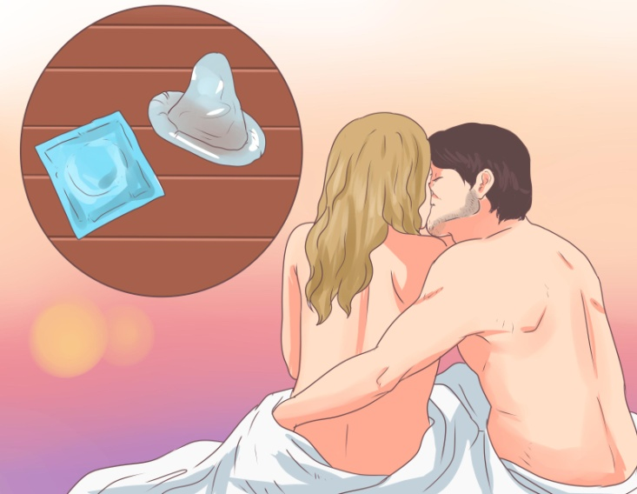
Children in Divorced Families

Slide 29
Adjustment Strategies For Communication with Children About Divorce
Explain the separation in a sensitive way
Explain that the separation is not child’s fault
Explain that it may takes time to feel better
Keep the door open for further discussion
Provide as much continuity as possible
Provide support for your children

Slide 30
Ethnicity and Parenting
African American and Latino children are more likely than white American children to live in single-parent families and larger families and to have extended family connections.

Slide 31
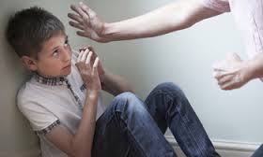
Child Abuse
Physical abuse
Sexual abuse
Child neglect
Emotional abuse

