Slide 1
Workplace Emotions, Attitudes, and Stress
Nurin Nadhilla
Enrico
Thasya

Slide 2
Bagaimana emosi dan kognisi mempengaruhi sikap dan perilaku.
Mengidentifikasi kondisi yang mengharuskan, dan masalah dengan emosional labor.
3. Menjelaskan empat dimensi emosional intelligence
4. Merangkum kepuasan kerja pada masing2 term.
5. Mendiskusikan efek dari kepuasan kerja pada job performance dan customer service
6. Membedakan afektif dan komitmen serta pengaruhnya pada karyawan
7. 5 strategi untuk meningkatkan organisasi
8. Menggambarkan stres dan yang menentukan stres
9. Menjelaskan mengapa stressor menghasilkan tinkat stres yg berbeda
10. Cara mengelola stres di tempat kerja
Learning Objectives

Slide 3
Emotions in The Workplace
98
Apa sih Emosi itu??
Emosi merupakan pengalaman episode fisiologis, perilaku dan psikologis terhadap suatu objek, orang atau kejadian yang menciptakan keadaan
Emotions are experiences.
-physiological state (blood pressure, heart rate
-psychological ( ability to think clearly)
-behavior (facial expression).

Slide 4
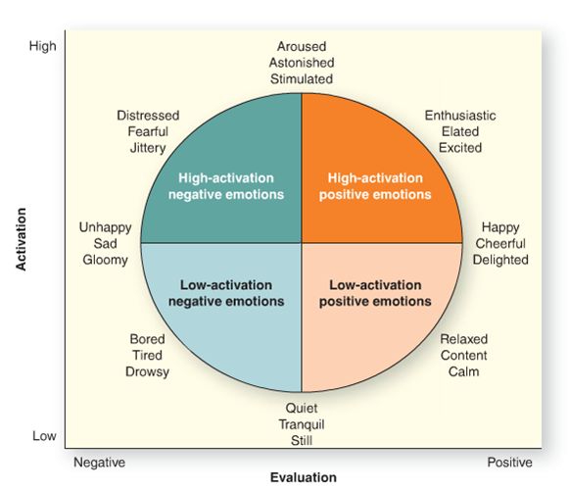
Types of Emotions
99

Slide 5
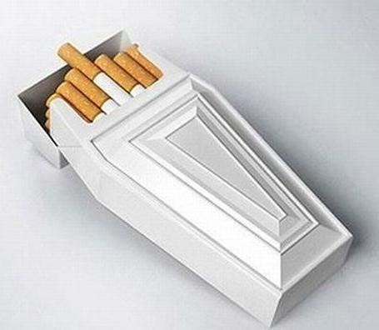
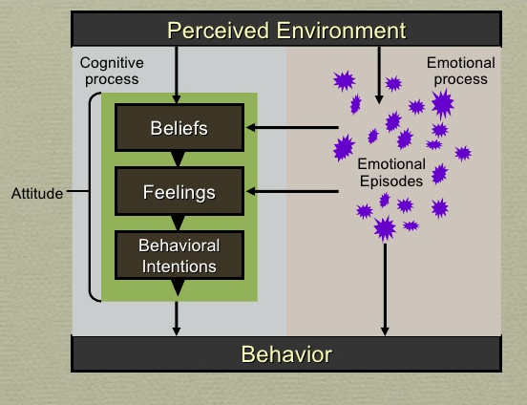
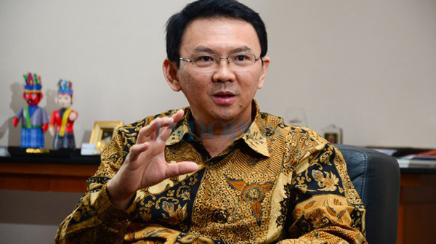
Emotions , Attitude, and Behavior
100
Attitude ialah serangkaian keyakinan, penilaian perasaan, dan niat dari perilaku terhadap seseorang, sebuah benda, atau peristiwa
Apa itu Attitudes?
Beliefs adalah persepsi tentang sikap objek apa yang kamu yakinkan kebenarannya.
Feelings adalah representasi dari negatif atau positifnya penilaian objek sikap
Behavioral intensions adalah representasi dari dorongan untuk terlibat kedalam perilaku tertentu mengenai objek sikap

Slide 6
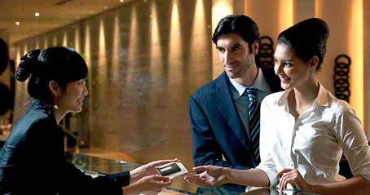
Managing Emotion at Work
101
Emosional Labor:
Usaha perencanaan dan kendali yang dilakukan oleh seseorang dalam mengeksoresikan emosi. Emosi yang dianggap layak oleh organisasi dalam berinteraksi dengan orang lain.

Slide 7
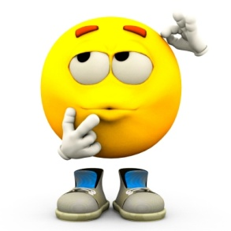
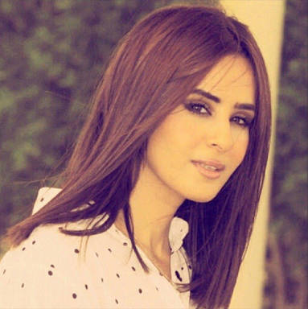
Emotional Display Norms across Cultures
103

Slide 8
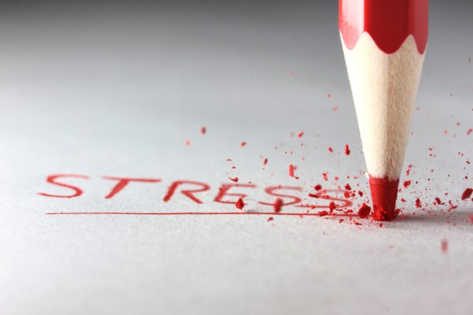
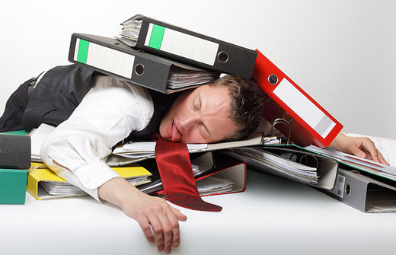
Emotional Dissonance
104-105
Konflik antara emosi yang seharusnya dapat diterima lingkungan dengan emosi yang sebenarnya

Slide 9
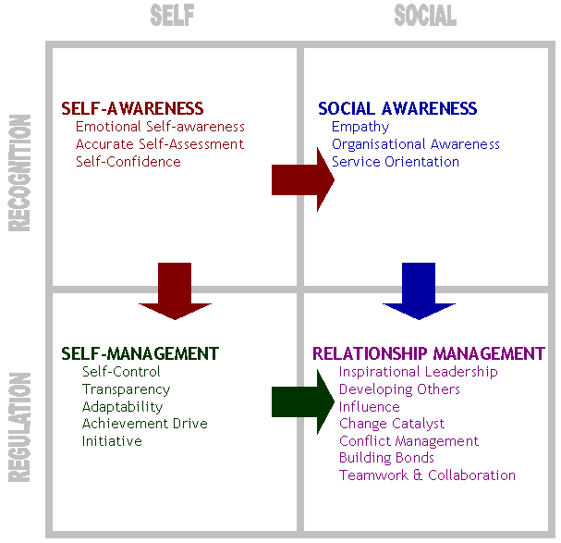
Emotional Intelligence
Emotional Intelligence:
Sekumpulan kemampuan untuk memahami dan mengekspresikan emosi , mengasimilasi emosi di dalam pikiran, dan mengatur emosi diri sendiri dan orang lain.

Slide 10
Job Satisfaction
Evaluasi seseorang dari pekerjaannya dan konteks kerja. Ini adalah penilaian dari karakteristik pekerjaan yang dirasakan, lingkungan kerja dan pengalaman emosional di tempat kerja.
Job Satisfaction and Work Behavior
Exit
Loyalty
Voice
Neglect

Slide 11
Job satisfaction and Performance
Job Satisfaction and Customer Satisfaction
The Ethics of job Satisfaction

Slide 12
Organizational Commitment
Consequences of Organizational Commitment
Building Organizational Commitment
Justice and Support
Organizational Comprehension
Trust
Shared Values
Employee Involvement

Slide 13
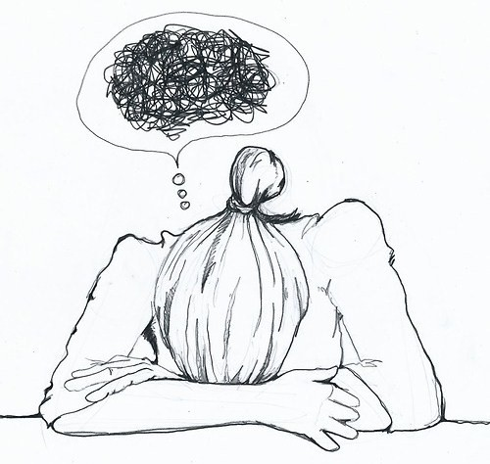
STRESS
An adaptive response to a situation that is perceived as challenging or threatening to a person’s well-being.
And stress is typically described as a negative experience. known as distress.
However, some level of stress called eustress, its a
necessary part of life because it activates and motivates
people to achieve goals.

Slide 14
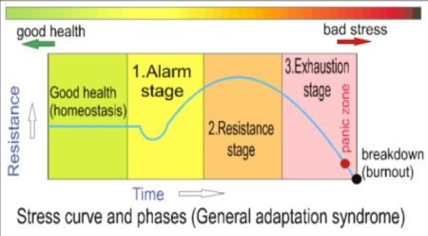
General Adaption Syndrome (Hans Selye, 1930)
A model of the stress experience, consisting of three stages:
Alarm Reaction
Resistance
Exhaustion

Slide 15
Consequences of Distress
Stresss takes its toll on the human body.
Stress also produce various psychological consequences, such as job dis-satisfaction, moodiness, depression, and lower organizational commitment.
Job Burnout. A particular stress consequence that refers to the process of emotional exhaustion, cynicism, and reduced feeling of acommplishment that results from prolonged exposure to stressors.

Slide 16
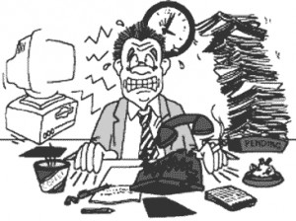
Stressor: The Cause of Stress
Include any environmental conditions that place a physical or emotional demand on a person. the most common stressors in the workplace and in life in general:
Harassment and Incivility (Psychological and Sexual Harrassment)
Work Overload
Low Task Control

Slide 17
Individual Differences in Stress
Resilience is the capability of individuals to cope successfully in the face of significant change, adversity, or risk.
Workaholic (also called work-addict) is highly involved in work, feels compelled or driven to work because of inner pressures, and has a low enjoyment of work

Slide 18
Managing Work-Related Stress
Remove The Stressor
Withdraw from The Stressor
Change Stress Perceptions
Control Stress Consequences
Receive Social Support

