Slide 1
Internal Regulation
Mellisa Mariana – 2016031045
Nyayu Sophia Olivia C. Henry – 2013031012
Samantha June – 2016031033

Slide 2
Temperature Regulation

Slide 3
Homeostasis and Allostasis

Slide 4
Controlling Body Temperature
Why we have to control our temperature body?
Basal Metabolism
Poikilothermic
Homeothermic
Is it any relation with those thing?

Slide 5
The Advantages of Constant High Body Temperature

Slide 6
Brain Mechanisms

Slide 7
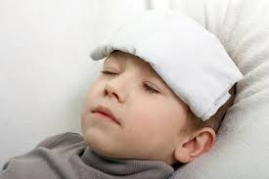
Fever

Slide 8
Thirst

Slide 9
Mechanism of Water Regulation

Slide 10
Osmotic Thirst
Tekanan Osmotik
Membran Semi Permeabel
Haus Osmotik

Slide 11
Haus Hipovolemik dan Lapar Spesifik terhadap Natrium

Slide 12
Osmotic Thirst

Slide 13
Proses Pencernaan

Slide 14
Hunger

Slide 15
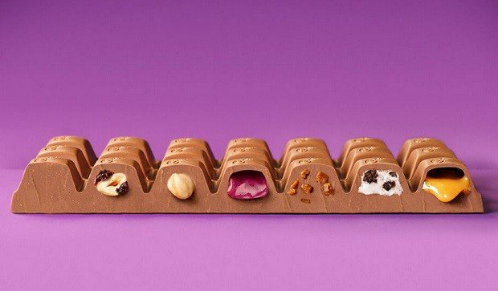
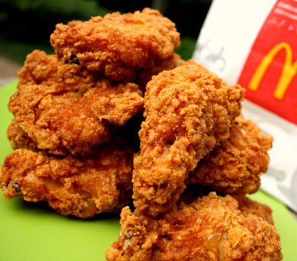
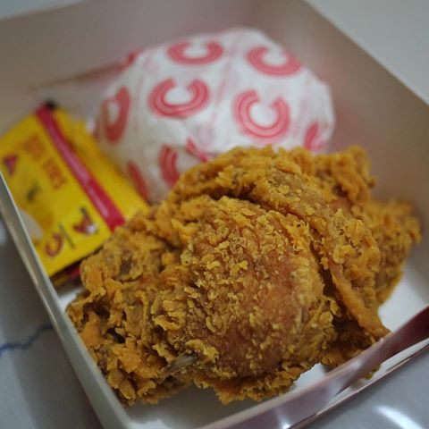

Slide 16
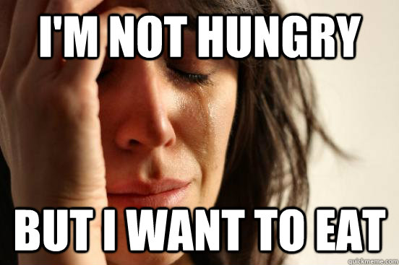
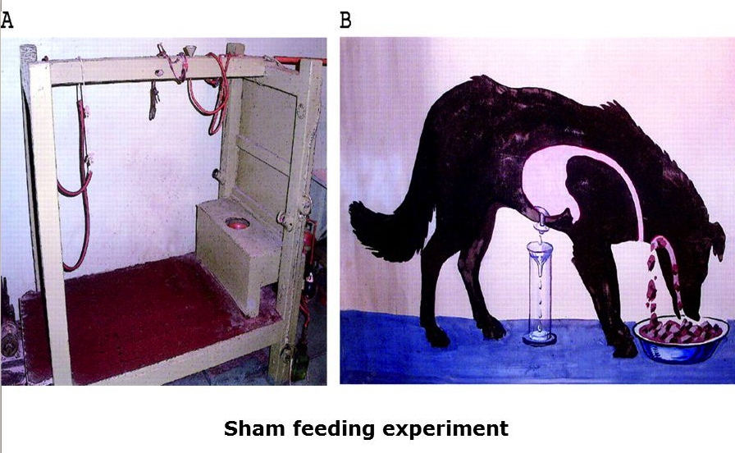
Regulasi Makan Jangka Waktu Pendek dan Panjang
Faktor oral
Sham-Feeding Animal

Slide 17
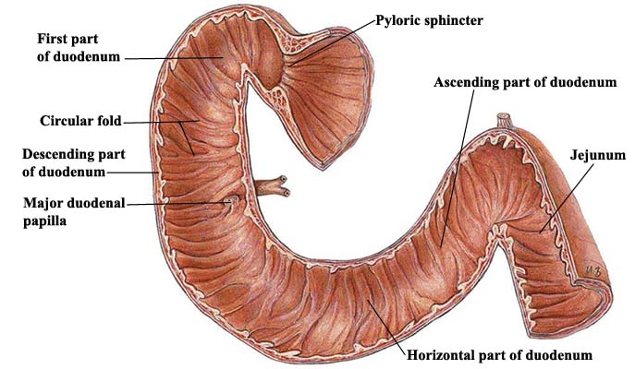
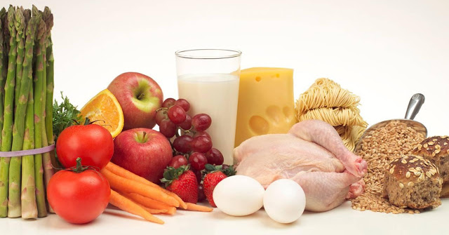
Faktor Pengendali Rasa Lapar

Slide 18
Glucose, Insulin and Glucagon

Slide 19
Leptin

Slide 20
Mekanisme Otak

Slide 21
Medial Areas of The Hypothalamus

Slide 22
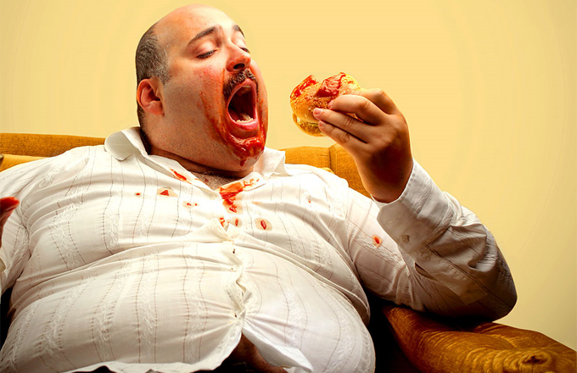
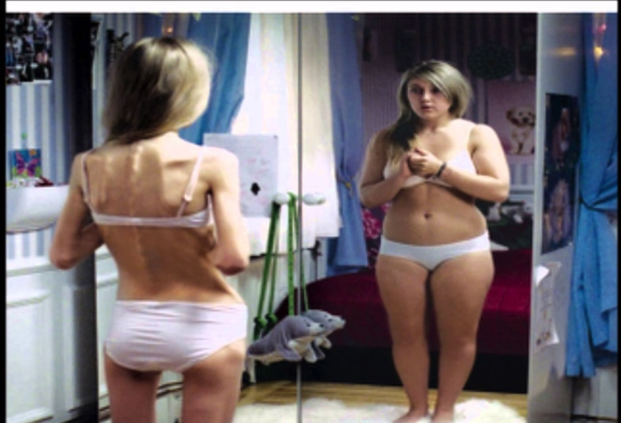
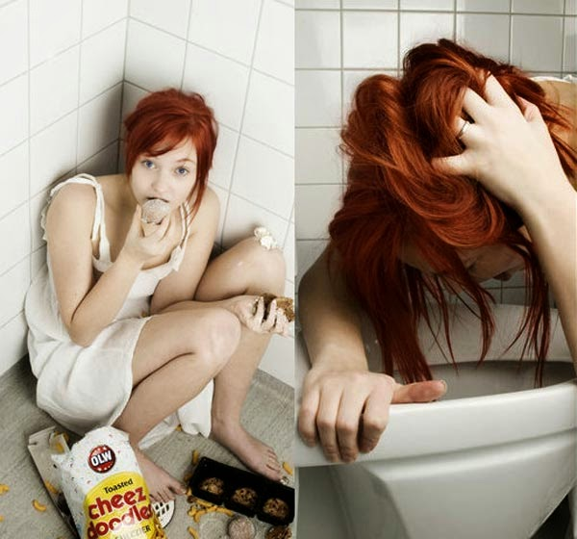
Eating Disorders
Obesity
Anorexia
Bulimia Nervosa

