Slide 1
KERJA PRAKTEK
PORTFOLIO MAKING - 3
Donna Angelina

Slide 2
08. Stay current
Trends, techniques and technology change quickly, so don't include anything that's more than three years old. You don’t want to look dated.
Displays some pieces very non-traditionally and eye-catching instead of using flat photos or PDFs. These both show they’re up on the latest trends.
Create a one-page, very hip and trendy online portfolio.
Example: https://www.behance.net/gallery/15858619/JOHN-Responsive-One-Page-Portfolio-Joomla-Template ;

Slide 3
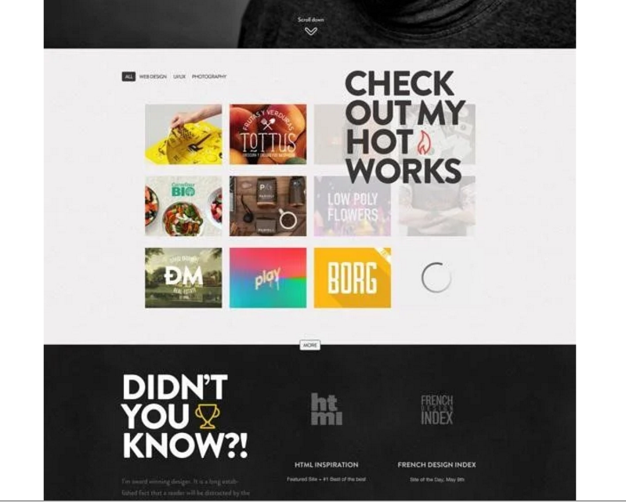
Keep updating

Slide 4
09. The chosen few
Once you have the final pieces selected, make sure theye’re cohesive that they form you’re ‘brand’. Make your portfolio different than others.
Make your portfolio consistent in each page.
Example: http://mhou.es/portafolio/

Slide 5
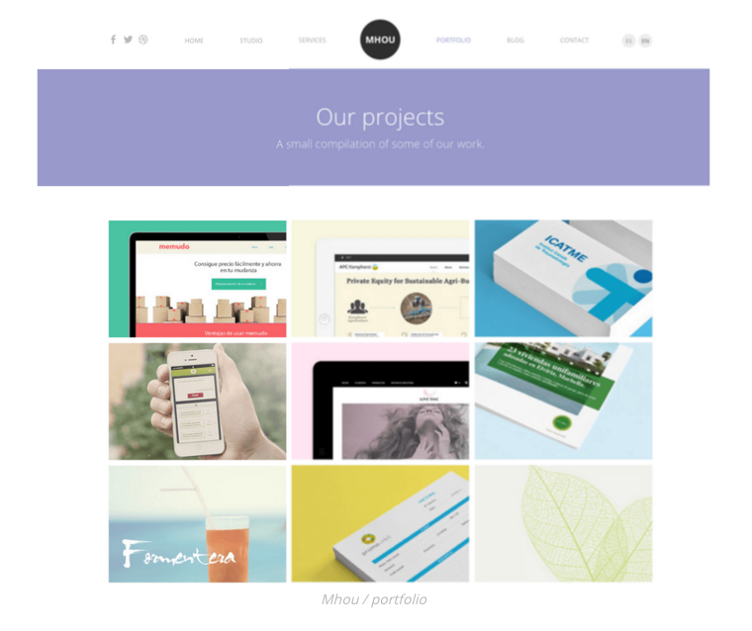
Contoh tampilan portfolio

Slide 6
10. Make sure the pieces flow nicely from one to the next
Doesn’t mean to group all web design together, all logos together, etc.
It would be better if the colors, line and angles works together.
Keep images consistent until they rolled over

Slide 7
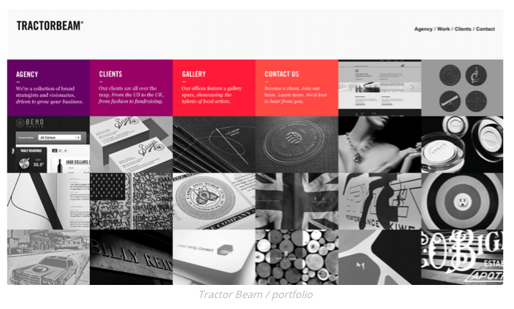
Don’t make your viewer jump over

Slide 8
11. Snap a pic
Take a few photo of your print piece and make it on line.
Use your professional camera or maybe you can use professional photographers to take a photo shoot of your products. You can do it with barter services.

Slide 9
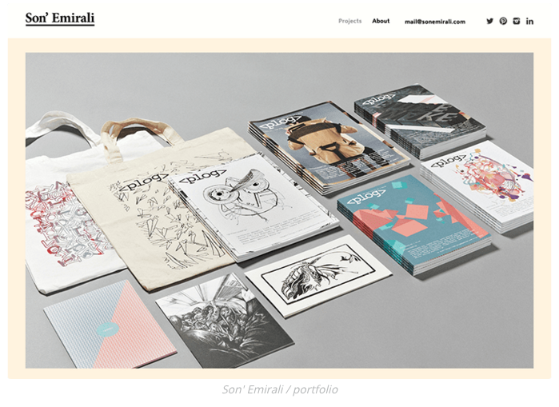
From off line to on line

Slide 10
12. Make it interesting
If you only have a PDF of a magazine or poster you designed, search online of mock up resources such as Graphicburger. They have free downloads of layered Pdf files to drop your artwork into so they look like they hired a photographer.
Taking a photo of a website on your monitor (screen shot) is not acceptable.
Create your own portfolio with template
Example: http://kendraschaefer.com/portfolio/

Slide 11
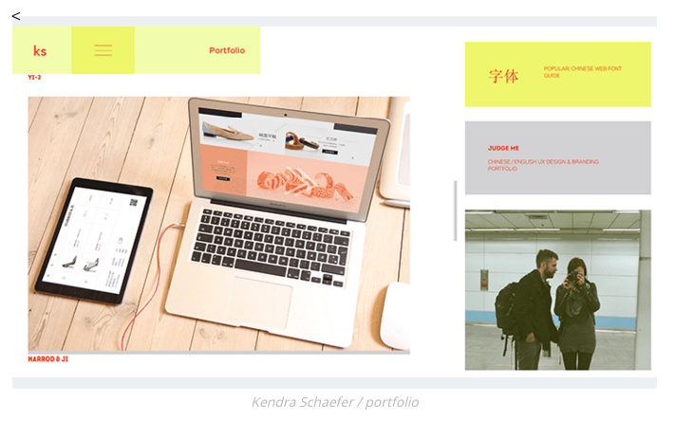
Don’t do the screen shot

