Slide 1
Gambar Konstruktif
PART 2

Slide 2
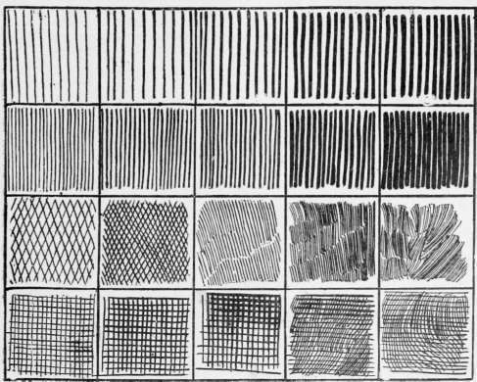
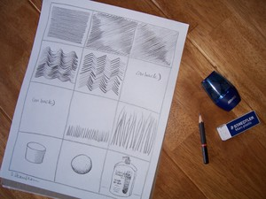
1st EXERCISE - Line weight

Slide 3
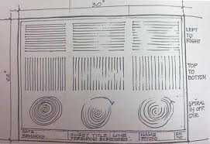
KERTAS UKURAN A2

