Slide 1
DESAIN PRODUK 3 Ismail Alif Siregar M.A

Slide 2
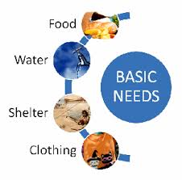
FOKUS PADA KEBUTUHAN SOSIAL

Slide 3
HUMAN-ENVIRONMENTAL-SOCIETY NEEDS

Slide 4
SURVEY DESAIN
Quantitative / Qualitative Survey?
Quesionairre
Survey Wawancara
Survey Observasi
Pengambilan Data

Slide 5
DATA?
Data Teknis
Data Lingkungan
Data Manusia

Slide 6
Analisa Data
Hasil Analisa Data dirangkum untuk dijadikan:
DESIGN BRIEF
BATASAN DESAIN

Slide 7
DESIGN CONCEPT

Slide 8
TIMELINE
Week 1 | Week 2 | Week 3 | Week 4 | Week 5 | Week 6 | Week 7 | WEEK 8 UTS PRESENTASI INDIVIDUAL
DESIGN BRIEF | SURVEY QUESTIONAIRRE MAKING | SURVEY SURVEY SURVEY SURVEY SURVEY SURVEY SURVEY SURVEY | ANALISA | PEMBUATAN KONSEP SKETSA SKETSA SKETSA SKETSA SKETSA SKETSA SKETSA SKETSA SKETSA SKETSA SKETSA SKETSA SKETSA | SKETSA SKETSA SKETSA SKETSA SKETSA SKETSA SKETSA SKETSA SKETSA SKETSA SKETSA SKETSA SKETSA SKETSA SKETSA | PEMILIHAN DESAIN PERSIAPAN PRESENTASI

