Slide 1
CMF – Colour Material Finish
Dosen: I Alif Siregar

Slide 2
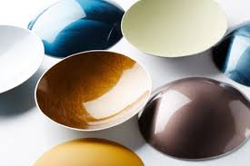
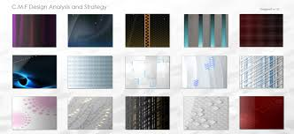
WHAT IS CMF?
Color, Materials, Finish (CMF) is an area of industrial design that focuses on the chromatic, tactile and decorative identity of products and environments.

Slide 3
“CMF is a specialized area of design that focuses on color, material and finish development. This involves trend research, materials and processes R&D, analysis, strategy and lots of creative thinking.” –Reiko
Reiko Morrison, a CMF consultant directly responsible for the look and feel of the Microsoft Xbox 360

Slide 4
Belkin iPod Case Color Trend Research

Slide 5
Belkin iPod Case Color Proposals

Slide 6
HTC Trend Forecast and Sample Direction for Taiwan Design Team

Slide 7
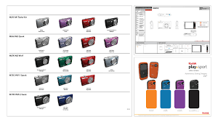
PAINT FINISH
When choosing a paint sheen, it's important to consider the area you are painting. Types of sheens include Flat, Matte, Eggshell Enamel, Satin Enamel, Semi-Gloss Enamel and Hi-Gloss Enamel. Each offers its own distinct benefits.

