Slide 1
Market entry strategies
Chapter 10

Slide 3
Strategic planning for global expansion
Managerial commitment
Market and competitive analysis
Internal Analysis
Competitive Strategy Formulation
Starts with overview of different regions, further splits into analysis by country.
South-East Asia: Indonesia, Malaysia, the Philippines, Singapore, Thailan, and Vietnam
Cost Leadership Strategy
Offers identical product or service at lower cost than competitors
Differentiation Strategy
Take advantage of brand, name, product or service
Focus Strategy
Single nice segment

Slide 4
International Business research
Research spotlights on new opportunities, exposes potential risk, vital in strategy development (identifying all requirements of market entry, penetration and expansion)
Secondary and primary research

Slide 5
Entry and Development Strategies
Exporting and Importing
Indirect Involvement
Direct Involvement
International Intermediaries
Can assist with troublesome yet important details such as documentation, financing and transportation
Export Management companies-Domestic companies that specialise in performing international business services as commision representatives or as distributors
Expansion of Trading Companies
Export Trading Company (ETC)
Private Sector Facilitators
Public Sector Facilitators
© PhotoDisc

Slide 7
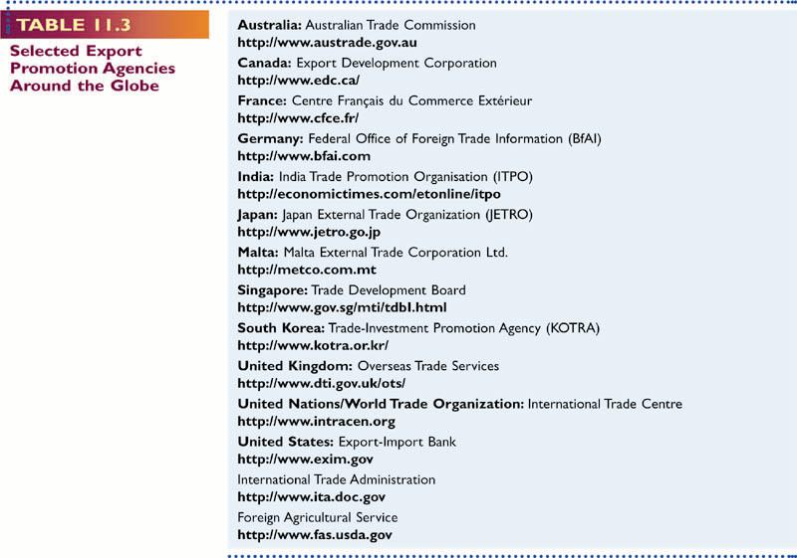

Slide 8
Entry and Development Strategies
Licensing
Licensing Agreement: patent, trademarks, copyrights, business skills
Royalty
Franchising
Allows distributors or retailer exclusive rights to sell a product or service in a specified area
© PhotoDisc

Slide 9
Licensing and Franchising
0
Advantages of licensing
Capital investment or knowledge or marketing strength is not required.
Additional return on R&D investments already incurred.
Reduces the risk of R&D failures
Ongoing licensing cooperation and support enables the Licensee benefits from new developments.
Allows a firm to test a foreign market without major investment of capital or management time.
Preempts a market for competition, especially if the licensor’s resources permit full-scale involvement only in selected markets.
Increases protection of intellectual property rights.

Slide 10
Licensing and Franchising
0
Disadvantages of licensing
Licensor gets limited expertise.
Licensor creates its own competitor.
Allows multinational corporations (MNCs) to capitalize on older technology.

Slide 11
Foreign Direct Investment
0
Types of ownership - Joint ventures
Collaborations of two or more organizations for more than a transitory period.
Partners share assets, risks, and profits in proportion to ownership.
Governmental and commercial reasons for joint ventures

Slide 12
Foreign Direct Investment
0
Advantages of joint ventures
Pooling of resources.
Better relationships with local organizations.
The partner’s knowledge of the local market.
Minimize exposure to political risk.
Tap local capital markets.
Disadvantages of joint ventures
Different levels of control are required.
Difficulty in maintaining the relationship.
Disagreements over business decisions.
Disagreements over profit accumulation and distribution (profit repatriation).

Slide 13
Foreign Direct Investment
0
Firms are categorized as:
Resource seekers - Search for natural and human resources.
Market seekers - Search for better opportunities to enter and expand within markets.
Efficiency seekers - Attempt to obtain the most economic sources of production.

Slide 14
Foreign Direct Investors
0
Bring in capital, economic activity, and employment.
Transfer technology and managerial skills.
Encourage competition, market choice, and competitiveness.
But, they:
Drain resources from host countries.
Starve smaller capital markets.
Discourage local technology development.
Bring in outmoded technology.
Create new competition for local firms.

Slide 15
In Class discussion
Based on the information given on web site www.bestfoods.com, what benefits does a company derive from having a global presence? How is the acquisition by Unilever likely to affect the company’s future?

