Slide 1
JSON Object and JSON Schema
Week 2 - 3

Slide 2
JSON Syntax & Data Types
Let's have a quick look at the basic syntax of JSON.
it includes the following:
Data is represented in name/value pairs
Curly braces hold objects and each name is followed by ':' (colon)
The name/value pairs are separated by , (comma)
Square brackets hold arrays and values are separated by , (comma)

Slide 3
{
"book": [
{
"id":"01",
"language": "Java",
"edition": "third",
"author": "Herbert Schildt"
},
{
"id":"07",
"language": "C++",
"edition": "second“,
"author": "E.Balagurusamy"
}]
}
This is a simple example:

Slide 4
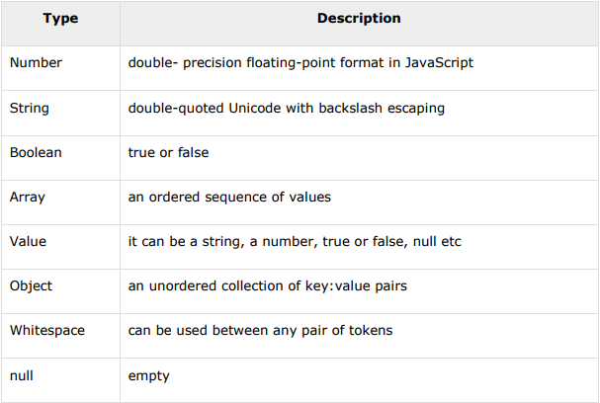
JSON format supports the following data types:

Slide 5
Number :

Slide 6
Number :
It is a double precision floating-point format in JavaScript and it depends on implementation
Octal and hexadecimal formats are not used
No NaN or Infinity is used in Number
Syntax
var json-object-name = {"string" : number_value, .......}
Example
var obj = {"marks": 97}

Slide 7
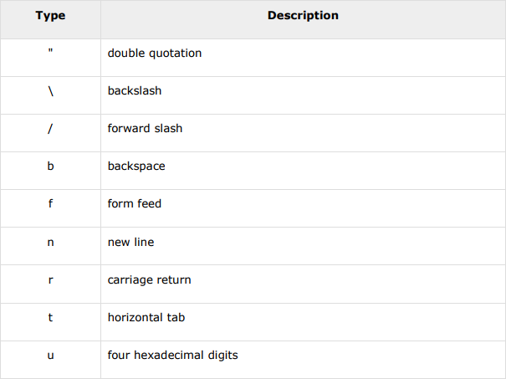
String :

Slide 8
String :
It is a sequence of zero or more double quoted Unicode characters with backslash escaping
Character is a single character string i.e. a string with length 1
Syntax
var json-object-name = { string : "string value", .......}
Example
var obj = {"name": "Amit"}

Slide 9
Boolean :
It includes true or false values
Syntax
var json-object-name = { string : true/false, .......}
Example
var obj = {"name": "Amit", "marks": 97, "distinction": true}

Slide 10
Array :
It is an ordered collection of values
These are enclosed in square brackets which means that array begins with '[' and ends with ']'
The values are separated by , (comma)
Array indexing can be started at 0 or 1
Arrays should be used when the key names are sequential integers

Slide 11
Array :
Syntax
[ value, .......]
Example
{
"books": [
{ "language":"Java" , "edition":"second" },
{ "language":"C++" , "lastName":"fifth" },
{ "language":"C" , "lastName":"third" }
]
}

Slide 12
Object :
It is an unordered set of name/value pairs
Objects are enclosed in curly braces that is, it starts with '{' and ends with '}’
Each name is followed by ':'(colon) and the key/value pairs are separated by , (comma)
The keys must be strings and should be different from each other
Objects should be used when the key names are arbitrary strings.

Slide 13
Object :
Syntax
{ string : value, .......}
Example
{
"id": "011A",
"language": "JAVA",
"price": 500
}

Slide 14
Whitespace :
It can be inserted between any pair of tokens. It can be added to make a code more readable.
Syntax
{ string : “ ”, .......}
Example
var obj1 = {"name": "Sachin Tendulkar"}
var obj2 = {"name": "SauravGanguly"}

Slide 15
Null :
It means empty type
Syntax
null
Example
var i = null;
if( i==1 ) {
document.write("value is 1");
} else {
document.write("value is null");
}

Slide 16
JSON Object
JSON objects can be created with JavaScript. Let us see the various ways of creating JSON objects using JavaScript:
Creation of an empty Object:
var JSONObj = {};
Creation of a new Object:
var JSONObj = new Object();
Creation of an object with attribute bookname with value in string, attribute price with numeric value. Attribute is accessed by using '.' Operator:
var JSONObj = { "bookname ":"VB BLACK BOOK", "price":500 };

Slide 17
This is an example that shows creation of an object in javascript using JSON : (Simple Objects)
<html>
<head>
<title>Creating Object JSON with JavaScript</title>
<script language="javascript" >
var JSONObj = { "name" : "tutorialspoint.com", "year" : 2005 };
document.write("<h1>JSON with JavaScript example</h1>");
document.write("<br>");
document.write("<h3>Website Name="+JSONObj.name+"</h3>");
document.write("<h3>Year="+JSONObj.year+"</h3>");
</script>
</head>
<body>
</body>
</html>

Slide 18
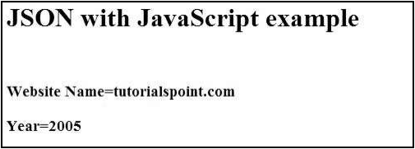
Now let's try to open file using IE or any other javascript enabled browser. It produces the following result:

Slide 19
This is an example that shows creation of an object in javascript using JSON : (Array Objects)
<html>
<head>
<title>Creation of array object in javascript using JSON</title>
<script language="javascript" >
document.writeln("<h2>JSON array object</h2>");
var books = {
"Pascal" : [
{ "Name" : "Pascal Made Simple", "price" : 700 },
{ "Name" : "Guide to Pascal", "price" : 400 }
],
"Scala" : [
{ "Name" : "Scala for the Impatient", "price" : 1000 },
{ "Name" : "Scala in Depth", "price" : 1300 }
]
}
var i = 0

Slide 20
document.writeln("<table border='2'><tr>");
for(i=0;i<books.Pascal.length;i++){
document.writeln("<td>");
document.writeln("<table border='1' width=100 >");
document.writeln("<tr><td><b>Name</b></td><td width=50>"
+ books.Pascal[i].Name+"</td></tr>");
document.writeln("<tr><td><b>Price</b></td><td width=50>"
+ books.Pascal[i].price +"</td></tr>");
document.writeln("</table>");
document.writeln("</td>");
}
for(i=0;i<books.Scala.length;i++){
document.writeln("<td>");
document.writeln("<table border='1' width=100 >");
document.writeln("<tr><td><b>Name</b></td><td width=50>"

Slide 21
+ books.Scala[i].Name+"</td></tr>");
document.writeln("<tr><td><b>Price</b></td><td width=50>"
+ books.Scala[i].price+"</td></tr>");
document.writeln("</table>");
document.writeln("</td>");
}
document.writeln("</tr></table>");
</script>
</head>
<body>
</body>
</html>

Slide 22
Now let's try to open file using IE or any other javascript enabled browser. It produces the following result:

Slide 23
JSON Schema
JSON Schema is a specification for JSON based format for defining the structure of JSON data. It was written under IETF draft which expired in 2011. JSON Schema:
Describes your existing data format
Clear, human- and machine-readable documentation
Complete structural validation, useful for automated testing
Complete structural validation, validating client-submitted data

Slide 24
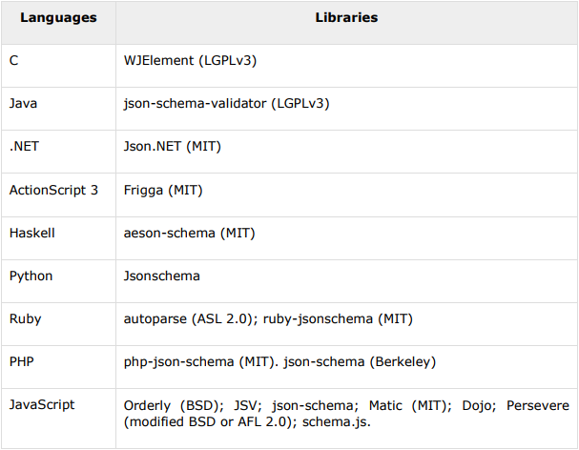
JSON Schema Validation Libraries
There are several validators currently available for different programming languages. Currently the most complete and compliant JSON Schema validator available is JSV

Slide 25
Example
Given below is a basic JSON schema, which covers a classical product catalog description:
{
"$schema": "http://json-schema.org/draft-04/schema#",
"title": "Product", "description": "A product from Acme's catalog",
"type": "object",
"properties": {
"id": {
"description": "The unique identifier for a product", "type": "integer"
},
"name": {
"description": "Name of the product",
"type": "string"
},
"price": {
"type": "number",
"minimum": 0,
"exclusiveMinimum": true
}
},
"required": ["id", "name", "price"]
}

