Slide 1
Social Media for a Purpose
Komputer dan Masyarakat
Suhendro

Slide 2
Social media can be used as a mean to reach your goal

Slide 3
Bisnis
Notes:
Gambar: http://cdn2.hubspot.net/hub/164795/file-2203361742-jpg/How_to_Set_Up_a_Professional_LinkedIn_Account.jpg

Slide 4
What is LinkedIn ?
Social media for professional, founded by Reid Hoffman at 2002
Profile picture is important. So, make it looks like a pro
Build professional network by following famous person in the industry that you seek
Add keyword and tagline in your linkedin profile

Slide 5
Rules of Social Media for Freshgrad
Create Social Accounts
Especially LinkedIn. In US, some 90% recruiter use LinkedIn.
Maintain and clean up existing accounts
Update profile and remove inappropriate contents
Use social networking to — well, network
Social investment for future, you don’t know what will happen to them in the future
Do your homework
Use social media to find out about some one or your future company
Find your voice
Don't just never update your profile or never post anything
Be agile
Social platform will change, but the network you create will follow you
Notes:
Sumber: http://mashable.com/2014/06/26/social-media-for-mba-grads/

Slide 6
Personal Branding: The Lazy Way
Stop and think
Analyze your idol
Find your niche
Label your expertise
Get your opinion out
Use one photo across the board
Have one user name
Audit your existing social media
Leave amazone book review
LinkedIn, LinkedIn, LinkedIn
Notes:
Source: http://mashable.com/2014/11/10/personal-branding-lazy-guide/
Gambar: http://addisonwhitney.com/Media/Default/images/personal-branding-by-theavinashmishra.jpg
Look what image or expertise you want others to know
Idol is some one you mimic, analyze their brand value and compare it with yours
Companies are always looking to hire people who have a core area of expertise
make sure it's in all of your social media profiles; so that it’s searchable
People who research you will want to know just how much of an expert you are in your chosen profession
Use same photo in every social media so that people can associate those account
Consistency across social media
have professional content and other social content to balance it out
It's one of the first things that shows up if people Google you, and will automatically show people just how passionate you are about your area of expertise.
Perfect place to create personal branding, use linkedIn blog platform

Slide 7
Social

Slide 8
Social Media for Social Cause
A majority of respondents first learn about social good initiatives through social media
Prefer donate money rather than time
people need to believe in the cause to donate to it
social media is more effective for spreading information about a cause than for raising money for one
LinkedIn users are more charitable than any other network's users with their money or time
people don't view LinkedIn as a valuable resource for social good initiatives
Many people enjoy a little social good in their Facebook News Feeds, but not on twitter
Those who don't follow charities on Facebook say there are too many updates
Notes:
Sumber: http://mashable.com/2014/09/19/social-media-habits-charity/
Ice bucket challenge

Slide 9
Tips for a Successful Social Media Cause Campaign
Create a Strong Theme with Clear Goals
“You want to make it as easy for people to participate as possible; in social media, distractions fly a mile a minute,” said Melissa Jones
Seek a Non-Profit Partner That's Active in Social Media
Campaigns partnered with causes that have a dedicated social media presence are more successful
Connect the Theme, Sponsor, and Non-Profit
Unity of purpose helps streamline the coordination of the campaign
Identify and Utilize Your Best Social Assets
Social media cause campaigns are challenging, and organizers should use the tools and people at their disposal effectively.
Notes:
Sumber: http://mashable.com/2010/05/10/social-cause-campaign/

Slide 10
Tips for a Successful Social Media Cause Campaign (2)
Target a Well-Defined Audience
Campaign organizers who know their audience, who listen to and engage them, will be more successful
Energize and Motivate Your Supporters
Keep people energized throughout the campaign. Create mini-campaigns within the larger one to keep participants active
Pay Attention to Timing
Social media has its own timetable. Partake in a cause campaign every day for weeks, even months, their excitement and passion for the cause can deteriorate
Follow Up
Evaluation of successes and failures is vital.
Notes:
Sumber: http://mashable.com/2010/05/10/social-cause-campaign/

Slide 11
Digital Persuasion: Social Media Motivates People to Contribute Beyond Clicks
Notes:
Sumber: http://csic.georgetown.edu/news/1299/digital-persuasion-social-media-motivates-people-to-contribute-beyond-clicks

Slide 12
54%
respondents indicate they are more likely to support a cause through social media rather than offline.
Notes:
Gambar: http://goalistics.com/wp-content/uploads/2012/03/Living-with-Severe-Pain-Support-that-Helps-425x250.jpg

Slide 13
55+%
who engaged with causes via social media have been inspired to take further action.
Notes:
Gambar: http://blog.straightnorth.com/wp-content/uploads/2013/02/further-engagement-social-media.jpg

Slide 14
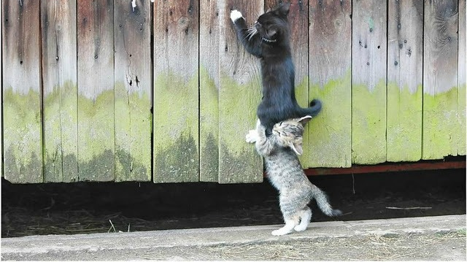
70%
agree that it’s important to them to influence others to care about the charities and causes they care about.
Notes:
Gambar: http://www.silversparrowsm.com.au/wp-content/uploads/2013/07/3-ways-to-promote-yourself-on-Social-Media.png

Slide 15
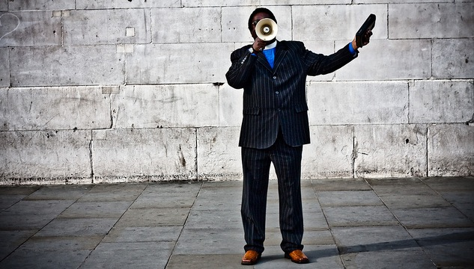
82%
agree that social media is effective in getting more people to talk about causes or issues.
Notes:
Gambar: http://austinsbigworld.com/wp-content/uploads/2013/09/how-to-get-free-media-coverage-for-your-business.jpg

