Slide 1
Project Management Methodology
Analisis Proses Bisnis

Slide 2
PROJECT MANAGEMENT PHILOSOPHY & MISSION
Notes:
Six Sigma is a philosophy of doing business with a focus on eliminating defects through fundamental process knowledge.
Its methods integrate principles of business, statistics, and engineering to achieve tangible results.
Six Sigma is a rigorous management discipline that systematically eliminates errors and improves the economics of business processes.
It culminates in a transformation to a data-driven, customer-driven, cost-reduction-driven culture.

Slide 3
PROJECT MANAGEMENT
Project management is both an art and a science.
The science consists of a systematic approach using a standard methodology.
The art consists of “soft skills” including leadership, trust, credibility, problem solving, and managing expectations.
The art of project management is developed through experience, practice, and intuition.
Notes:
The processes presented in this document illustrate the science of project management.

Slide 4
WHAT IS PROJECT …?

Slide 5
A Project has Boundaries, So Its Extent is Defined
Projects must have a clear, definitive goal or objective
The objective is; specific, identifiable, and can be accomplished
Many efforts are called “projects” but actually become programs as they extend indefinitely and cover broader, less specific business objectives
Notes:
Banyak upaya yang disebut "proyek" tapi benar-benar menjadi program karena mereka memperpanjang tanpa batas waktu dan mencakup lebih luas, tujuan bisnis kurang spesifik

Slide 6
A Project is A One-time Effort, Usually Requiring Finite Resources
Finite
Finite

Slide 7
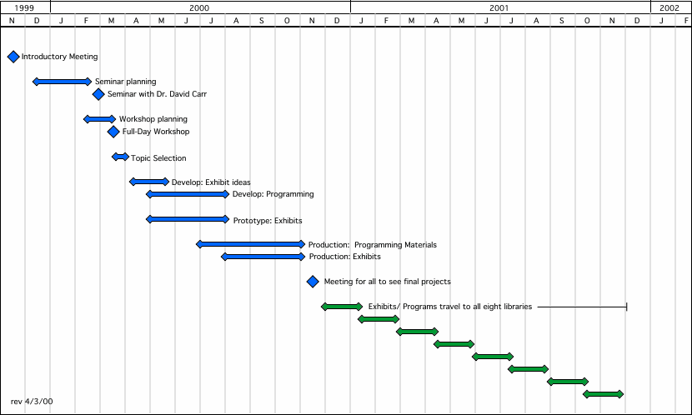
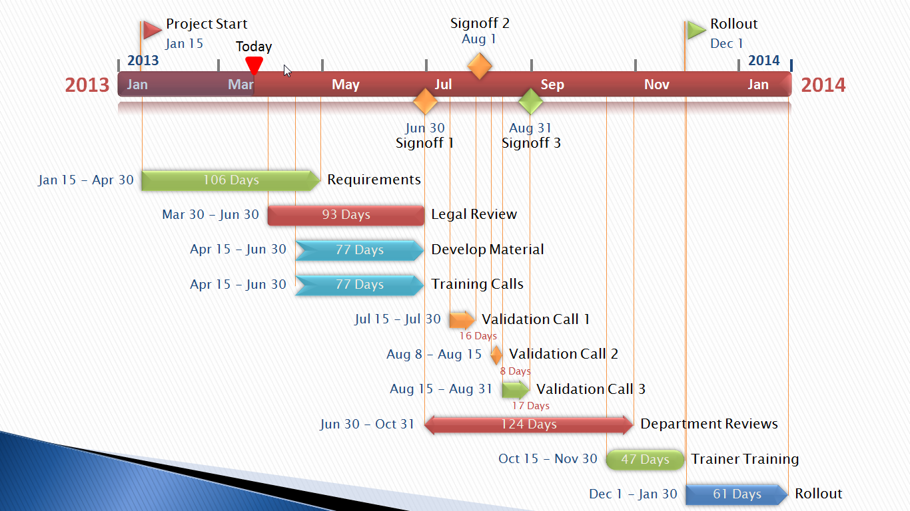
There are Distinct Start and End Dates for Projects
Specific Time Frame

Slide 8
You know when you have reached the end of the project
OR

Slide 9
What is Project Management …?

Slide 10
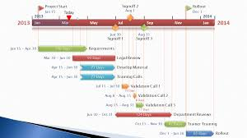
Project Management is the process of achieving project objectives (schedule, budget and performance) through a set of activities that start and end at certain points in time and produce quantifiable and qualifiable deliverables

Slide 11
THAT’S ALL
See You Next Session

Slide 12
REFERENSI
Project Management Methodology Guidebook, Chandler - Arizona, 2010

