Slide 1
Artificial Intelligence Lecture 1: Course Overview and Motivation
By:
Nur Uddin, Ph.D

Slide 2
Lecturer
Name: Nur Uddin, PhD.
Email: nur.uddin55571@gmail.com
Education:
PhD in Eng. Cybernetics, NTNU, Norway (April 2016)
M. Eng in Mechanical Eng., GSNU, South Korea (Feb 2009)
B. Eng in Aeronautics Eng., ITB, Indonesia (Mar 2002)

Slide 4
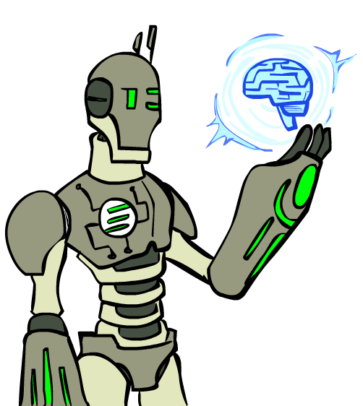
Today
What is artificial intelligence?
Where did it come from?
What can AI do?
What is this course?

Slide 5
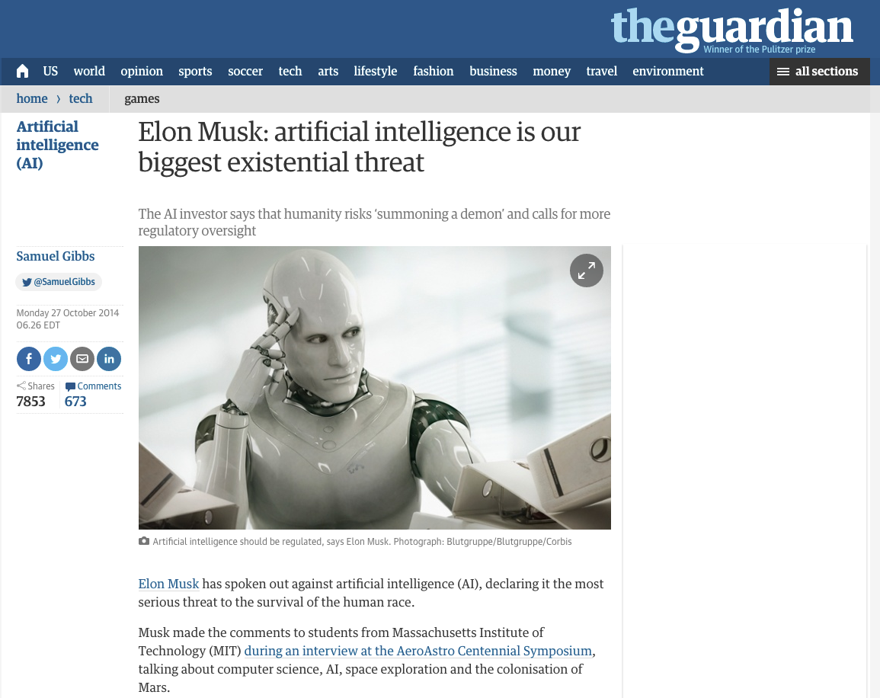
AI in the News
Source: The Guardian, 10/27/2014

Slide 6
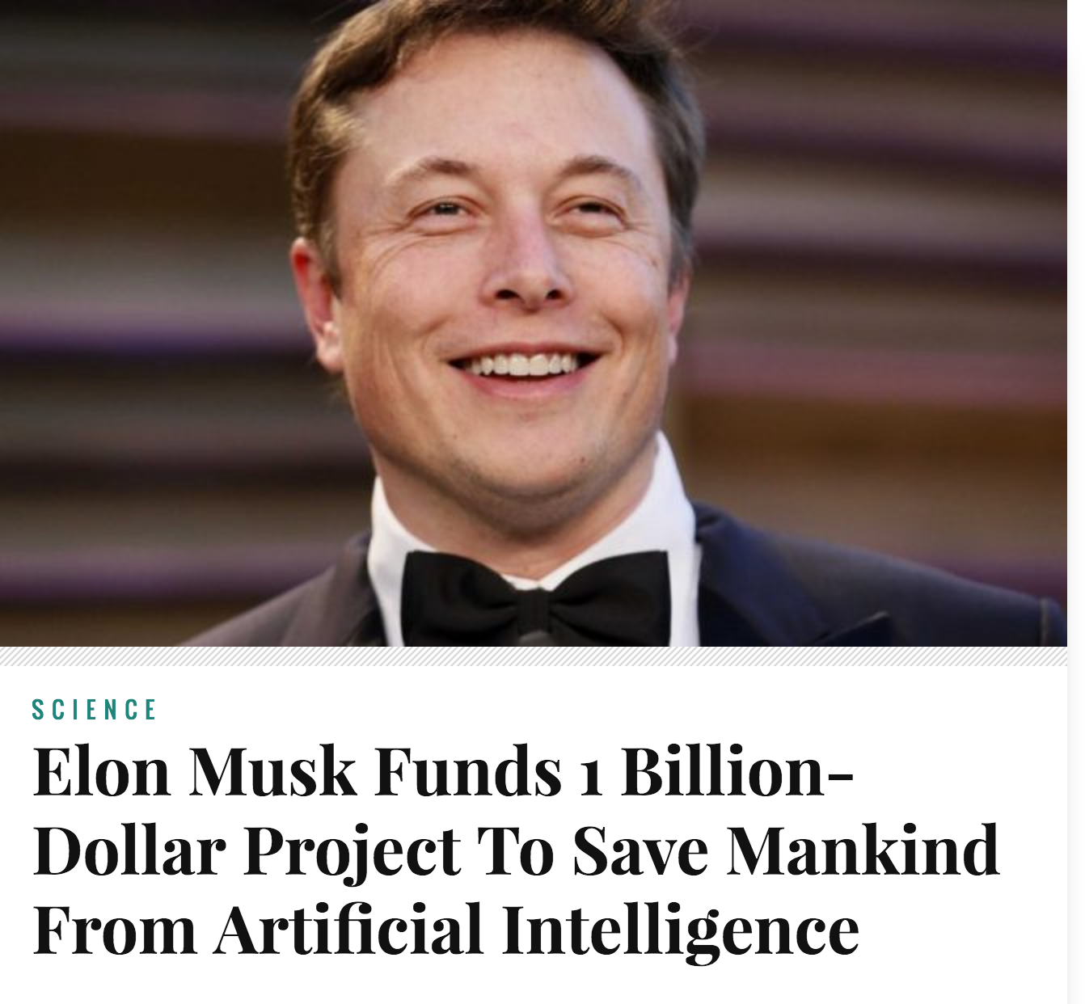
AI in the News
Source: WakingScience

Slide 7
Center for Human-Compatible AI

Slide 8
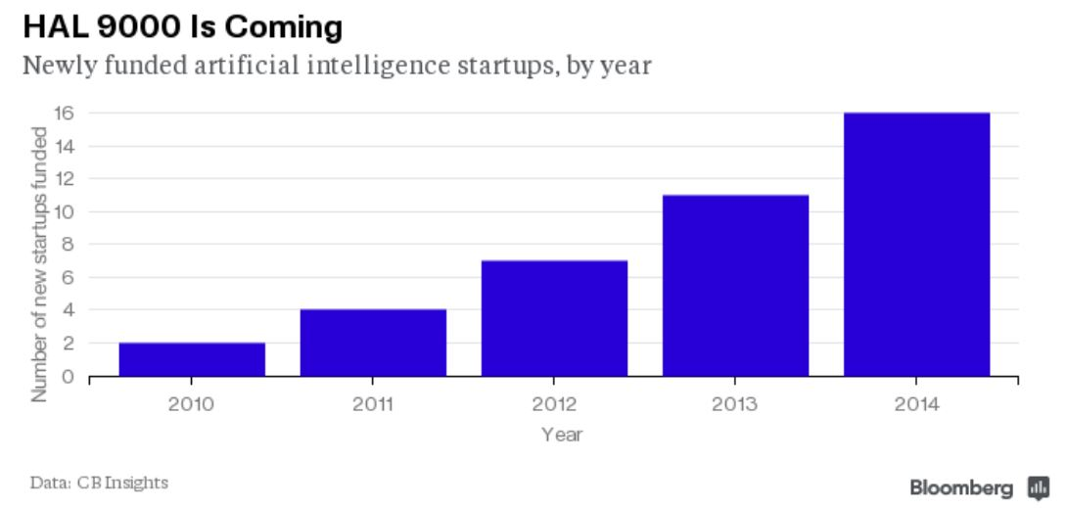
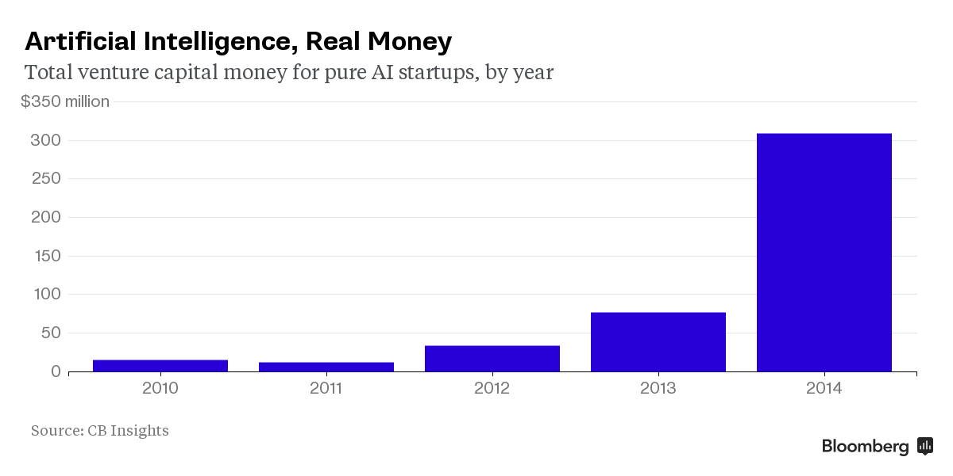
AI Booming in Industry

Slide 9
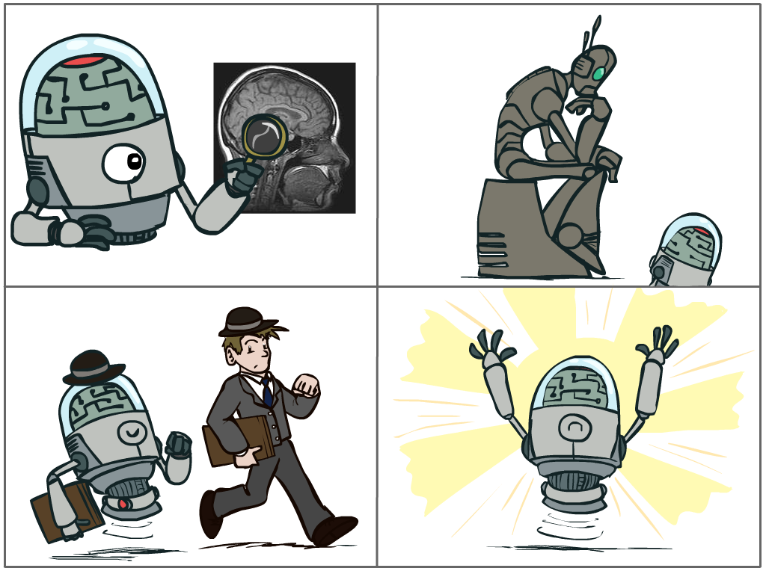
What is AI?
The science of making machines that:
Think like people
Think rationally
Act like people
Act rationally
Notes:
Top left: Think like people --- cognitive science, neuroscience
Bottom left: act like people --- actually very early definition, dating back to Alan Turing --- Turing test; problem to do really well you start focusing on things like don’t answer too quickly what the square root of 1412 is, don’t spell too well, and make sure you have a favorite movie etc. So it wasn’t really leading us to build intelligence
Think rationally – long tradition dating back to Aristotle --- but not a winner, because difficult to encode how to think, and in the end it’s not about how you think, it’s about how you end up acting

Slide 10
Rational Decisions
We’ll use the term rational in a very specific, technical way:
Rational: maximally achieving pre-defined goals
Rationality only concerns what decisions are made
(not the thought process behind them)
Goals are expressed in terms of the utility of outcomes
Being rational means maximizing your expected utility
A better title for this course would be:
Computational Rationality
Notes:
Example of utilities. 10 for A, 1 for each Friday with friends

Slide 11
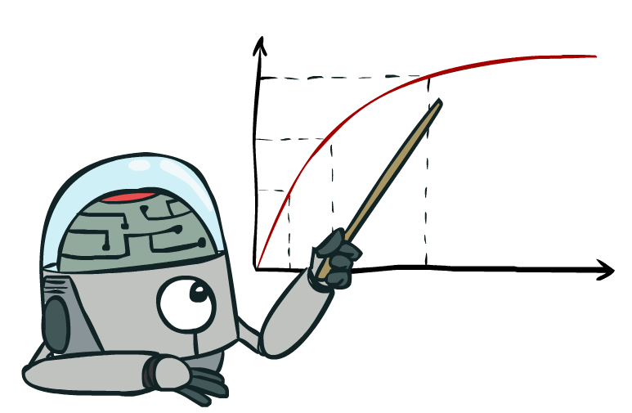
Maximize Your
Expected Utility
Notes:
Think about ai fears – this is what an ai does, what can go wrong? Utility definition

Slide 12
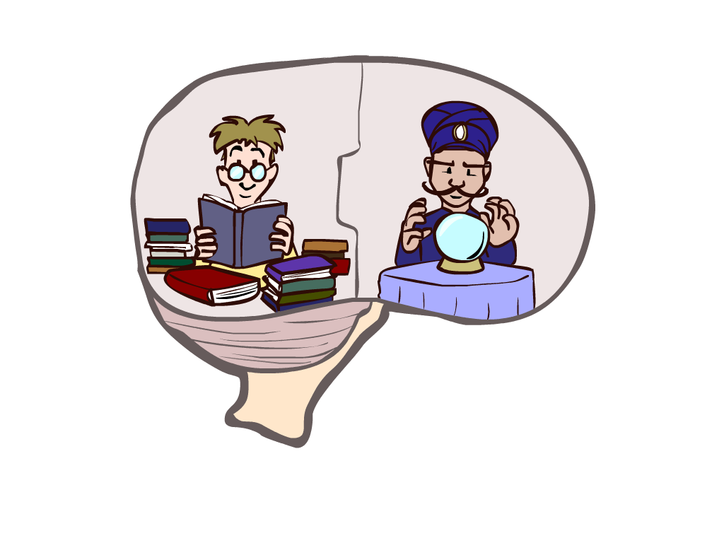
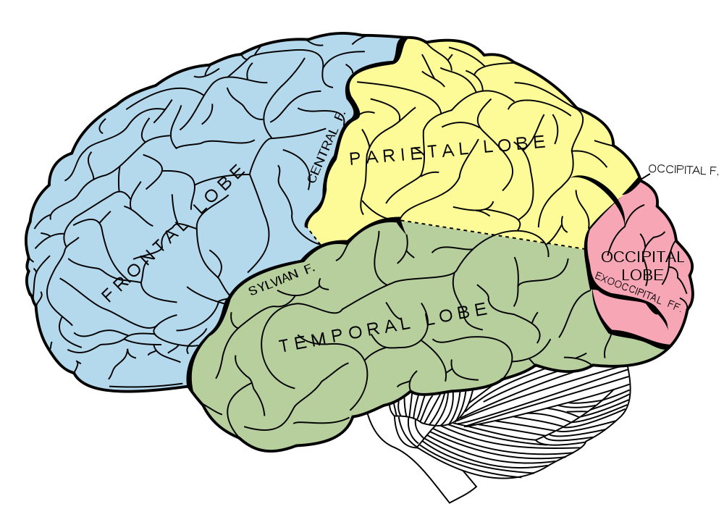
What About the Brain?
Brains (human minds) are very good at making rational decisions, but not perfect
Brains aren’t as modular as software, so hard to reverse engineer!
“Brains are to intelligence as wings are to flight”
Lessons learned from the brain: memory and simulation are key to decision making
Notes:
Stopped making wings that flap

Slide 13
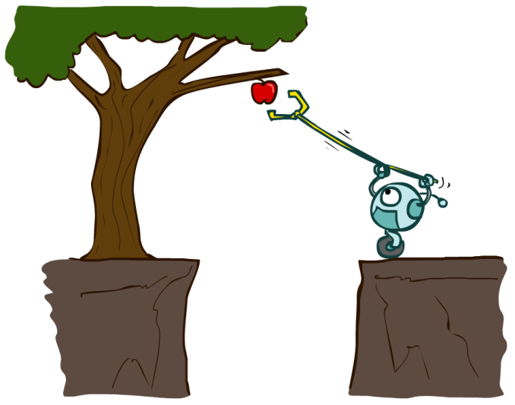
Designing Rational Agents
An agent is an entity that perceives and acts.
A rational agent selects actions that maximize its (expected) utility.
Characteristics of the percepts, environment, and action space dictate techniques for selecting rational actions
This course is about:
General AI techniques for a variety of problem types
Learning to recognize when and how a new problem can be solved with an existing technique
Sensors
Agent
Percepts
Environment
?
Actuators
Actions

Slide 14
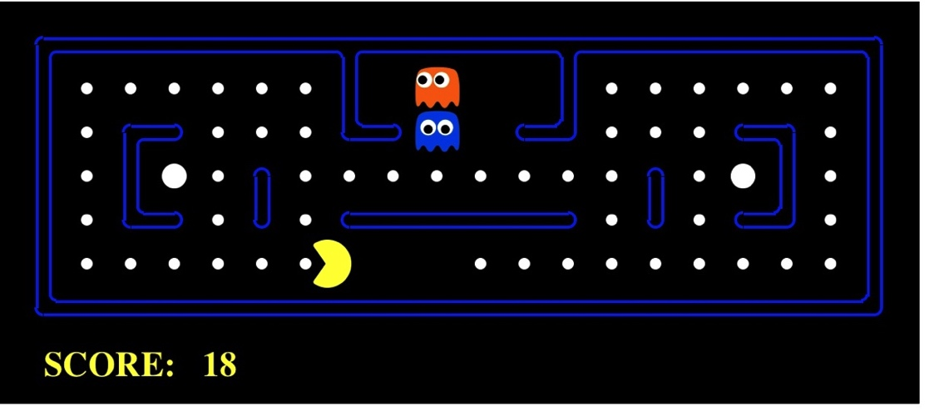
Pac-Man as an Agent
Agent
Environment
Sensors
Percepts
?
Actuators
Actions
Pac-Man is a registered trademark of Namco-Bandai Games, used here for educational purposes
Demo1: pacman-l1.mp4

Slide 15
AI
Machine Learning
[learning decisions; sometimes independent]
Robots
[physically embodied]
Rational
Agents
[decisions]
Human-AI Interaction
NLP
Computer Vision
Notes:
Google maps route planning – not physically embodied
Independent decisions: typical ml prediction, e.g. spam filtering

Slide 16
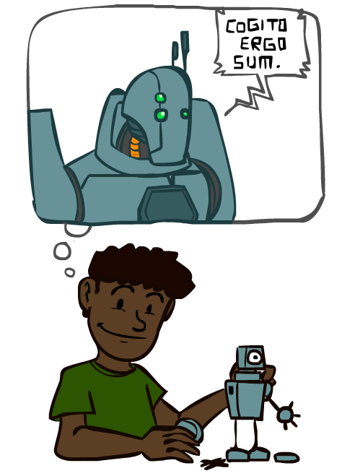
A (Short) History of AI
1940-1950: Early days
1950: Turing's “Computing Machinery and Intelligence”
1950—70: AI begins as a field
1956: Dartmouth meeting: “Artificial Intelligence” adopted
1965: Robinson's complete algorithm for logical reasoning
1970—90: Knowledge-based approaches
1969—79: Early development of knowledge-based systems
1980—88: Expert systems industry booms
1988—93: Expert systems industry busts: “AI Winter”
1990—: Statistics and decision making under uncertainty
Resurgence of probability, focus on uncertainty
General increase in technical depth
Agents and learning systems… “AI Spring”?
2000—: Where we are now?
Notes:
Million dollar computer with less computation than your phone
MT was

Slide 17
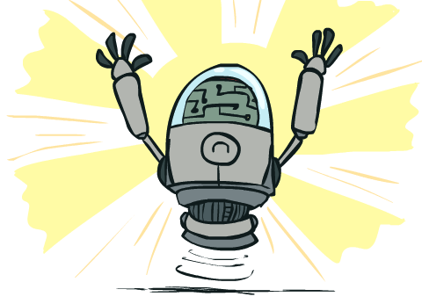
What Can AI Do?
Quiz: Which of the following can be done at present?
Play a decent game of Jeopardy?
Win against any human at chess?
Win against the best humans at Go?
Play a decent game of tennis?
Grab a particular cup and put it on a shelf?
Unload any dishwasher in any home?
Drive safely along the highway?
Drive safely along Telegraph Avenue?
Buy a week's worth of groceries on the web?
Buy a week's worth of groceries at Berkeley Bowl?
Discover and prove a new mathematical theorem?
Perform a surgical operation?
Unload a known dishwasher in collaboration with a person?
Translate spoken Chinese into spoken English in real time?
Write an intentionally funny story?

Slide 18
Natural Language
Speech technologies (e.g. Siri)
Automatic speech recognition (ASR)
Text-to-speech synthesis (TTS)
Dialog systems
Language processing technologies
Question answering
Machine translation
Web search
Text classification, spam filtering, etc…

Slide 19
What’s the difference?
Speech recognition
Match one pattern (audio) to another (text)
Lots of examples – human transcription
Machine translation
Match one pattern (French text) to another (English text)
Lots of examples – human translation
Generating stories
Requires common sense, outside knowledge…

Slide 20
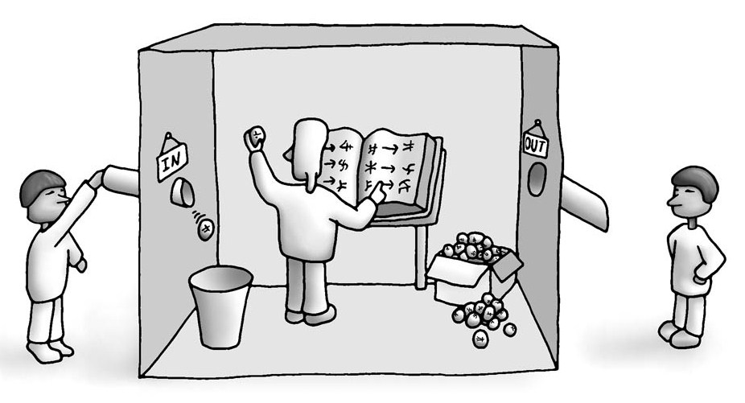
The Chinese Room
Can we process natural language without understanding it?

Slide 21
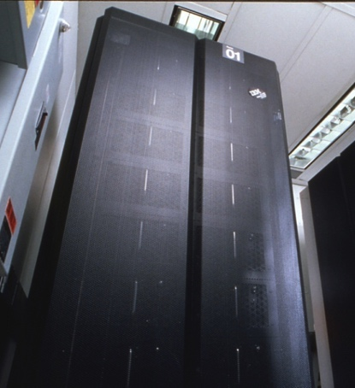
Game Agents
Classic Moment: May, '97: Deep Blue vs. Kasparov
First match won against world champion
“Intelligent creative” play
200 million board positions per second
Humans understood 99.9 of Deep Blue's moves
Can do about the same now with a PC cluster
1996: Kasparov Beats Deep Blue
“I could feel --- I could smell ---
a new kind of intelligence across the table.”
1997: Deep Blue Beats Kasparov
“Deep Blue hasn't proven anything.”
Text from Bart Selman, image from IBM’s Deep Blue pages
Notes:
Yeah, Kasparov comment probably says more about humans than about computers

Slide 22
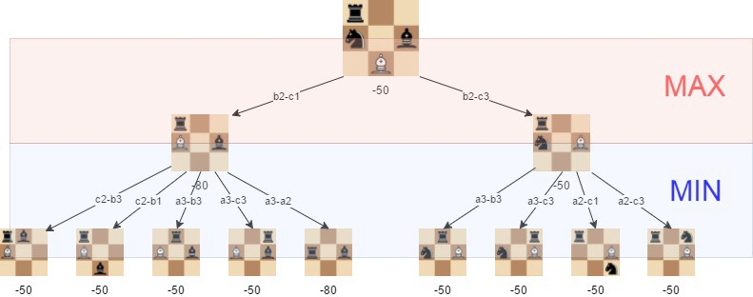
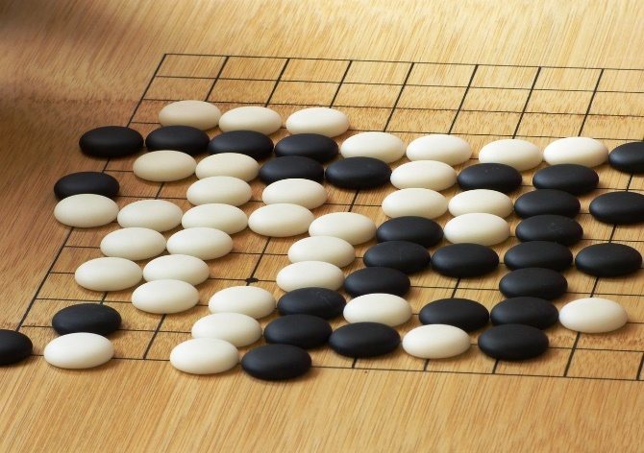
Some games are harder than others…
Playing chess
Playing Go
Way too many possibilities…

Slide 23
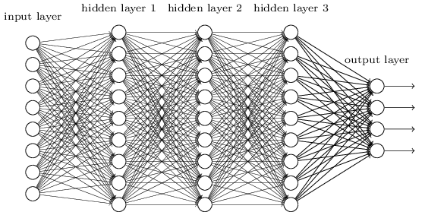
Backgammon with Reinforcement Learning
1992: Reinforcement Learning for Backgammon (TD-Gammon)
probability of winning
learned operation
(neural network)

Slide 24
What Makes Games Hard vs. Easy?
Games are a closed world
Rules are known
No prior knowledge or “common sense” is needed
Utility maximization (winning) is always the right thing
Games are competitive
Directly pits machine intelligence against human intelligence
Is this a level playing field?
Notes:
Yeah, Kasparov comment probably says more about humans than about computers

Slide 25
Why is the real world harder?
The real world is open
Rules are unknown
“Common sense” is important
Uncertainty is pervasive
Not always clear which utility to maximize
Other agents (pesky humans) can ruin all your plans
Notes:
Yeah, Kasparov comment probably says more about humans than about computers

Slide 26
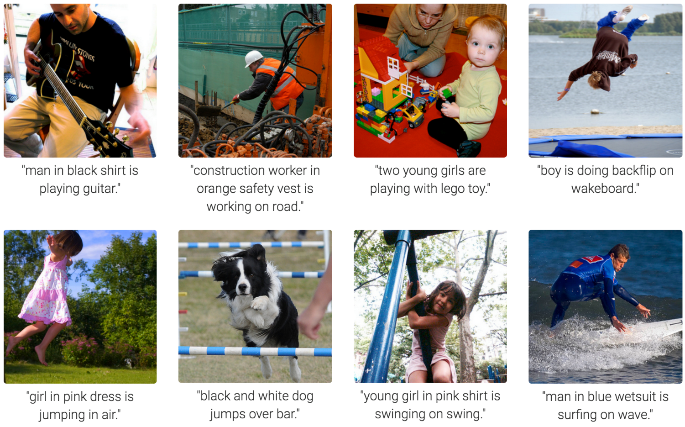
Computer Vision
Karpathy & Fei-Fei, 2015; Donahue et al., 2015; Xu et al, 2015; many more

Slide 27
What makes an AI problem easy or hard?
Rational behavior
Easy in closed worlds
Extremely hard in open worlds
Perception
Easy to match patterns
Extremely hard to understand meaning

Slide 28
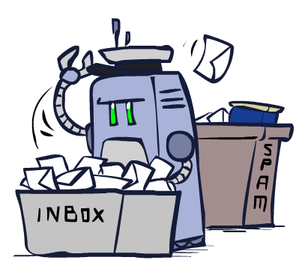
Other places you will meet AI
Applied AI involves many kinds of automation
Scheduling, e.g. airline routing
Route planning, e.g. Google maps
Medical diagnosis
Web search engines
Spam classifiers
Automated help desks
Fraud detection
Product recommendations
… Lots more!
Notes:
All applications can be thought of as decision making or useful sub-components of decision making

