Slide 1
Calculus Lecture 2: Functions
By:
Nur Uddin, Ph.D

Slide 2
Functions
Functions are fundamental to the study of calculus.
Functions are a tool for describing the real world in mathematical terms.
A function can be represented by an equation, a graph, a numerical table, or a verbal description.

Slide 3
Functions

Slide 4
A function as a machine

Slide 5
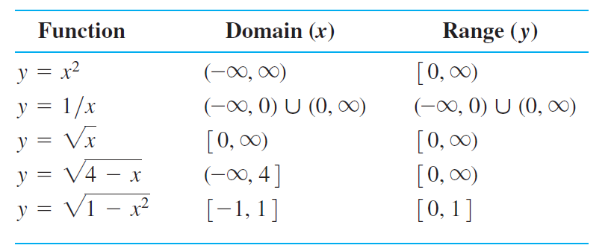
Domain and Range

Slide 6
Graph of Function

Slide 7
How to build a graph ?

Slide 8
Representing a function numerically
We have seen how a function may be represented algebraically by a formula (the area function) and visually by a graph (Example 2).
Another way to represent a function is numerically, through a table of values.
Numerical representations are often used by engineers and experimental scientists. From an appropriate table of values, a graph of the function can be obtained using the method illustrated in Example 2, possibly with the aid of a computer.
The graph consisting of only the points in the table is called a scatterplot.

Slide 9
Representing a function numerically: Example
Housing price

